Slide 1
Differences in the Cognitive Skills of Bonobos and Chimpanzees
Ariel Strayer
Patti Carlson

Slide 2
Background
Chimpanzees and Bonobos are humans’ closets living relatives.
Despite this closeness, their behaviors differ in many ways.
Chimps in their natural habitat are extractive foragers who use many different types of tools to obtain food. Bonobos, on the other hand, rely on tools very little. This might suggest a difference in causal analysis between the two species.

Slide 3
Background Cont.
Bonobos are more socially cooperative, shyer of new things, and more tolerant in feeding situations than their close relatives the chimps.
Judging by the results of studies which showed that young children with shy temperaments demonstrated better theory of mind skills than their more boisterous counterparts, it might be expected that bonobos would have more advanced social cognitive skills than chimpanzees.

Slide 4
The Study
Looked at cognitive similarities and differences in juvenile and adult bonobos and chimpanzees using a broad spectrum of 16 cognitive tasks covering physical symptoms and social cognition.
Study was non invasive, and was approved by the internal ethics committee at Max Planck Institute for Evolutionary Anthropology.

Slide 5
Study Cont.
Most chimps and bonobos had access to large areas of tropical forest (5-40 hectares) during the day, and came in from the forest at night to stay at indoor enclosures.
They were never food deprived and voluntarily participated in the study.
Infants were not tested and methods were used to try and control for age effects.

Slide 6
Subjects
34 bonobos ( 21 male, 13 female)
Age 5-22
106 chimpanzees (53 male, 53 female)
3-21 years of age
Bonobos lived at Lola ya Bonobo sanctuary, or Democratic Republic of Congo.
Chimpanzees lived either at the Ngamba Island chimpanzee sanctuary, Lake Victoria, Uganda, or at the Tchimpounga chimpanzee sanctuary, Republic of Congo.

Slide 7
Subjects Cont.
No subjects had previous experience or participated in a similar study.
Participants were tested individually by a human experimenter, and completed all PCTB (Primate Cognition Test Battery) tasks within 3-5 hours, in the same order.

Slide 8
Procedure
Subjects tested on PCTB that comprised of 16 different physical and social cognitive tasks.
Physical world:
  4 spatial tasks
    Locate reward (spatial memory)
    Track reward after invisible displacement (object permanence), a rotation (rotation), or a location change (transposition).
  2 quantity tasks
    Discriminating quantities (relative numbers) and added quantities (addition numbers)
  4 tools and causality tasks
    Causal understanding of noise production (noise) and change in appearances (shape)
    Using tools to achieve a goal (tool use) and discriminating between a functional and non-functional tool for a task (tool properties)

Slide 9
Procedure Cont.
Social world:
  1 social learning task
    Imitate another’s solution to a problem
  3 communication tasks
    Nonverbal communicative cues to indicate a reward’s hidden location (comprehension) and two tasks involving subjects having to produce communicative gestures in order to retrieve a hidden reward (pointing cups and attentional state)
  2 theory of mind tasks
    Follow experimenter’s gaze to a target (gaze following)
    Understand what an experimenter is intending to do (intentions)

Slide 10
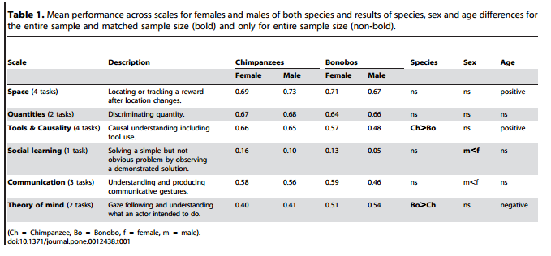
Results
Notes:
Chimps performed better than bonobos at tools and causality
Bonobos performed better than chimps at theory of mind tasks
Females performed better than males in social learning and communication

Slide 11
Results Cont.
Consistent with experimenters’ expectations:
  Bonobos performed significantly higher on the “theory of mind” scale than chimps
  Chimpanzees outperformed bonobos on the tools and causality scale

Slide 12
Results Cont.
Interesting finds:
  Strong tendency for performance in tools, causality, and space tasks to improve with age
  Opposite true for theory of mind scale; skills decrease with age
    Age only had a significant influence in tasks where there was a species difference
    After controlling for sample size and variation within data, age effects are no longer significant
  Females outperformed males in communication tasks
  Also showed a strong tendency to outperform males in social learning tasks
    After controlling for sample size and variation within data, females no longer outperform males in social learning tasks
Notes:
Learning? Important skills for survival learned & impacts critical years?
Importance of female sociality/communication - allegiances

Slide 13
Discussion
Cognitive differences between species directly reflect the most pronounced differences observed in their naturally occurring behavior. Supports the hypothesis that socio-ecological pressures play an important role in shaping cognitive differences observed between species
  Bonobos outperforming chimps in theory of mind tasks suggests that they are more skilled at solving problems requiring an understanding of social causality
    Importance of social structure and allegiances in nature
  Chimpanzees are more skilled at solving problems relating to physical causality
    Use of tools and the mechanical solving of problems in the wild
Notes:
Fits, as bonobos rely greatly on social structure and allegiances

Slide 14
Discussion Cont.
Sex differences
  Well established that male mammals tend to outperform females on tasks relating to spatial rotation
    Not seen in Panis in this study
  Outperformance of males by females in communication tasks was unexpected
  Females outperforming males in the social learning scale is the only sex difference that is consistent with previous behavioral observations
    Long-term observations of wild chimpanzees has suggested that females acquire more proficient tool-using techniques faster than males
    Similar pattern seen in captive bonobos in other studies
Why might these differences be present?

Slide 15
Discussion Cont.
Age effects
  Improvement in performance with age on space, tools, and causality tasks
    Generally shown that inferential abilities in apes increase with age
    In the wild older individuals outperform younger individuals in using tools
  Decreasing performance with age on theory of mind tasks
    Why might we see this decrease?
Notes:
Ape dementia? Do they just not give a damn anymore?

Slide 16
Discussion (Last one!)
This study provides the first experimental comparison of our two closest living relatives in a range of cognitive tasks that allow us to look at many differences in cognitive performance
Studies like this and those that compare the genomes of chimps and bonobos should aid in identifying heritable differences that underlie cognitive differences.
Understanding the evolution of this split in development can then inform and create hypotheses regarding our own cognitive evolution from our last common ancestor with the Panis.

Slide 17
The End
Differences in the Cognitive Skills of Bonobos and Chimpanzees
  Esther Herrmann, Brian Hare, Josep Call, Michael Tomasello

