Slide 1
Structure Prediction
Biochemistry 530, 2015
David Baker

Slide 2
Principles underlying protein
structure prediction
Physical chemistry
Evolution

Slide 3
Structure Prediction
Secondary structure prediction: prediction of location of helices, sheets, and loops
Fold recognition (threading): determine whether a protein
sequence is likely to adopt a known fold/structure.
Comparative Modeling: prediction of structure based on
structure of a closely related homologue
Ab initio structure prediction: predict protein tertiary structure de novo.
CASP protein structure prediction competition/experiment.

Slide 4
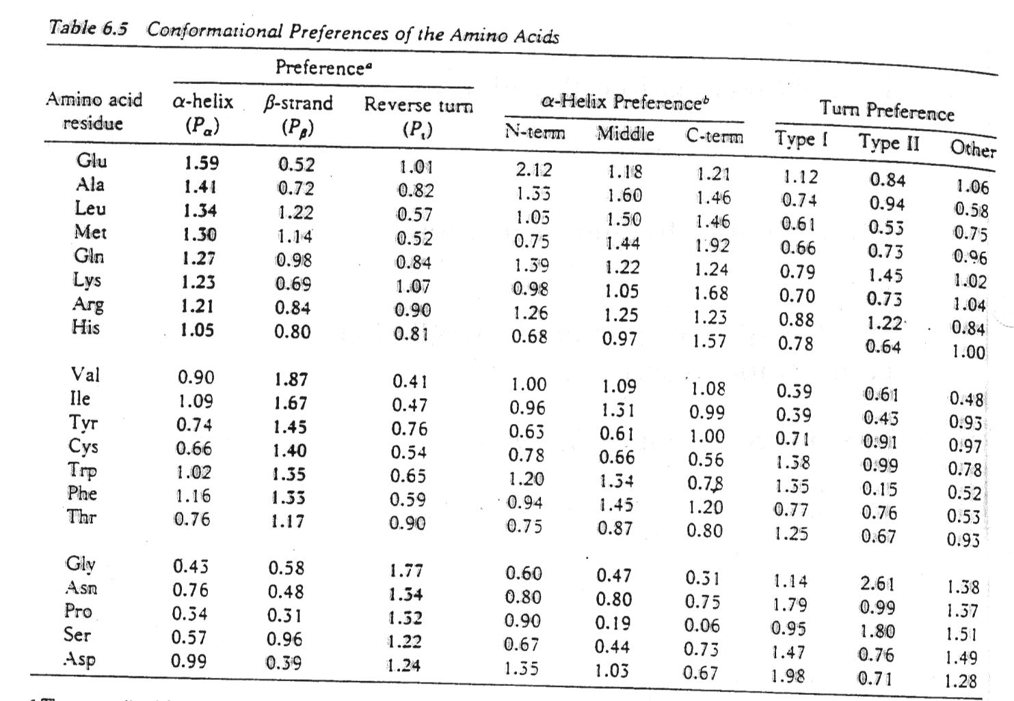
I. Secondary structure prediction
The basis for secondary structure prediction is that the different amino acid residues occur with different frequencies in helices, sheets, and turns:

Slide 5
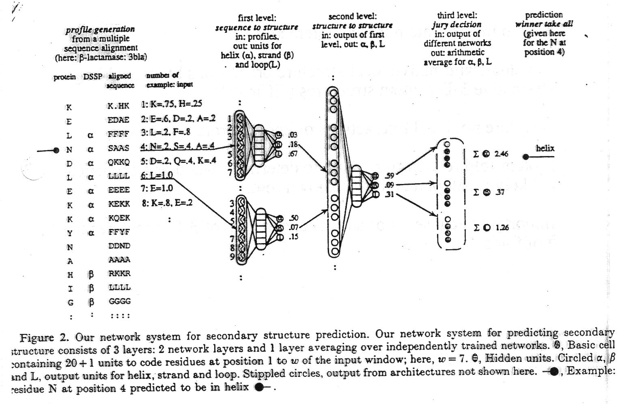
The Psipred methodology
The best current method, psipred, can be accessed at http://bioinf.cs.ucl.ac.uk/psipred.
Psipred and other state of the art methods use a neural network to extract information from multiple sequence alignments.

Slide 6
Limits in seconday structure prediction accuracy
Upper limit to success of secondary structure and solvent accessibility predictions from local sequence information:
  Non-local interactions play critical roles in stabilizing protein structures
  Non-local interactions not taken into account in local structure prediction
How to incorporate interactions?
  Evaluate alternative local structure predictions by assembling alternative 3D protein structures (difficult!)
  Explore non-local interactions of known protein structures.
Protein fold recognition: how to determine whether a sequence is likely to adopt an already known fold.
Important because # of aa sequences >> # of 3D structures >> # of folds

Slide 7
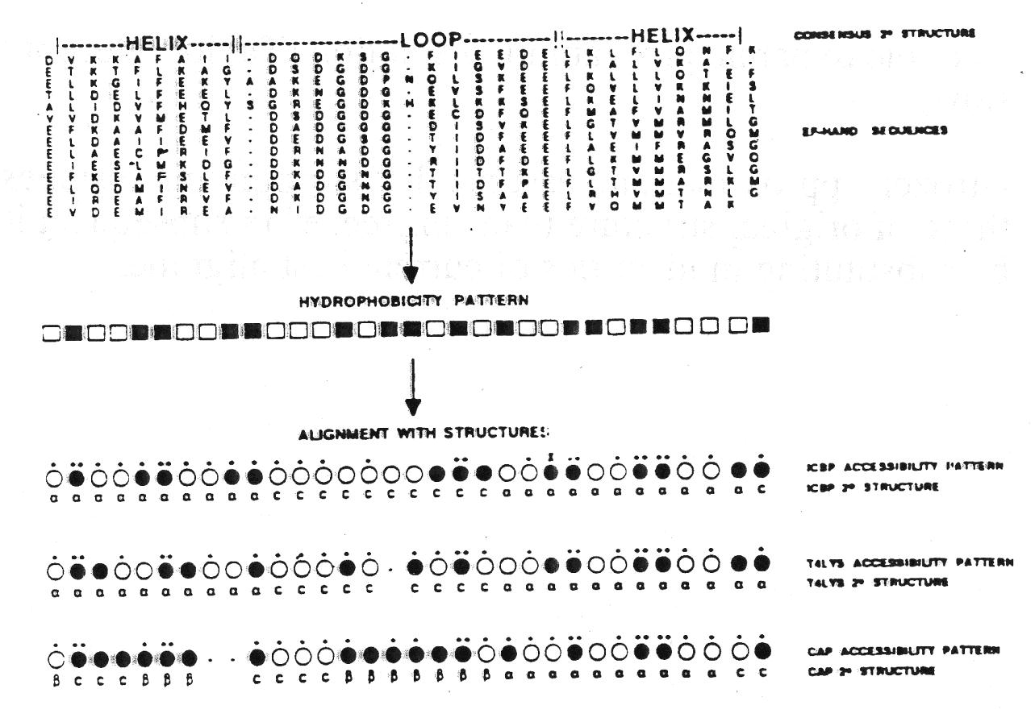
II Fold recognition
Match sequence hydrophobicity patterns to solvent accessibility patterns calculated from known structures.
  Calculate hydrophobicity patterns from aligned sequence sets (higher signal to noise since few conserved hydrophobic residues on surface)
  Use dynamic programming algorithm to align sequence + solvent
accessibility patterns.
Key insight: reduce 3D structure to 1D solvent accessibility string.

Slide 8
Fold recognition (cont)
Most successful current fold recognition servers use a combination of sequence and structural information to match sequences with folds:
Query sequence Sequence profile from msa Hydrophobicity pattern
Predicted secondary structure
Target structure
Sequence profile from msa Solvent accessibility pattern Known secondary structure

Slide 9
Comparative Modeling
Given a sequence with homology to a protein of known structure, build accurate model
Four steps:
  1) Generate accurate alignment
  2) Based on alignment, extract from structure of template either distance constraints or starting coordinate positions
  3) Build de novo regions not included in the
alignment
  4) Refine completed model using evolutionary and/or physical information

Slide 10
Challenges in comparative
modeling
Creating accurate alignments. Particularly for proteins with <20% sequence identity to template. Edge beta strands are particularly difficult. Have to consider multiple alternative templates and alignments.
Accurate modeling of loops and insertions (are in less deep minima than protein core)
Modeling systematic shifts in backbone coordinates

Slide 11
Ab initio protein structure prediction
The “holy grail”: we’ve known for 40 years that structure is determined by amino acid sequence (Anfinsen), but can we predict protein structure from amino acid sequence alone?
First, have to decide how to represent polypeotide chain:
  1. All atom: every atom in the protein treated. (very complicated and time intensive)
  2. Lattice models (important features left out?)
  3. Off lattice, but simplified relative to all atom representation.
Typically, side chains are represented by 1-2 pseudo atoms and the only degrees of freedom are the backbone torsion angles and ~1 rotation for the side chains.
Greatly reduces number of interacting groups (# of residues << # of atoms), and numbers of degrees of freedom of chain.

Slide 12
Ab initio protein structure prediction (cont)
Second, have to choose what energy function to optimize when searching through possible protein conformations
Sources of information
  1. physical chemistry (cf lecture 1)
  2. chemical intuition
  3. high resolution protein structures
  4. Electronic structure calculations (QM).
Finally, once representation and potential functions are chosen, need to search space for low energy states.
  Simplest procedure—always go downhill (steepest
descent)
Doesn’t work (energy surfaces have multiple minima)

Slide 13
Search Algorithms
Molecular Dynamics: Popular because models actual protein
dynamics. But slow because time step has to be very small
Monte Carlo: Make random perturbation (typically to backbone or sidechain torsion angles), compute energy, and accept if the energy is decreased, and roll the dice if the energy increases. Allows overcoming of barriers
Monte Carlo Minimization: Same as Monte Carlo, but minimize
before computing energy
Simulated Annealing: MD or MC starting with high temperature and then slowly cooling
Replica Exchange: Carry out multiple parallel MD or MC trajectories at different temperatures, allowing occasional swaps between trajectories
Genetic Algorithms: Start with population of conformations. Evolve by iterating between mutation, recombination, and selection

Slide 14



Implementation of insights from experimental folding studies
in ROSETTA
Local interactions bias but do not uniquely determine conformations sampled by short segments of the chain.
Folding occurs when local structure segments oriented so as to bury hydrophobic residues, pair beta strands, etc.
Stability determined by detailed sidechain -sidechain interactions in folded structure.
Folding rates are largely determined by contact order of native structure. Short folding times low contact order struc tures.

Slide 15
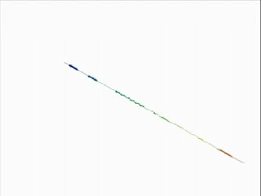

Slide 16
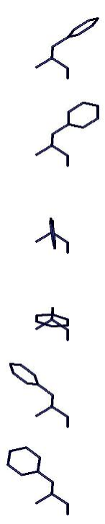
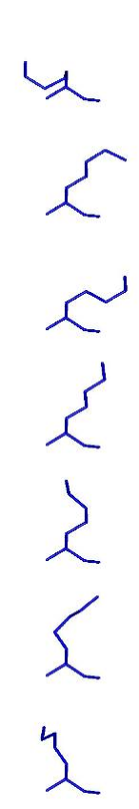
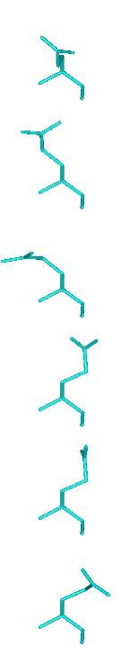
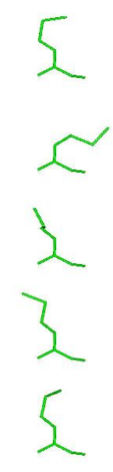
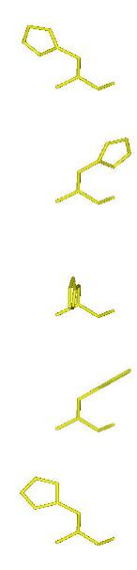
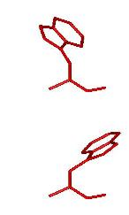
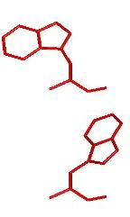
Rosetta high resolution refinement
SAMPLING PROTOCOL--Monte Carlo minimization with combinatorial sidechain optimization in torsion space
  1) randomly chosen backbone deformation (phi/psi change, fragment insertion, etc.)
  2) sidechain repacking (Monte Carlo search through Dunbrack library)
  3) gradient-based minimization of energy with respect to torsion angles (DFPmin)
  4) acceptance according to standard Metropolis criterion
POTENTIAL FUNCTION
Lennard Jones, LK implicit solvation, orientation-dependent hydrogen bonding, PDB derived torsional potential
random perturbation
repack
START
minimization
FINISH

Slide 17
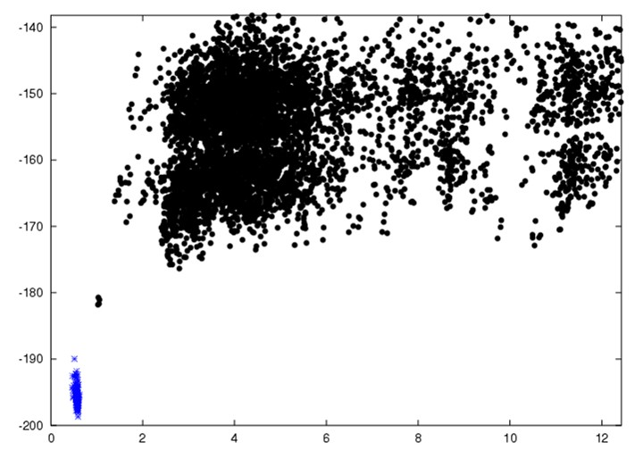
Lowest energy structures sampled on independent
trajectories
Energy
RMSD

Slide 18
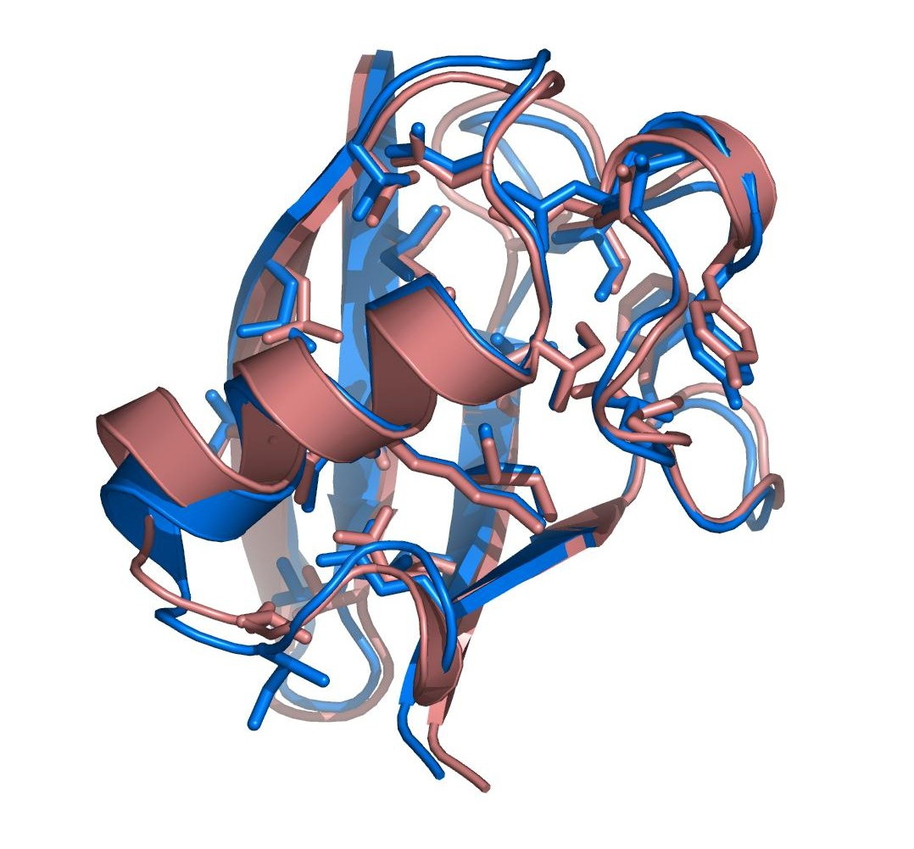
Phil Bradley Science 2005
1ubq

Slide 19
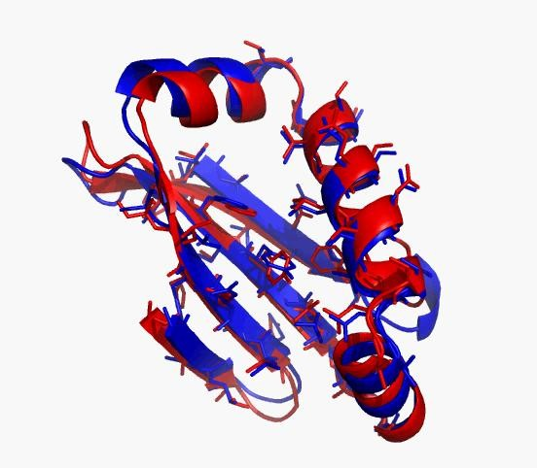
Highly unrepresentative blind de novo
Rosetta server prediction (CASP9)

Slide 20
Native free energy gaps recurrent feature
of structure prediction problems
Soluble proteins, multimeric proteins, heterodimers, RNAs, membrane proteins, etc.
Reflection of very large free energy gaps required for
existence of single unique native state
Prediction possible because (magnitude of actual free energy gap) >> (error in free energy calculation)
Challenge: how to sample close to native state?

Slide 21
How to find global minimum?
Smarter algorithms
Volunteer computing: rosetta@home
Start closer: comparative modeling
Use experimental data to limit search
Collective brain power of game playing
humans: http:fold.it

Slide 22
Use experimental data to help locate
global minimum
X-ray diffraction data
Backbone only NMR data
Low resolution CryoEM density
Different from traditional approaches: data guides search, does not specify structure

Slide 23
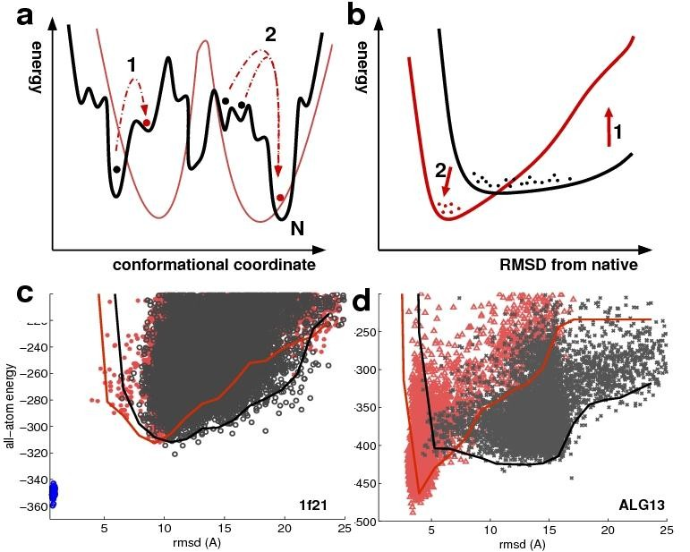
Strong validation criterion—lower energies in
data-constrained calculation

Slide 24
MPMV retroviral protease had resisted
crystal structure determination efforts for
> 5 years
Diffraction data collected but no phase
information
Despite extensive efforts, molecular
replacement failed with all available templates
Only known monomeric retroviral protease
Posted as FoldIt puzzle two months ago

Slide 25
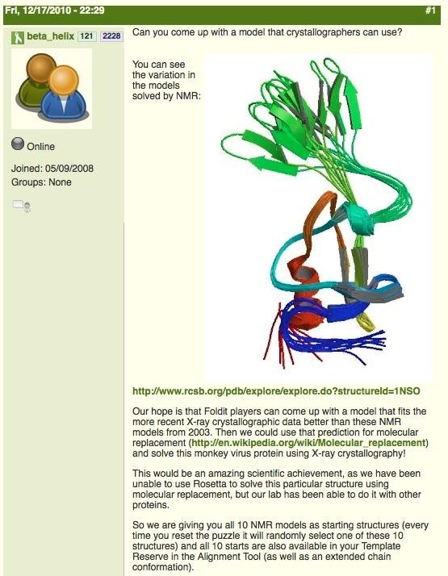

Slide 26
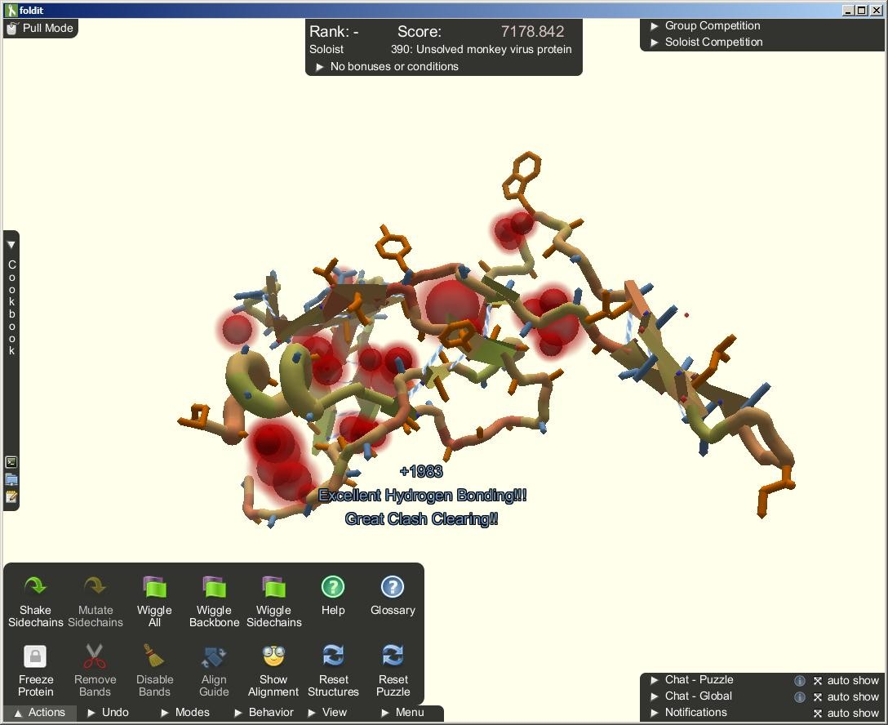

Slide 27
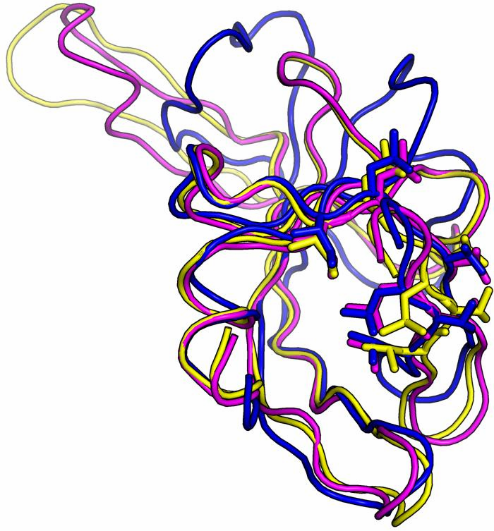
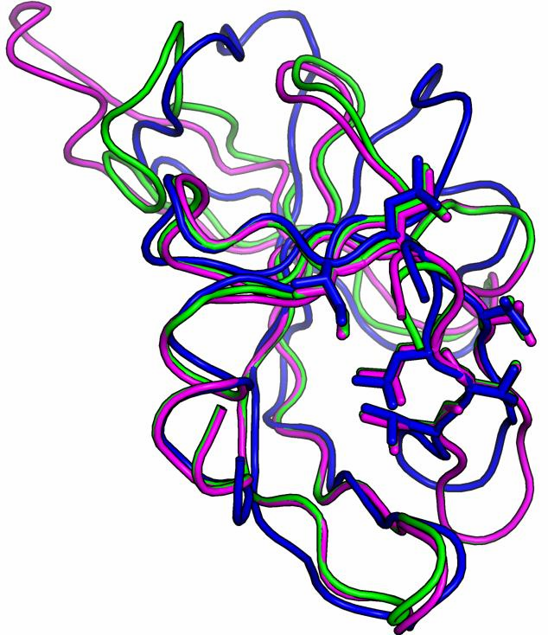
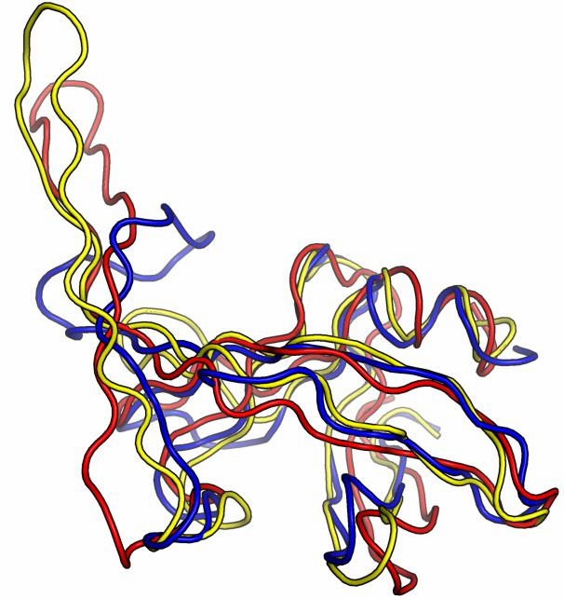




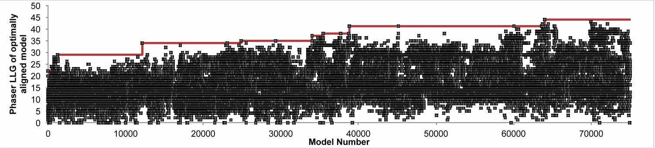

Molecular replacement was successful with
Mimi’s model and allowed rapid determination of the structure (blue)
grabh
mimi
spvincent
orn

Slide 28
End of lecture

Slide 29
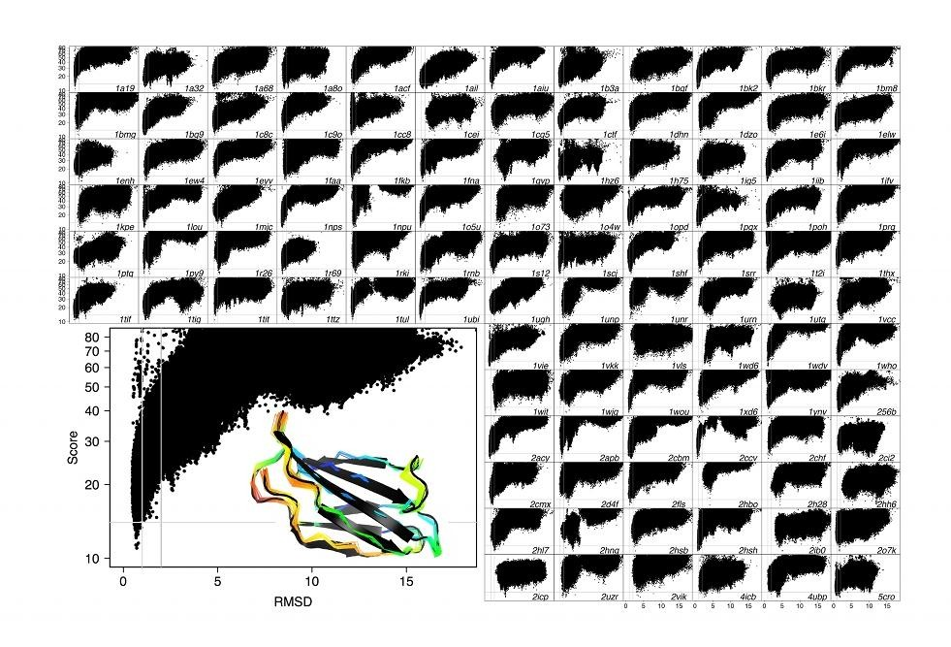
Energy landscapes for 117 proteins

Slide 30
Blind tests of current methods: CASP
43-70 new NMR and X-ray structures (unpublished)
4000 predictions from 98 different groups
Types of predictions
  Homology modeling: predict the structure adopted by a sequence a that is related to a sequence b with known structure B.
  Fold recognition
  Ab initio

Slide 31
Native free energy gaps recurrent feature of structure prediction problems
Soluble proteins, multimeric proteins, heterodimers, RNAs, membrane proteins, etc.
Reflection of very large free energy gaps required for
existence of single unique native state
Prediction possible because (magnitude of actual free energy gap) >> (error in free energy calculation)
Challenge: how to sample close to native state?

Slide 32
Structure modeling in combination with experimental data
Phase diffraction data with models (ab initio, NMR, homology)
Higher resolution models starting from low resolution X-ray or cryo EM maps
Accurate and rapid model generation from limited NMR data
Rosetta now generalized to model
  Membrane proteins
  Protein-protein, protein-DNA and protein-small molecule complexes
  Amyloid fibrils and other symmetric assemblies
  RNA

Slide 33
FoldIt players can solve hard refinement problems!

Slide 34
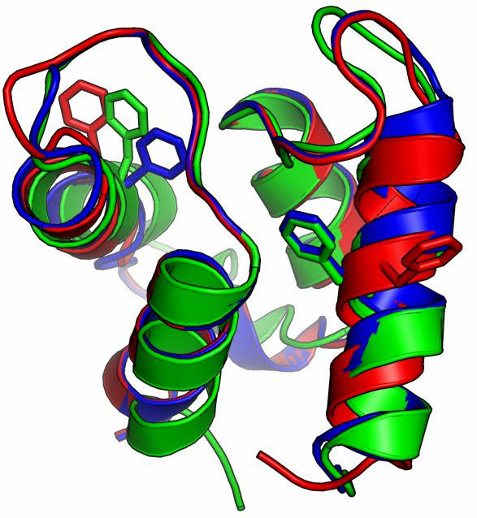
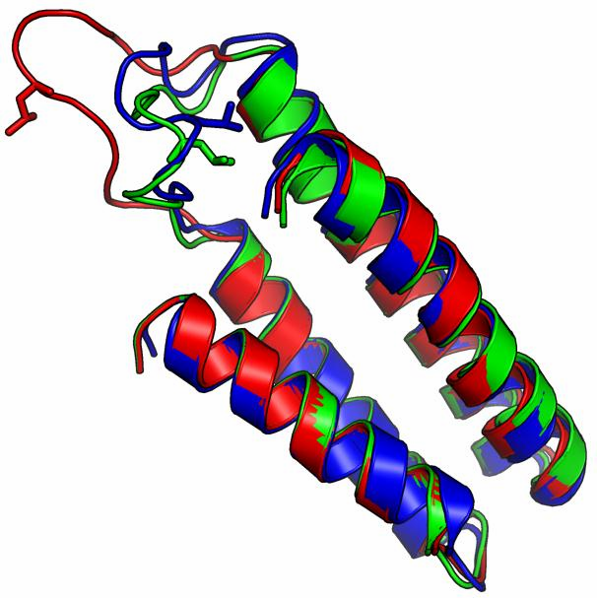
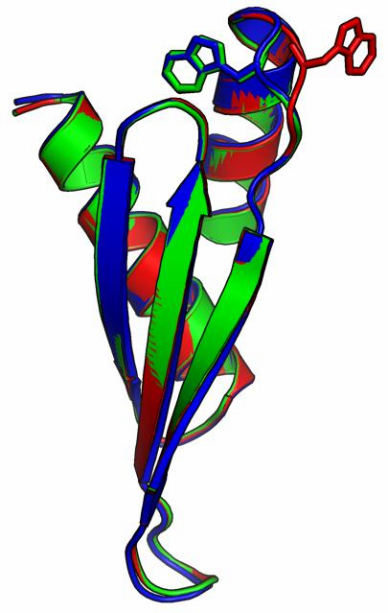
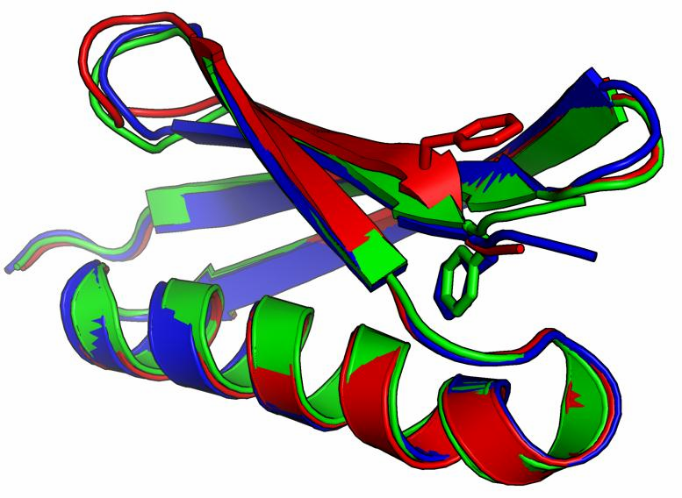
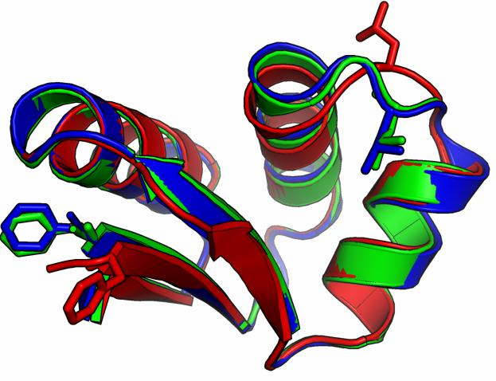
Blue = Native Red = Foldit Puzzle
Green = Foldit Solution

Slide 35
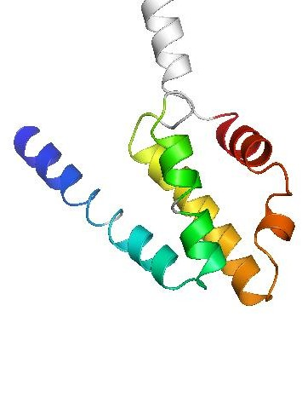
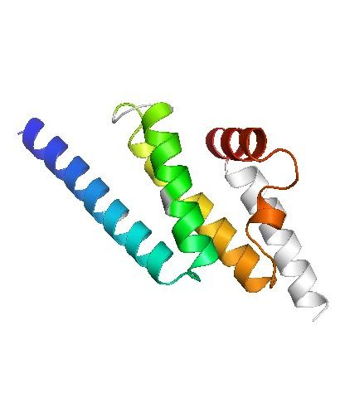
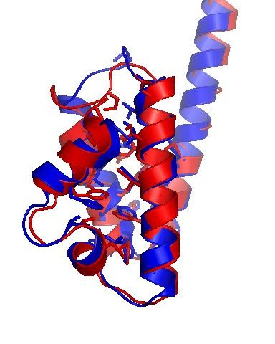
CASP7 target T0283 (112 residues)
Native
Model 3
1.40 Å over 90 residues

Slide 36
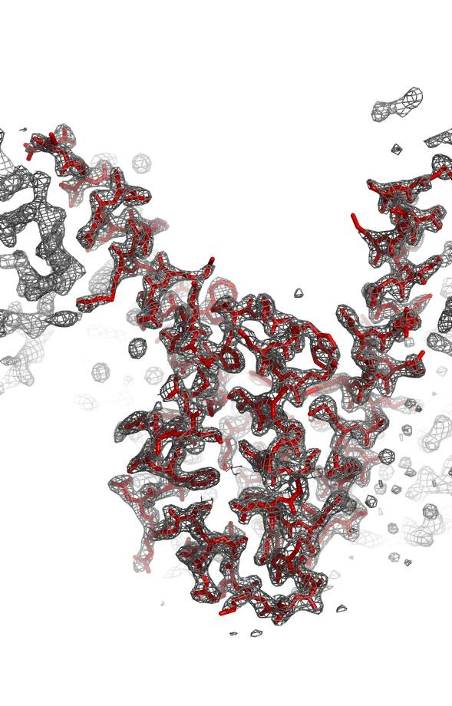
In some cases, can solve phase problem with computed structures
Red: PDB coordinates from crystal structure phased by selenium SAD
Gray: Electron density map, phased by molecular replacement with ab initio Rosetta model
Rhiju Das, Randy Read, Nature 2007

Slide 37
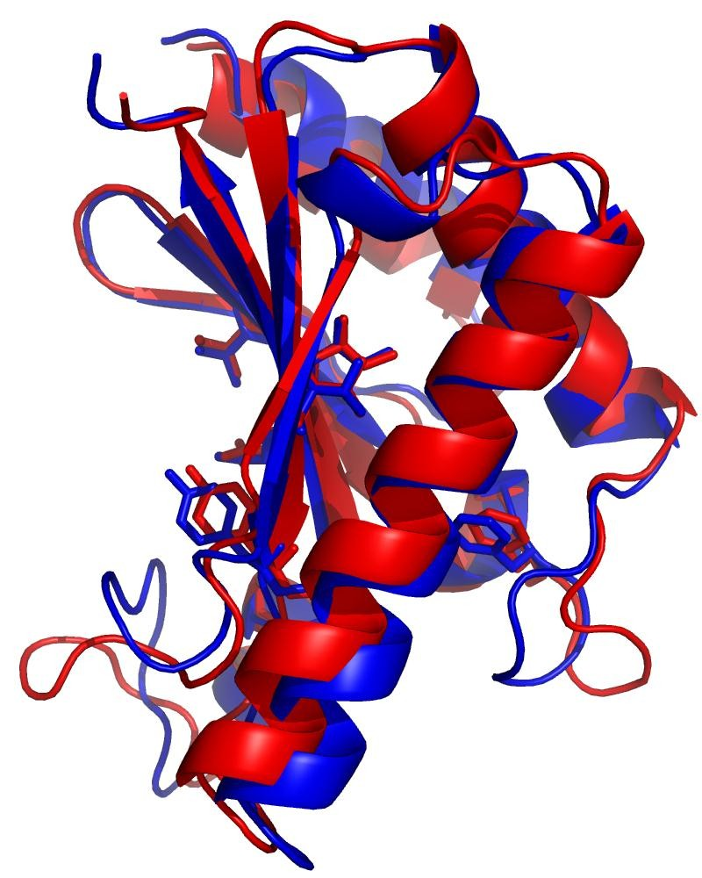
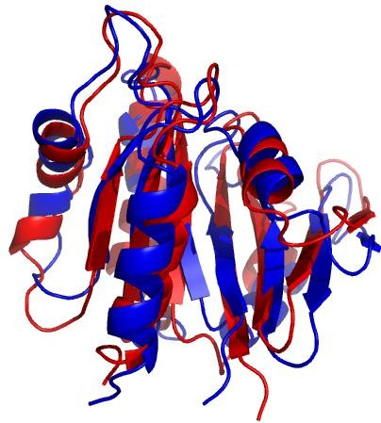
Accurate models from chemical shifts and RDCs: new paradigm for NMR structure determination?
ER553
149 aa
1.4 Å
ARF1
166 aa
2.6 Å
BLUE : Native structure RED : Rosetta model

Slide 38
Strong validation criterion—lower energies in data-
constrained calculation

Slide 39
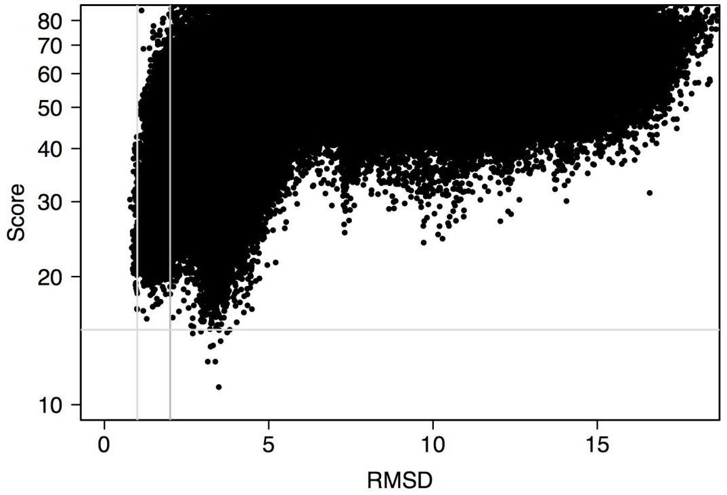
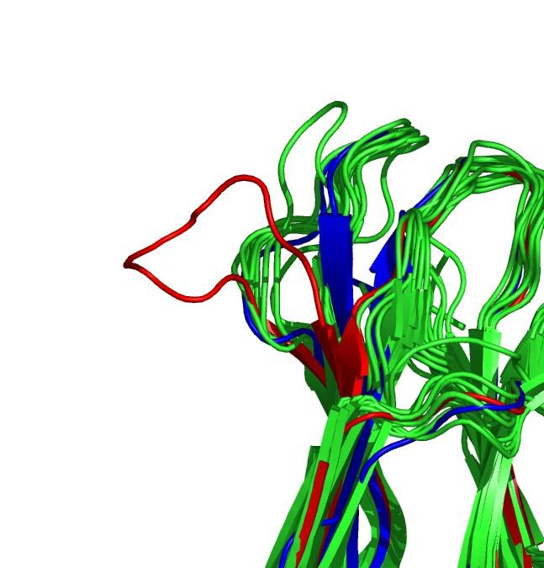
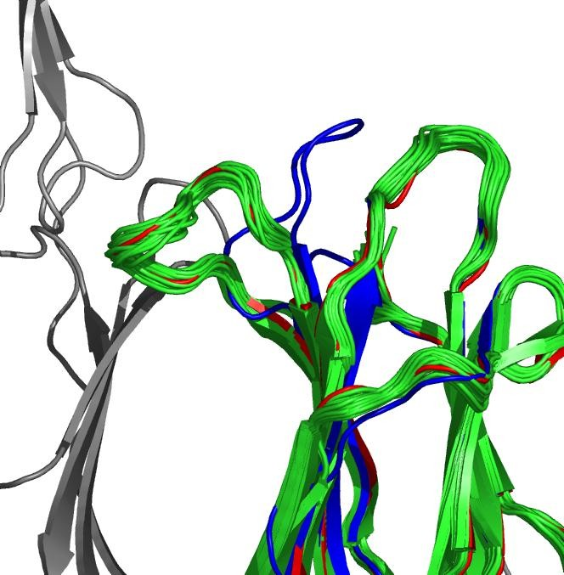
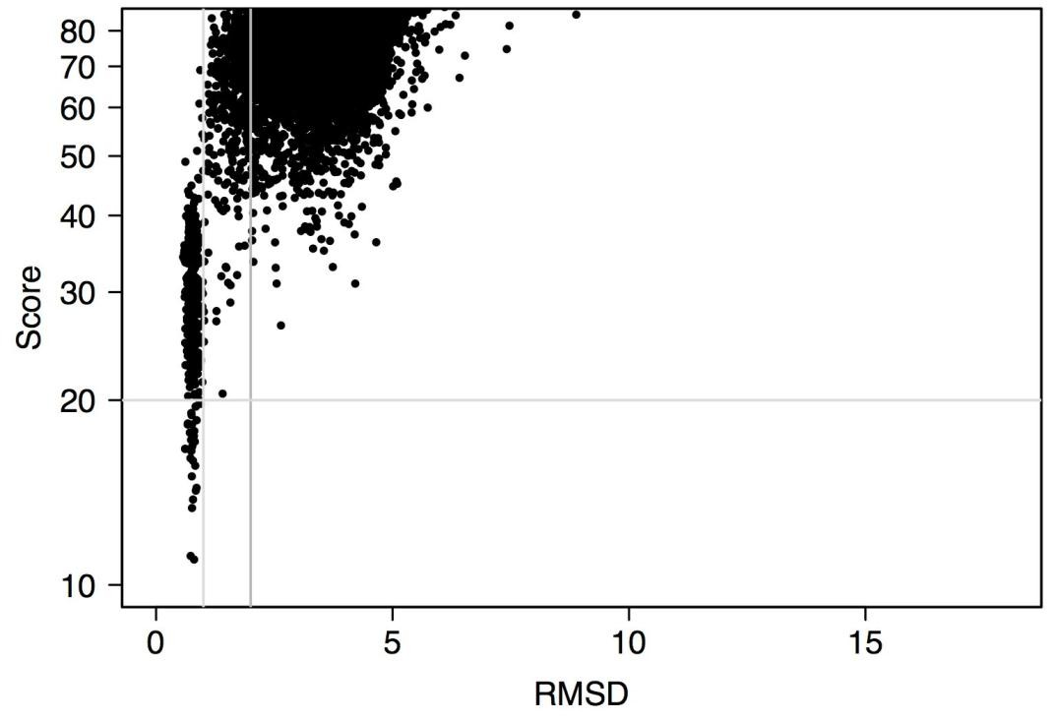
Discrepancies are primarily
at crystal contacts!

Slide 40

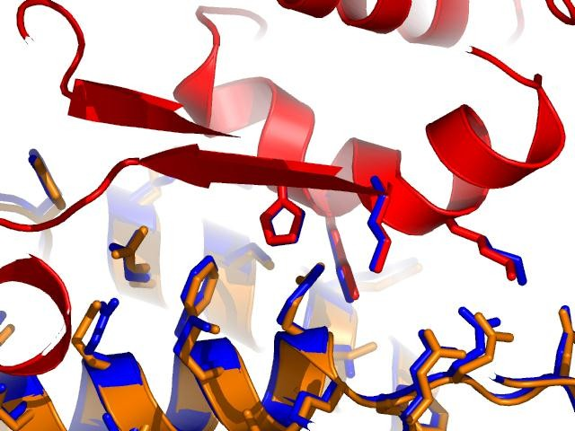




Protein-protein docking: CAPRI T15 Interface
colicin
H611
K607
K610
K608
E56
E68
D61
E59
immunity protein
red,orange– xray blue - model

Slide 41
Results
Homology Modeling
  three problems:
    properly aligning sequence with known structure
    remodeling backbone segments with altered structure
    repacking the sidechains
  For 1), psiblast is pretty good.
  For 2), best to keep the backbone fixed outside of loop regions (current all atom potentials not good enough to let backbone move).
  3) is largely solved by rotamer search methods.
Difficult to improve starting template structure!
Secondary structure prediction greatly enhanced by multiple sequence information; often quite successful (PsiPred currently the best method, 77% accuracy)

Slide 42
Fold Recognition
Automated web servers do quite well. Best results are with “meta” servers that incorporate results from a variety of different methods and generate significantly more sensitive results than psiblast.
http://bioinfo.pl/LiveBench/

Slide 43
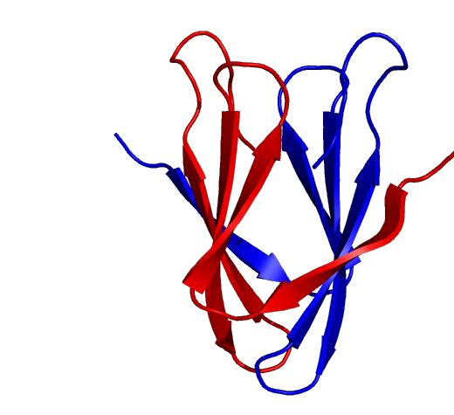
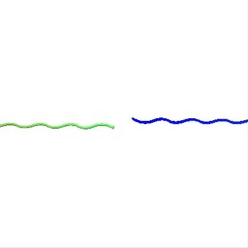


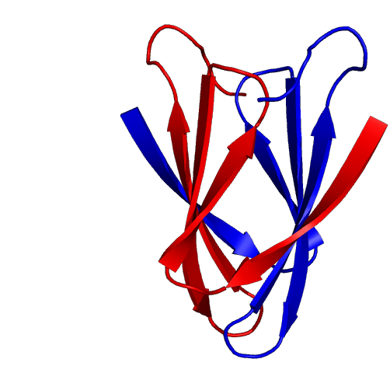
Prediction of homo- oligomeric structures
structures
2bti: Model
Sequence
Ingemar Andre, Rhiju Das
2bti: Native

