Slide 1
Bone Remodeling Slides
Part 1
Susan Ott
2019

Slide 2
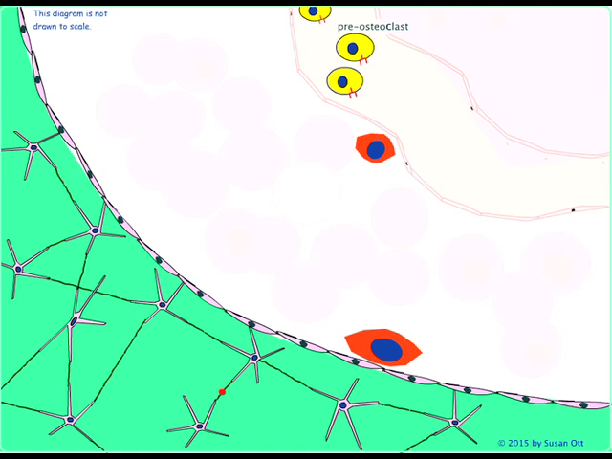
Quiescent
The mineralized bone is green. Osteocytes secrete sclerostin (red dot) that inhibits stromal cells. In the marrow capillaries, pre-osteocytes circulate. They express RANK.

Slide 3
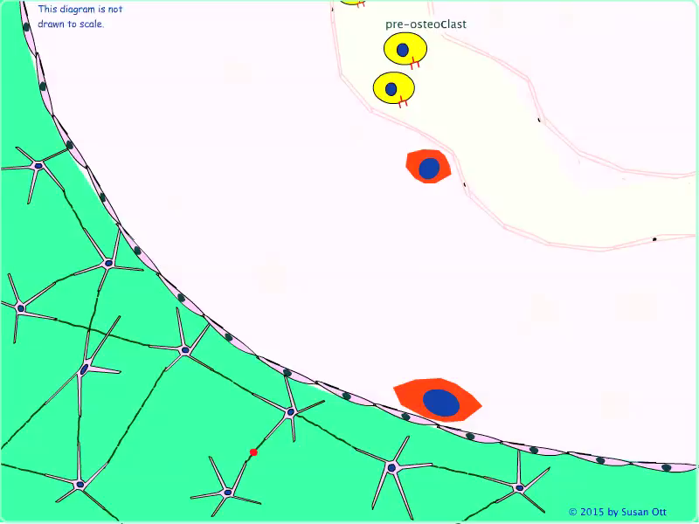
Microcrack
A microcrack develops and the nearby osteocytes undergo apoptosis and secrete factors as they do. They also will start to express RANK-ligand.

Slide 4
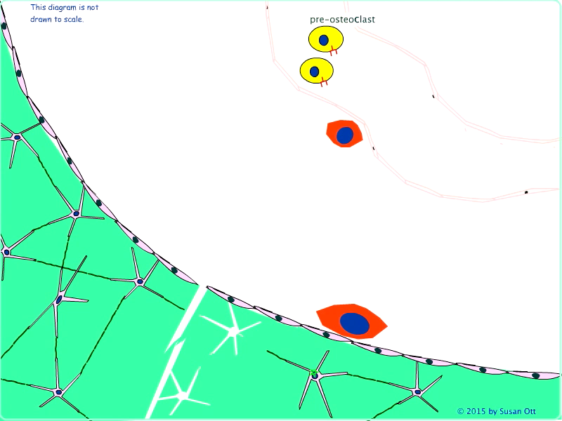
Canopy
The lining cells separate from the bone mineral, fuse with capillaries and form a space that allows the osteoclasts inside.

Slide 5
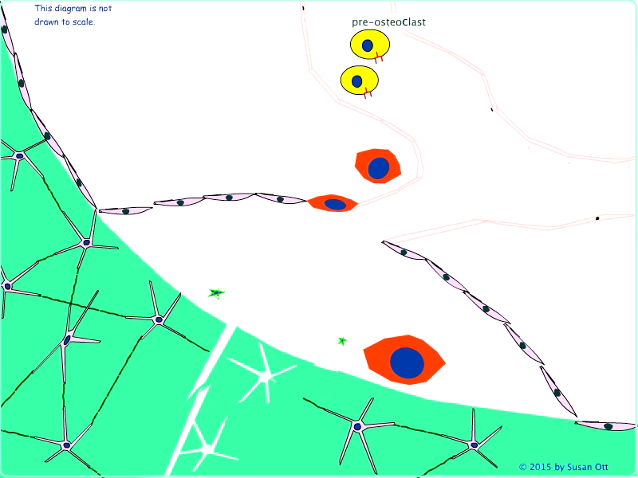
Stromal cells proliferate
The factors secreted by osteocytes now cause stromal cells to become active and proliferate, forming early osteoblasts.

Slide 6
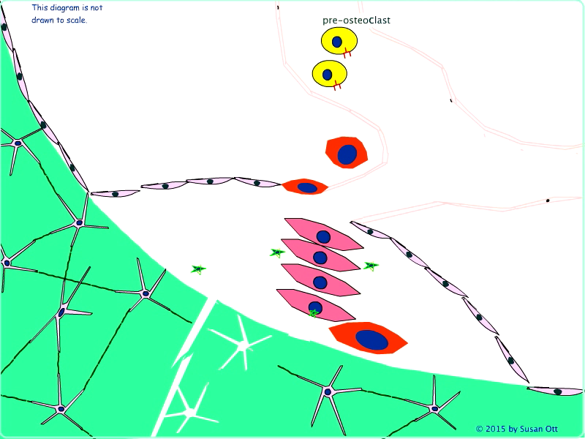
Osteoclast fusion
The osteoblasts and osteocytes express RANK-ligand which attracts the pre-osteoclasts.

Slide 7
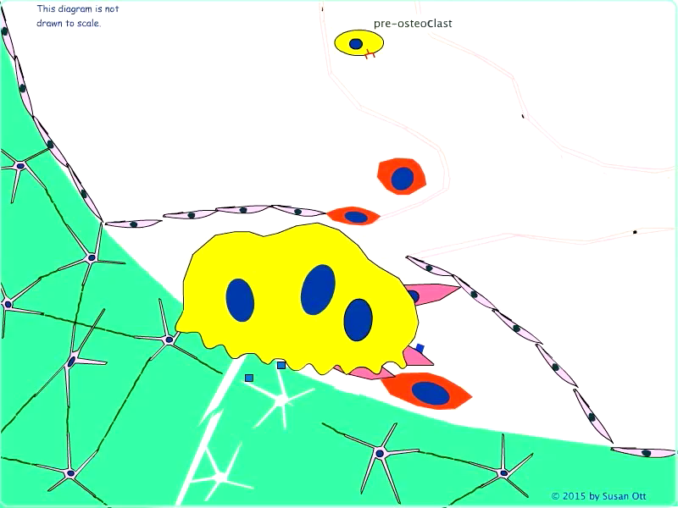
Bone resorption
The osteoclast resorbs bone, thereby releasing growth factors such as IGF and TGFß, which will start to activate pre-osteoblasts.

Slide 8
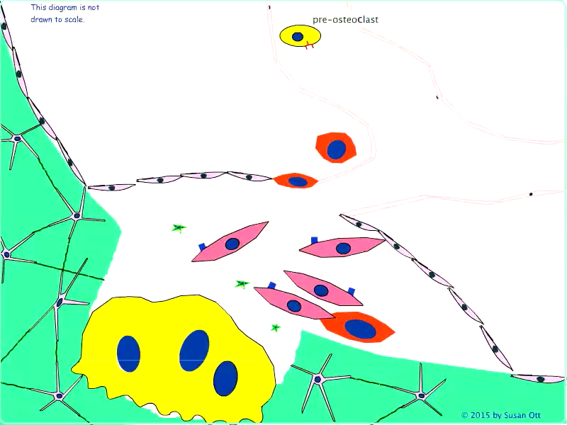
Osteoclast apoptosis
The osteoclasts resorb bone for about 2 weeks, then undergo apoptosis, but if there is low estrogen the apoptosis is delayed. Meanwhile, the osteoblasts form osteoprotegerin (OPG) to block the RANK-ligand. After resorption there is a short reversal phase.

Slide 9
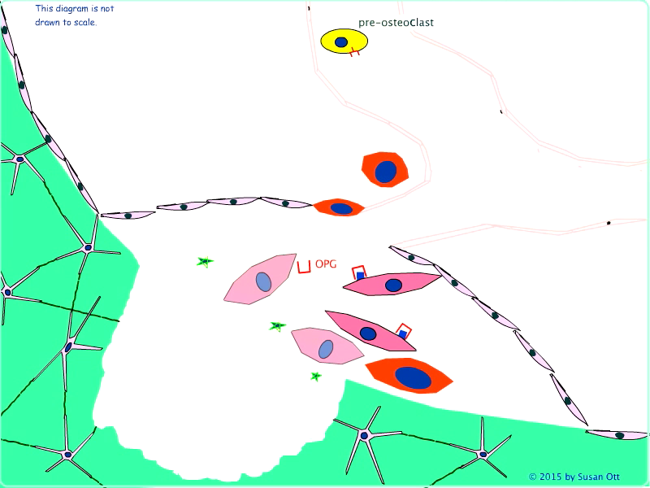
Bone Formation
The preosteoblasts proliferate and form a team of cells that lines the cavity and slowly fills it in, over about 6-9 months. Some remain in the matrix and will become osteocytes, some will become lining cells, the rest undergo apoptosis. Unmineralized osteoid matrix is colored red.

