Slide 1
Treating Osteoporosis in Advanced CKD: Bisphosphonates and Beyond
Susan M. Ott
University of Washington

Slide 2
Disclosures
2018:Attended a scientific advisory board meeting for Amgen, declined honorarium
2016: Gave lecture to course about renal osteodystrophy sponsored by Amgen international
Distant past (>5yrs ago): Research support from Merck, Lilly, and Hoffmann-La Roche

Slide 3
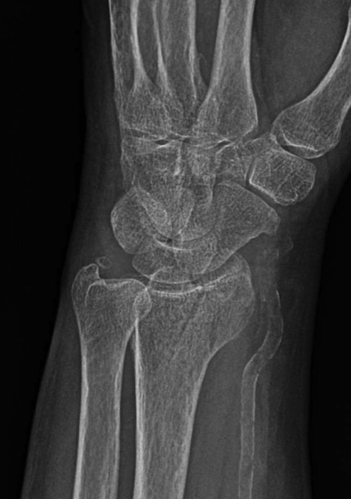
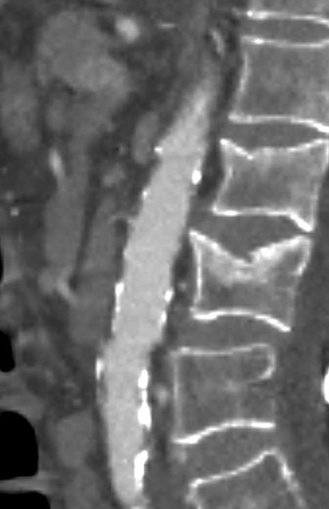
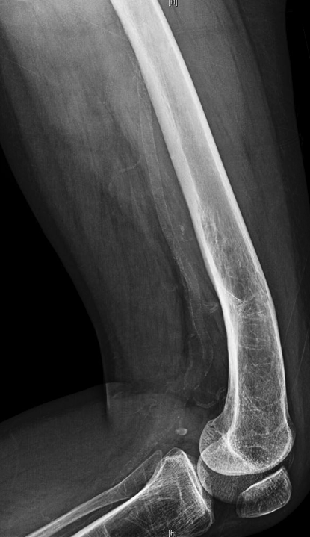
Patients with CKD have high fracture risk
and they die of heart failure

Slide 4
Medications used to treat osteoporosis
Bisphosphonates
Denosumab (antibody to RANK)
Romosozumab (antibody to sclerostin)

Slide 5
CKD-MBD
Ordinary 0steoporosis
Increased PTH and alkaline phosphatase | Normal PTH and alkaline phosphatase
Bone density weakly related to fractures | Bone density predicts fractures
Bone loss mostly in cortical bone | Bone loss in trabecular and cortical bone
High prevalence of adynamic bone or very high bone formation | Bone formation generally normal to slightly high
Associated with vascular calcifications | Weakly associated with vascular calcifications
Abnormal calcium, phosphate, FGF23, BMP7, Klotho, 1,25-vitamin D, iron, bicarbonate, sclerostin, and cytokines | Normal or mildly abnormal

Slide 7
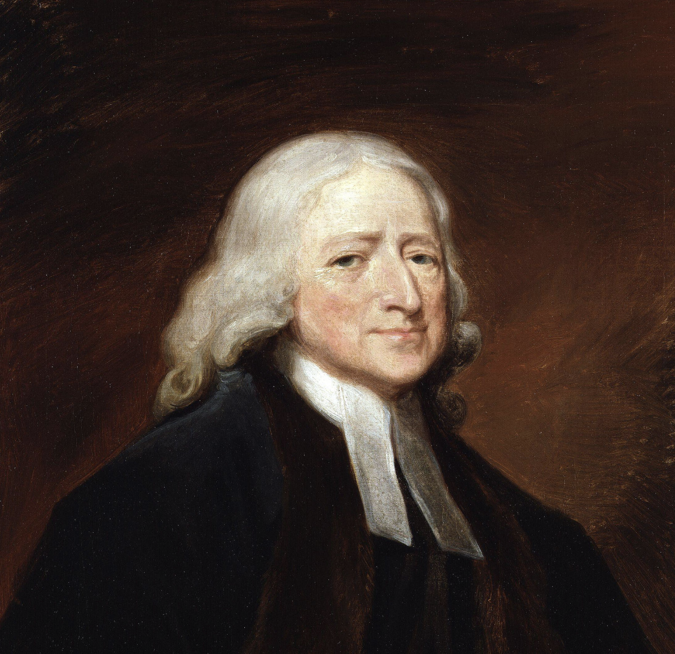
The Fall of Man
"Dust thou are, and unto dust shalt thou return." Gen. 3:19.
“In extreme old age, the arteries themselves, the grand instrument of the circulation, by continual apposition of earth, become hard, as it were bony, till, having lost the power of contracting themselves they can no longer propel the blood, even through the largest channels, in consequence of which death naturally ensues”
John Wesley 1703-1791

Slide 9
Treatment of CKD-MBD is a conundrum
If a clinical problem has been addressed by a large, randomized double-blinded clinical trial with significant and consistent results, then it would not be a conundrum.
Long-term effects of treatments can not be addressed by clinical trials.
Therapies should be based on physiological principals.

Slide 10
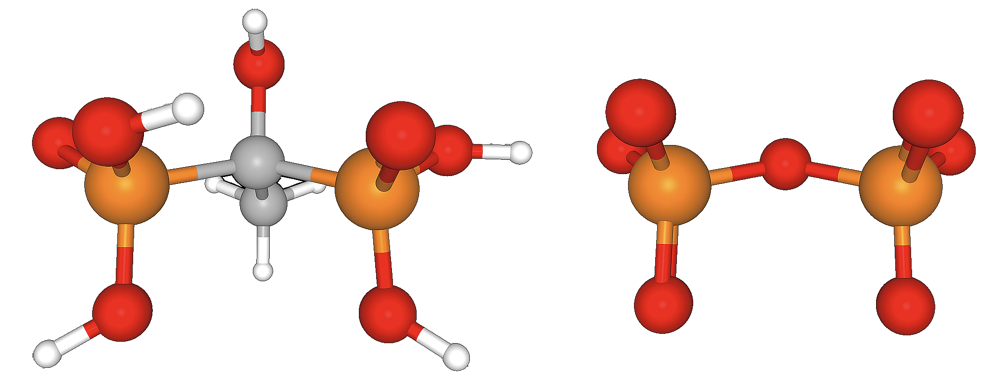
Etidronate Pyrophosphate

Slide 11
Bisphosphonates in ordinary osteoporosis
Large randomized trials, totally about 35,000 subjects, have shown that 2nd generation bisphosphonates reduce fractures during the first 3-4 years of treatment.
They work by blocking bone resorption, which prevents deterioration of the bone architecture.
They secondarily inhibit bone formation.

Slide 12
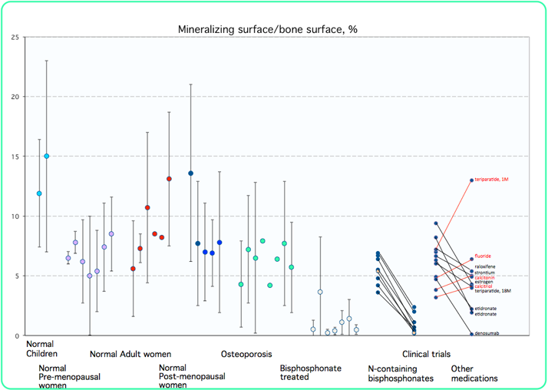

Slide 13
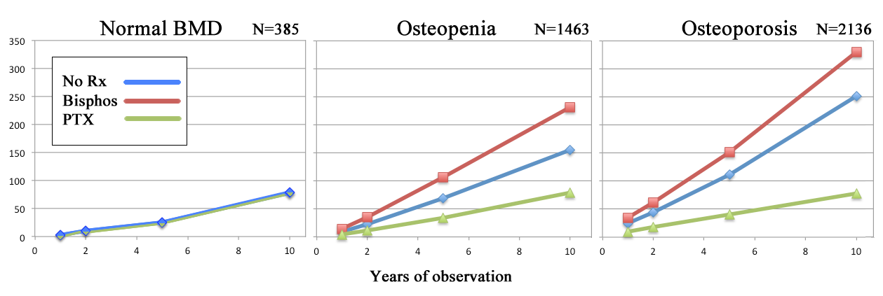
Fractures in primary hyperparathyroid patients without CKD
Bisphosphonate use significantly increased the bone density,
but there were more fractures
Graph shows risk of any fracture per 1,000 patients according to baseline BMD
Yeh, Annals Internal Medicine, 2016

Slide 14

CKD grade 3
In the studies of bisphosphonates, raloxifene, teriparatide and denosumab, the subjects with age-related CKD grade 3 had fracture benefit, similar to patients with normal eGFR
These studies excluded sick patients. The subjects had normal calcium, PTH, and alkaline phosphatase.

Slide 15
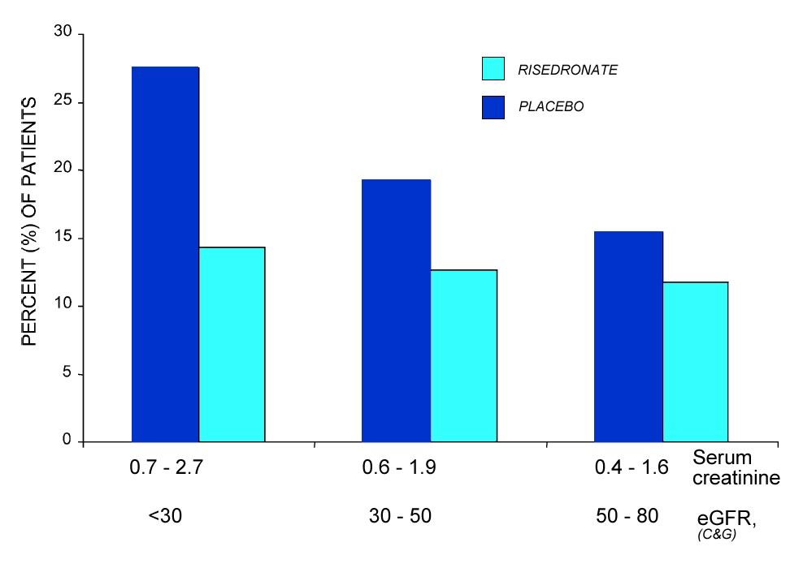
Risedronate in early CKD: Fractures
* mean age 75, normal PTH and alk phos
(42 by MDRD)
Miller, JBMR ‘05

Slide 16
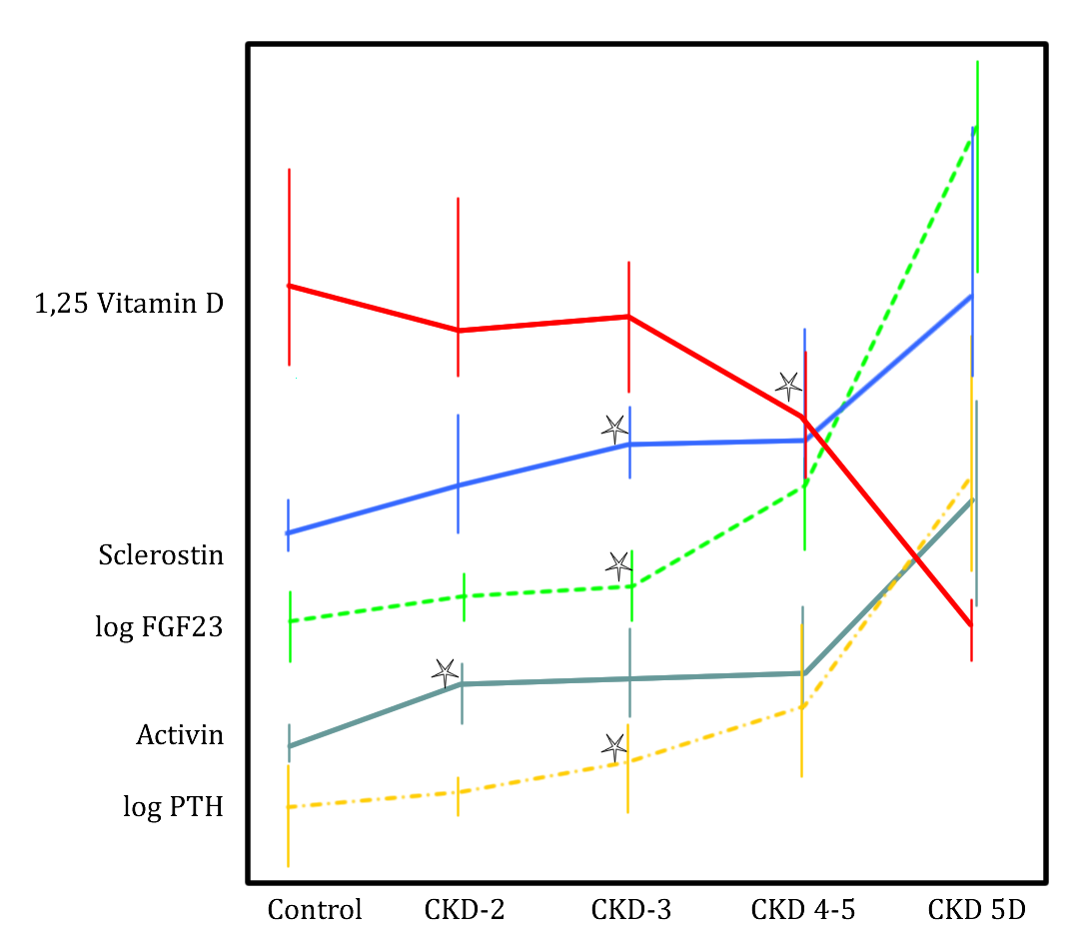
Changes in mineral-related hormones according to grade of CKD
Data from
Lima, Clin Nephrol 2019

Slide 17
Randomized clinical trials of bisphosphonates in CKD stage 4-5
(minimum criteria: N>49, duration >5 mo)

Slide 18
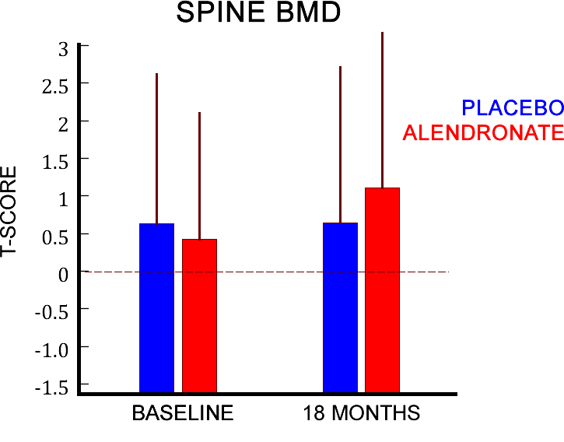
Alendronate in CKD stage 4-5
N=51
48 completed
18 months
Fem neck T scores were -1.26 and -1.28 at baseline.
At 18 mo. the difference between groups was not significant at the hip (∆ = 0.03 T-score units)
Vascular calcification progression was not different.
Toussaint, AJKD 2010

Slide 19
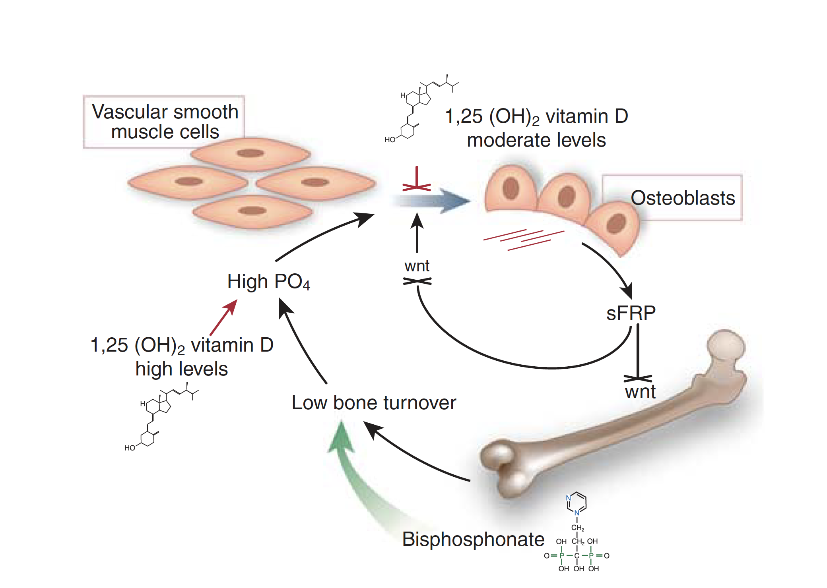

Slide 20
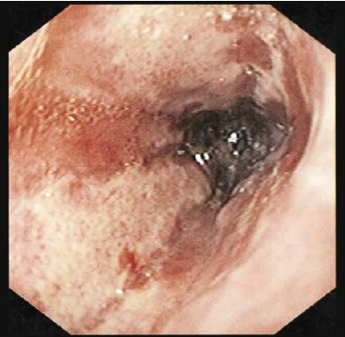
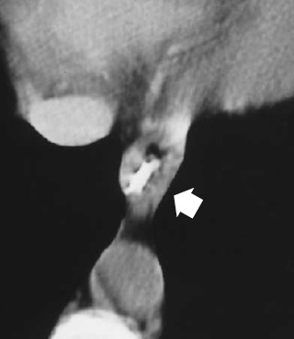

Endoscopic Image of the Esophagus (Panel A) and Contrast-Enhanced CT Scan of the Chest (Panel B)
DE GROEN
1996
de Groen P et al. N Engl J Med 1996;335:1016-1021
Notes:
Figure 1. Endoscopic Image of the Esophagus (Panel A) and Contrast-Enhanced CT Scan of the Chest (Panel B) in Patient 1. Panel A shows severe, extensive hemorrhagic ulcerations and inflammatory exudates, which were still present in the distal esophagus on the ninth day of hospitalization. Panel B shows concentric esophageal-wall thickening (arrow) suggestive of transmural inflammation.

Slide 21
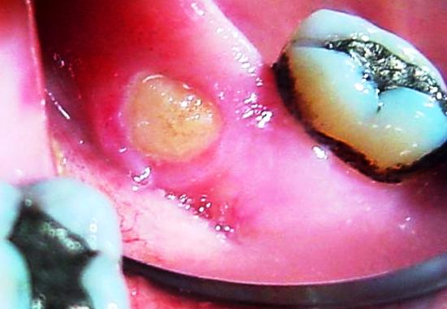
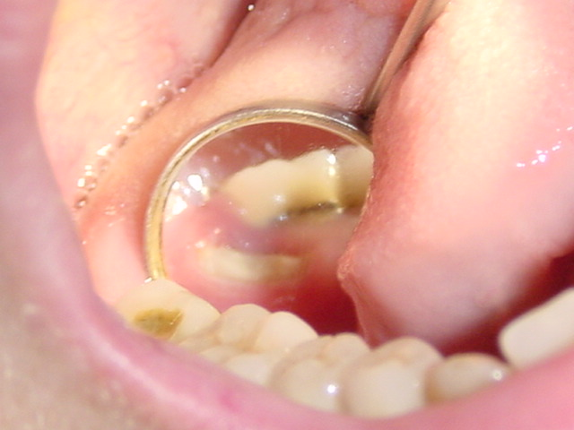
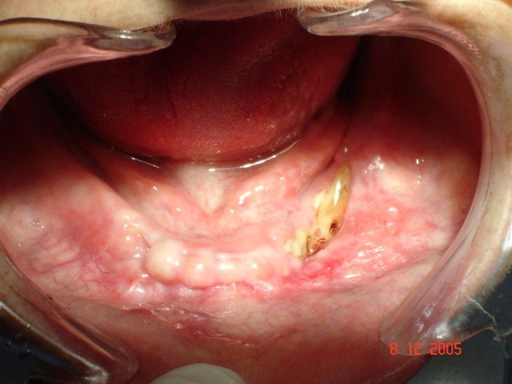
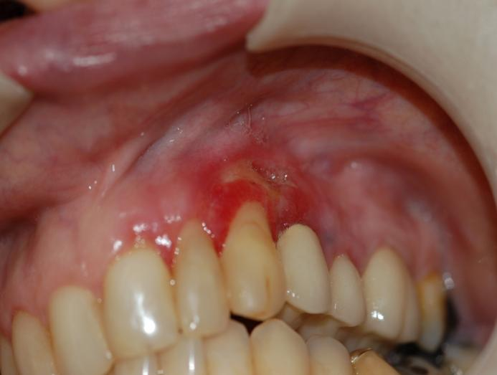
Schubert 2004
Schubert 2007
Correa 2006
Notes:
21

Slide 22
Bone strength with long-term bisphosphonates
Bone biopsies from ordinary osteoporotic patients on bisphosphonates from 1 to 17 years found strength peaked at 7 years and then declined to levels below baseline. Crack density increased progressively.
Pienkowski, Wood, Malluche.
ASBMR 2019

Slide 23
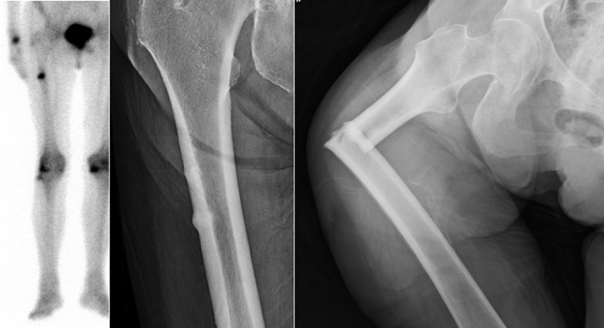

Slide 24
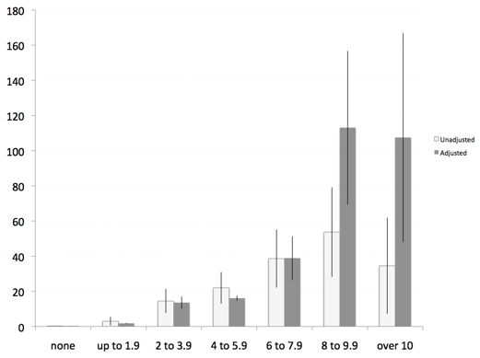
Incidence of atypical femur fracture
Rate/
100,000/
year
Duration bisphosphonate use, years
Dell, JBMR, 2012

Slide 25
Be wary about bisphosphonates in patients with CKD stages 4-5
Inadequate studies in this population.
Data from patients with early stages of CKD may not reliably be extrapolated to later stages.
Bisphosphonates can increase PTH.
Bisphosphonates markedly reduce the bone formation rates.
In osteoporotic patients prolonged use increases incidence of atypical femur fractures.
In primary hyperparathyroidism patients treated with bisphosphonates had higher fracture rate than untreated patients despite increase in bone density.
Long-term effects on vascular calcifications uncertain.

Slide 26
Denosumab:
From the frying pan into the fire
Denosumab inhibits bone formation
more than bisphosphonates.
It is not cleared by the kidney,
but this does not mean it is effective in CKD.

Slide 27
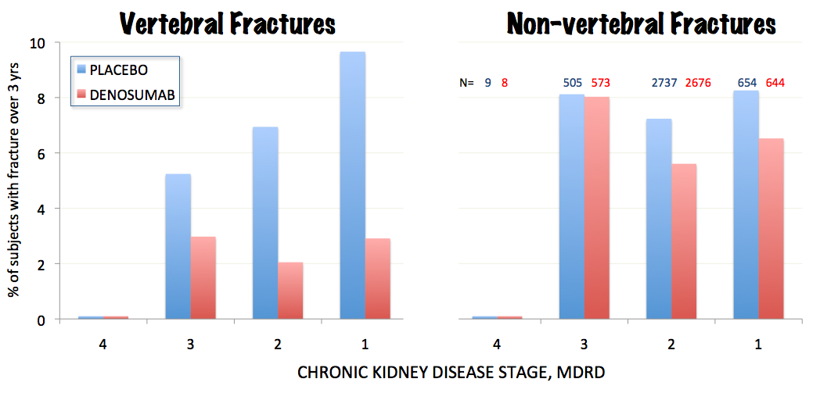
Denosumab in early CKD
Jamal, JBMR, 2011

Slide 28
Denosumab lowers serum calcium in CKD
 | Normal | Stage 2 | Stage 3 | Stage 4 | Stage 5
N | 12 | 13 | 13 | 9 | 8
# with Ca<7.5 | 0 | 1 | 0 | 2 | 2
Others have reported seizures, tetany, cardiac problems, laryngospasm.
Incidence as high as 40% in CKD grades 4-5
FDA

Slide 29
Rapid progression of calcifications with denosumab
Ueki, Yamada, et al, Internal Medicine, 2015

Slide 30
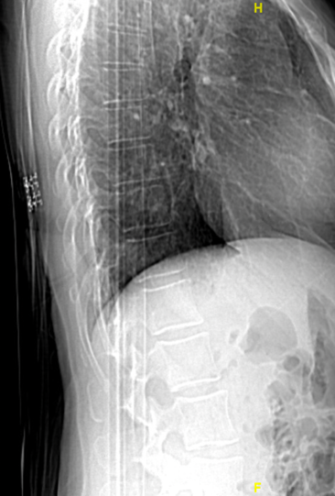
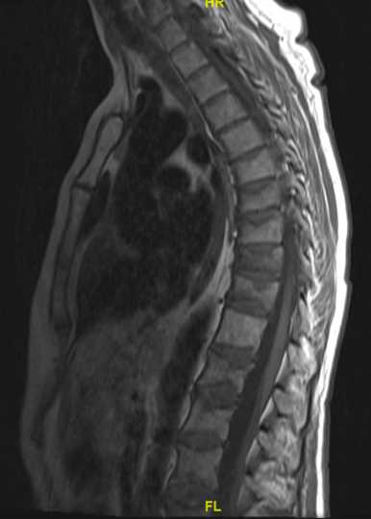
Before
and after skipping a dose of denosumab

Slide 31
ASBMR 2019 abstracts about denosumab
McDonald: Intravital imaging of osteoclasts in vivo: discovered osteoclast fission, which is different from apoptosis and results in small round cells that accumulte with OPG treatment, and then they can re-fuse to form large active osteoclasts.
Kendler: N = 115 patients took DMAB for one year and then Alendronate 70/wk for one year.
Bone density stable after transition, but the ones with larger BMD increases in first year most likely to lose in year 2.
Tsai: N=53 patients took teriparatide for 9 months, DMAB at Mo 3 and 9 and zoledronate at month 15 (range 5 - 7 mo after DMAB injection. BMD did not decrease at spine during mo 15-27. At hip, 3% decrease in those treated early (<26 wks)

Slide 32
Zanchetta: N = 98, The 65 not treated after DMAB treatment (mean 2.3 yrs) lost 4.1% from spine. Those treated with bisphosphonates lost 3.3% Hip lost 3.3% vs 0.9%
Dickens: chart review 94 patients had received DMAB followed by bis. and 35 had complete data. Average 2.5 years treatment. BMD decrease less than 3% in 11/20 patients on oral and 8/15 on IV. 3 had vertebral fractures
Popp: N=20 CTX decreased after zol in women with at least 2 doses of DMAB and zol average 9 months later. But 12 mo after ZOL the CTX was again back as high as before the ZOL.
Selling: N = 60, treated for 4.6 yrs with DMAB and then ZOL at 6 mo or 9 mo or observed, but if CTX increased in 9mo or Obs they were also treated with ZOL. Half the obs group developed high CTZ and received ZOL.
One year after discontinuation, loss of spine was 4.8%, 4.2% and 4.9% in the groups

Slide 33
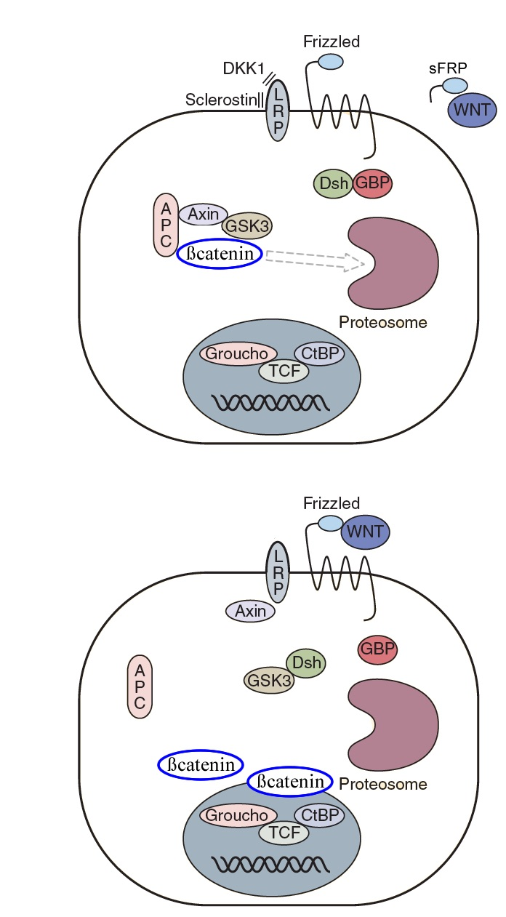
Wnt-signaling pathway
This pathway is necessary for differentiation of osteoblasts
Klotho

Slide 34
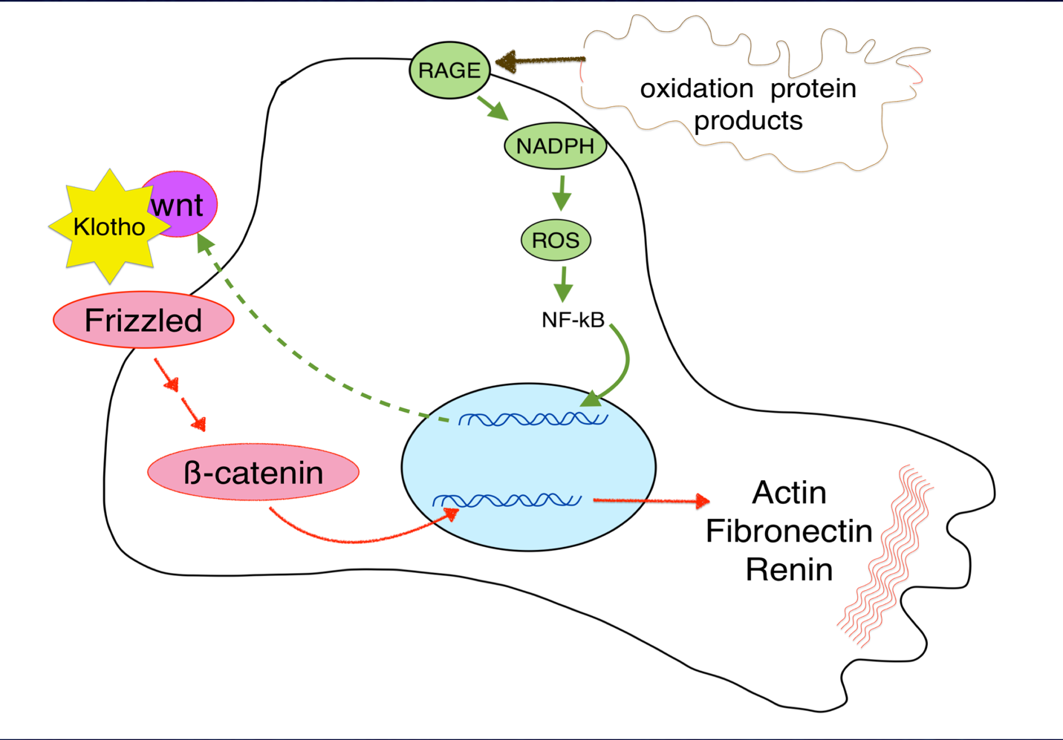

Slide 35


Wnt-signaling
Increases bone formation and decreases bone resorption
Increases renal fibrosis
Increases arterial wall calcification
Is inhibited by klotho in the bone, kidney, and vasculature

