Slide 1
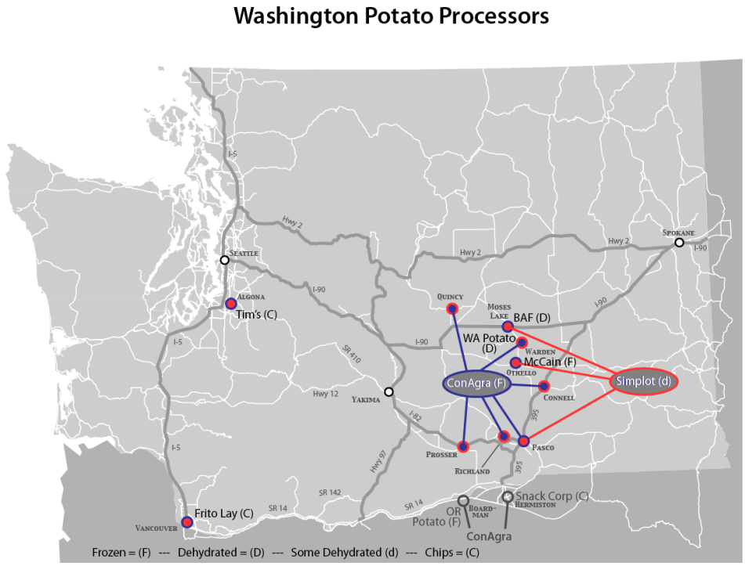
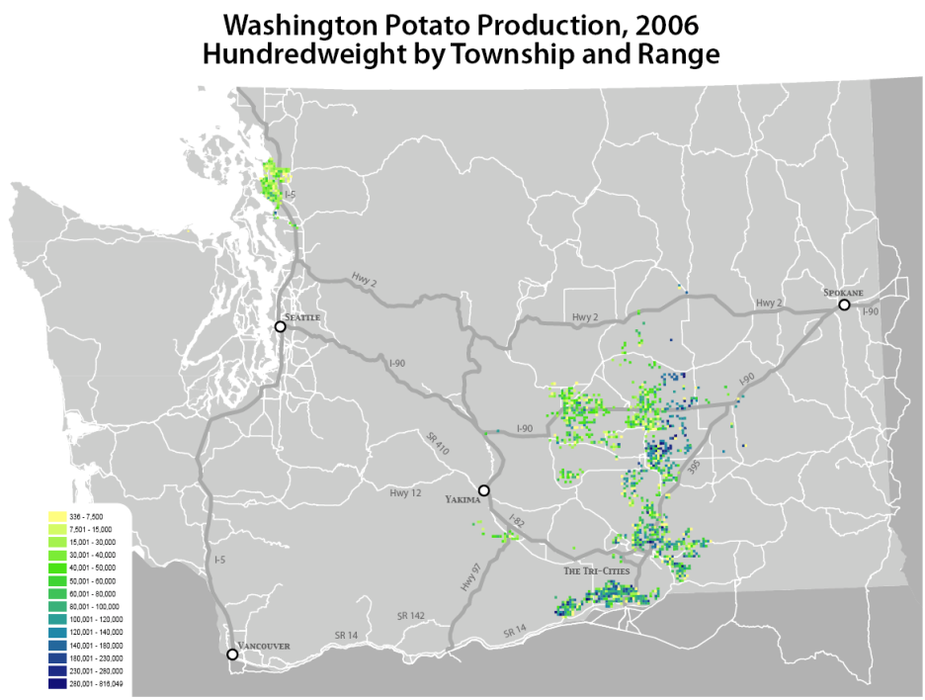
Collecting Local Freight Data – Washington Potatoes
Potato production identified by USDA data
Supply chain and potato processors identified by State Potato Commission
Source: WSDOT Development and Analysis of a GIS-Based Statewide Freight Data Flow Network; Goodchild, Jessup et al, 2009

Slide 2
Collecting Local Freight Data – Diesel Distribution
Sources of diesel data
WA DOA – regulates fuel at gas stations
WA Department of Ecology – regulates active underground storage tanks
U.S. EPA – regulates above-ground storage tanks
WA DOR – responsible for assessing and collecting fuel taxes at terminal locations
Other agencies monitor mode-specific activity (e.g., pipeline, waterborne activity, railroads)
Source: WSDOT Development and Analysis of a GIS-Based Statewide Freight Data Flow Network; Goodchild, Jessup et al, 2009

Slide 3
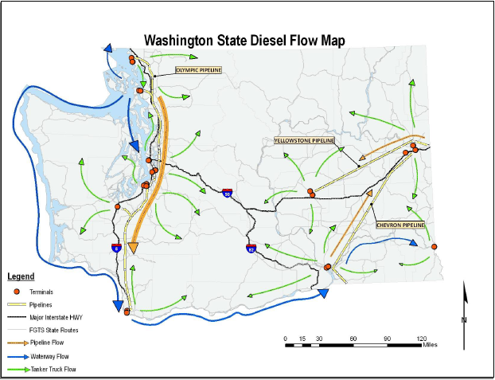
Collecting Local Freight Data – Diesel Distribution (continued)
Source: WSDOT Development and Analysis of a GIS-Based Statewide Freight Data Flow Network; Goodchild, Jessup et al, 2009

Slide 4
Development of Generic Supply Chain Descriptions
Identify commodities that represent high volume and high value
Identify industries and commodities where disaggregation have been problematic
Based on literature review
Identify industries and commodities where CFS data are weak

Slide 5
Development of Generic Supply Chain Descriptions (continued)
Propose to identify five supply chains total
Potential candidates include
Containerized imports of retail consumer products
Bulk domestic products (e.g. agricultural products)
LTL shipments of mixed manufactured products
Domestic plastics and rubber manufacturing
Building and/or road construction
Parcel and mail shipped commodities

Slide 6
Supply Chain Example: Supermarket
Food Processors’ Plants and D/Cs
Supermarket’s Facilities
Finished Goods
Regional D/C
Stores
Consumers
Local Vendors
Transportation and shipment size: to D/C is rail carload and truckload; to stores are truckload; local vendors are small local peddle trucks
Distribution: Demand pull from point of sale data. Finished goods are nationwide; regional D/Cs are local

Slide 7
Example: Construction
Distributors
Construction Site
Short-Term Inventory; Materials To Be Erected
Inventory for Site
Erected Facility
Construction Supplies, Tools
Equipment, Forms, Trucks, etc.
Contractor’s Yard
Temporary Yard; Near Site
Transportation and shipment size: to site and yards are truck of various sizes
Distribution: Timely sequencing/staging is key. Materials to be installed are national; supplies and equipment for use in erection of facility are regional/local

Slide 8
Example: Food Processing and Distribution
Growers
Processing Plant
Distributor
Harvest Slaughter Ship
Can, Dress, Freeze, Protect, Inventory
Inventory
Supermarkets’ Regional D/C
Flow Thru; Consolidations
Inventory
Inventory
Warehouse at Origin
Regional D/Cs
Transportation and shipment size: to warehouse, distributor, D/Cs, supermarkets’ D/Cs is rail carload and truckload
Distribution: Slow, predictable. Finished goods are nationwide; D/Cs are regional

