Slide 1
Sidewalks in bellevue
Team JACK
Matt Schnell
Peter Kwon
Hiroyuki Ikeda
Malissa Phok
Friday, 11th of December, 2009

Slide 2
PreseNTATION contents
Goals/objectives
Data
Analysis
Results and Conclusion
Sources (links etc)

Slide 3
GOALS / OBJECTIVES
Find criteria in Bellevue area that needs sidewalks
Bus stop
School zone
Parks
Libraries

Slide 4
Data
Initial data layers
  King County TNET
  Bellevue city limits
  King County schools
  Bellevue buildings (libraries)
  King County parks
  King County Metro bus stops
  Bellevue sidewalk data

Slide 5
Analysis
Input data and clipped it to only what we needed
Buffered criteria we were interested in
Intersected with existing streets
Intersected those with existing sidewalks

Slide 6
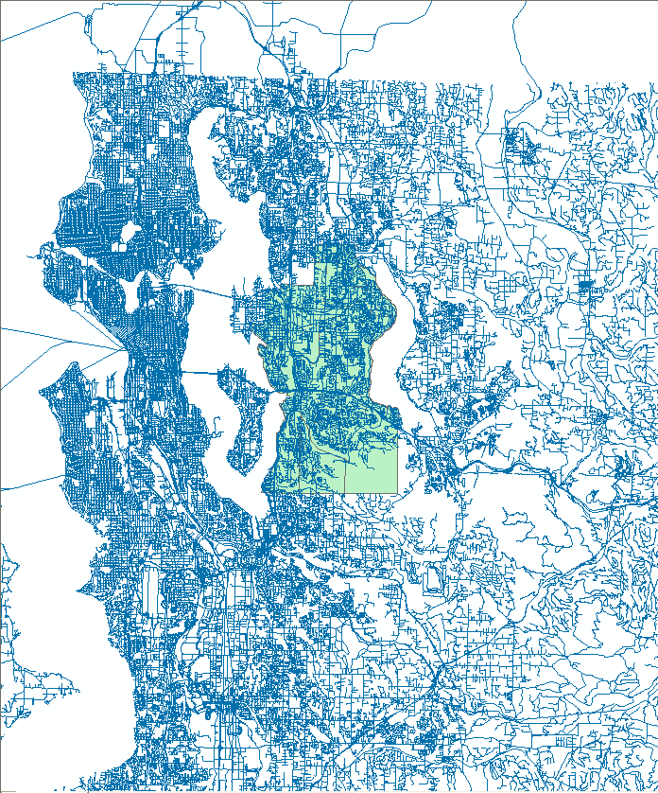
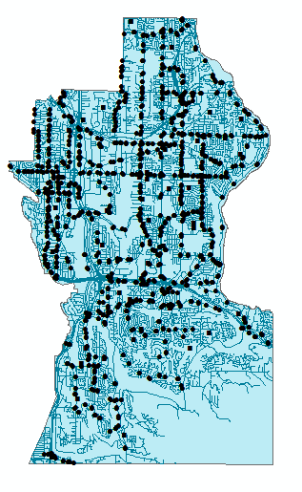
Data: INITIAL & CLIP

Slide 7
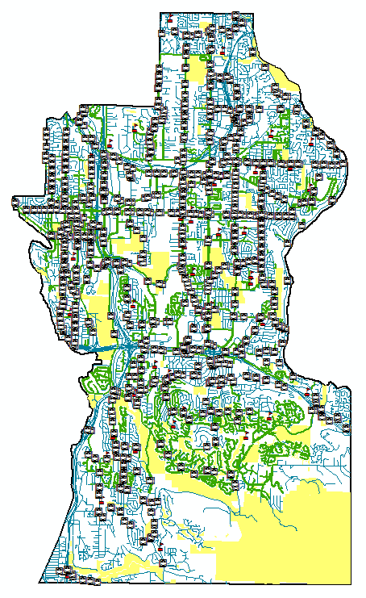
DATA: ALL CRITERIA & BUFFERS

Slide 8
Results and conclusion
What have we found?
Amount of pavement needed: 395 mi (too much)
Locations: South - parks; North -
How was this information useful to Bellevue

Slide 9
Sources
WAGDA
Google Earth
King County

