Slide 1

Where can an Onsite Wastewater Treatment System be built?
Jesse Greenough
Ryan Mun
Adnan Shabir
Stephany Wei

Slide 2
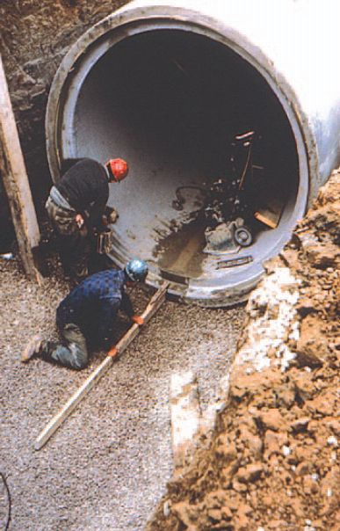
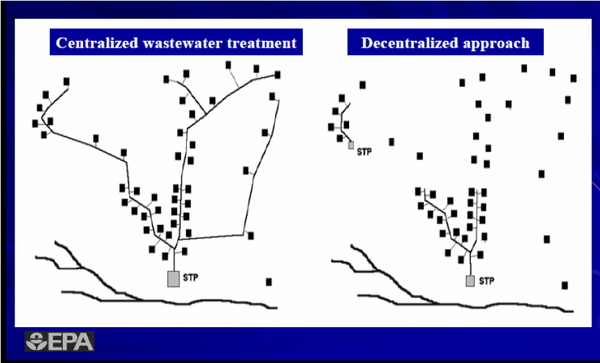
Why Onsite Systems?
Avoid conveyance cost- Cheaper
Allow water reuse- More Sustainable
Notes:
We will be focusing specifically on Seattle residential areas

Slide 3
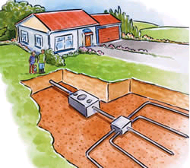
Onsite System Constraints
1.) Soil type
Avoid clay or silt.
2.) Residential parcel
Size ≧ 4000 sq ft
3.) Avoid Wetlands
At least 100 feet away
4.) Slope
less than 40%
Notes:
Adnan: Our data constraints are as follows: The soil type needed for the onsite wastewater treatment system are anything but clay and silt because clay and silt are impermeable, which would prevent the natural filtration that the wastewater should undergo. We determined our residential parcel size should be at least roughly 4000 square feet, which includes a Seattle average 2000 square foot house and calculations we made based off of the Washington state regulations of on site sewage systems for the size of the treatment system. To avoid our water being contaminated we will avoid wetlands by placing a buffer of 100 ft around the wetlands. A slope of less than 40 percent is required to avoid build up of sludge within the naturally permeable soil filtration system.

Slide 4
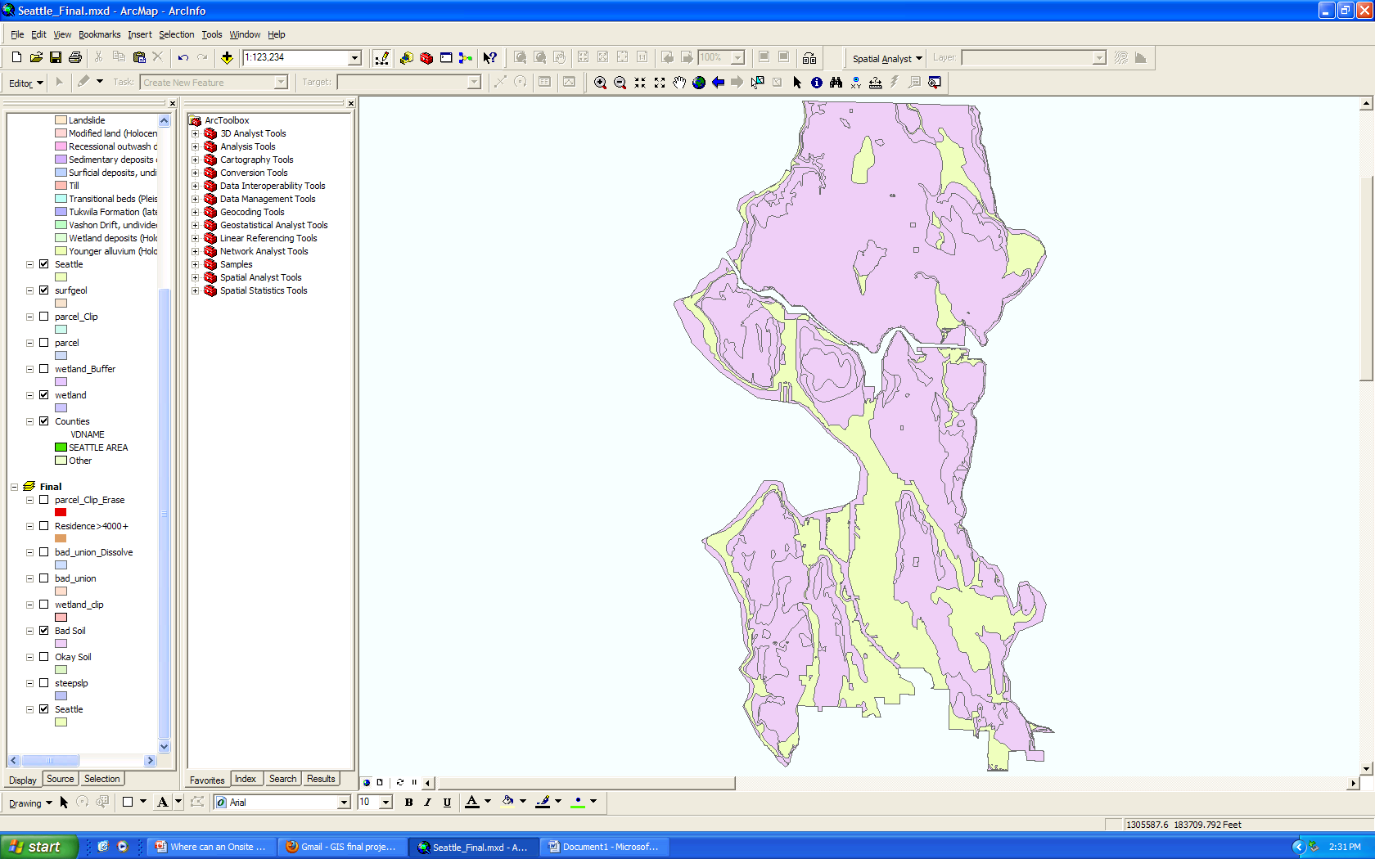

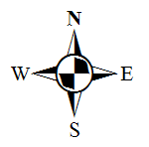
GIS Analysis
Scope: Individual houses in Seattle
Soils
Avoid clay
and silt

Slide 5
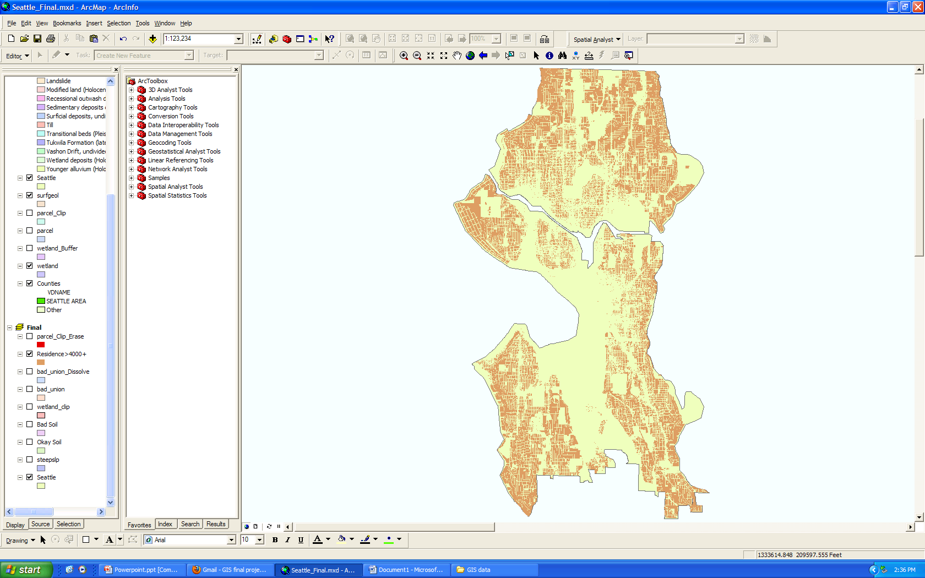
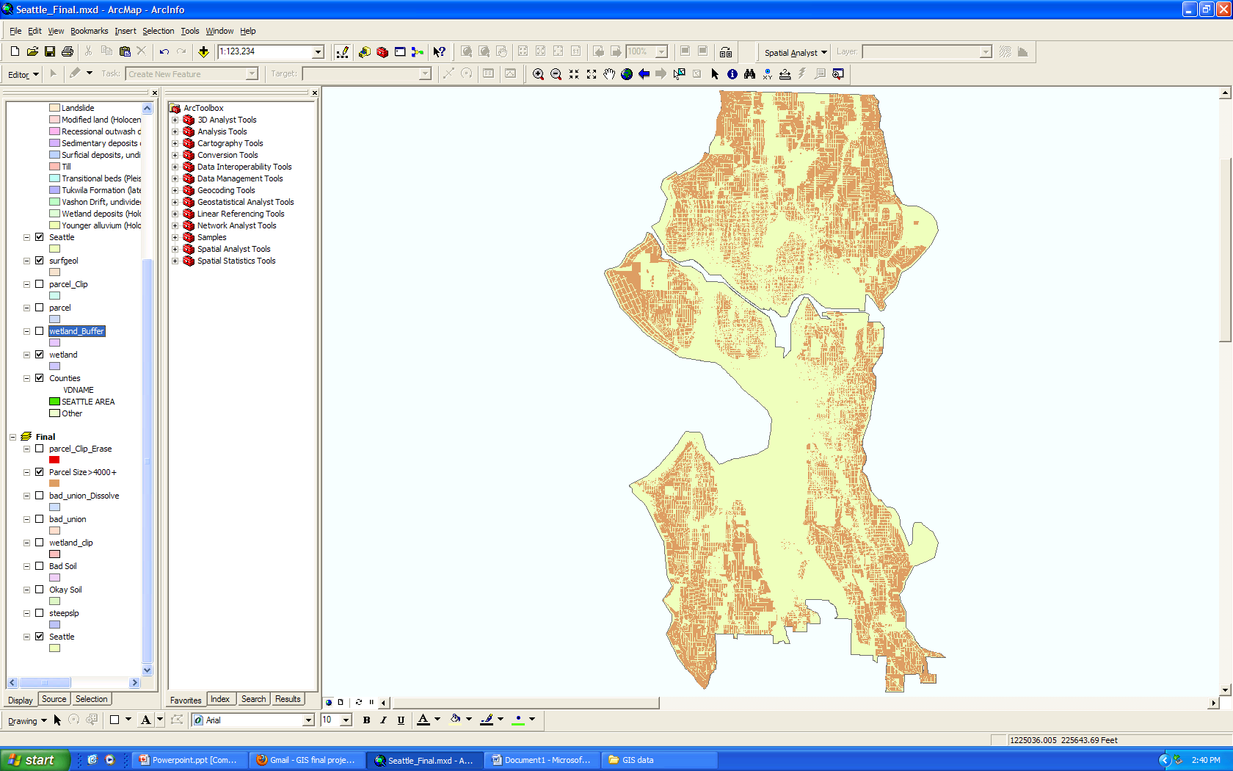
Residential parcel size: at least 4000 sq ft needed

Slide 6
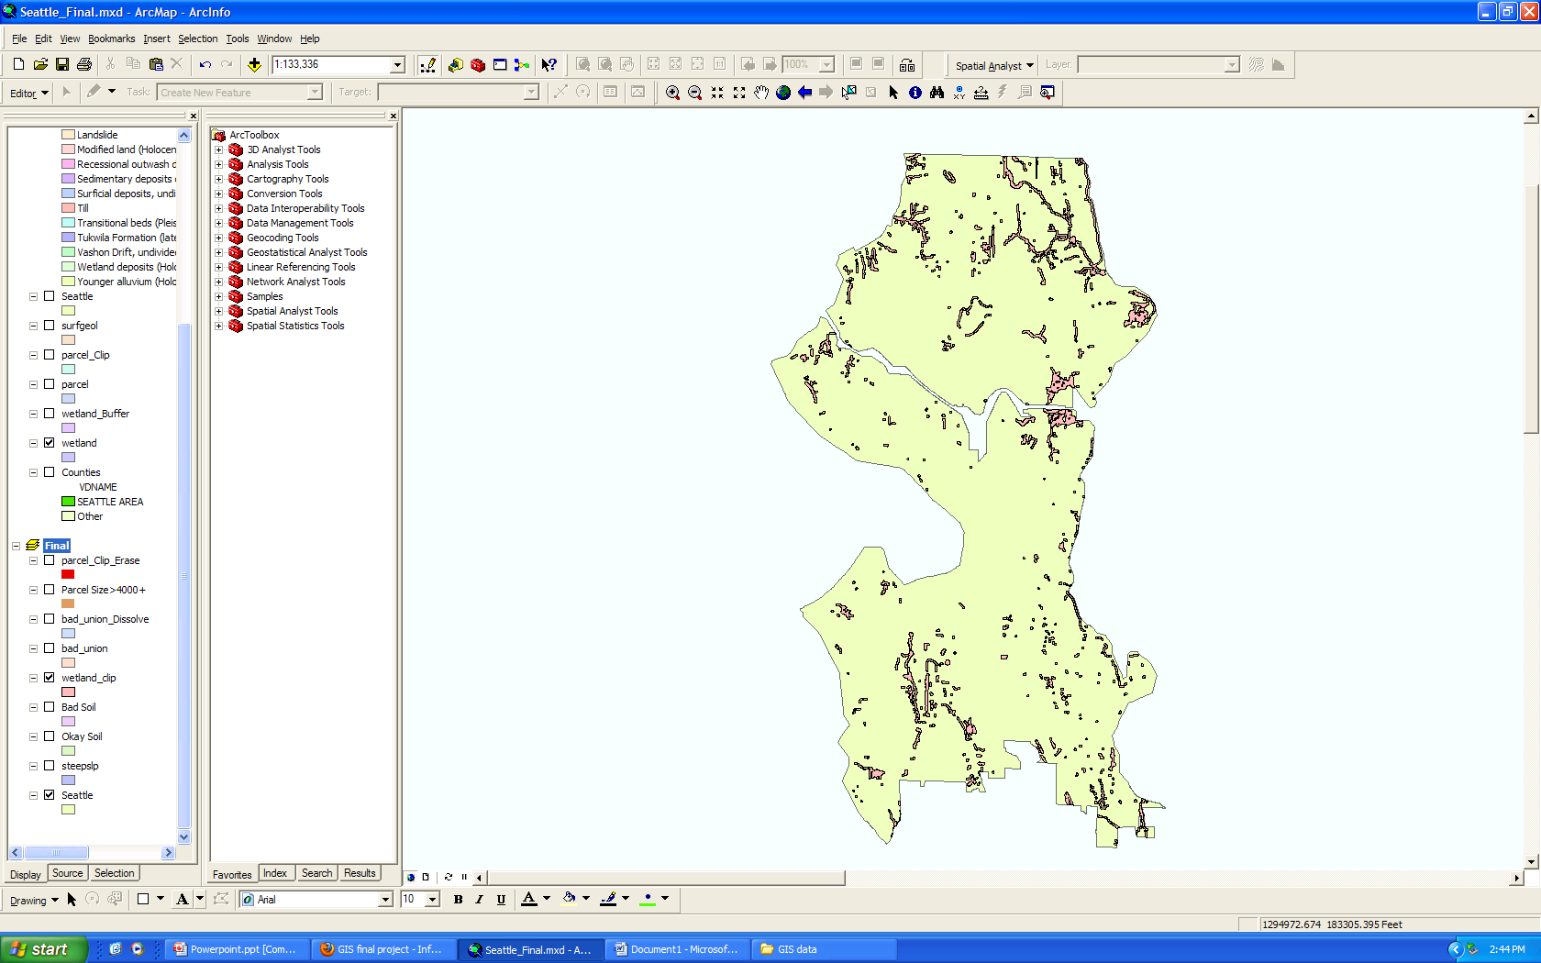
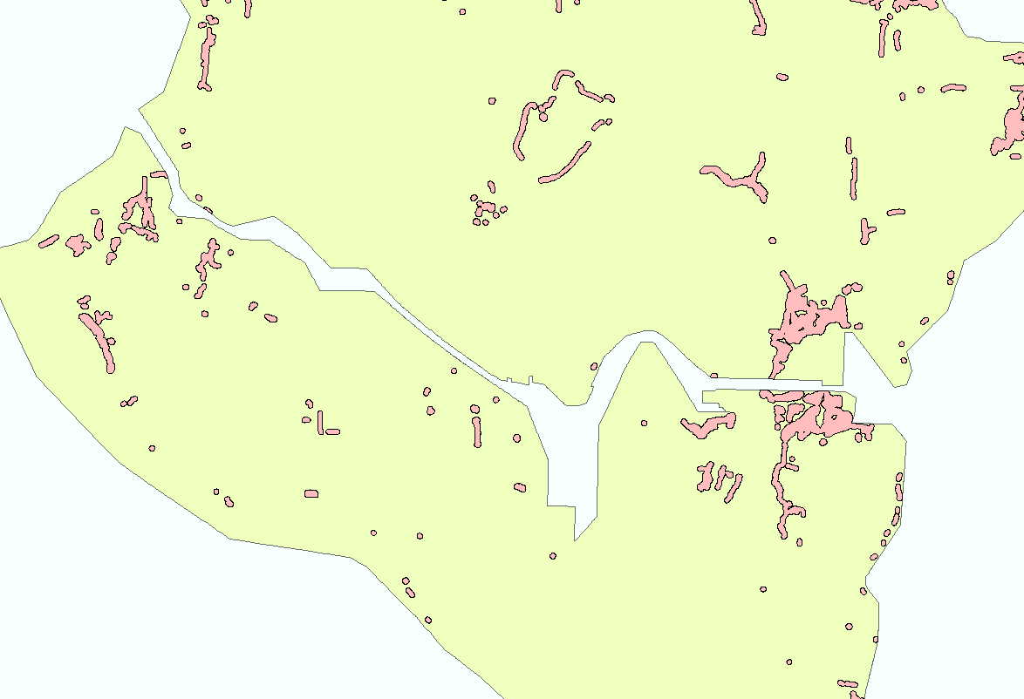

Wetlands: At least 100 ft away

Slide 7
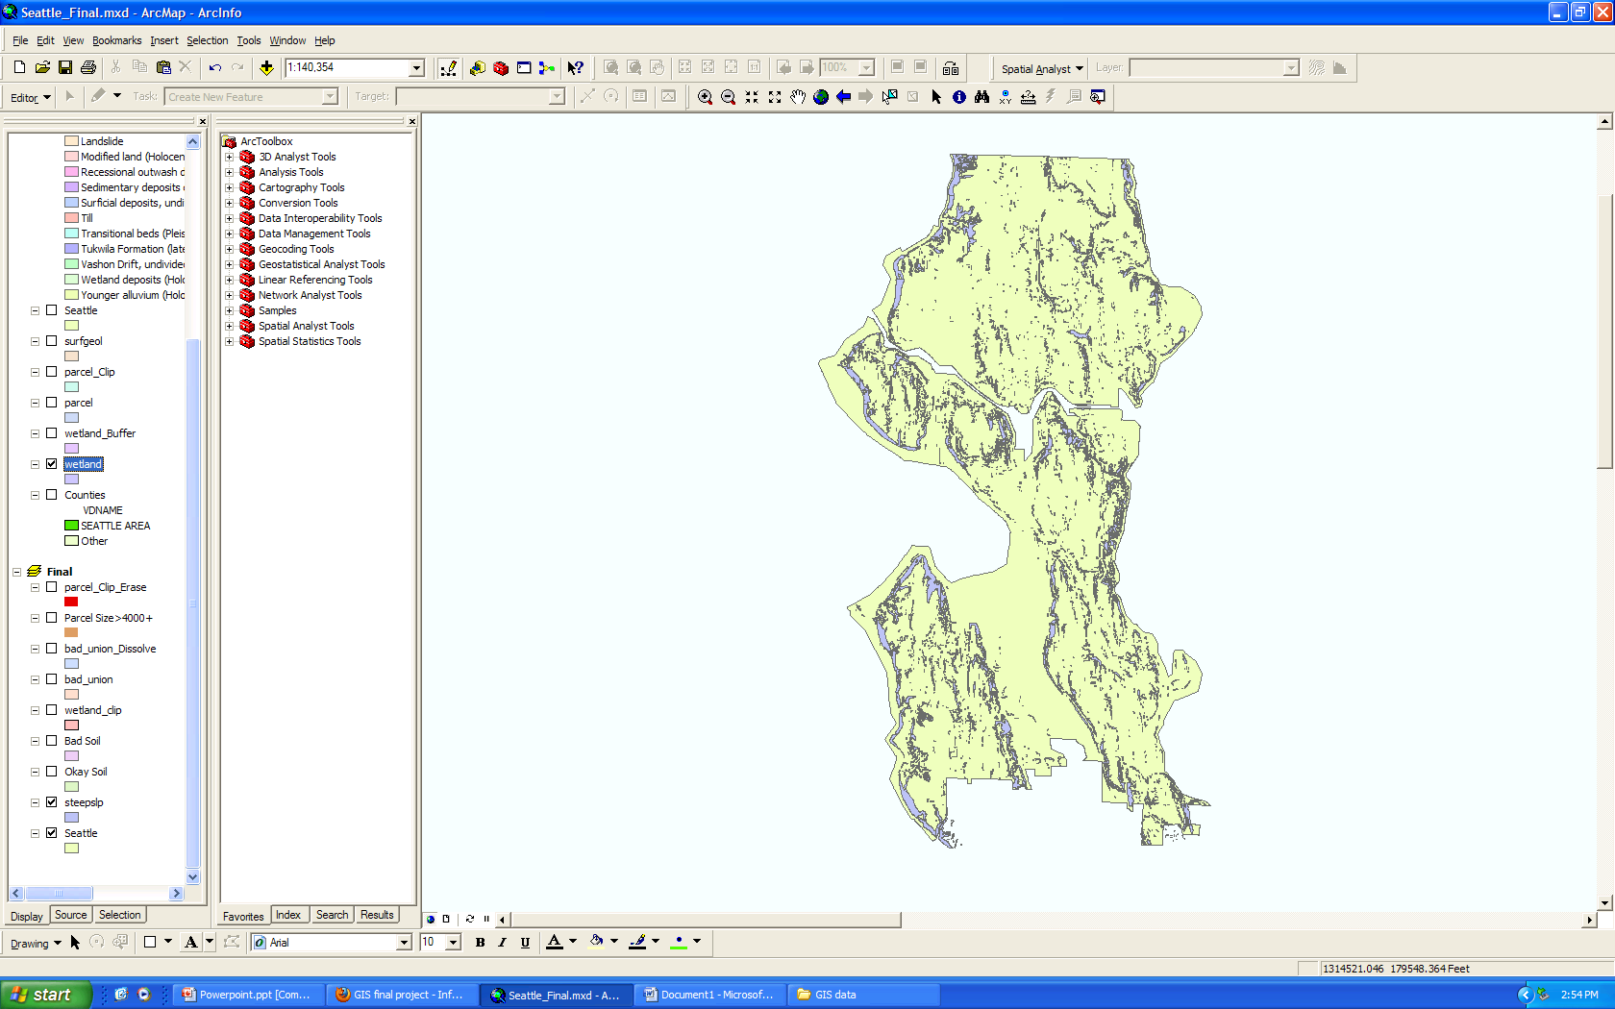

Slopes: should be less than 40%
Slope > 40%

Slide 8
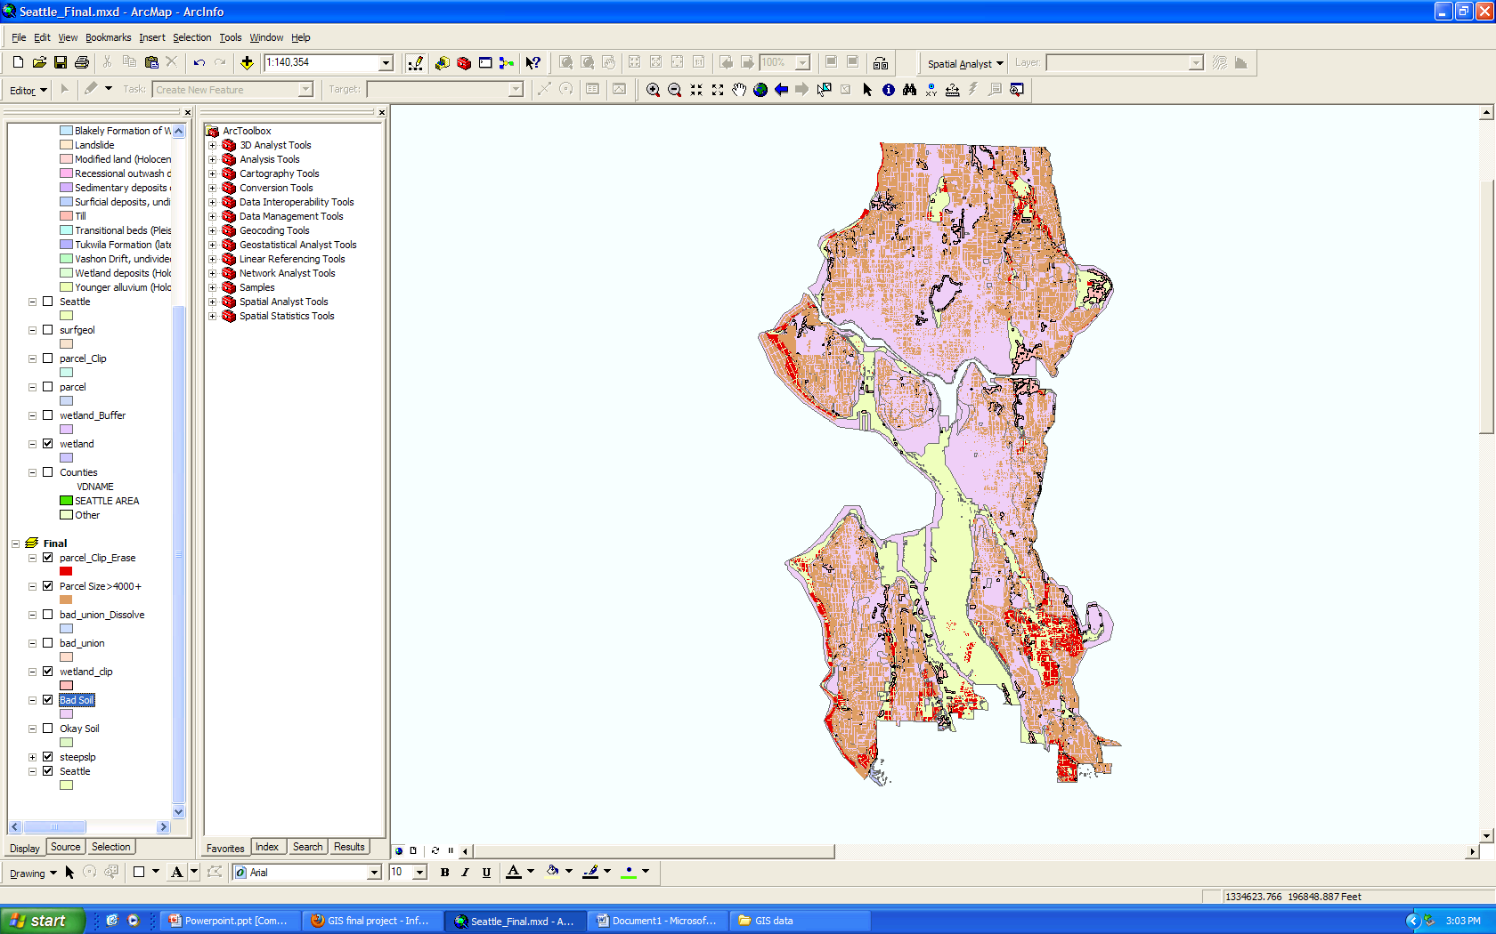

Results
Residential areas good for on site wastewater treatment systems
Notes:
We union dissolved all the criteria in one layer and we use that to clip our residential parcels that are greater than 400 square feet. And here is our result.
The red shows the residential areas good for onsite wastewater treatment systems.
And it makes sense because all the residents are located mostly on the outer skirt of Seattle, and our result shows that characteristic.

Slide 9
Conclusion
Even though only a small percentage of the Seattle residential area allows implementation of onsite sewage treatment systems, they should be built anywhere possible. Because this will allow:
Less cost
More sustainable
Notes:
Less cost because less construction material is needed. More sustainable because not only does construction work is reduced, but also allows more water reuse opportunity.

Slide 10
Thank You!
"City of Seattle GIS Data." WAGDA Home. Web. 30 Nov. 2010. <https://wagda.lib.washington.edu/data/geography/wa_cities/seattle/index.html>.
"King County GIS Data." WAGDA Home. Web. 30 Nov. 2010. <https://wagda.lib.washington.edu/data/geography/wa_counties/king/index.html>.
COHEN, AUBREY. "Bungalows Biting Dust for Suburban-size Homes." Seattle News, Sports, Events, Entertainment | Seattlepi.com - Seattle Post-Intelligencer. Web. 30 Nov. 2010. <http://www.seattlepi.com/local/304253_teardown19.html>.
"Chapter 246-272A WAC: On-site Sewage Systems." On-site Sewage Systems. Washington State Legislature. Web. 30 Nov. 2010. <http://apps.leg.wa.gov/wac/default.aspx?cite=246-272A>.

