Slide 1
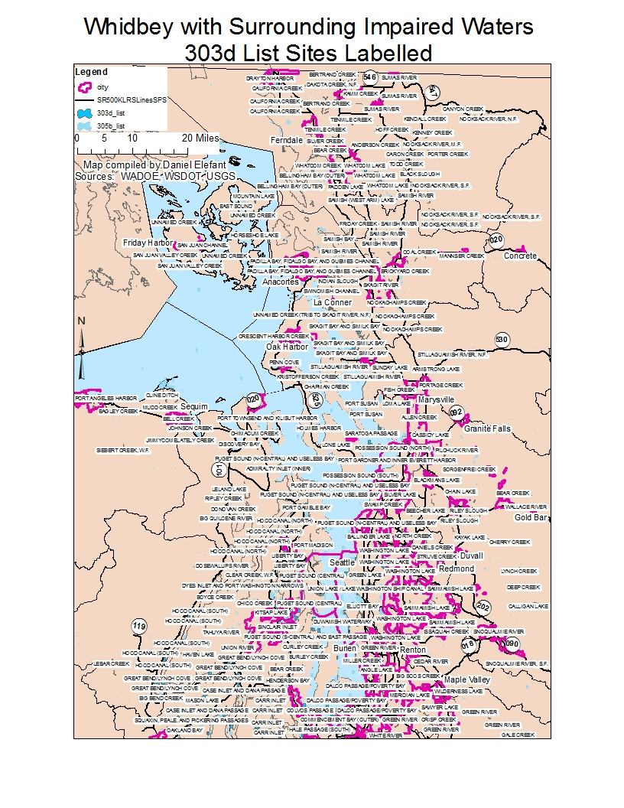
The Big Question: How do we prioritize sites for restoration and protection to protect water quality?
Notes:
The Big Question: How do we prioritize sites for restoration and protection?

Slide 2
One Approach from Ecology:
WRIA 6 Draft Analysis Maps for Island Watersheds
November 8, 2010
Water Flow Assessment as part of the Puget Sound Characterization Project
Lake Analysis Update
N://wet/wtshd/2009_PS/WRIA6_ Draft Results_11_8_2010.ppt

Slide 3
Management Matrix for Restoration & Protection
With GIS Attributes
High
PROTECTION
P1
H,L
Protection 1 Restoration
P1R
H, M
Restoration 1
R1
H,MH
RESTORATION
R
H,H
Protection 2 Restoration
P2R
MH,M
Restoration 2
R2X
MH,MH
Restoration 2
R2
MH,H
Protection 2
P2
MH, L
Level of Importance
Protection 3 Restoration
P3R
M,M
Restoration With Development
RD2
M,MH
Restoration With Development
RD1
M,H
Protection 3
P3
M, L
Conservation 1
C1
L,L
Conservation 2
C2
L,M
Development 2
D2
L,MH
Development 1
D1
L,H
Low
High
Red Letter = H, MH, M, or L
for Importance Score
Level of Degradation
Black Letter = H, MH, M, or L
for Degradation Score

Slide 4
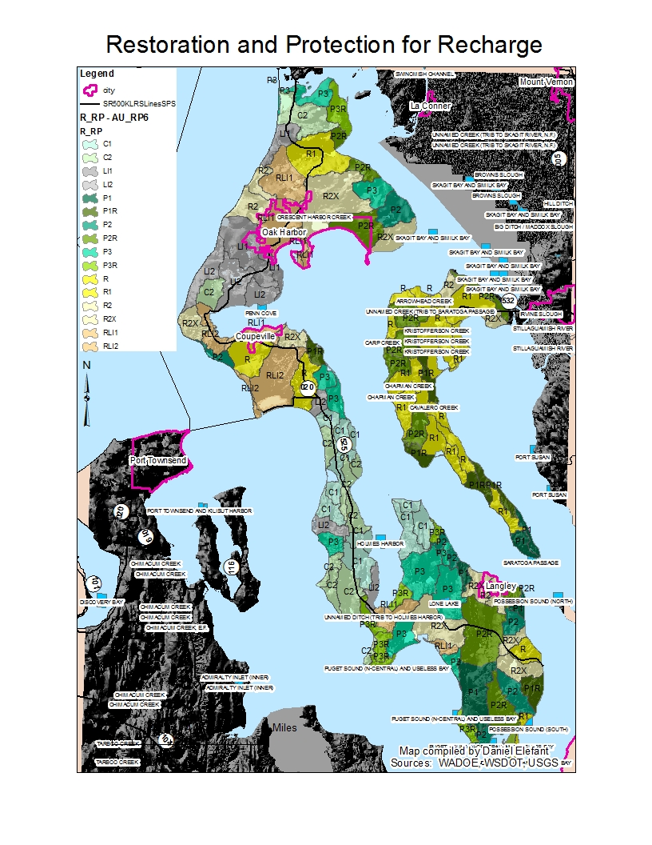
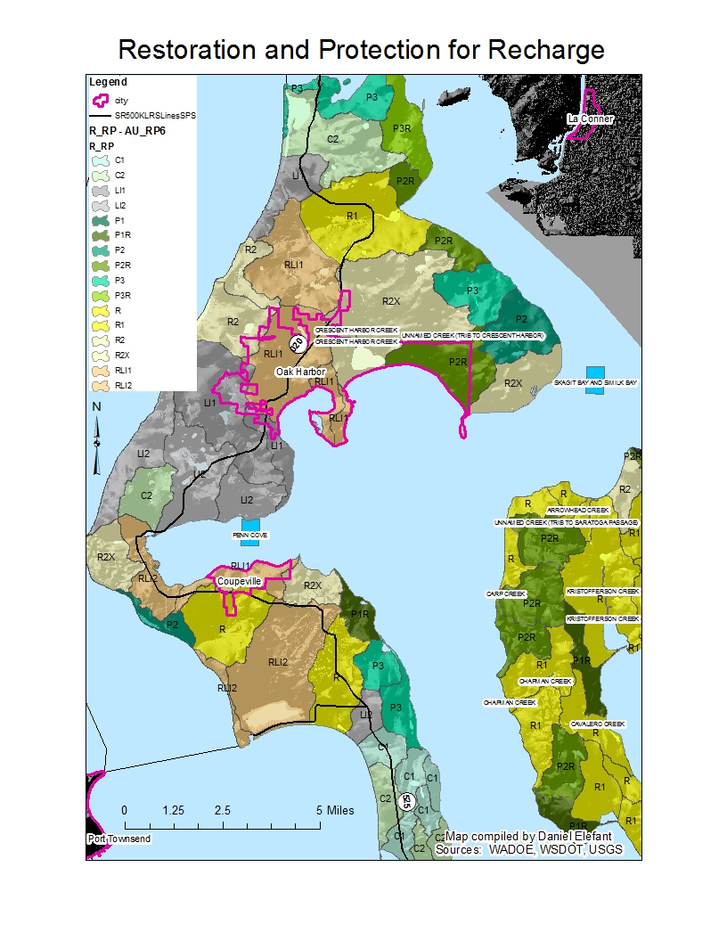
R_RP – Restoration & Protection for Recharge

Slide 5
