Slide 1
King County Public Schools Hazard Assessment
By Chong Il Chong & Jason Hung

Slide 2
Objective
Analysis of schools that are within environmental hazard areas.
Hazardous areas include:
    Areas Susceptible to Groundwater Contamination
    Coal fields
    Erosion Hazard Areas
    Seismic Hazard Areas
    Landslide Hazard Areas

Slide 3
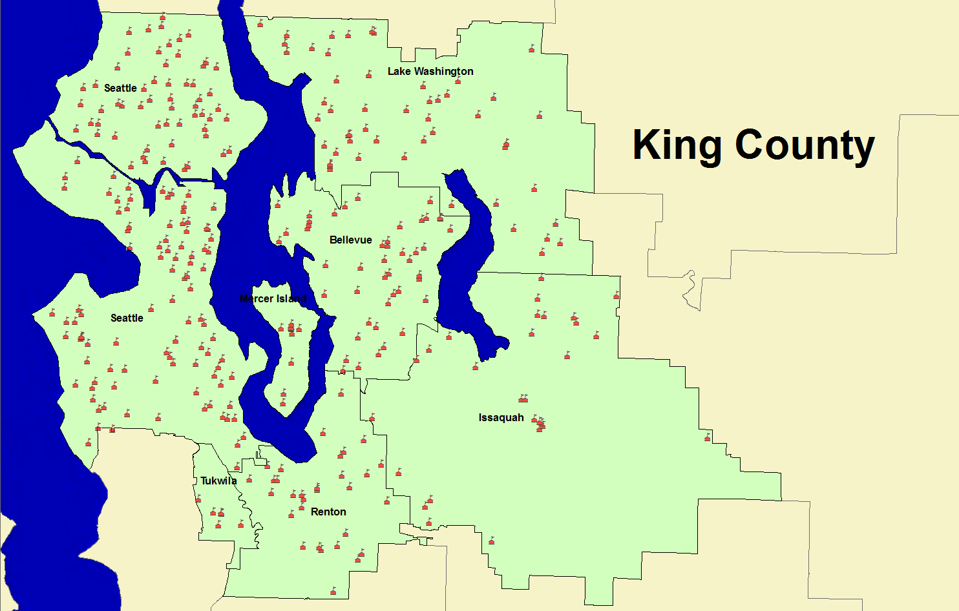
Areas under observation

Slide 4
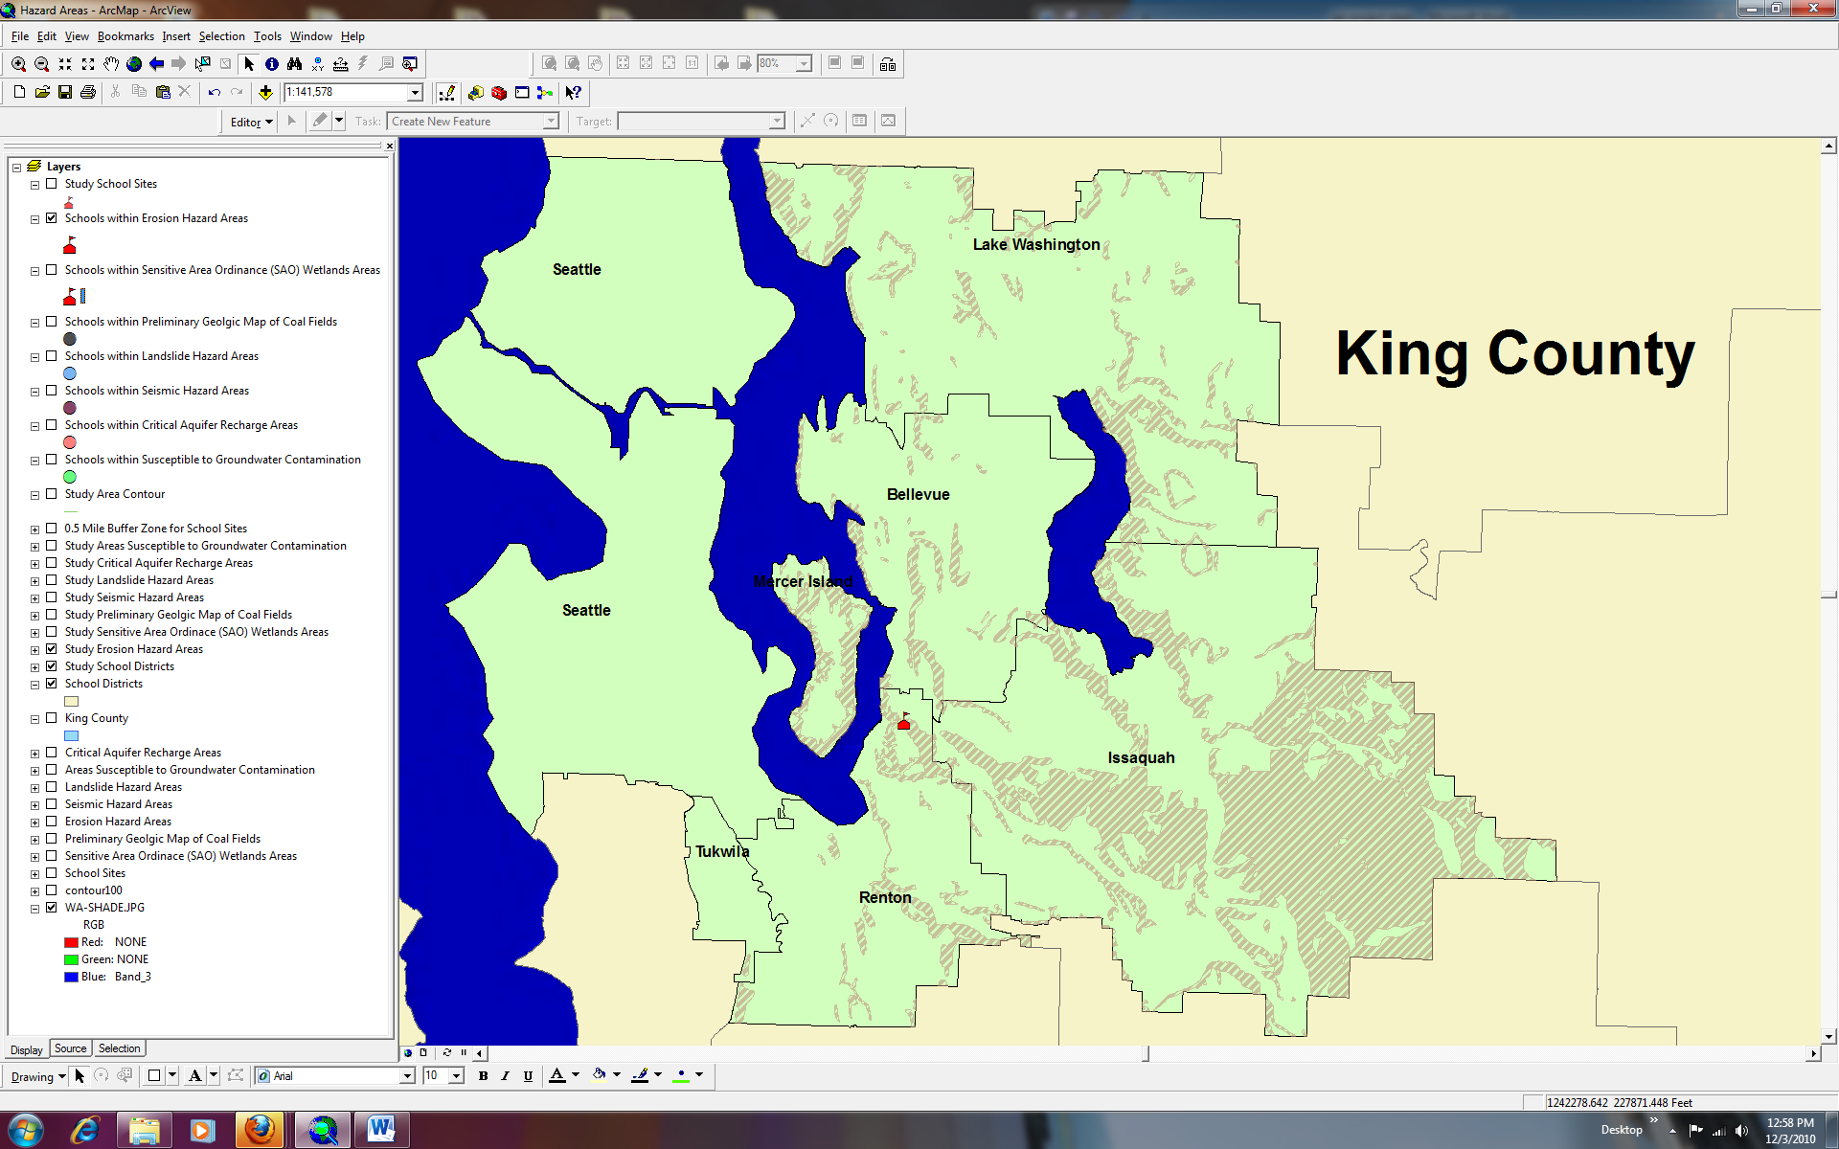
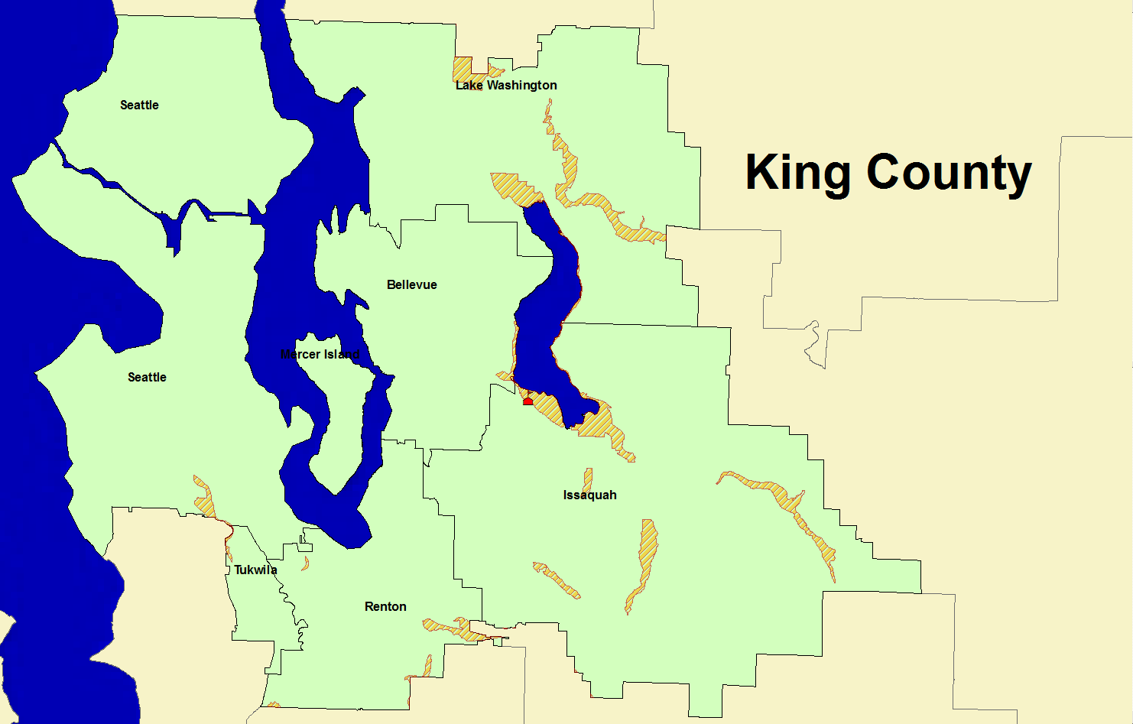
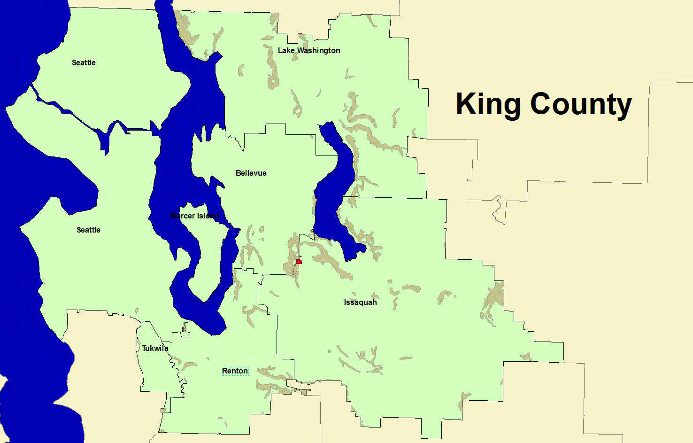
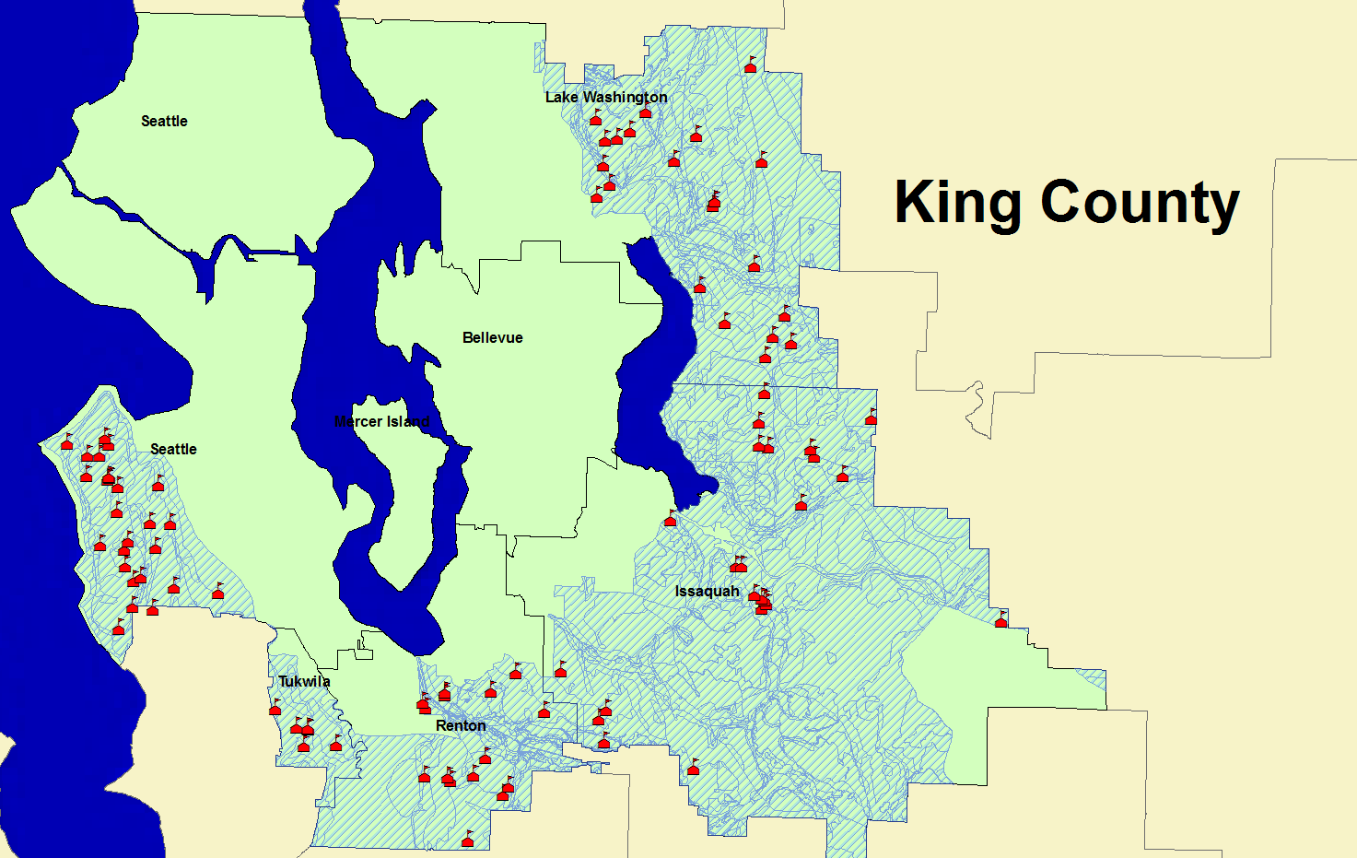

Affected areas and schools
Erosion
Seismic
Landslides
Groundwater Contamination
Coal Fields

Slide 5
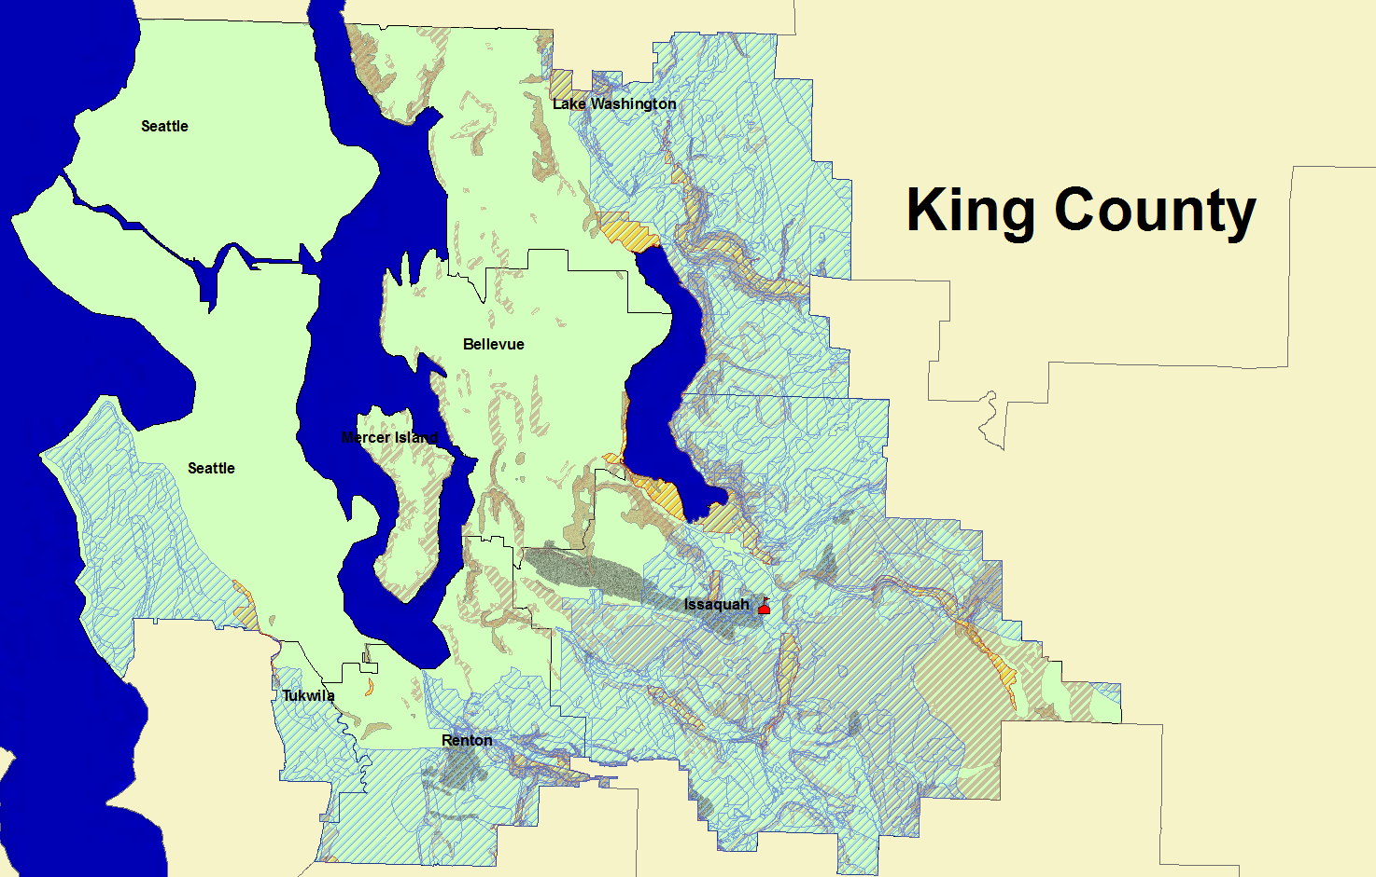
Schools in more than one Hazard Area

Slide 6
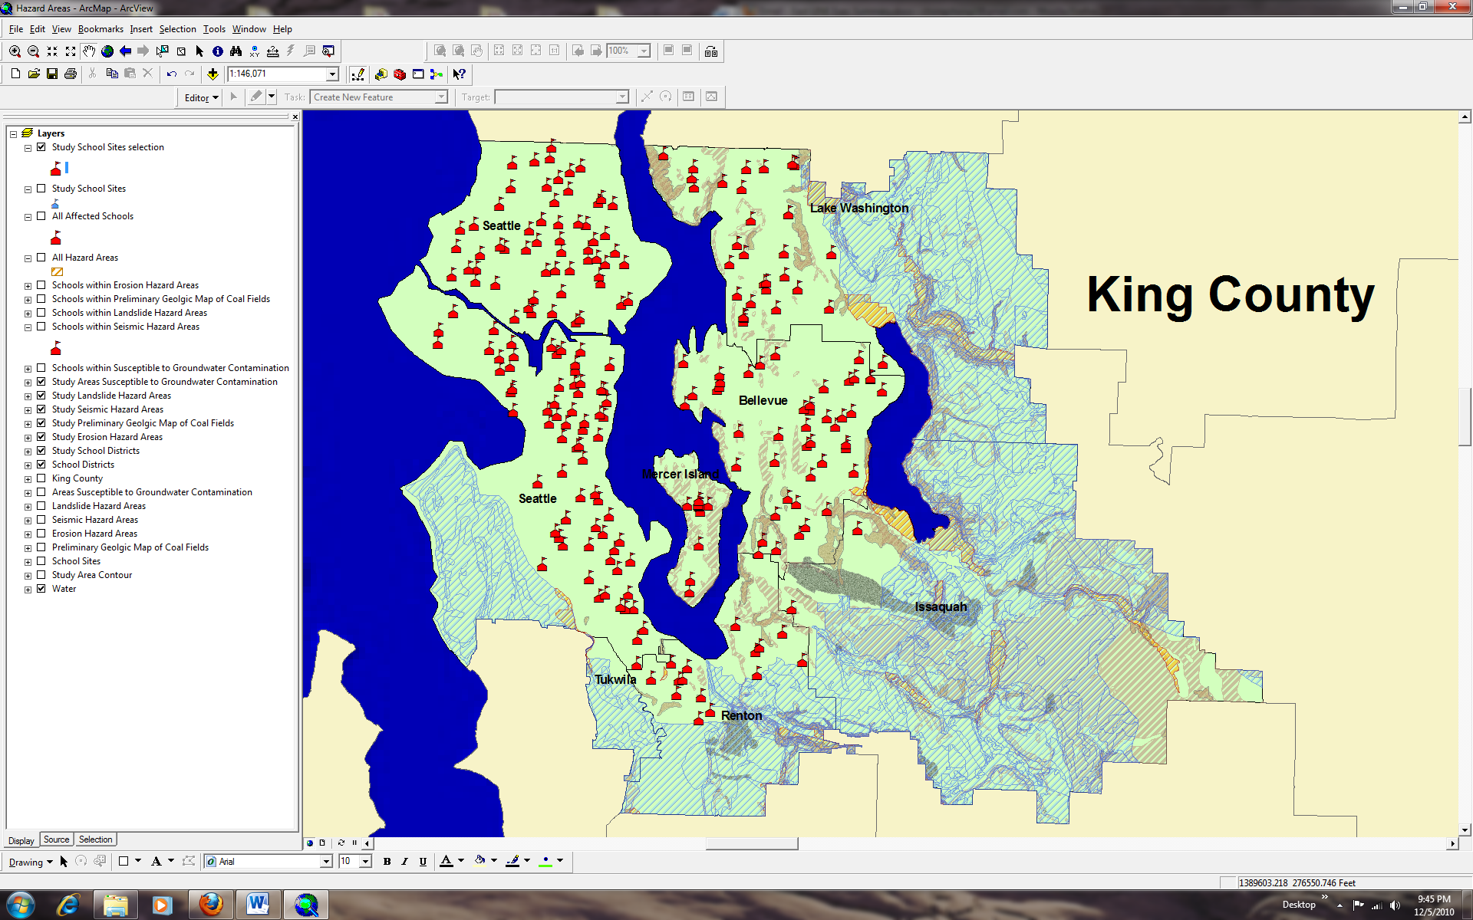
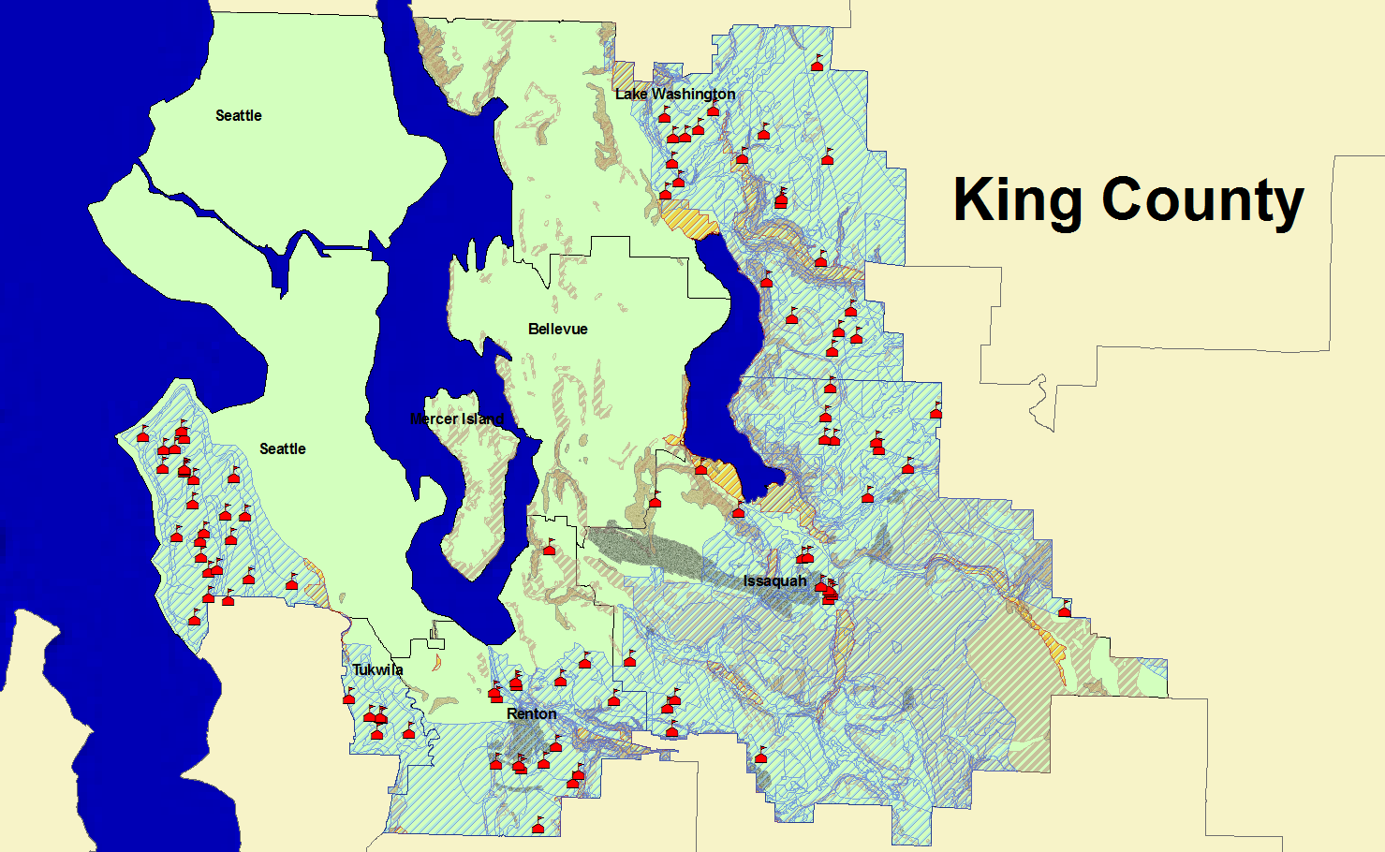
Affected and Unaffected schools
Unaffected schools
Affected schools

Slide 7
Results
  Schools affected by one Hazard Area
    92 schools in Areas Susceptible to Groundwater Contamination
    1 school in Coal fields area
    1 school in Erosion Hazard Areas
    1 school in Seismic Hazard Areas
    1 school in Landslide Hazard Areas
  Schools unaffected by Hazard Areas
    242 schools unaffected by any hazards
  Schools in more than one Hazard Area
    Issaquah Middle School (Coal Field and Groundwater Contamination)

