Slide 1
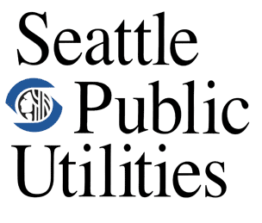
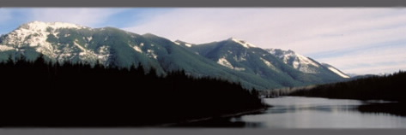
A GIS Analysis to Identify Future Study Site Locations in the Cedar River Municipal Watershed, WA
Jenna Forsyth
12/07/09
Chester Morse Lake, Cedar River Watershed, WA
Photo Courtesy of http://www.seattle.gov/UTIL/About_SPU/Water_System/Water_Sources_&_Treatment/Cedar_River_Watershed/COS_002326.asp

Slide 2
Outline
Introduction
Objectives
Analysis
Results
Conclusions
Questions?

Slide 3
Introduction
The Cedar River Watershed
Owned and operated by Seattle Public Utilities
Provides fresh water for the ~ 1.45 million residents of Seattle
Area: 3,946,330,736.44 sq. feet
Located approximately 34 miles east of Seattle, off Interstate-90

Slide 4
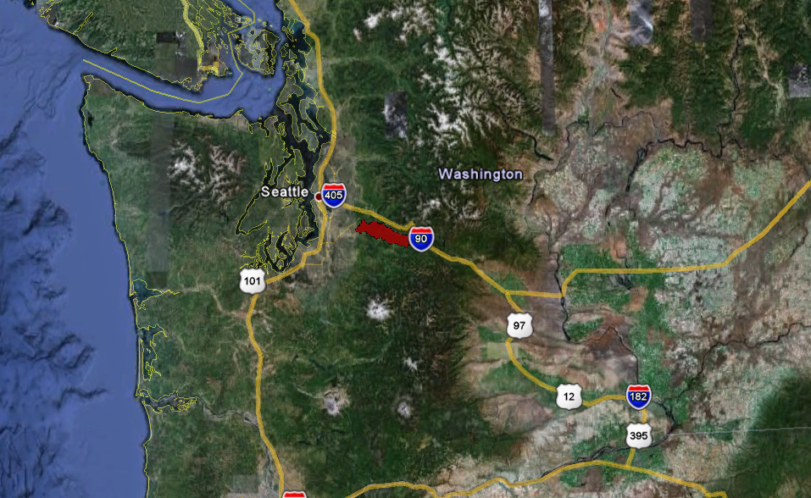
Where is the Cedar River Watershed?
Introduction

Slide 5
Introduction
What is the Scientific study in the Cedar River Watershed?
Scientific question: What is the effect of forest density and structure on snow accumulation in the watershed?
  Forest density relates to canopy density
  Forest structure relates to forest stand age and type (coniferous vs. deciduous)
 |  snow accumulation |  snow accumulation
Canopy Density | Low density? | High Density?
Forest Age | Old/Primary Growth? | Young?
Forest Type | Deciduous? | Coniferous?

Slide 6
Introduction
What is the Scientific study in the Cedar River Watershed? Continued…
Scientific question: What is the effect of forest density and structure on snow accumulation in the watershed?
  Snow accumulation in forested areas such as the Cedar River Watershed, largely depends on how much snow is intercepted or “stuck” in the trees.

Slide 7
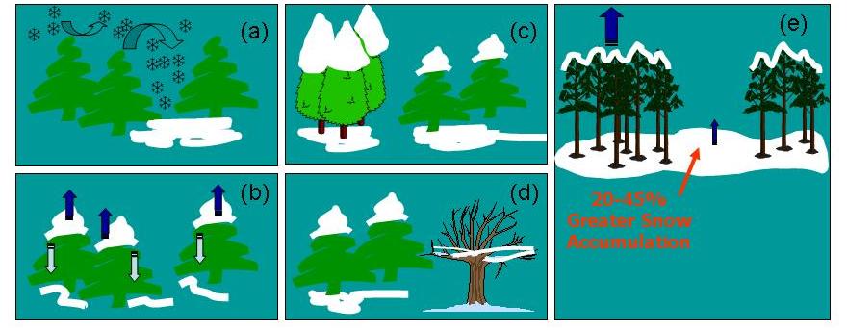
Introduction
What is the Scientific study in the Cedar River Watershed? Continued…
(a) Turbulence within the forest canopy causes variability in how snow is deposited.
(b) Snow intercepted in the canopy sublimates, or falls to the ground.
(c) Interception between different species of conifers is not significant, but
(d) Interception in conifers is significantly greater than interception by deciduous trees.
(e) Because of interception, 20-45% more snow accumulates in clear-cut areas or clearings.
(Graphics from Mark Williams, CU Boulder)

Slide 8
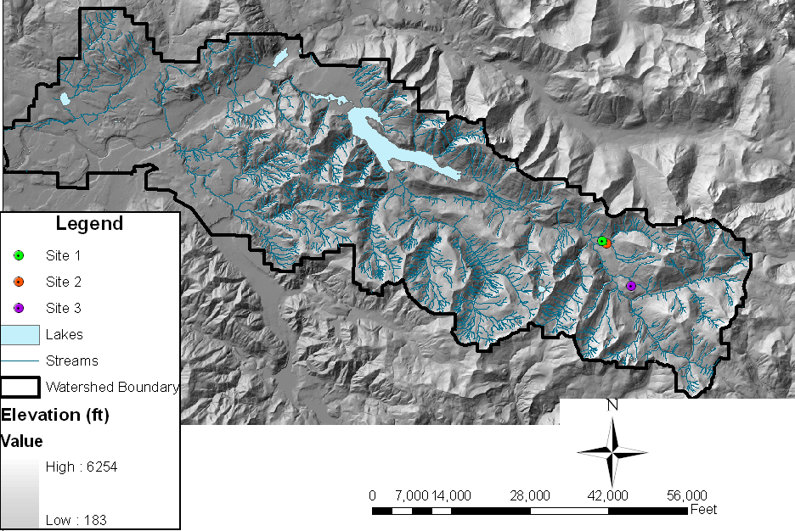
Introduction
What and where are the current study sites?
Three coniferous forest sites of ~ 50x50meter plots

Slide 9
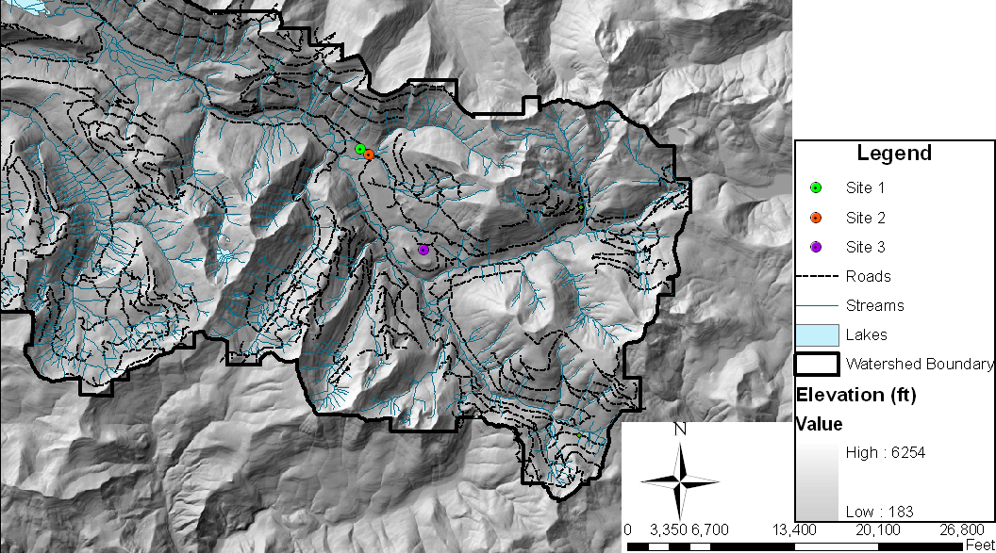

Slide 10
What are the forest and topographical characteristics of the sites?
Introduction
 | Elevation (feet) | Slope (degrees) | Aspect (cardinal direction) | Canopy Density (percentage) | Forest Age (years)
Site 1 | 1,731- 2,207 | 0-11.077 | West | 90-100 | 54
Site 2 | 1,731- 2,207 | 0-11.077 | South | 90-100 | 54
Site 3 | 2,207 - 2,676 | 0-11.077 | North | N/A | Old Growth

Slide 11
What are the objectives of the current GIS analysis?
Objectives
Locate 3 potential sites to be pairs for the current sites:
  Similar forest and topographical characteristics
    Elevation
    Slope
    Aspect
    Canopy Density
    Forest Age
  Easily accessible (within 100 feet, but no more than 1,000 feet from the nearest road)
  Not overlapping with lakes, streams, or pre-existing study sites or meteorological stations

Slide 12
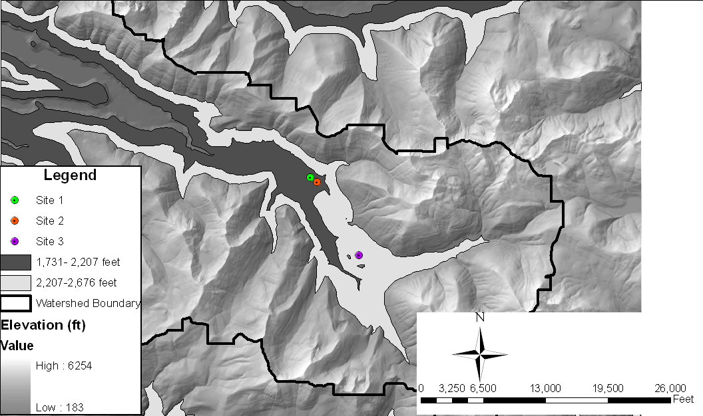
How was this accomplished?
Analysis
Elevation
  Reclassified to include only elevations of interest, then new layers with only those elevations for each site

Slide 13
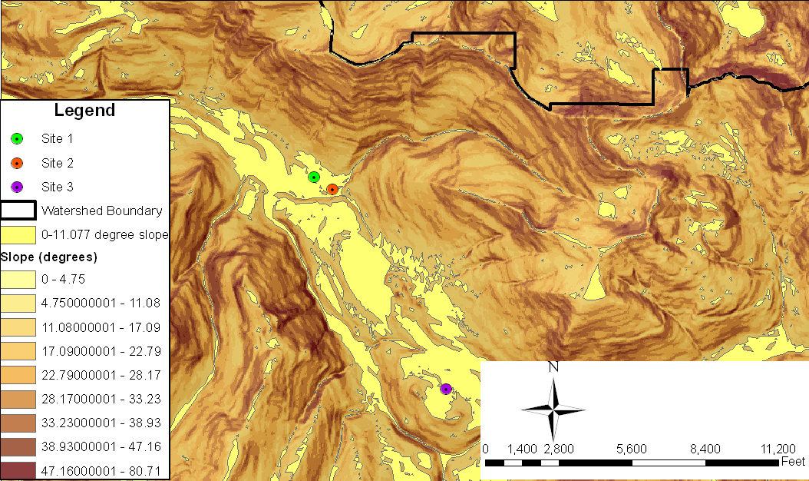
Analysis
How was this accomplished?
Slope
  First calculated slope ranges from elevation
  Second, analyzed similar to elevation technique, reclassified and created a new layer: slope range equal for all sites

Slide 14
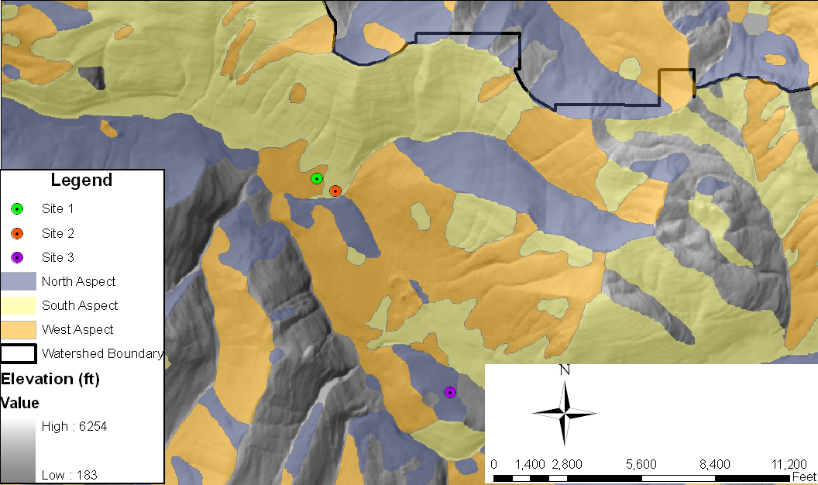
How was this accomplished?
Analysis
Aspect

Slide 15
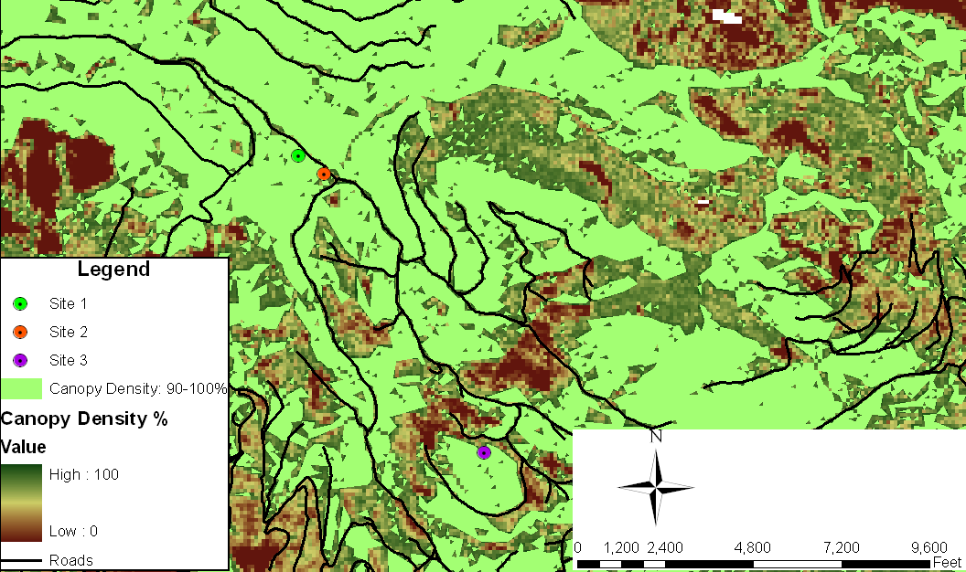
How was this accomplished?
Analysis
Canopy Density

Slide 16
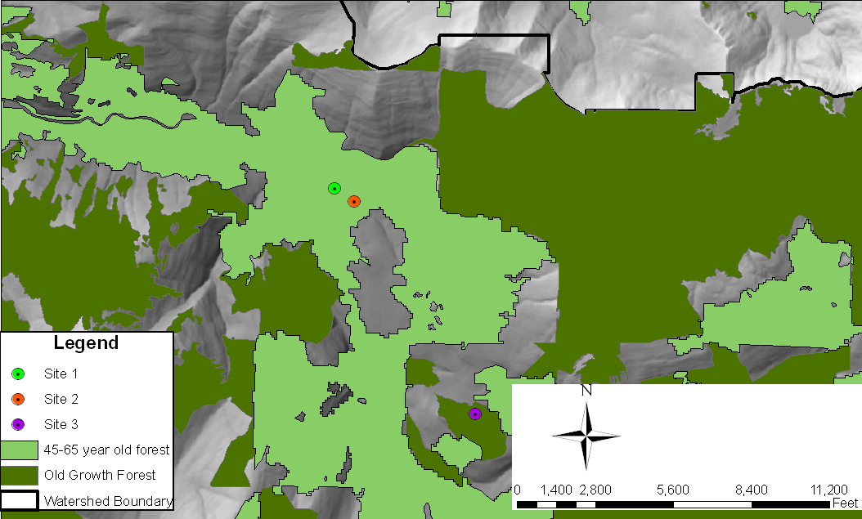
How was this accomplished?
Analysis
Forest Age

Slide 17
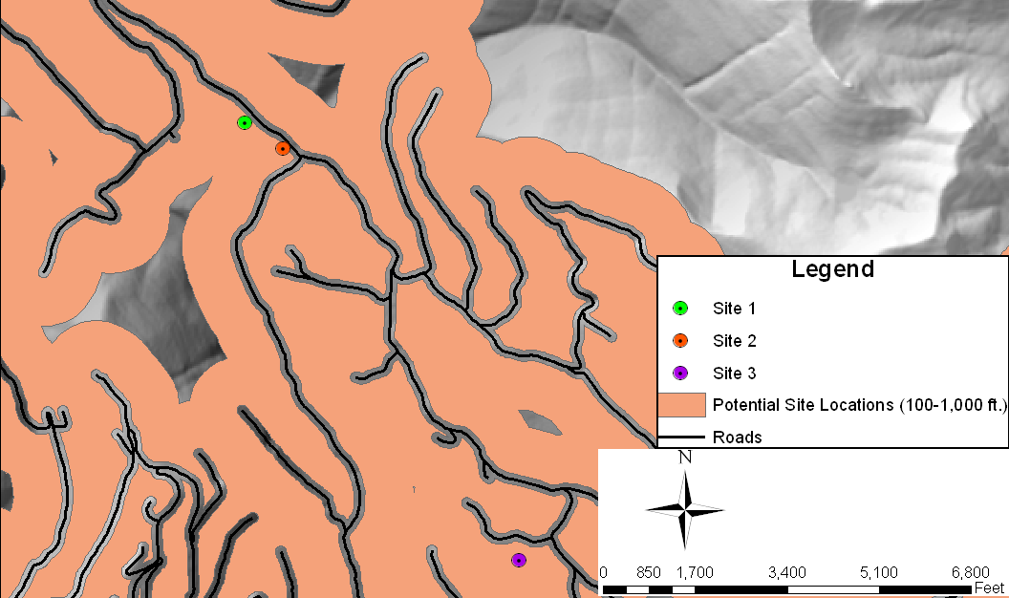
How was this accomplished?
Analysis
Buffer within a buffer
  New site>100 feet from road but <1,000feet

Slide 18
New potential sites?
Results and Conclusions
Intersected above layers
  New Site 1 Potential Area: 5,368,861 sq. feet
  New site 1
    At least 28,632.02 sq. feet in area (5x5 cells)
    1,854 feet from previous site (skiing)
    8,158.4 feet from previous site (along the road)
New Site 2 Potential Area: 4,273,018 sq. feet
  New site 2
    At least 28,632.02 sq. feet in area (5x5 cells)
    7,532.67 feet from previous site (skiing)
    8,035.22 feet from previous site (along the road)
New Site 3 Potential Area: 1,458,128 sq. feet
  New site 3
    Not possible due to overlap with current site area

Slide 19
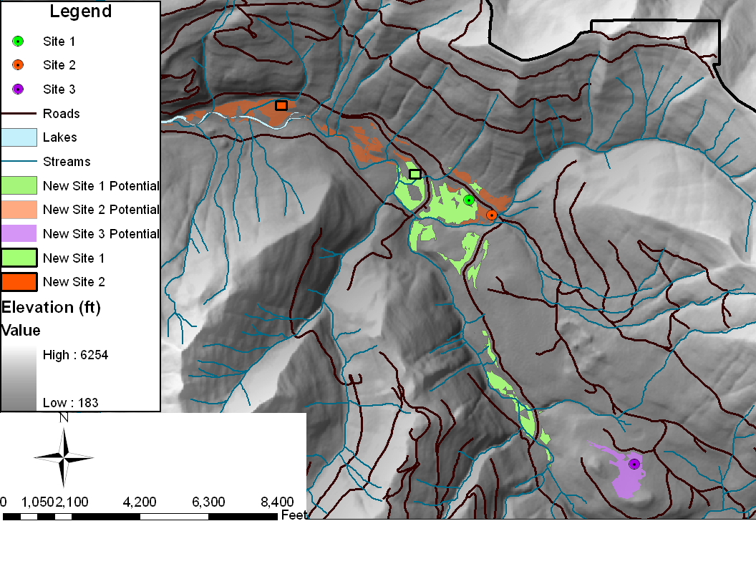
Results and Conclusions
Site 3 Not Possible

Slide 20
Site 3: Re-calculating Potential New Site Area
Results and Conclusions
Tried with new parameter ranges for elevation, slope, and aspect:
 | Elevation (feet) | Slope (degrees) | Aspect (cardinal direction) | Canopy Density (percentage) | Forest Age (years)
Potential Site 3 Pair | 1,731- 2,676 (DIFFERENT) | 0-17.09 (DIFFERENT) | North, East, or West (DIFFERENT) | N/A (SAME) | Old Growth (SAME)

Slide 21
Results and Conclusions
Site 3: Success!
  New Site 3 Potential Area: 7,528,051.11 sq. feet
  New site 3
    At least 28,632.02 sq. feet in area (5x5 cells)
    6,433.21 feet from previous site (skiing)
    14,415.37 feet from previous site (along the road)

Slide 22
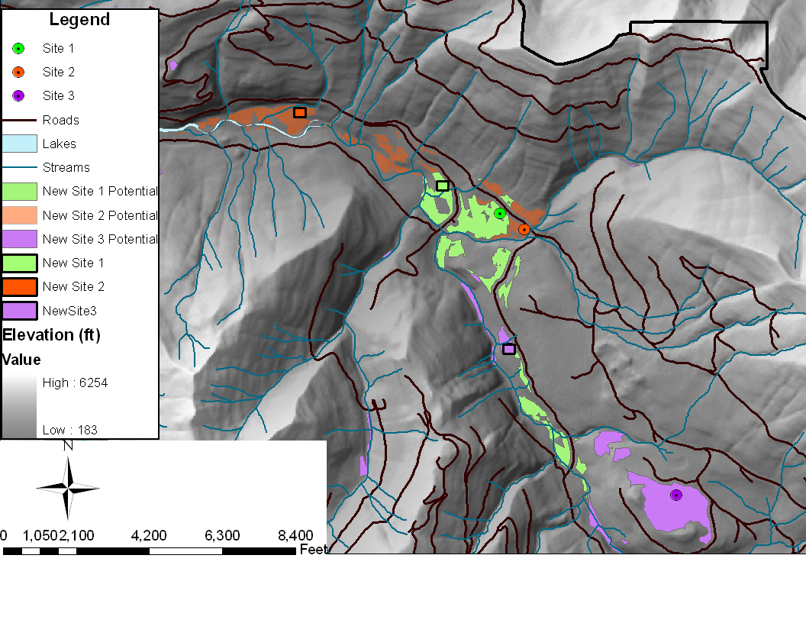
Results and Conclusions
Site 3: Success!

Slide 23
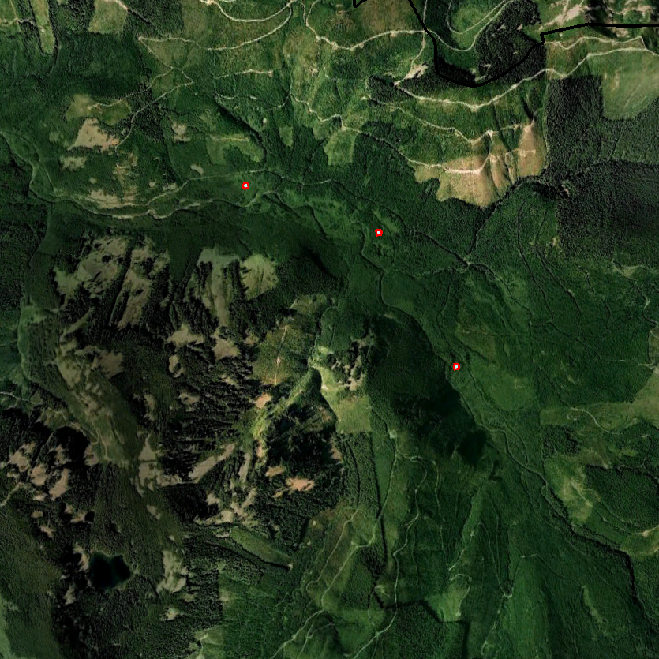
Questions?
Questions?
New Site 2
New Site 1
New Site 3
N

Slide 24
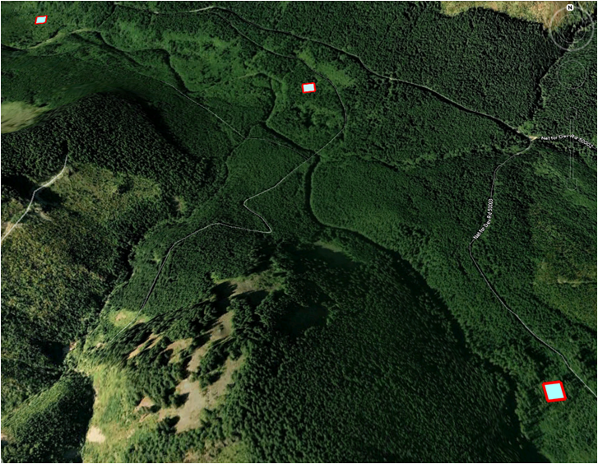
Thank You

