Slide 1
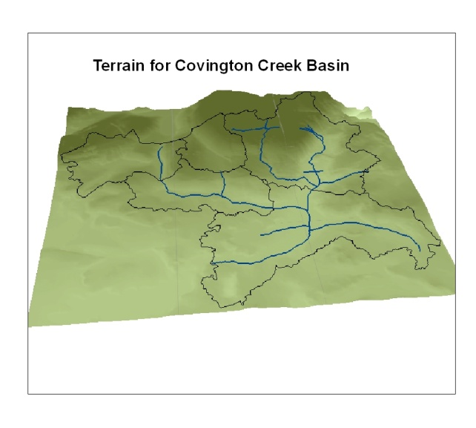
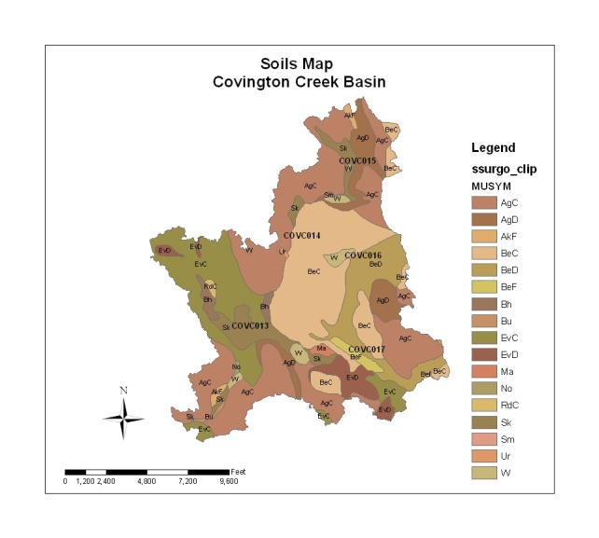
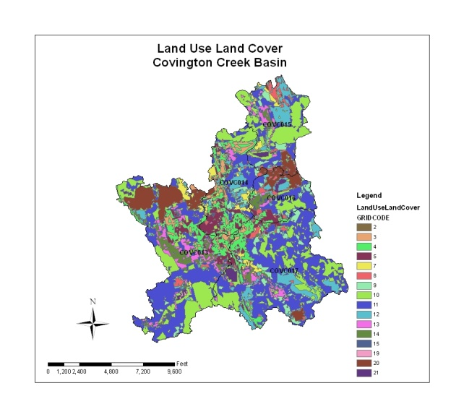
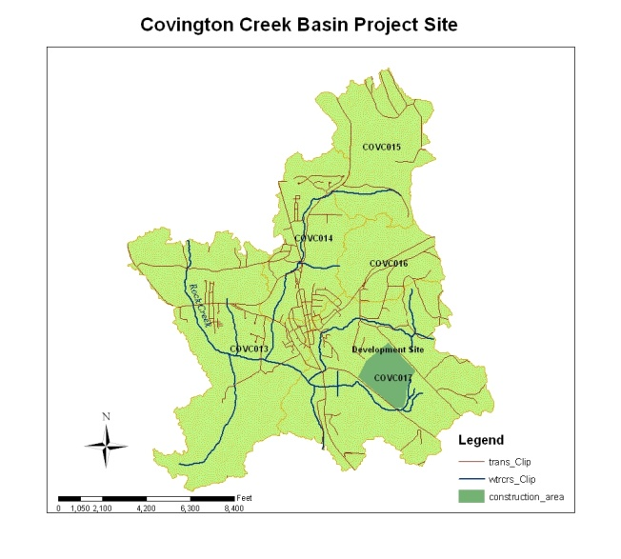
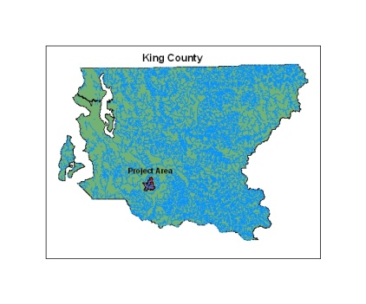
Hydrologic Model Preparation (EPA SWMM) for Covington Creek Basin
Input Data
Project Objectives
The purpose of this study is to test the viability of using a Geographic Information System (GIS)
to prepare data for hydrologic analysis of a stream basin by a commonly used computer software
program. The software package the resulting GIS data will be ported into is the EPA’s Storm Water
Management Tool (SWMM). The GIS will be used to collect all supporting spatial data used by the
modeling software. Data on land use and land cover, soils, and terrain will be collected for the study
area and analyzed for attributes required to run SWMM. The data required to run the model and
collected by the GIS will be output in a format readily usable by SWMM.
To further test the usability of the method a new commercial development will be added within
the basin. Attributes describing land use and terrain will be modified and the output compared
with the original data.
Land Use Land Cover Key
Code Land Use Land Cover Classification
2 High Intensity Development
3 Medium Intensity Development
4 Low Intensity Development
5 Developed Open Space
7 Pasture
8 Grassland
9 Deciduous Forest
10 Evergreen Forest
11 Mixed Forest
12 Scrub/Shrub
13 Palustrine Forested Wetland
14 Palustrine Scrub/Shrub Wetland
15 Palustrine Emergent Wetland
19 Unconsolidated Shore
20 Bare land
Results
Results of the analysis performed on each catchment are listed in the table 1. Additional data required for SWMM is provided in the example output file found table 2, including data describing Manning’s numbers and depth of storage for pervious and impervious surfaces for all polygons within a catchment.
Catchment | Area (acres) | Width (ft) | %Slope | % impervious
COVC013 | 1326 | 19256 | 4.54 | 0.007
COVC014 | 584 | 11067 | 1.44 | 0.290
COVC015 | 592 | 5058 | 7.73 | 0.010
COVC016 | 344 | 3257 | 10.49 | 0.020
COVC017 | 1307 | 16258 | 10.70 | 0.040
COVC017 C | 1307 | 16258 | 6.19 | 0.050
Description of Project Area
The study area, Covington Creek Basin, is located in Southern King County
near the town of Black Diamond It is made up of five catchments and covers an
area of 6.5 square miles. Land use is mixed, ranging from woods and
pasture to high intensity urban development. Terrain is made up of rolling
hills with an elevation range of 480 to 1177 feet.
Table 1.
FID_ | MUSYM | SOIL_GROUP | LU code | F_AREA | N_Imperv | N_Perv | Dstore_Imp | Dstore_Per | SSC_Curve
1 | AgC | B | 11 | 763.4 | 0 | 0.3 | 0 | 0.4 | 66
2 | AgC | B | 8 | 571.1 | 0 | 0.2 | 0 | 0.24 | 61
3 | AgC | B | 9 | 674.4 | 0 | 0.3 | 0 | 0.4 | 66
4 | AgC | B | 8 | 856.7 | 0 | 0.2 | 0 | 0.24 | 61
Table 2.

