Slide 1
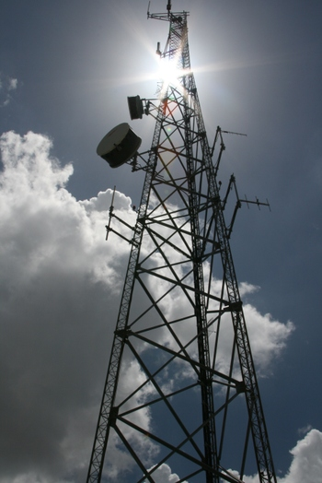
New Cell Tower using GIS
Fawm Saefong
Bryan Pereira
Marc Lamothe
Trevor Takara
Gerald Mickelsen
CEE 424
December 5th, 2011

Slide 2
Presentation Contents
Intro/Objectives
Data Collection
Data Analysis
Results/Conclusion
Works Cited

Slide 3
Intro/Objectives
Find a location for a new cell tower in the Seattle area
Increase service in areas with less coverage
Create better access through higher elevations
Find the most suitable location based on land features

Slide 4
Data
Elevations (Seattle area)
Environmental non-build areas (seismic, erosion, coal mines, landslides)
Hydraulic non-build areas (floodways, floodplains)
Buildings and Land Parcels
Current Cell Towers

Slide 5
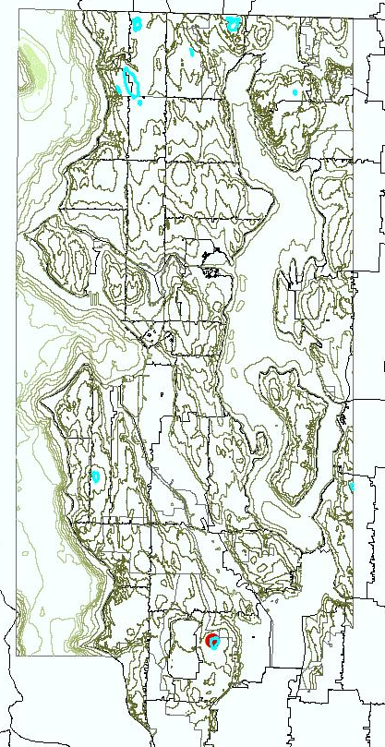
Elevations (Seattle Area)

Slide 6
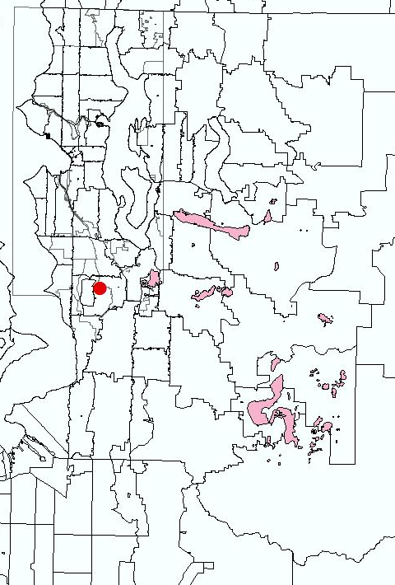
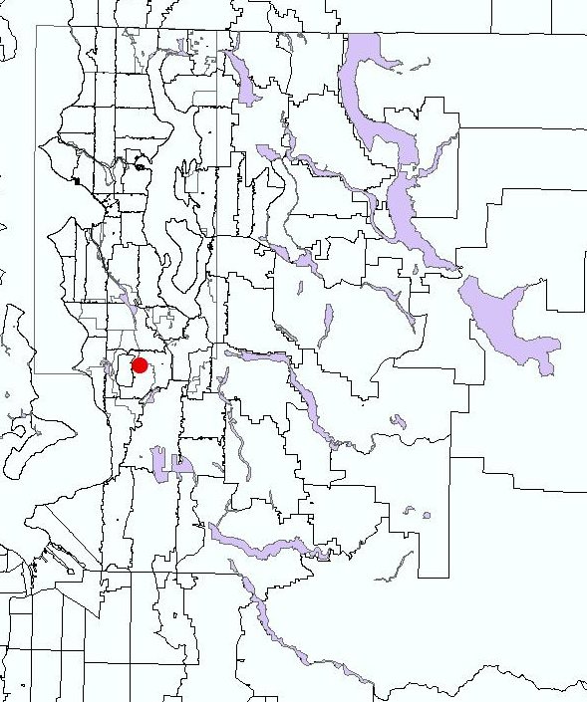
Coals Mines and Seismic
Coal Mines
Seismic
Projection: NAD_1983_StatePlane_Washington_North_FIPS_4601_Feet

Slide 7
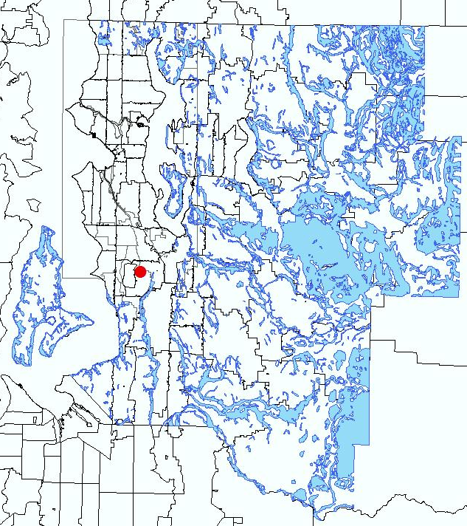
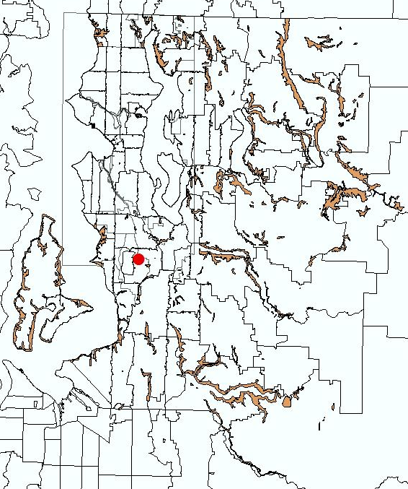
Erosion and Landslides
Erosions
Landslides
Projection: NAD_1983_StatePlane_Washington_North_FIPS_4601_Feet

Slide 8
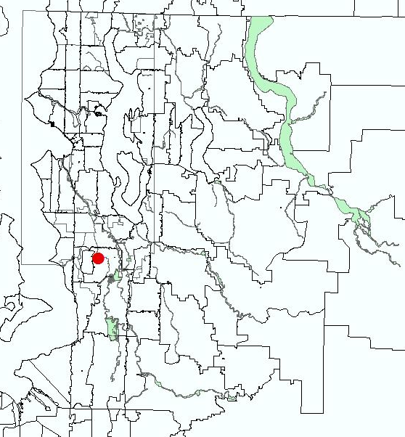
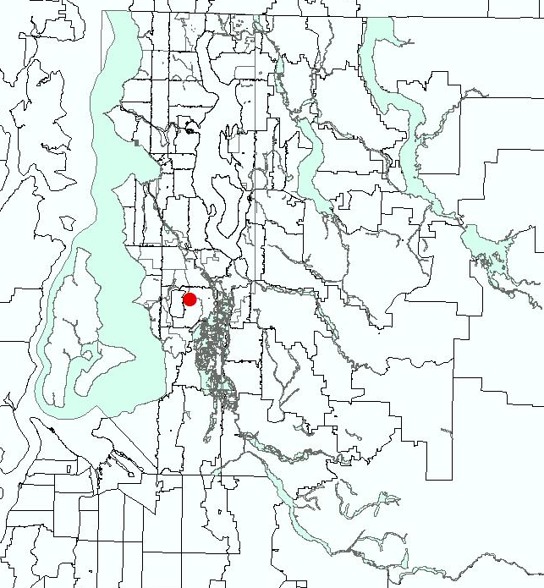
Floodways and Floodplains
Floodways
Floodplains
Projection: NAD_1983_StatePlane_Washington_North_FIPS_4601_Feet

Slide 9
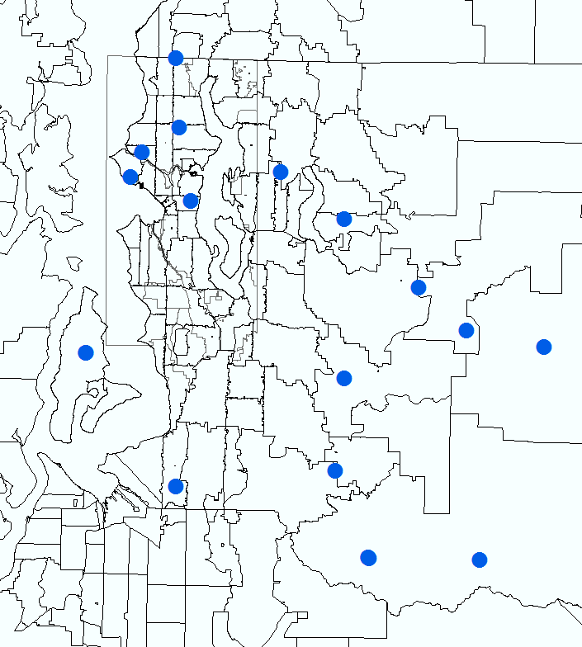
Current Cell Towers

Slide 10
Data Analysis
Merge non-build areas to create a single layer
Create 5 miles buffer around existing cell towers
Locate area to build new cell tower and examine existing buildings/parcels

Slide 11
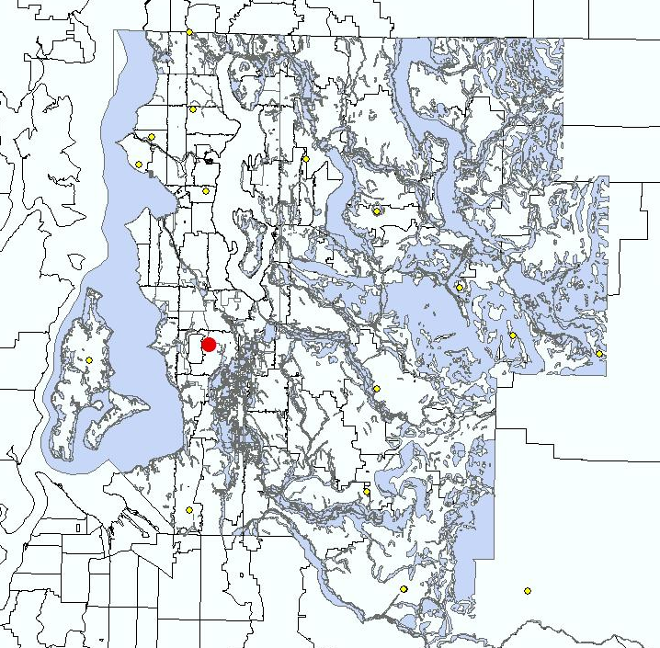
Single non-build layer
Projection: NAD_1983_StatePlane_Washington_North_FIPS_4601_Feet

Slide 12
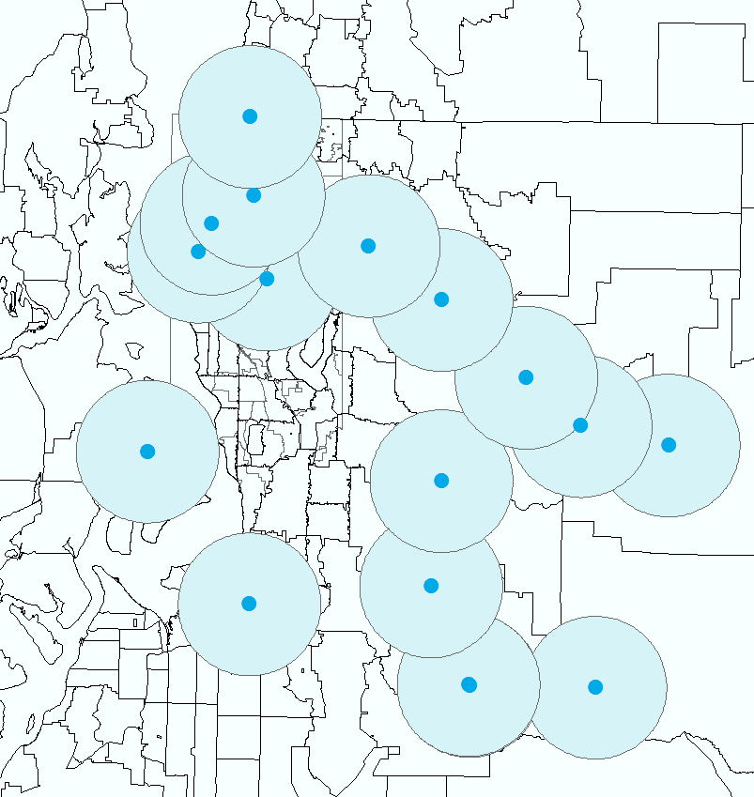
Current Cell Towers With 5 Mile Buffer
Projection: NAD_1983_StatePlane_Washington_North_FIPS_4601_Feet

Slide 13
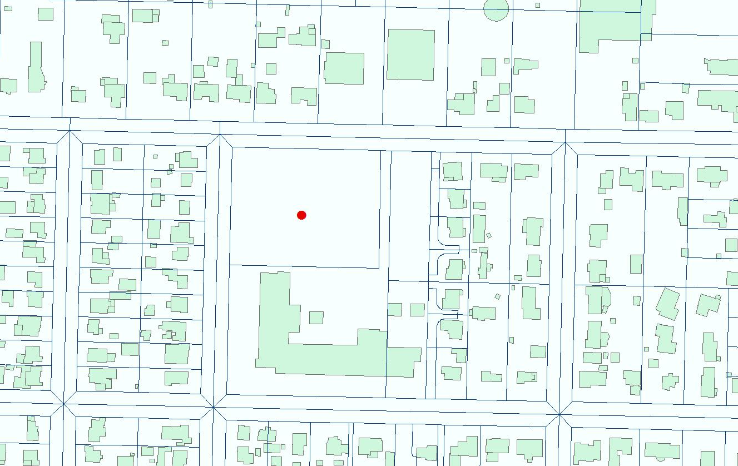
Location for New Cell Tower
Projection: NAD_1983_StatePlane_Washington_North_FIPS_4601_Feet

Slide 14
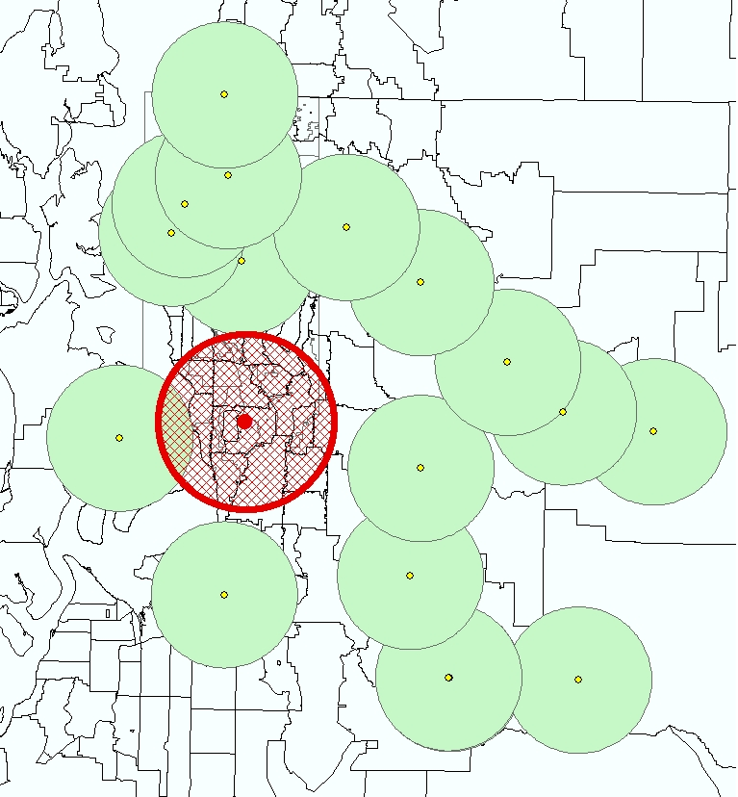
New Cell Tower Projected Coverage
Projection: NAD_1983_StatePlane_Washington_North_FIPS_4601_Feet

Slide 15
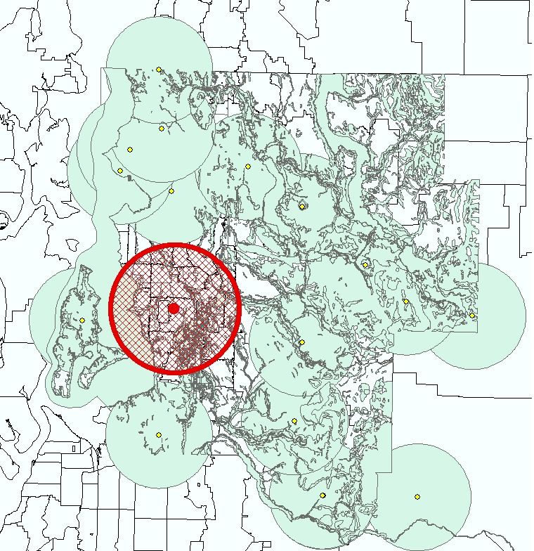
Final Product
Projection: NAD_1983_StatePlane_Washington_North_FIPS_4601_Feet

Slide 16
Results/Conclusion
Found the best location for a new cell tower
Increased cell coverage in the city
Avoided areas that were unable to build on

Slide 17
Works Cited
WAGDA
KCGIS
FCC Wireless Telecommunications Bureau

