Slide 1
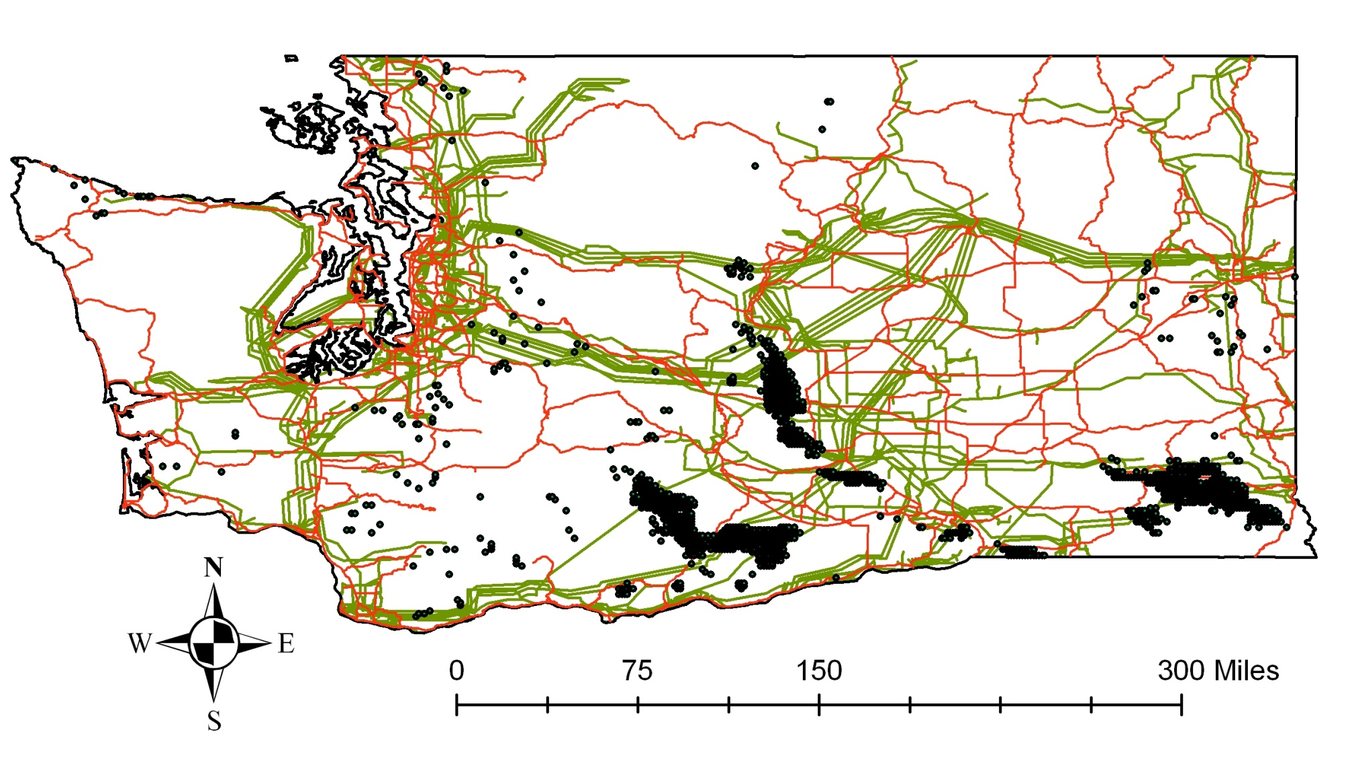
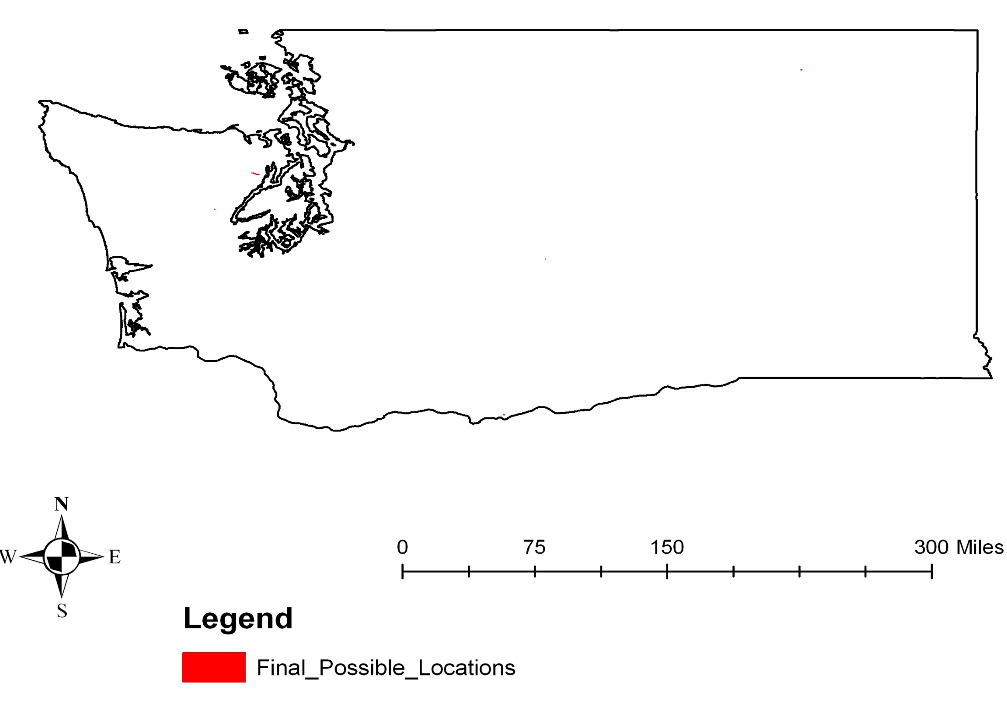
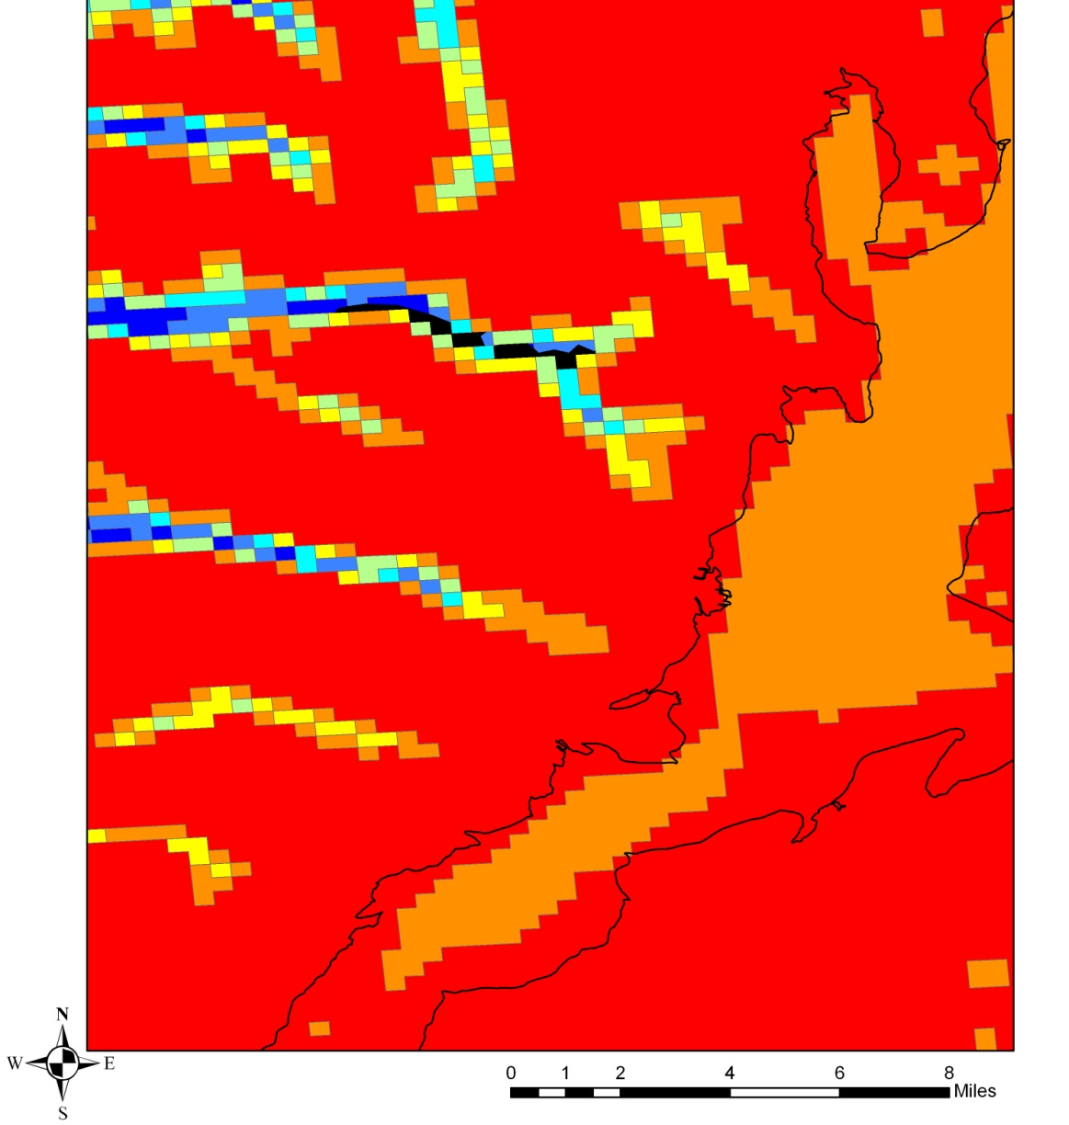
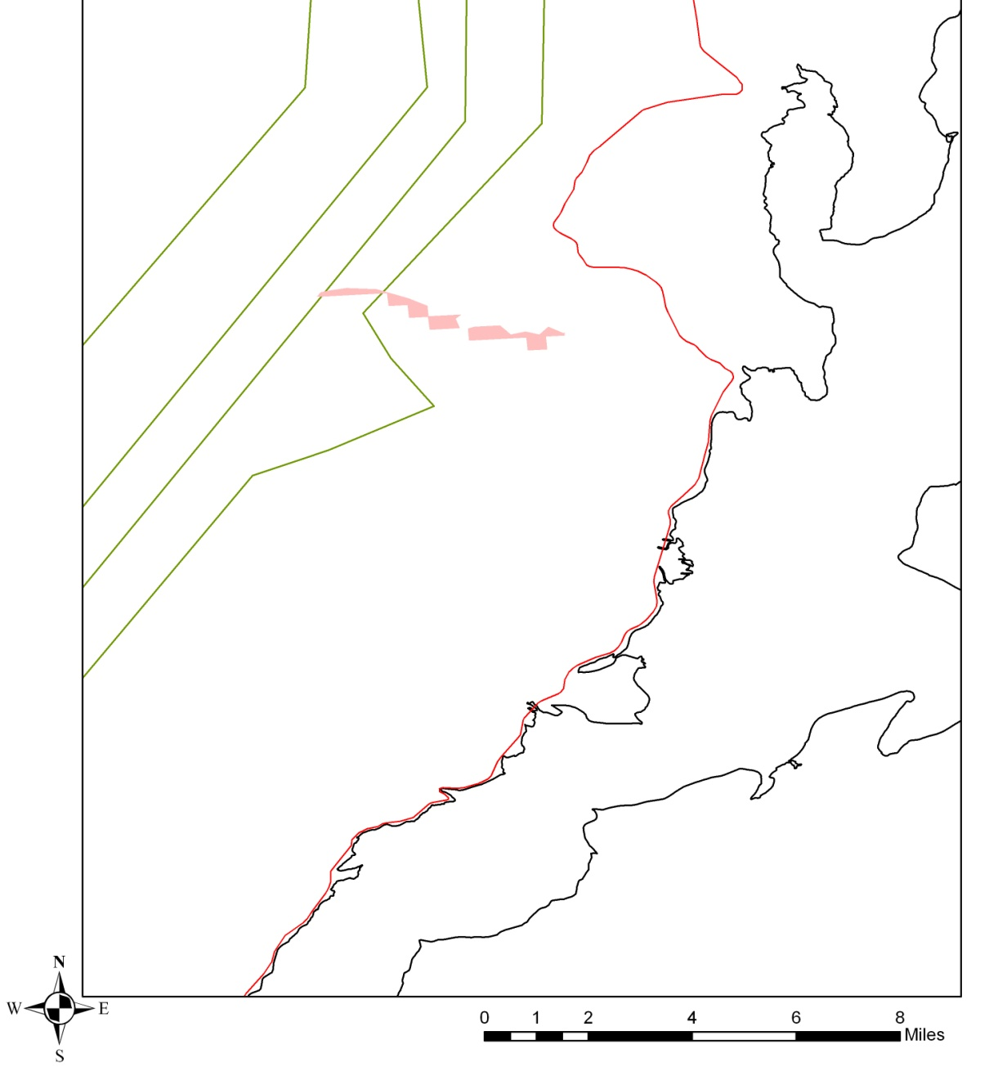
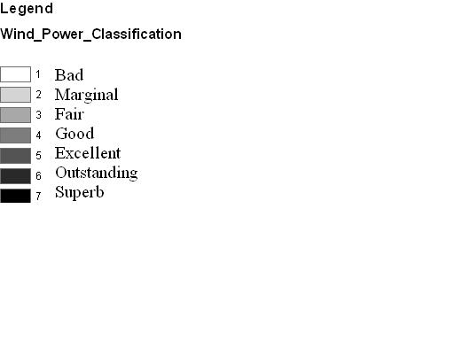
Ideal Locations for Wind Power Generation in Washington State
Prepared by: Dominic Pontarolo, Jamie Montemayor, Matt MacKinnon
CEE 424 GIS
Specifications:
10 miles from existing wind turbines
Within 5 miles of state highways
Within 5 miles of transmission lines
Outstanding or superb wind power resource potential
Land use of bare ground, agriculture, or non-forested
Not within national parks or mountain ranges
Figure 1: Existing Infrastructure
Figure 2: Final selected location
Figure 4: Selected Location Proximity to Roads and Transmission Lines
Figure 3: Potential wind power generation of selected location.

