Slide 1
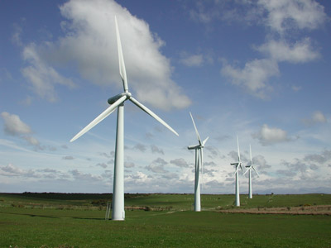
Ideal Locations for Wind Power Generation in Washington State

Slide 2
Background
We have been hired by an entrepreneur to locate areas within Washington State suitable for a small wind farm.
  A small number of turbines (<25)
  Low construction costs
  High potential for energy and subsequent revenue generation

Slide 3
Location Specifications
Land Use that would feasible for construction of wind turbines:
  Bare ground
  Agriculture or
  Non-forested land

Slide 4
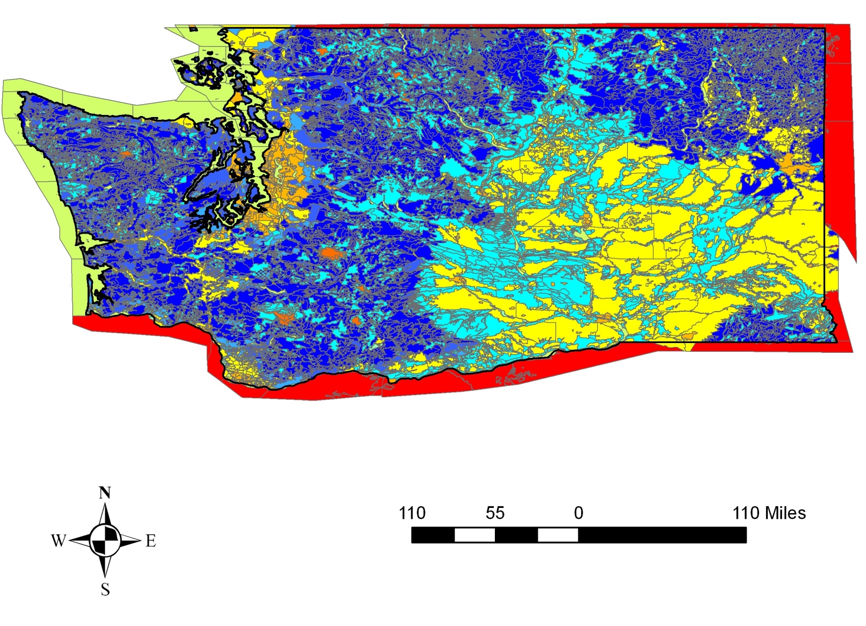
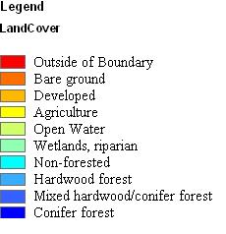
Land Cover

Slide 5
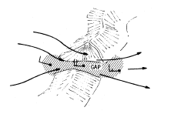

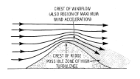
Wind Power Generation Potential
Outstanding to Superb wind power density
  > 600 W/m² at a tower height of 50 m
  This number is based upon multiple features including: wind speeds, terrain, and climate.
  Ridges High Points Funneling Points

Slide 6
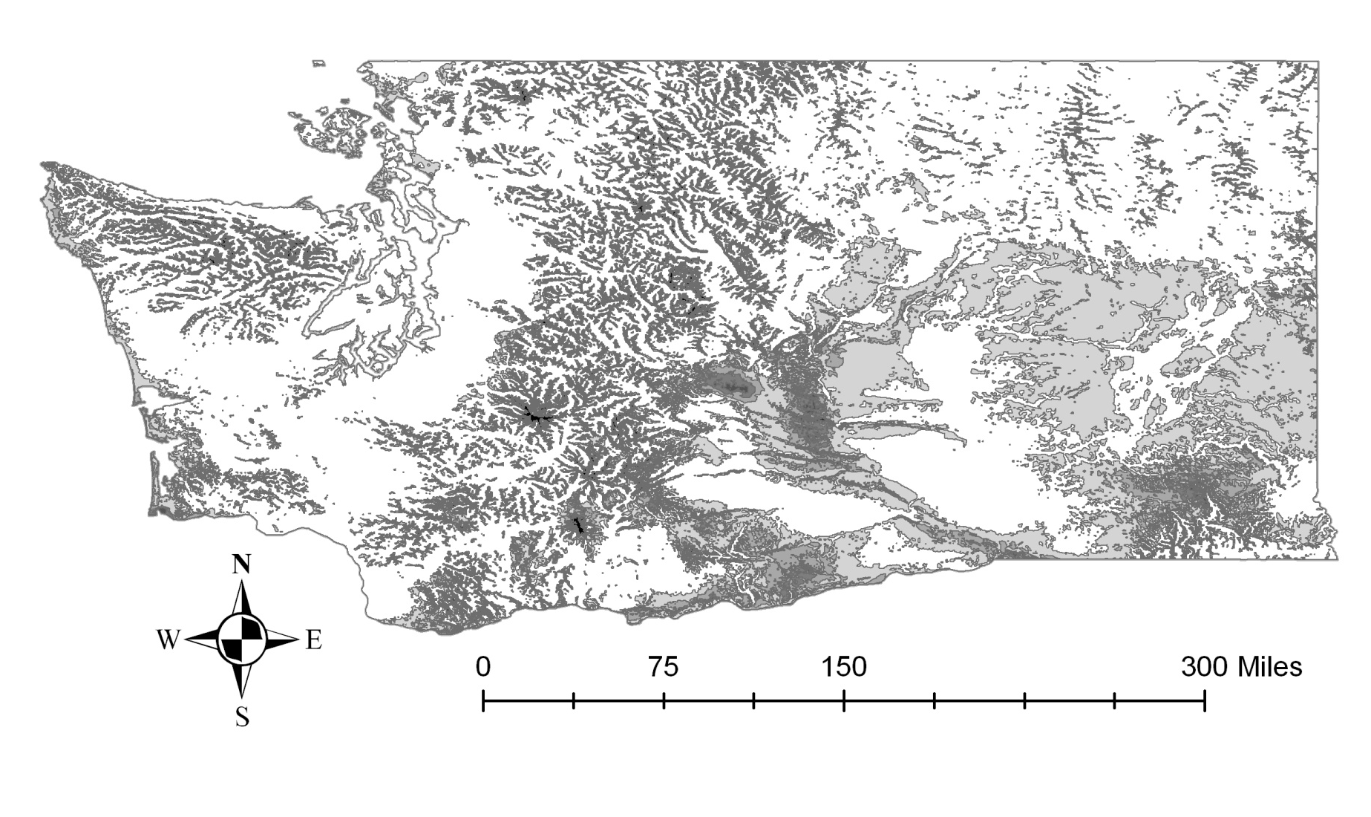
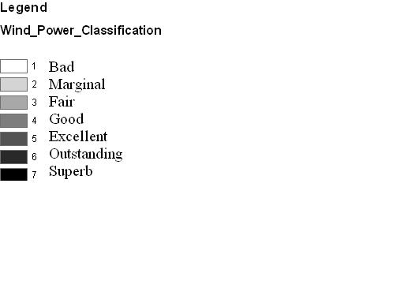
Wind Power Generation Potential

Slide 7
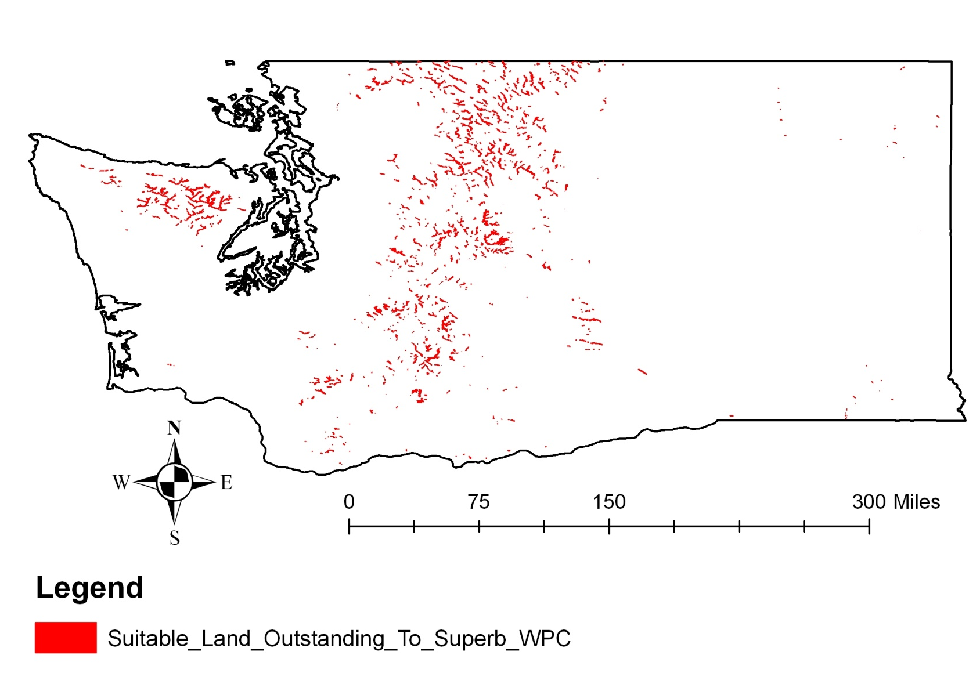
Outstanding to Superb Wind Power Classification and Suitable Land Cover Intersect

Slide 8
Proximity Requirements
Stay at least 10 miles away from existing wind farms
Within 5 miles of transmission lines
Within 5 miles of state highways

Slide 9
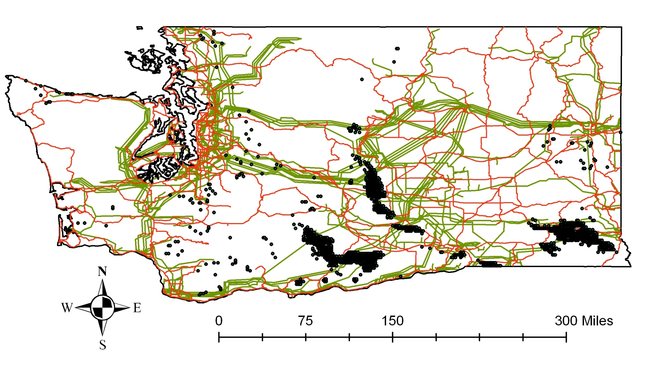
Transmission Lines, State Highways, and Current Locations

Slide 10
Other Exclusions
National Parks
All Washington State Mountain Ranges
  Cascade Mountains
  Blue Mountains
  Olympic Mountains

Slide 11
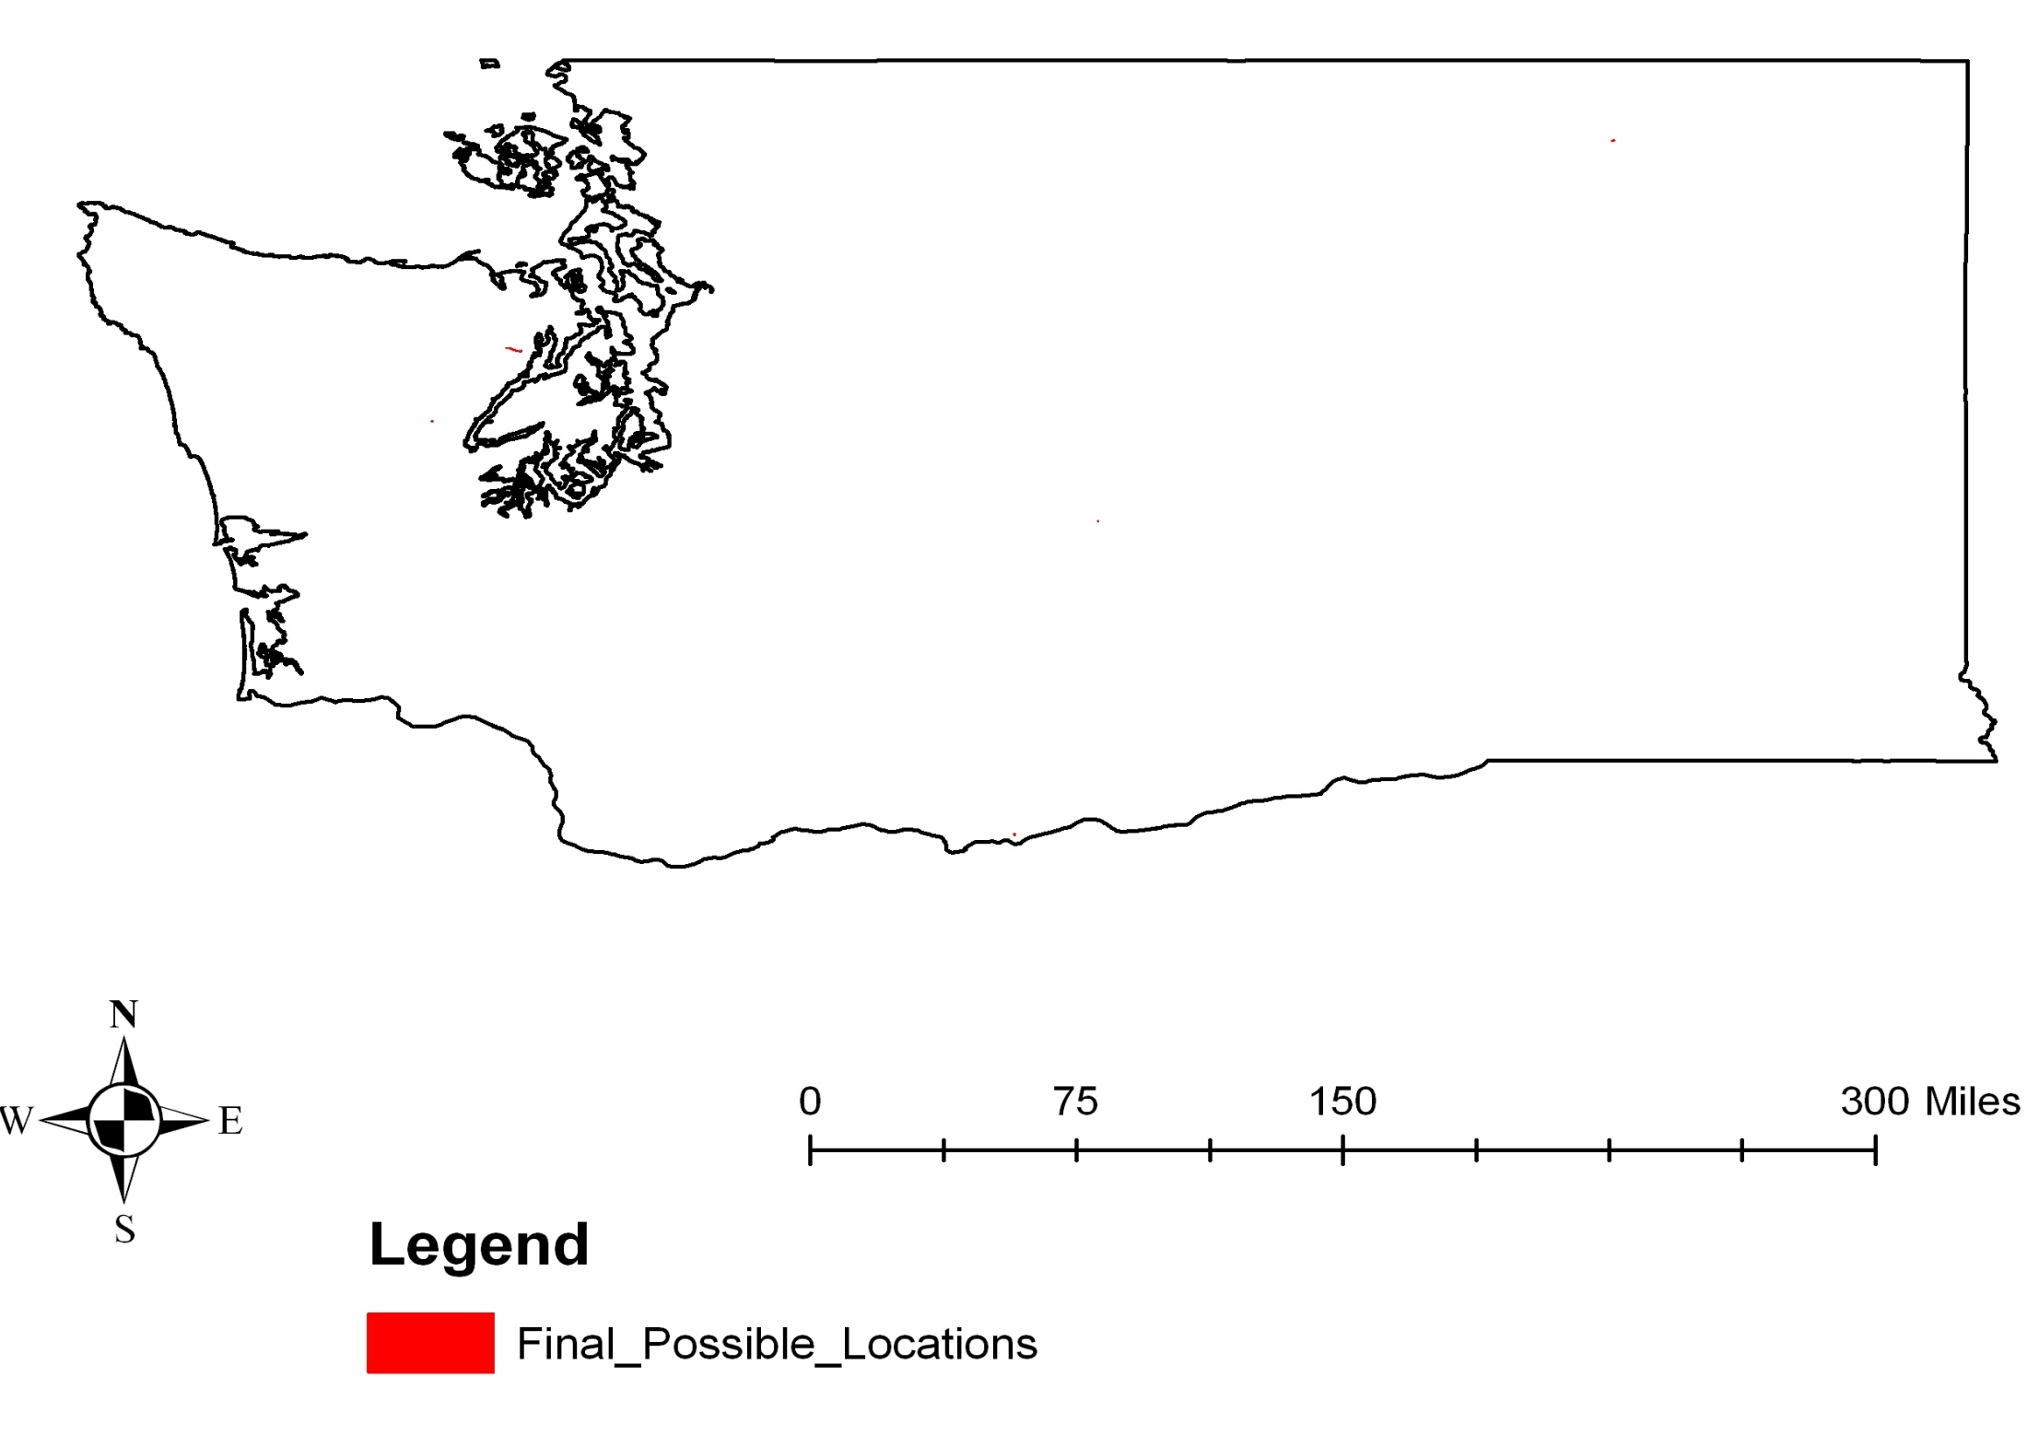
Final Possible Locations

Slide 12
Selected Location
Site with maximum area ~.5 square miles
Undeveloped area within Inner Olympic Peninsula
~1.5 miles west of Highway 101
South of the town of Quilcene
With a length of approximately 3.5 miles, the site’s unique shape allows for a high number of wind turbines to be installed along the ridge

Slide 13
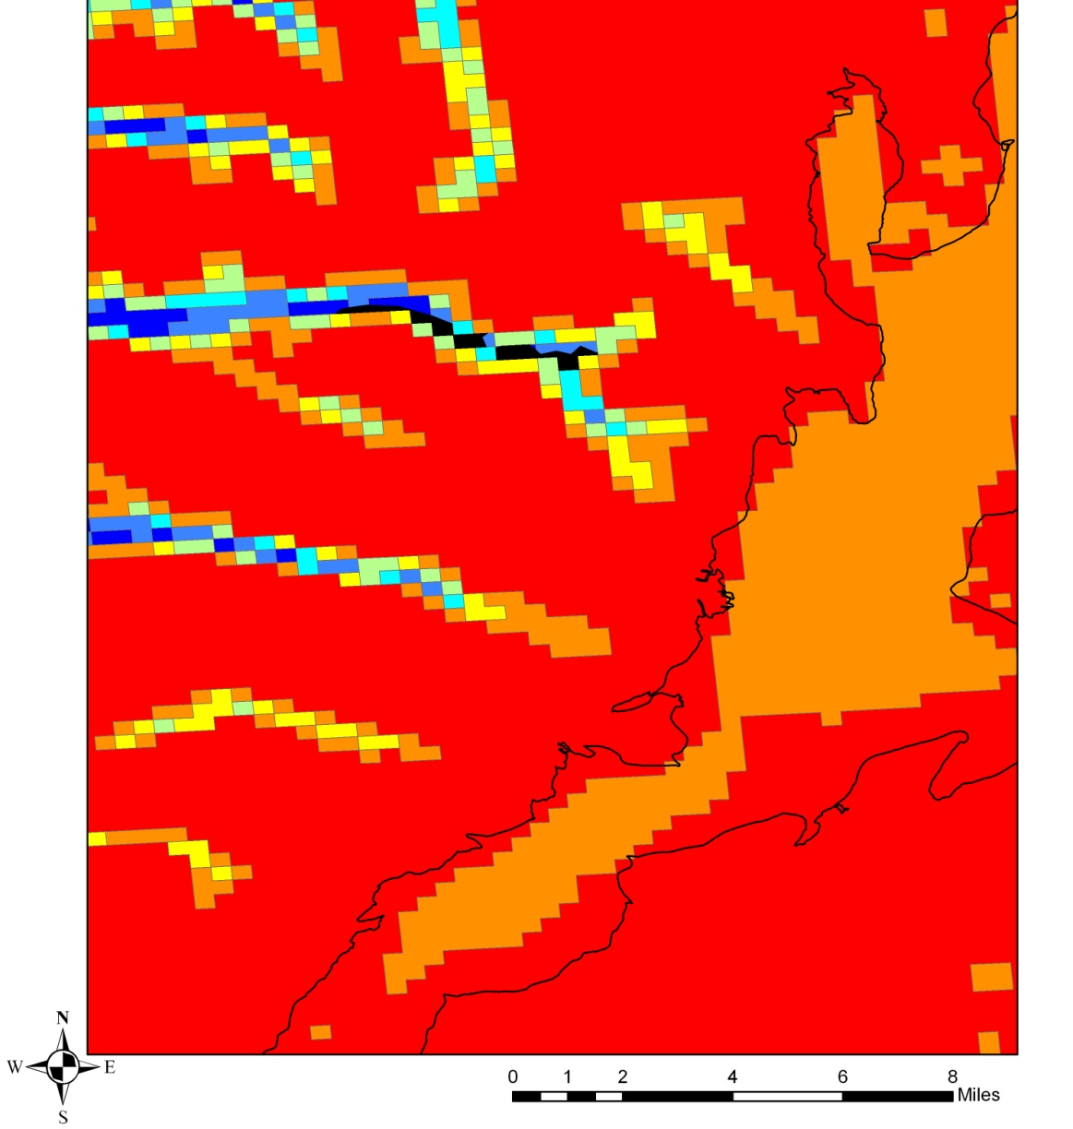
Selected Location Wind Power Generation Potential

Slide 14
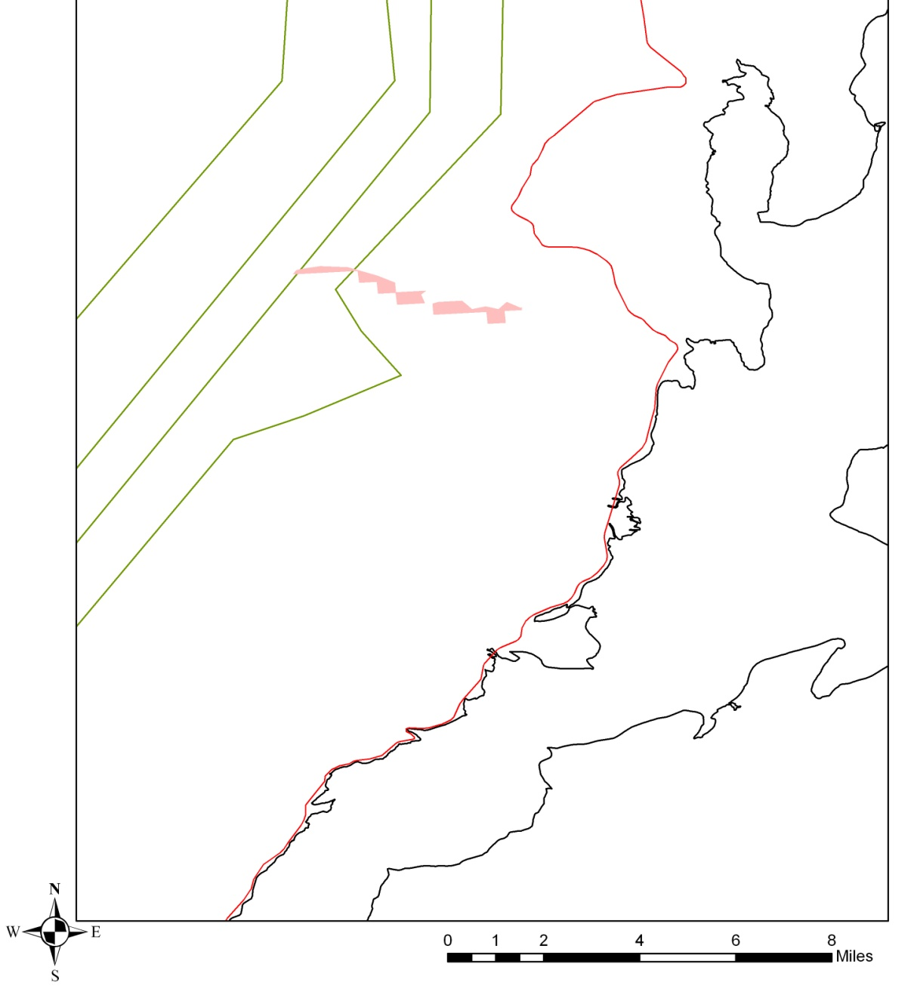
Selected Location Proximity to Roads and Transmission Lines

Slide 15
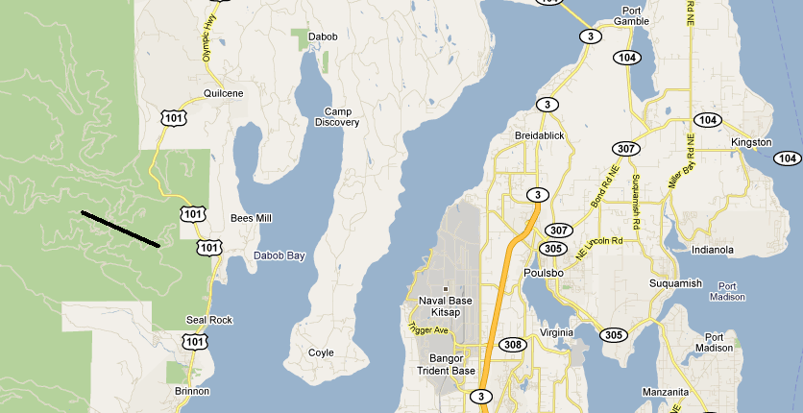
Final Location

Slide 16
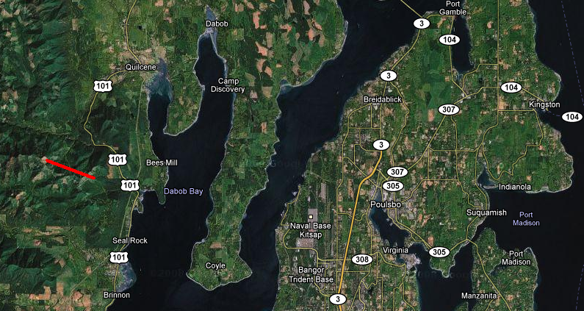
Final Location

Slide 17
Expected Power Generation
50m wind turbines are to be used (rated at 750 kW)
They will be spaced at least five 50 meter rotor diameters apart.
Therefore, we could fit at most, 22 turbines in a line along the 3.5 mile ridge

Slide 18
Power/Revenue Generation
Assuming a 40% power capacity factor
  This is on the high end because the site is particularly favorable
The site could potentially generate 6.6 MW of power which equates to about 57,800 MW*h over the course of one year

Slide 19
Data Sources
Washington State Geospatial Data Archive (WAGDA)
  wagda.lib.washington.edu/data/geography/us/vector/
Washington Department of Fish and Wildlife GAP Data Products
  http://wdfw.wa.gov/wlm/gap/landcov.htm
Washington State Department of Transportation (WSDOT) GeoData Distribution Catalog
  http://www.wsdot.wa.gov/mapsdata/geodatacatalog/default.htm#main
National Renewable Energy Laboratory
  http://www.nrel.gov/gis/

Slide 20
Questions?

