Slide 1

CEE 424
GIS for Civil Engineers
Geotechnical/ Structural:
High Risk Buildings in Downtown Seattle Due to Seismic Activity
Scott Watson Anthony San Gabriel
Luis Millones

Slide 2
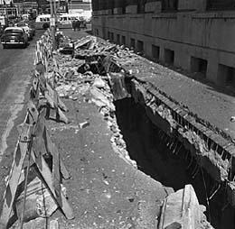
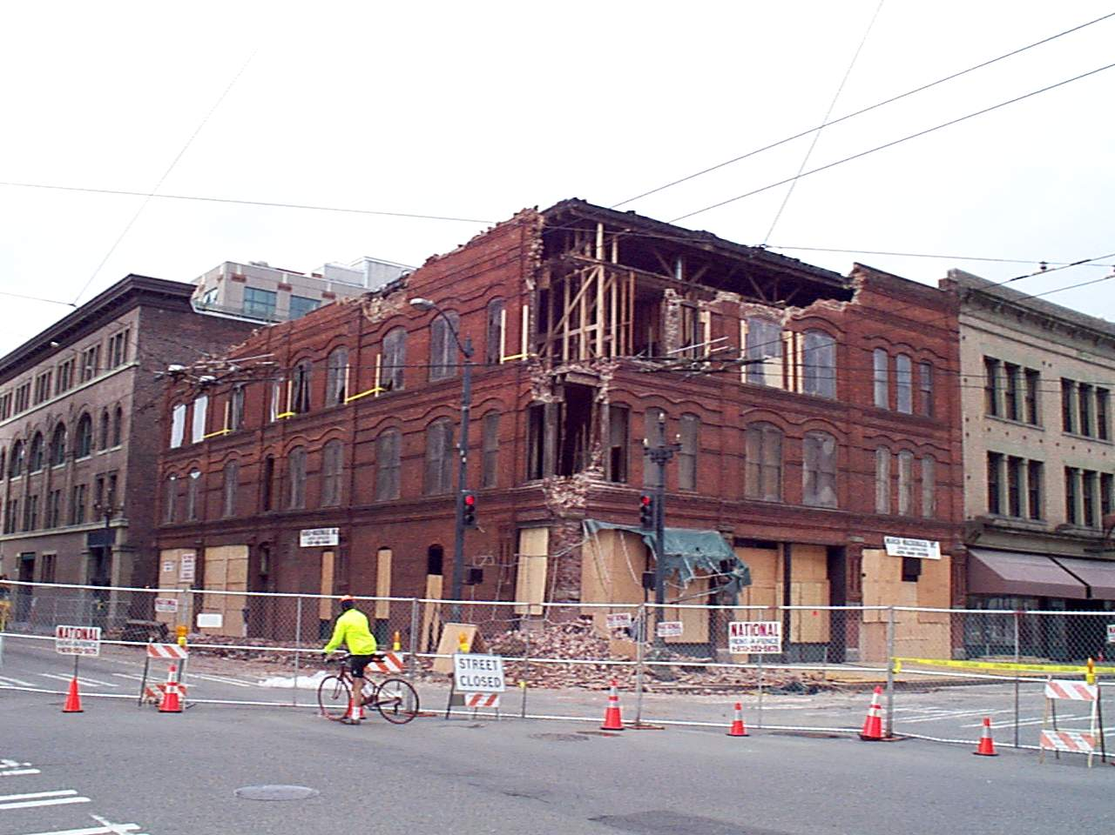
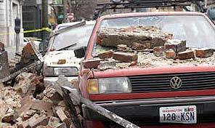
Shaky Past
Liquefaction
Seattle Union Station after 1965 quake
6.8 magnitude
Most damage is inflicted to old, brick buildings

Slide 3
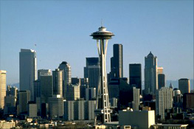
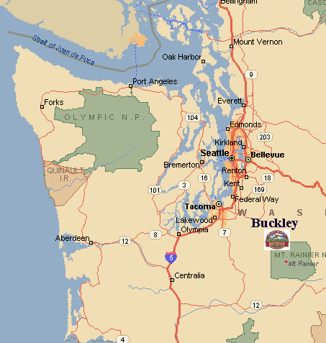
which buildings are susceptible to seismic activity?
Limited to downtown area
Distance to fault lines
Building use
Age of building
# of Stories
Structural Materials
Soil conditions (liquefaction)

Slide 4
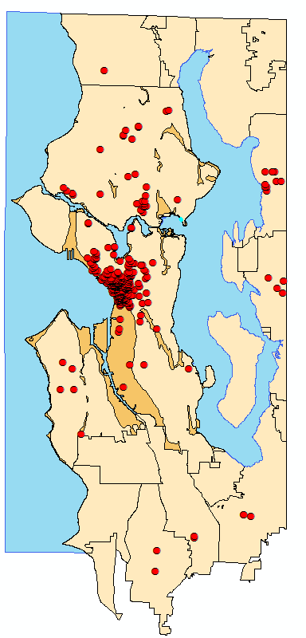

Geocoding
King County Department of Assessment
Too much data on residential buildings
Commercial buildings only

Slide 5
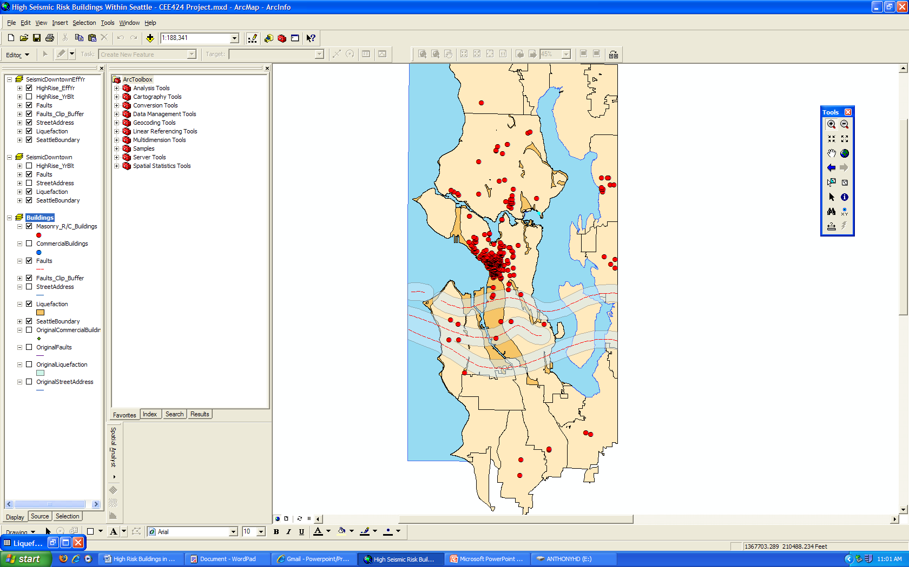
Fault lines and Liquefaction zones

Slide 6
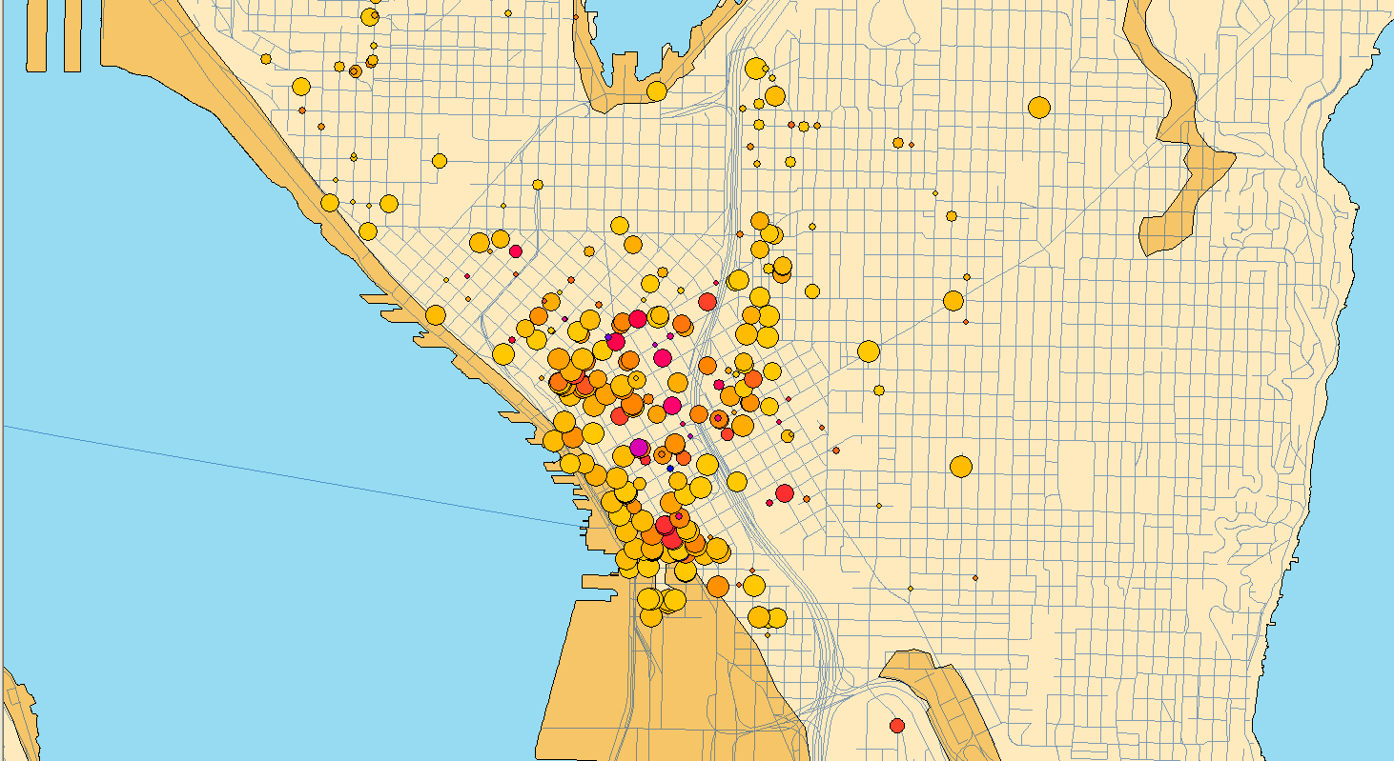
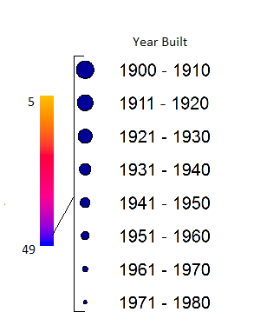
Susceptible Buildings

Slide 7
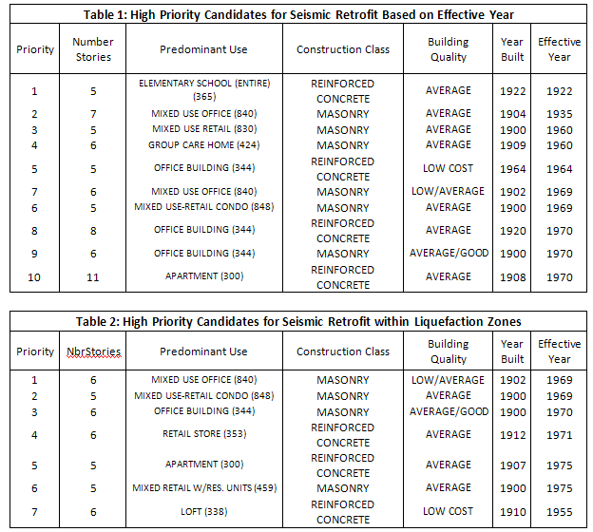

Slide 8
Solutions
Friction dampers
Fluid viscous dampers
Carbon fiber Reinforced Plastic (CFRP)
Fiber Reinforced Cement
External Prestressing

Slide 9
Questions?

