Slide 1
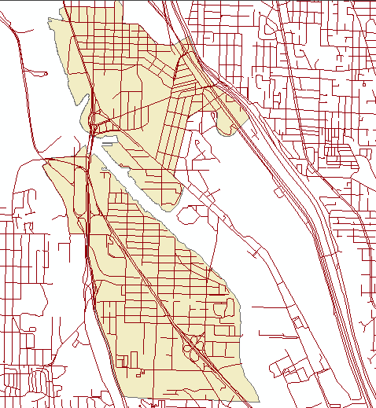
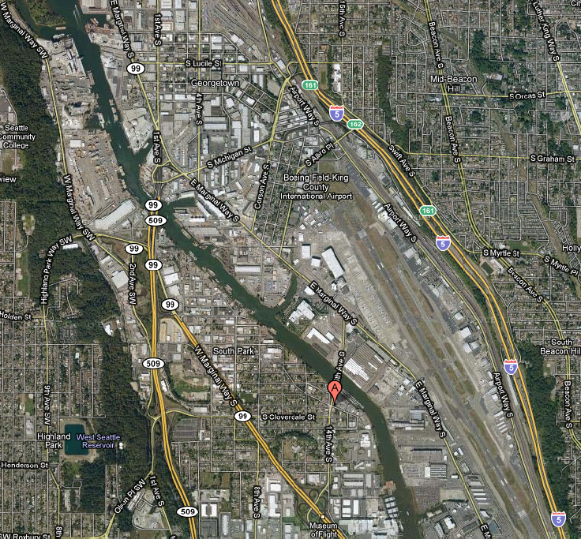
Exploration of Alternative Truck Routes through Georgetown and South Park
Prepared by Candice Au-Yeung. CEE 424: GIS for Civil Engineers. December 8, 2009.
Existing Routes
Map on right from Google Maps.
Georgetown and South Park areas of South Seattle contain a large number of industrial and commercial establishments.
Residents are concerned about air pollution resulting from heavy truck traffic between Port of Seattle Terminals and I-5.
Puget Sound Sage, a non-profit organization, requested the University of Washington to conduct air pollution studies on behalf of the residents.
The residents’ concern prompts the investigation of alternative truck routes.
The Alternatives: SR-509, East Marginal Way S., SR-99
Alternative routes investigated are best for trucks northbound to Terminals and southbound from the Terminals.
For northbound traffic from the terminals, most efficient are existing routes for significantly reduced travel distance.
Best to least favorable routes:
1.) Along SR-509
2.) Farther along E. Marginal Way S.
3.) Existing routes
4.) Along SR-99

