Slide 1
Exploration of Alternative Truck Routes through Georgetown and South Park, Seattle, WA
Candice Au-Yeung
CEE 424: GIS for Civil Engineers
Instructor: Dr. Kamal Ahmed
Autumn 2009
December 6, 2009

Slide 2
Motivation
Puget Sound Sage initiated study on particulate matter air emissions levels for Georgetown and South Park
Port of Seattle terminals are in these areas, resulting in heavy truck traffic
Puget Sound Sage hopes to convince governing agencies and the Port to help reduce air emissions
Thus, feasibility of alternative, lower impact truck routes through South Park and Georgetown are investigated in this project

Slide 3
Criteria for Feasible Alternative Truck Routes
Areas to avoid
  Relatively densely populated areas: 3638.33 persons in 1 square mile
  School walking routes
  Roads adjacent to schools
  Roads adjacent to playareas and playgrounds (except Carson Ave. S. onramps to I-5 and S. Lucile St. Overpass)
    The onramps and overpass are not easy to avoid
  Roads adjacent to hospitals

Slide 4
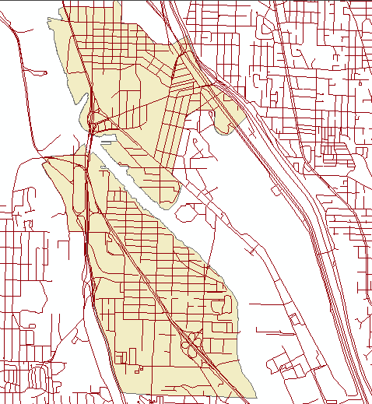
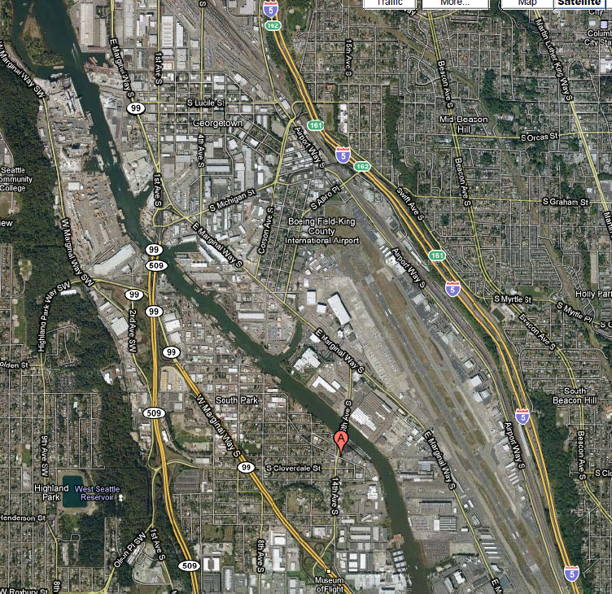
Georgetown and South Park
Areas of South Seattle
Large portions industrial or commercial establishments
Photo to right from Google Maps

Slide 5
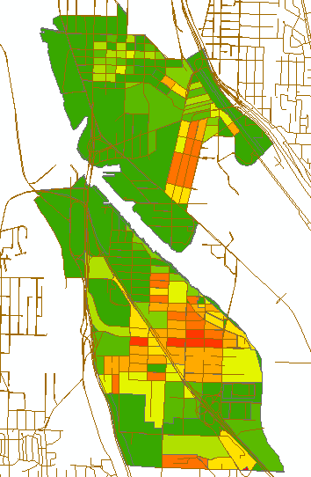
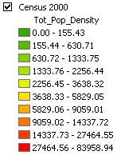
Denser Populated Areas
Population density calculated per block in persons/square mile
  2000 King County census
Do not want trucks to go through areas of density higher than 3638.33 persons/mi²
  Middle and southern South Park, and southeast Georgetown off limits to trucks

Slide 6
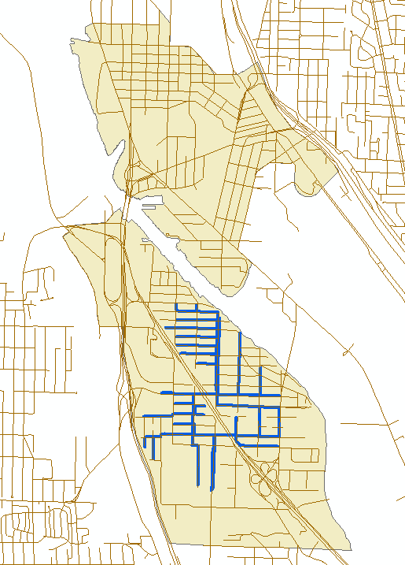
School Walking Zones
SR-99
School routes outlined in blue
  Routes do not traverse SR-99; there is an underpass for local streets
Routes only in South Park

Slide 7
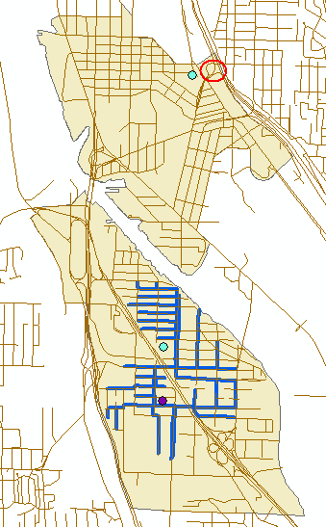

Roads Adjacent to Schools and Playareas
Corson Ave. S. I-5 onramps, S. Lucile St. Overpass
The only school is in South Park
  Surrounding area already constrained by school walking zones
There is one playarea in both South Park and Georgetown
  South Park playarea constrained by school walking zones
  Roads adjacent to Georgetown playfield off limits except for Corson Ave. S. and S. Lucile St. Overpass

Slide 8
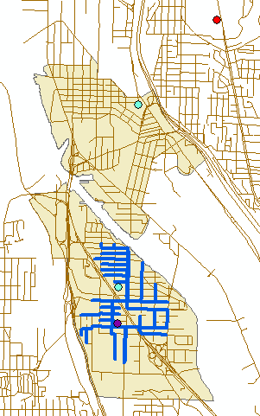
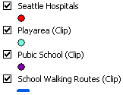
Roads Adjacent to Hospitals
There are no hospitals in Georgetown or South Park

Slide 9
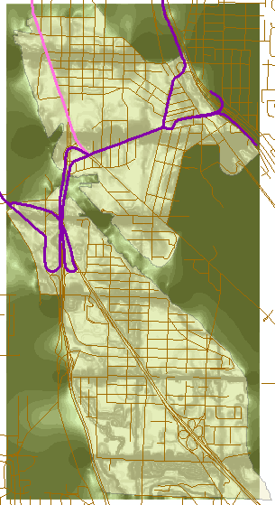
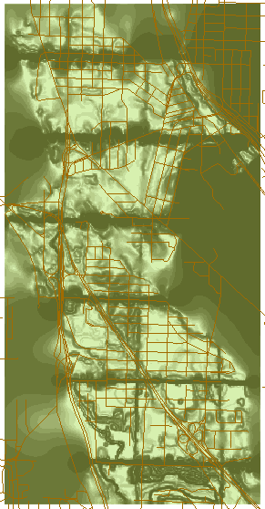
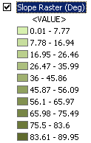
Topography
Generally, except for the edges of cells and the Georgetown and South Park areas, darker areas are more steep
Distinct and misleading boundaries in raster; not used for analyzing truck route

Slide 10
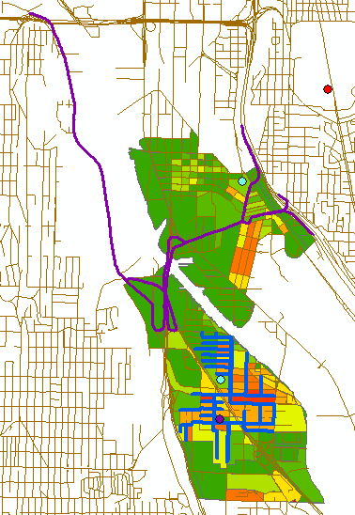
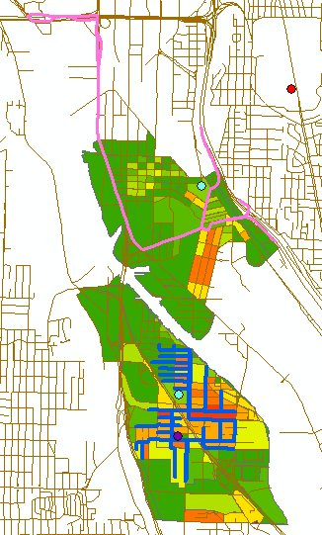
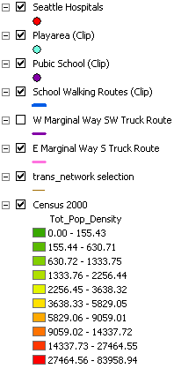
Existing Truck Routes
Both pass by blocks with densities of 5358.45 and 5328.13 persons per square mile, and pass through a block with density of 3129.76 persons per square mile (which is below the criteria)

Slide 11
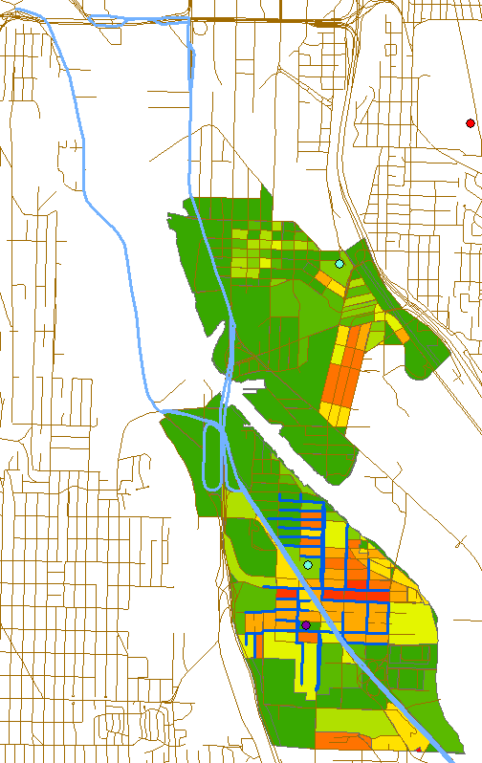
Alternative Route: SR-99
Not a good alternative
  Leads trucks through more areas of high population density than existing routes
SR-99
Existing routes

Slide 12
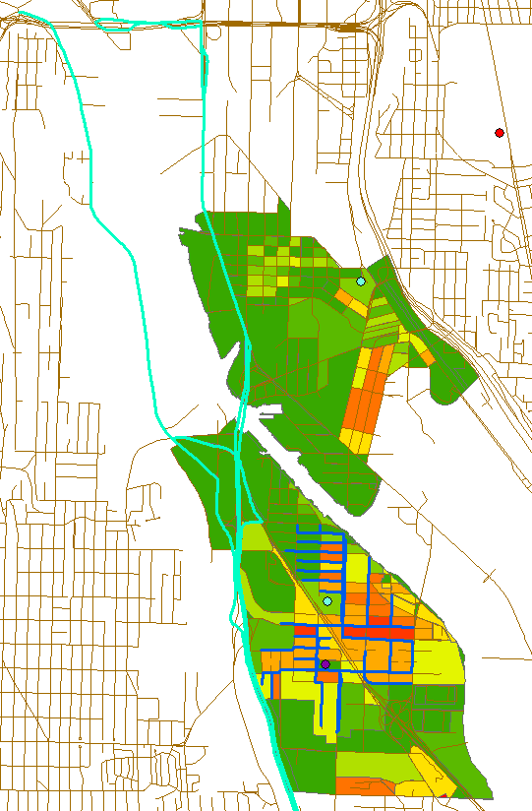
Alternative Route: SR-509
Feasible route
Farther away from high population areas
  Highest density adjacent block is bordered S. Henderson St., 3rd Ave. S., S. Barton St., and 2nd Ave. S. (in red box)
    Density of 3638.32 persons/mi², lower than the criteria
SR-509
Existing routes

Slide 13
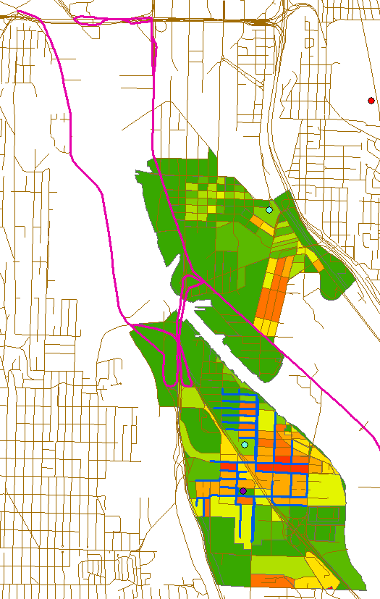
Alternative Route: E. Marginal Way S.
Feasible route
Adjacent to two higher density blocks (in red box)
  Density of 5046.63 and 5219.40 persons/mi² (left to right)
E. Marginal Way S.
Existing routes

Slide 14
Conclusion
The alternative routes investigated are best for trucks traveling northbound from south of South Park and southbound from the Port terminals
  For northbound traffic from the terminals, the most efficient route is along the existing routes for significantly reduced travel distance
Along SR-99 would be the least best alternative
Existing truck routes ranked third best
E. Marginal Way S. second best alternative
  Leads trucks along blocks with lower densities less than the existing routes do and is thus the second best alternative
Best alternative is along SR-509

