Slide 1
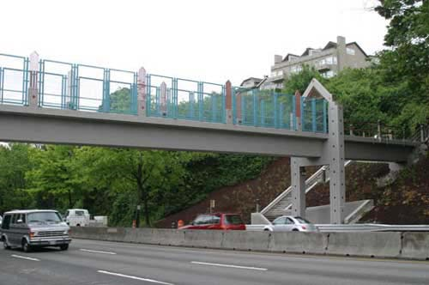

Pedestrian Overpass Locations
City of Kent

Slide 2
Objectives
Find a location in Kent for a pedestrian overpass
Allow better traffic movement by removing pedestrian crossings
Locate next to transit stops, bike trails and commercial areas
Avoid costly construction areas and sewer lines

Slide 3
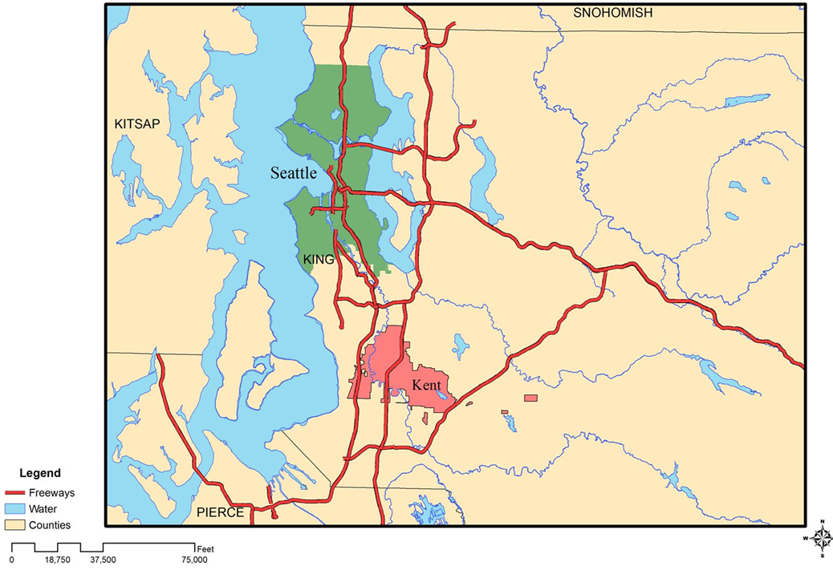
Overall Project Location

Slide 4
Costly Construction Areas
Erosion Hazard Areas
Seismic Hazard Areas
Landslide Hazard Areas

Slide 5
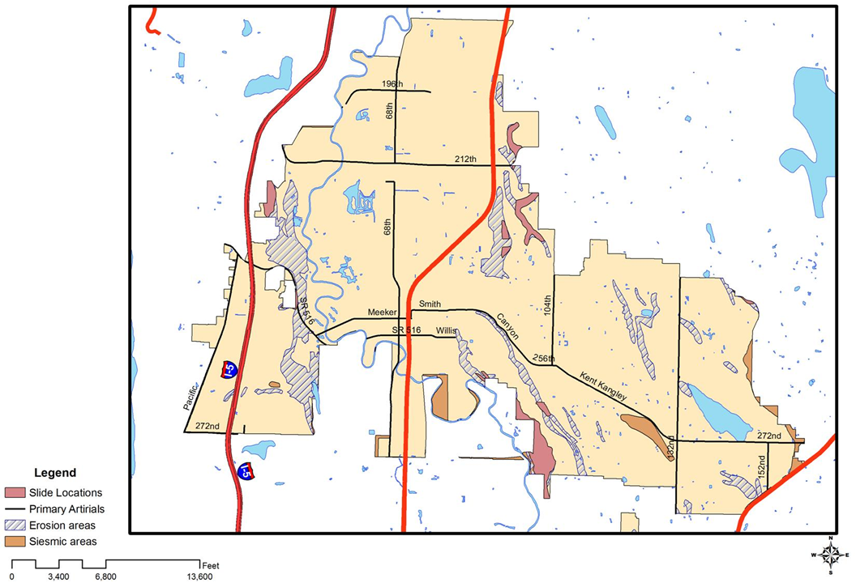
Costly Construction Areas

Slide 6
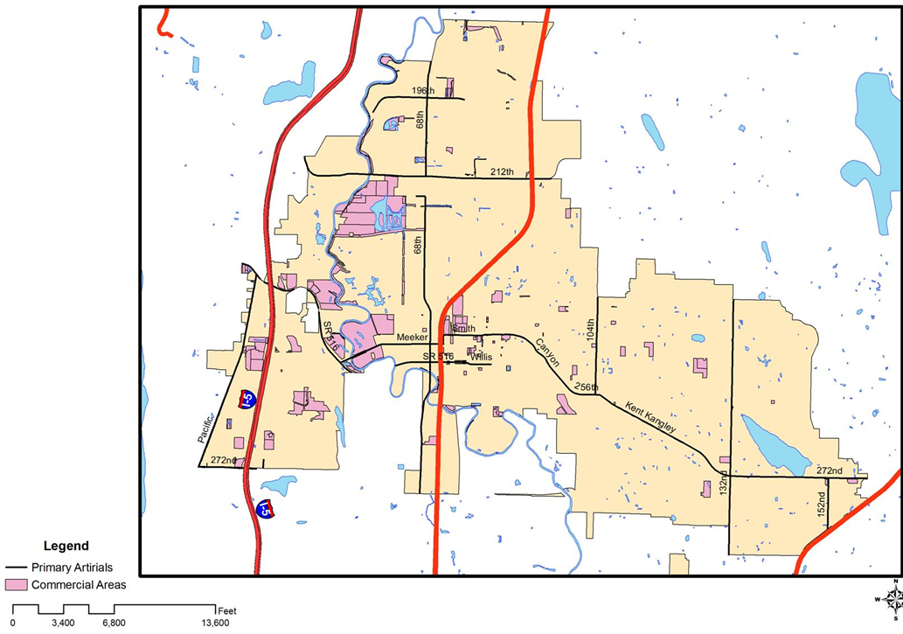
Commercial Areas

Slide 7
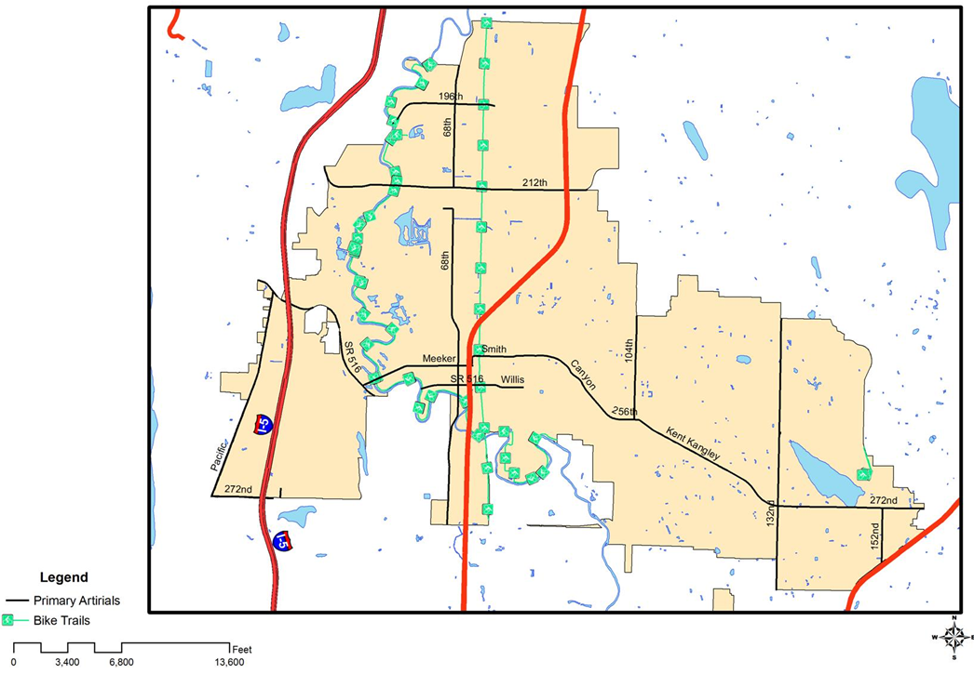
Bike Trials

Slide 8
Analysis
Buffer
  .5 miles for Trails
  .25 miles for commercial areas
Union
Intersections
Clip
Erase

Slide 9
Possible Locations
Along principal arterials
Within .5 mi of trials and .25 of commercial areas and transit stops
Avoid hazard areas and sewer lines

Slide 10
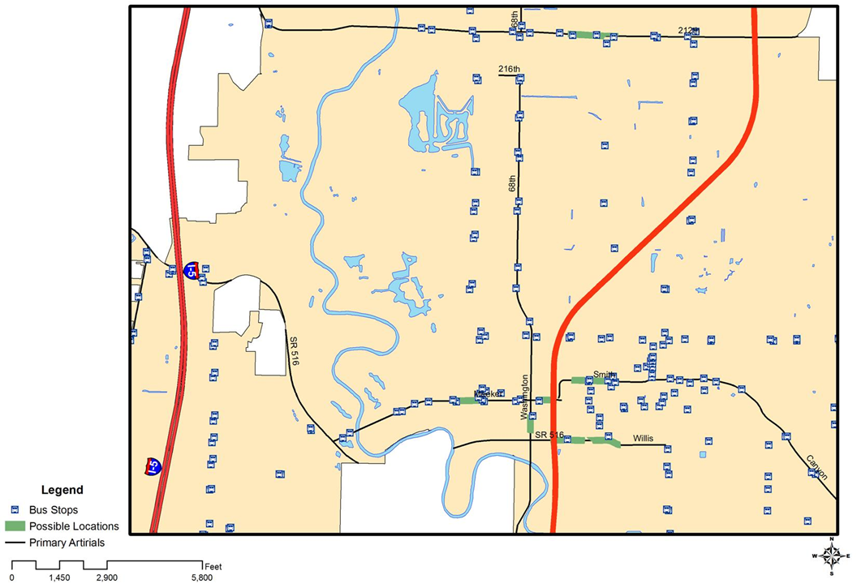
Possible Locations

Slide 11
Chosen Location
Just before intersection of Washington and Meeker
8 transit stops within close proximity
Commercial and shopping areas on both sides of Meeker

Slide 12
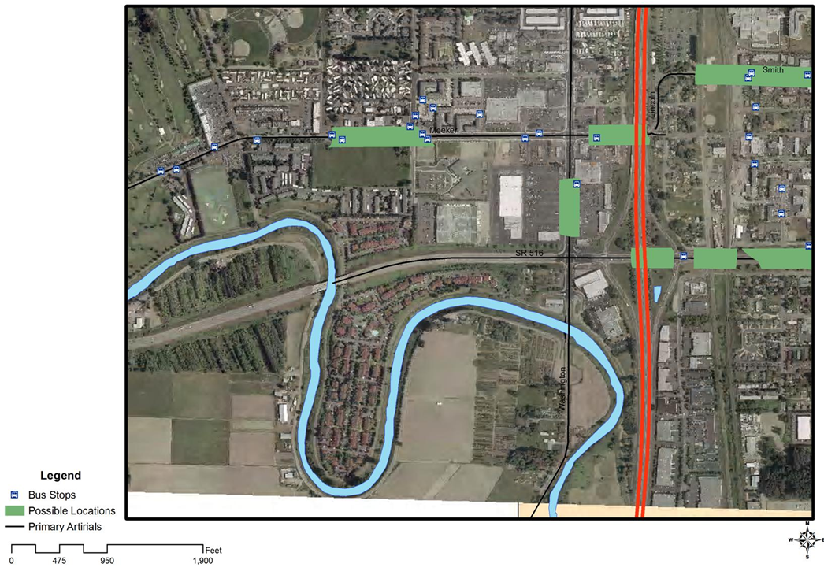
Chosen Location

Slide 13
Data Used
Cities / Incorporated Areas
Hazard Areas
  Seismic, Erosion and Landslide
Water Bodies
Washington Counties
Public Lands
Trails
King County Transportation Network
Sewer Lines
Metro Bus Stops

