Slide 1
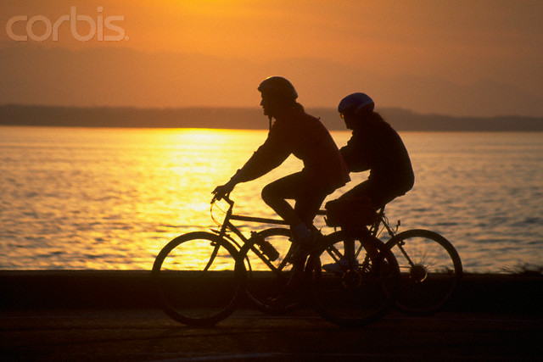
Seattle Bike Routes:
Establishing a Central Link
Courtesy Corbis Images
Presentation by: Ryan Hyde, Kael Martin, Kenneth Moffat
December 11, 2009

Slide 2
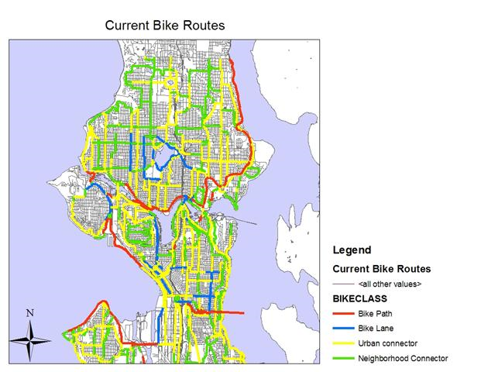
objective
Given:
  Seattle’s Environmentally Friendly Population
  Good Public Opinion of Low Impact Commuting
  Largely Fragmented Bike Route System
Create a Centralized Bike Route From North Seattle to Downtown

Slide 3
Data
2000 Census for Population Characteristics
Street Networks and Transit Centers
Existing Bike Paths and Parks
Bus Routes and Contours
Source: KCDOT and SDOT via, WAGDA

Slide 4
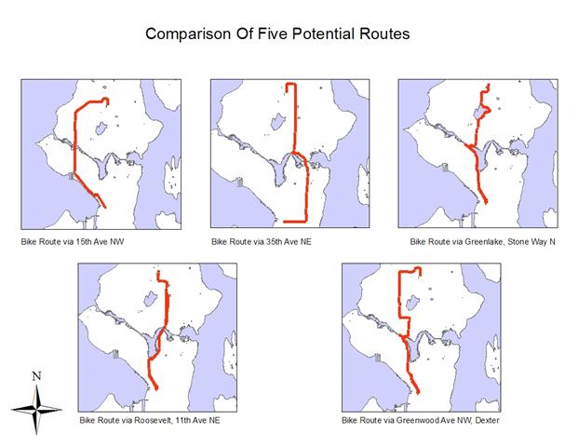
Analysis: Selecting Routes
Hand Selected Routes based on Major roads

Slide 5
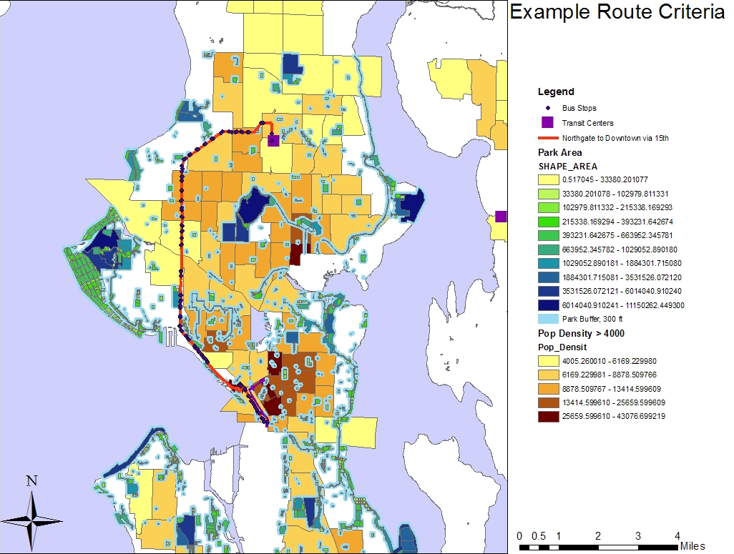
Analysis: Parameters & Weighting
Parameters Considered: Population Density, Length, Bus Stops per Length, Change in Elevation, Bike Right of Way on Route, Proximity to Parks

Slide 6
Analysis: Parameters & Weighting (cont.)
Parameters | Weight Factor | Ngate Way, Holman, 15th, 1st, Jackson | 35th, 24th, Jackson | Ngate to Jackson via Greenwood, Dexter, Westlake, 4/5th | Ngate to Jackson via roosevelt, 11th | Ngate to Jackson via Greenlake, Stone, Westlake
Population Density Tracts >4000 ppl/sqmi | 25 | 350 | 500 | 475 | 450 | 400
Length (miles) | -30 | -345.00 | -312.47 | -376.73 | -283.80 | -358.81
Bus stops per Length | 15 | 163.04 | 197.30 | 166.03 | 669.13 | 134.19
Change in Elevation | 5 | 586.09 | 852.57 | 642.63 | 718.82 | 430.59
Bike ROW on Route (miles) | 25 | 578.25 | 499.84 | 565.84 | 455.29 | 591.81
Proximity to park (miles) | 60 | 218.60 | 181.72 | 268.91 | 347.78 | 345.11
Total | 100 | 1550.98 | 1918.95 | 1741.69 | 2357.23 | 1542.91

Slide 7
Summary
Route 4 was selected as the superior route due to it possessing the shortest length, greatest accessibility to public transportation and close proximity to parks.

