Slide 1
Determining the Bikability of Bellevue’s Transportation Network
Stela Abed, Michael Cole, Yousef Al-Roumi, Tim Thomson, Xin Xin
CEE 424 GIS for Civil Engineers
December 8th 2010

Slide 2
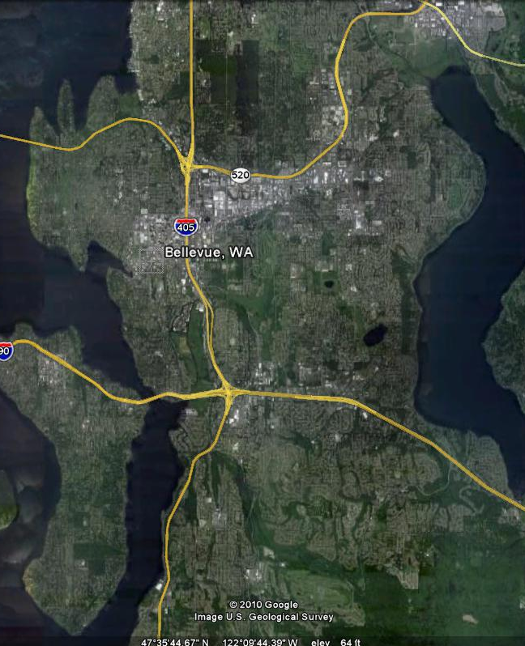
Objective
Use GIS data to form a bikability rating system for Bellevue’s roadway network.
Bellevue, WA

Slide 3
Data Collection
King County GIS Center
  King County Bike Facilities
  Metro Transit Bus Stops
  Metro Transit Bus Routes
  Transportation Network
City of Bellevue Standard Data
  2 Foot Topography
  Street Network
Google
  City of Bellevue aerial photograph

Slide 4
Analysis - Criteria
Rated bike network based on:
  Type of facility
  Slope
  Speed Limit
  Along bus route
  Proximity to bus stops
  Along truck routes

Slide 5
Model Equation
Rating =
1.00 * [Bike Facility Type]
+ (0.85 * 40) * [Slope]
+ (0.75 / 10) * [Speed Limit]
+ 0.25 * [Overlaps Bus Route]
+ 0.25 * [Overlaps Truck Route]
- 0.3 * [Within Bus Stop Buffer]
The smaller the rating the more bikeable the roadway.

Slide 6
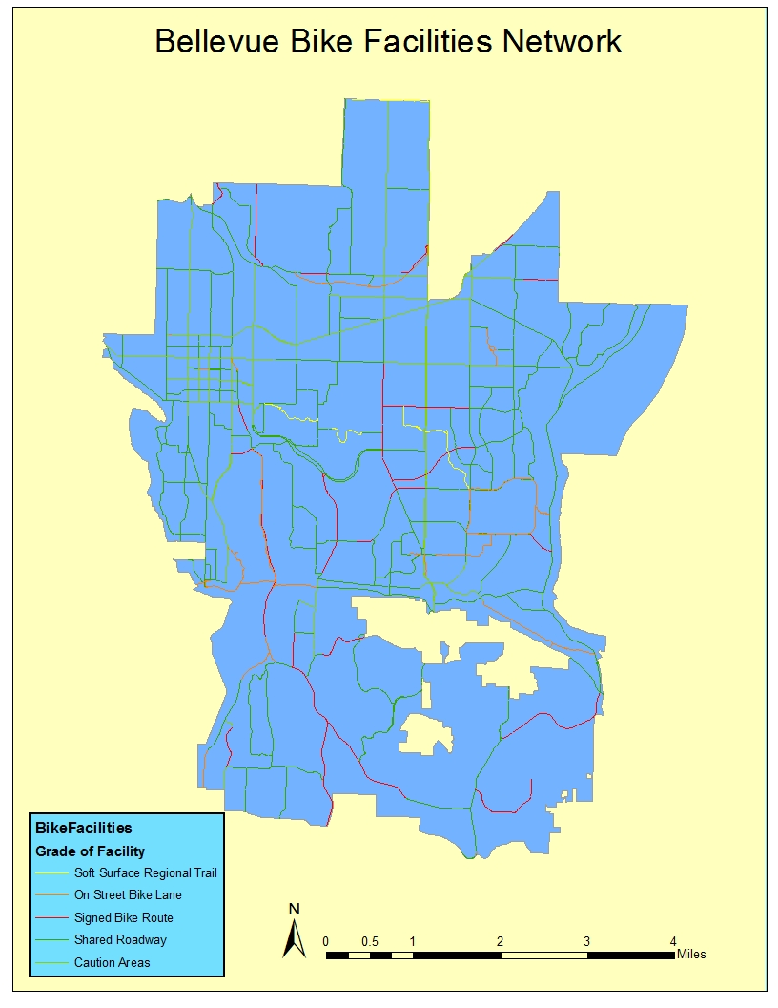

Slide 7
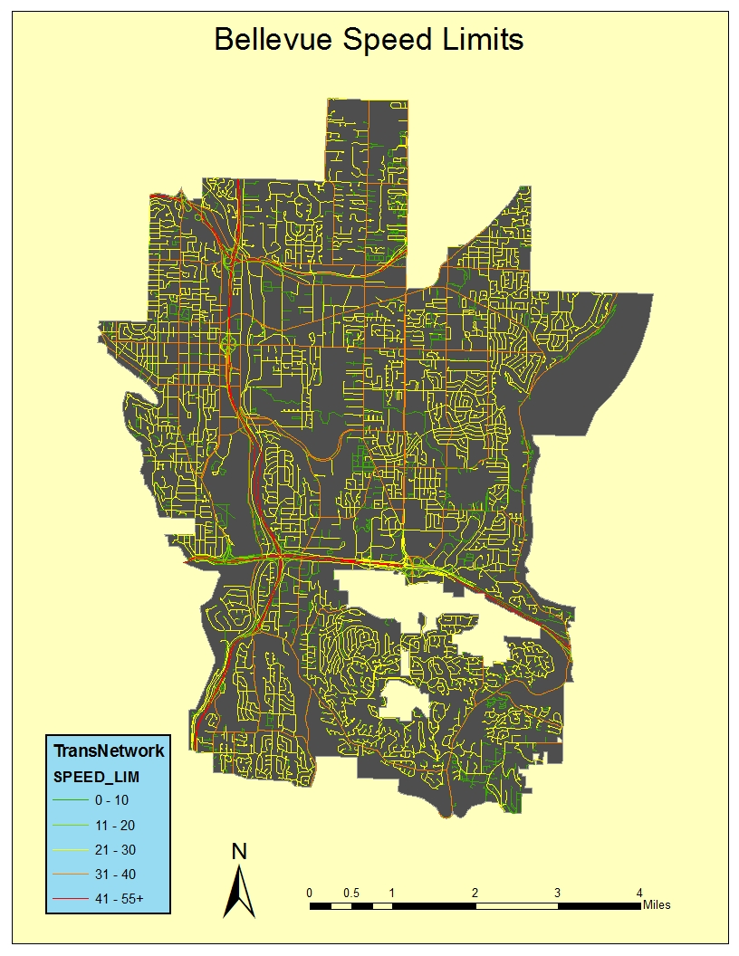

Slide 8
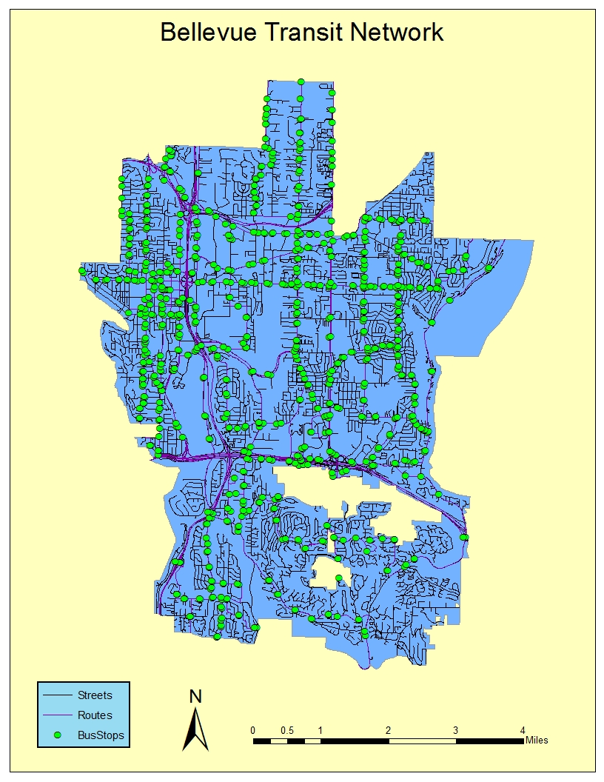

Slide 9
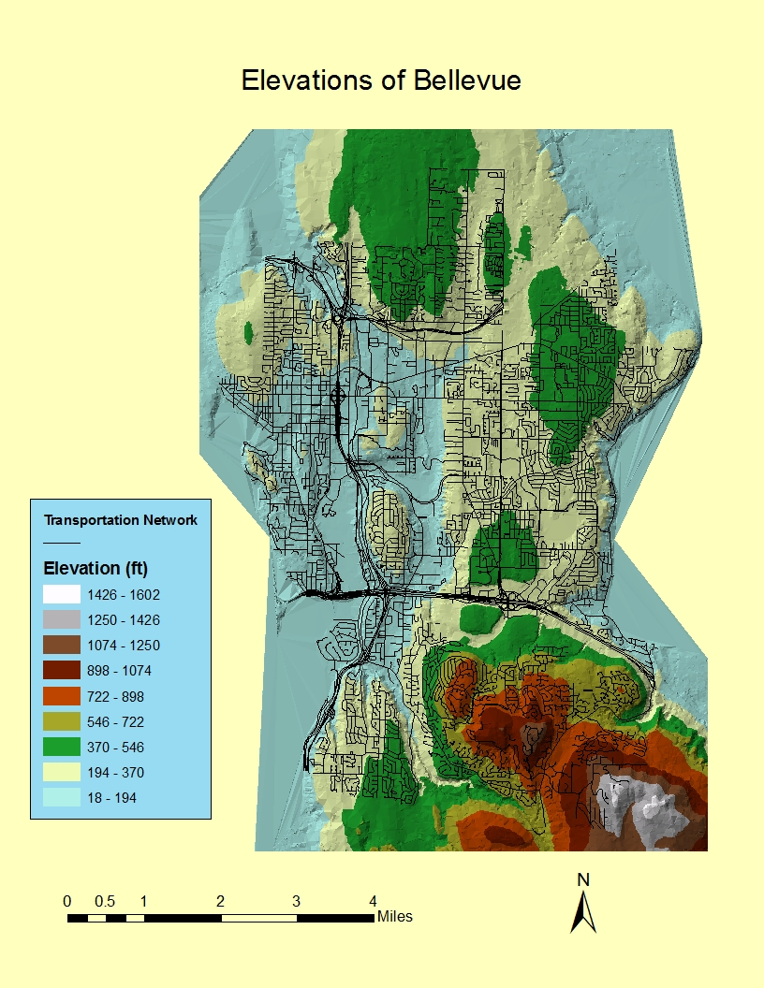

Slide 10
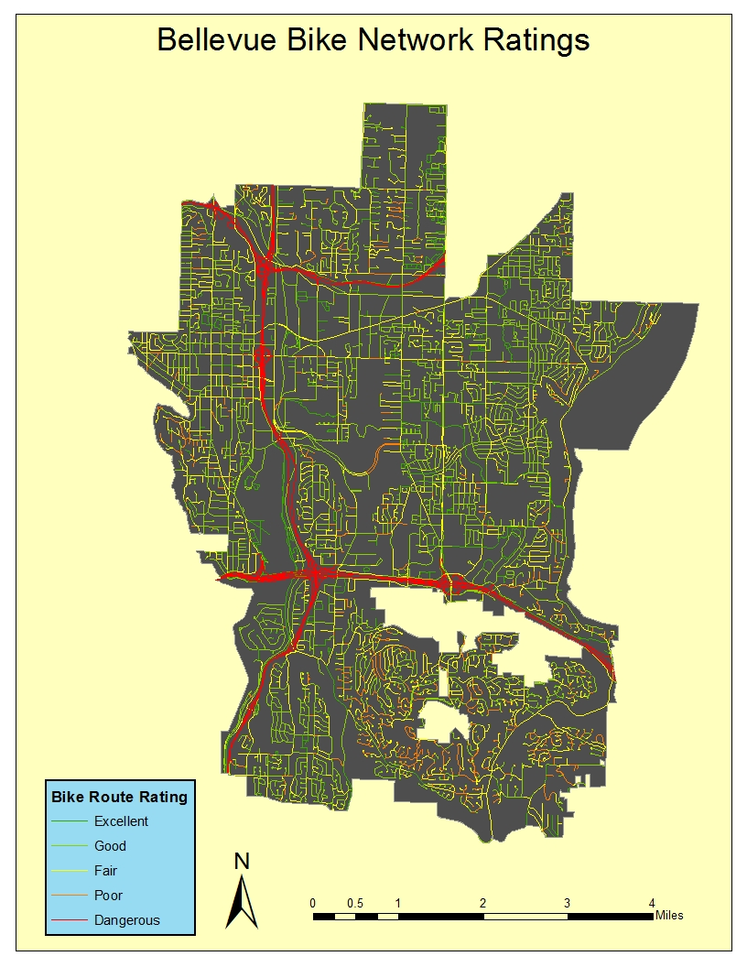
Results
Found best routes
Examined streets to verify index
All interstates & state routes - dangerous

Slide 11
Thank you
Questions?

