Slide 1
School Bike Route Analysis
City of Seattle
Michael Houston
CEE 424
Final Project

Slide 2
Biking in Seattle
More Seattle residents are biking every year
  Desire for safe, direct routes
  Choose routes that avoid major hills
Safe Routes to School Program is growing
  Federally funded program
  More schools are asking for projects

Slide 3
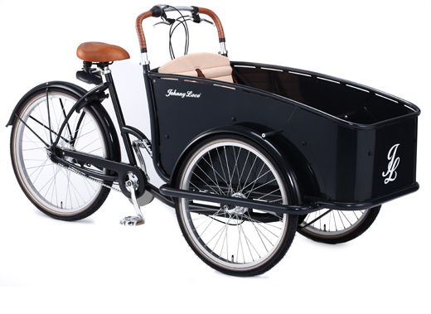
Analysis Problem
Scenario: Older sister at Nathan Hale
High School wants to pick up younger brother at Laurelhurst Elementary with her new bike

Slide 4
City of Seattle GIS Data
Street Network
  Arterials and neighborhood streets
Bike System
  Off-street facilities
  On-street routes
Elevation
  2-foot contours from the City of Seattle

Slide 5
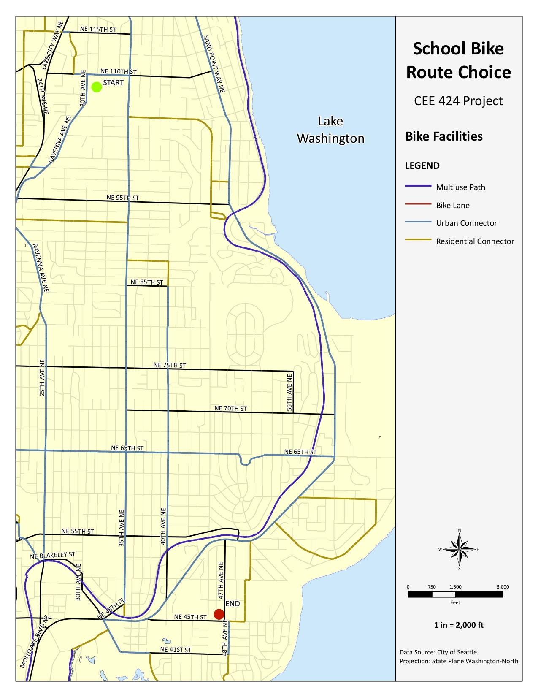
Bike Network
Multiuse paths
  Separate from roads
Bike lanes
  Painted lanes on roadway
Urban connectors
  Signed bike routes
Residential connectors
  Other streets preferred by bikers

Slide 6
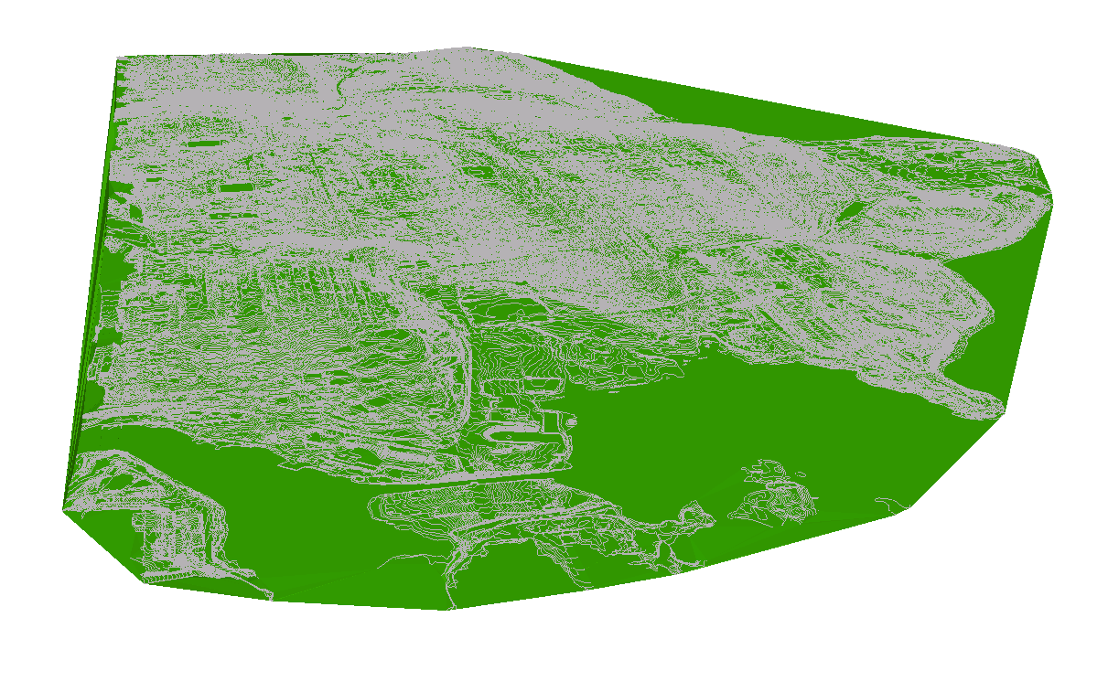
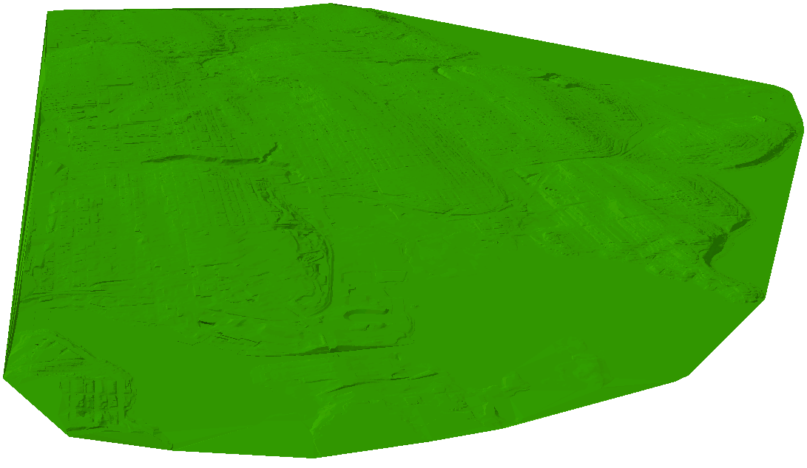
Elevation
2-foot contour shapefile
Created 3-D TIN
Lake
Washington
Lake City
Sand Point
UW
Union Bay

Slide 7
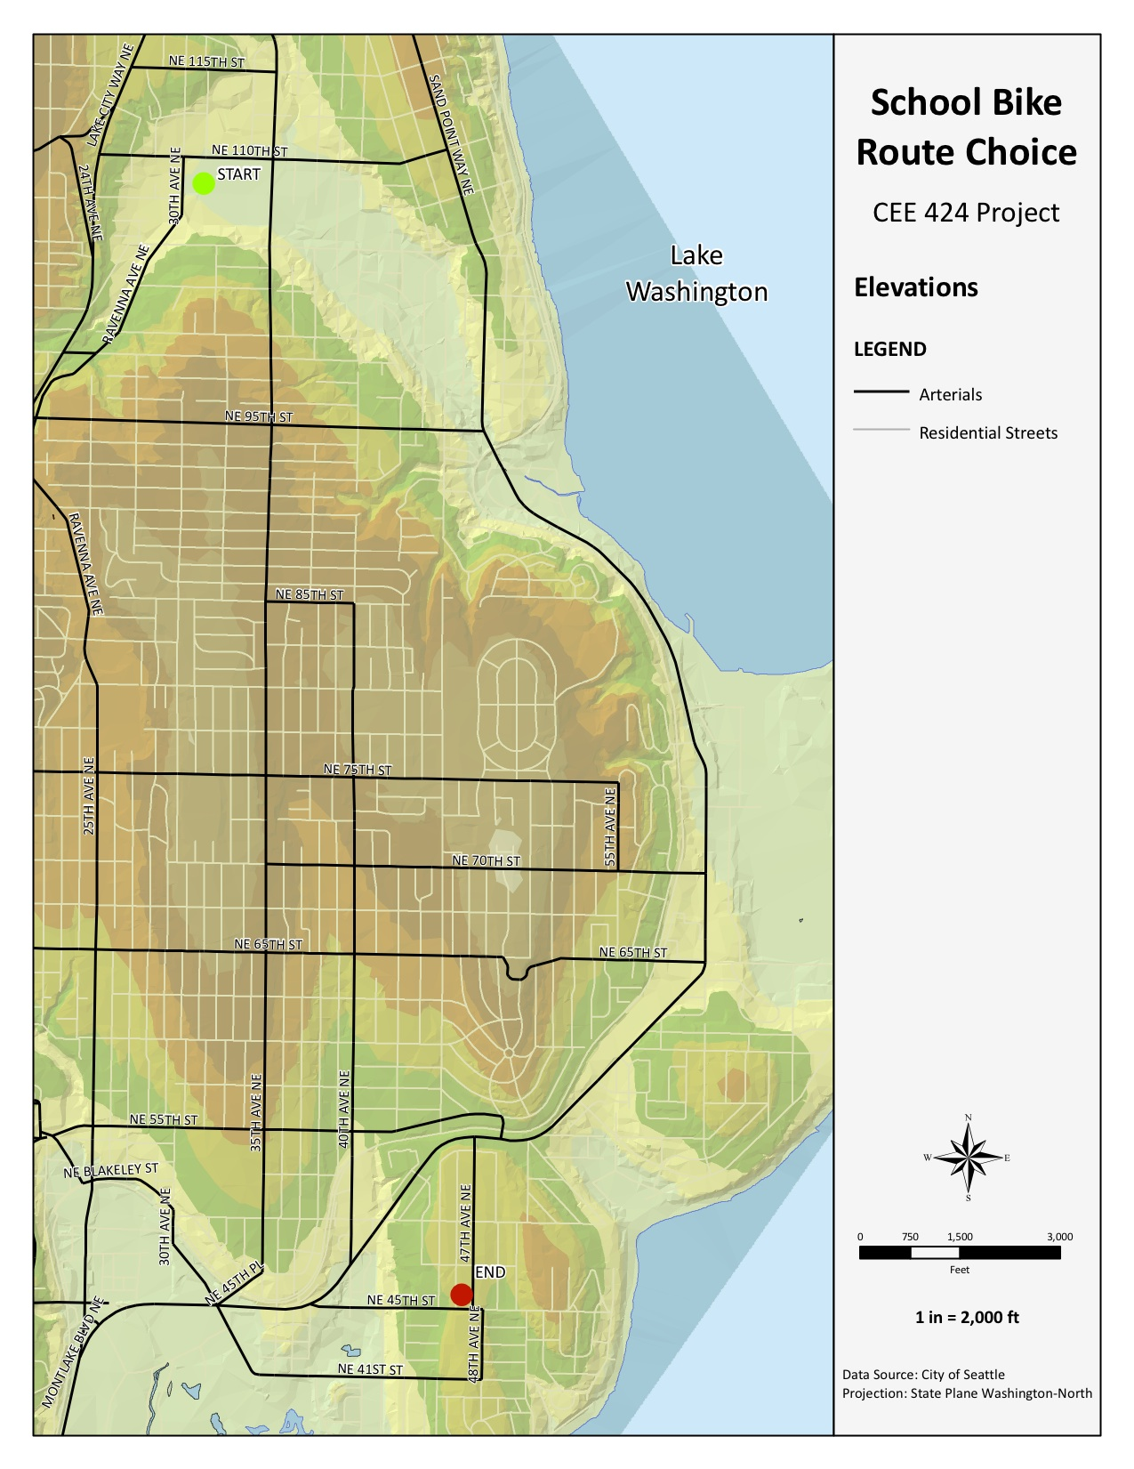
Elevation and Roadway Network
Assigned weights to preferred bike routes
  Multiuse paths have the highest rating
  Other streets have lowest rating
Grade determined from elevation profile
  Higher grades have lower ratings

Slide 8
Three Analyses
Shortest distance
  Street network to determine distance
Best bike facilities
  Best bike facilities and lowest grade between start and end
Bike facilities and distance
  Combines best bike facilities with distance

Slide 9
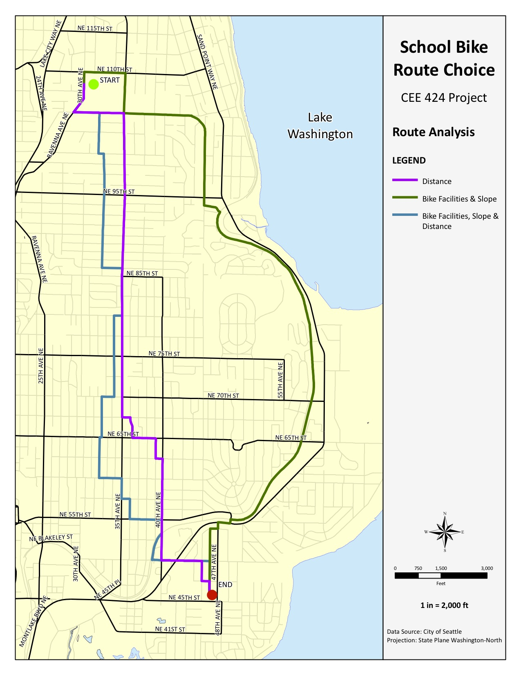
Results
Shortest distance uses arterial routes
Best bike facilities uses Burke-Gilman Trail
Combination uses a more direct, but compromised route

Slide 10
Conclusions
Shortest route for bikes usually includes arterial streets without bike facilities that may be unsafe
Routes with the best bike facilities often include significant out-of-direction travel to use high quality multiuse pathways
Routes that include bike facilities and distance use some routes with bike lanes and other streets
  Not the flattest or safest route, but limits total distance bikers travel

