Slide 1

Transportation Safety Characteristics of Washington’s Interstate 90
Presented by:
Tom Abbott & Aaron Hulst

Slide 2
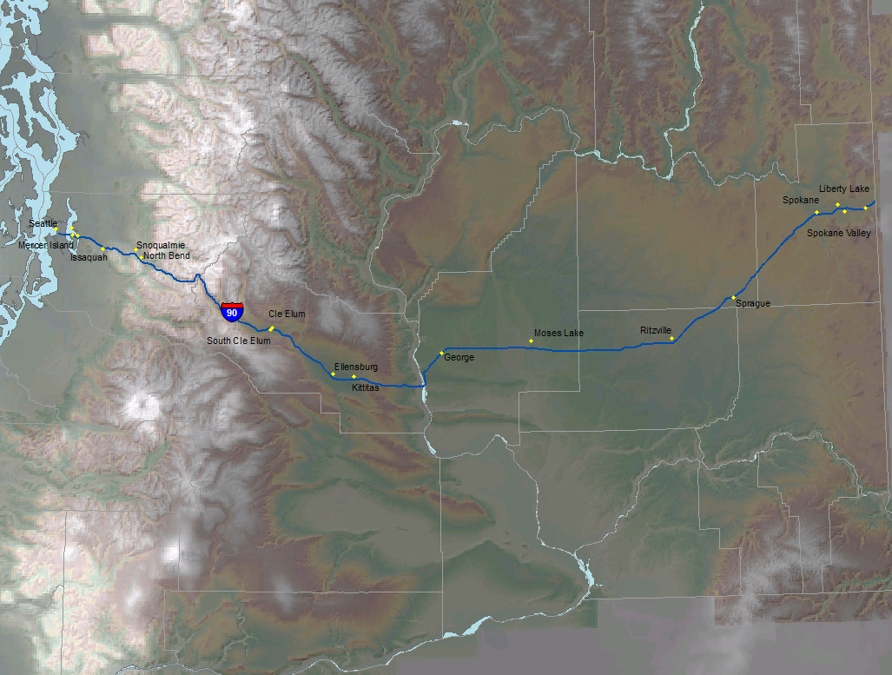
Data Used to Perform Analysis & Project Maps
WSDOT
  Interstate Polylines
  Cities Layer
  Accident data
  Precipitation Raster
  Elevation layer
  Coastline Layer
USGS
  Landslide data

Slide 3
Accident Density by Milepost
Analysis
Accident Density
Greatest density occurs around metropolitan areas
High accident density over Snoqualmie Pass
Analysis of Results
Pass accident density is due to increased elevation and high precipitation as snowfall
Metropolitan accident density is due to high traffic volumes

Slide 4
Accident Density by Milepost Recommendations
Recommendations
Safety measures should be taken by WSDOT to alert drivers to hazardous conditions

Slide 5
Analysis Tools Used In GIS
Dot Density
  Located Accidents by Milepost
Select by Attributes
  Created I-90 feature
Buffer
  To find cities within 2 miles of I-90
Intersect
  To find cities within 2 miles of I-90

Slide 6
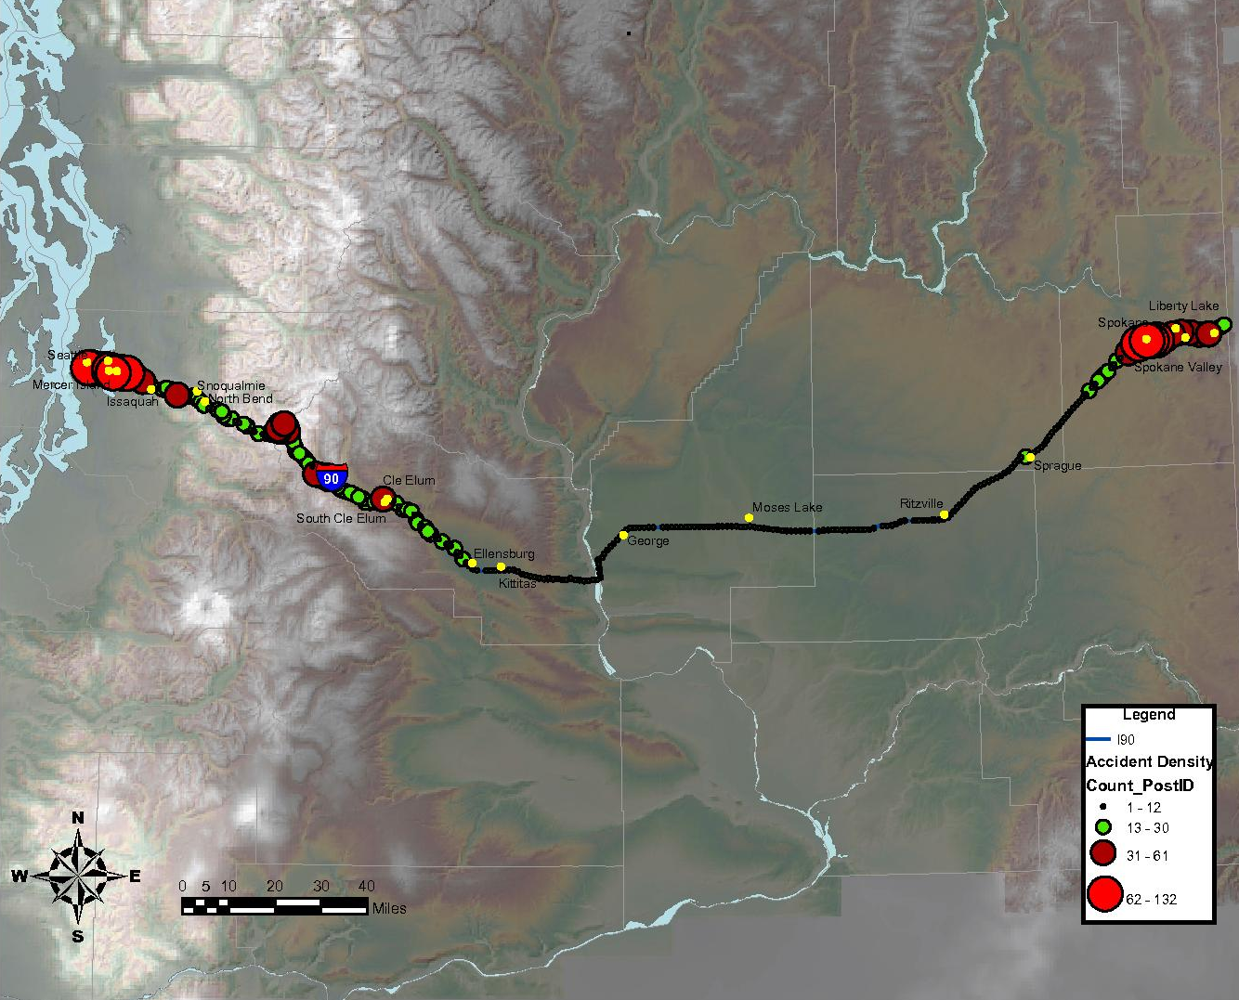
Accident Density by Milepost Map

Slide 7
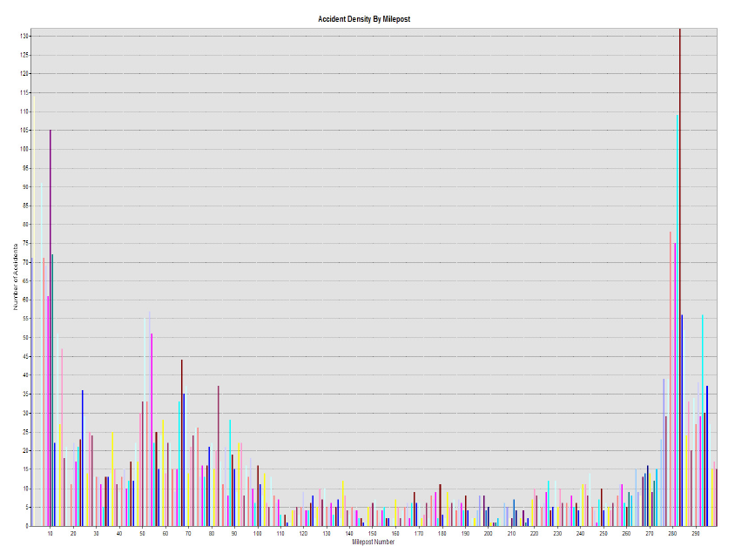
Accident Data by Milepost

Slide 8
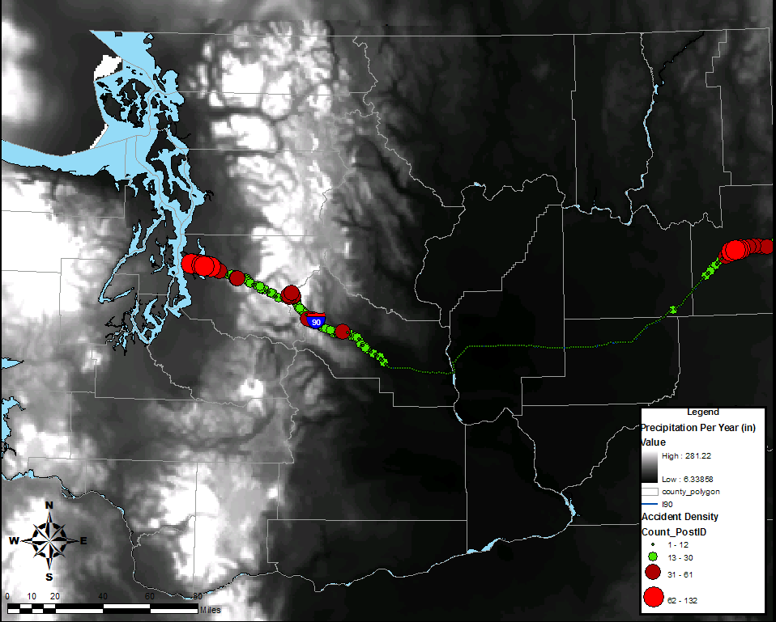
Accident Density & Precipitation

Slide 9
Landslide Hazard Areas
Recommendations
Hazard Areas
East of Issaquah
Isolated stretches through Snoqualmie Pass
Recommendations
- Proper construction such as retaining walls should be constructed along these stretches of I-90 to secure landslide hazard areas

Slide 10
Analysis Tools Used In GIS
Buffer
  200 ft around both past landslide areas and I-90
Intersect
  Determined where both buffers intersected
  Results determined Landslide hazard areas on I-90

Slide 11
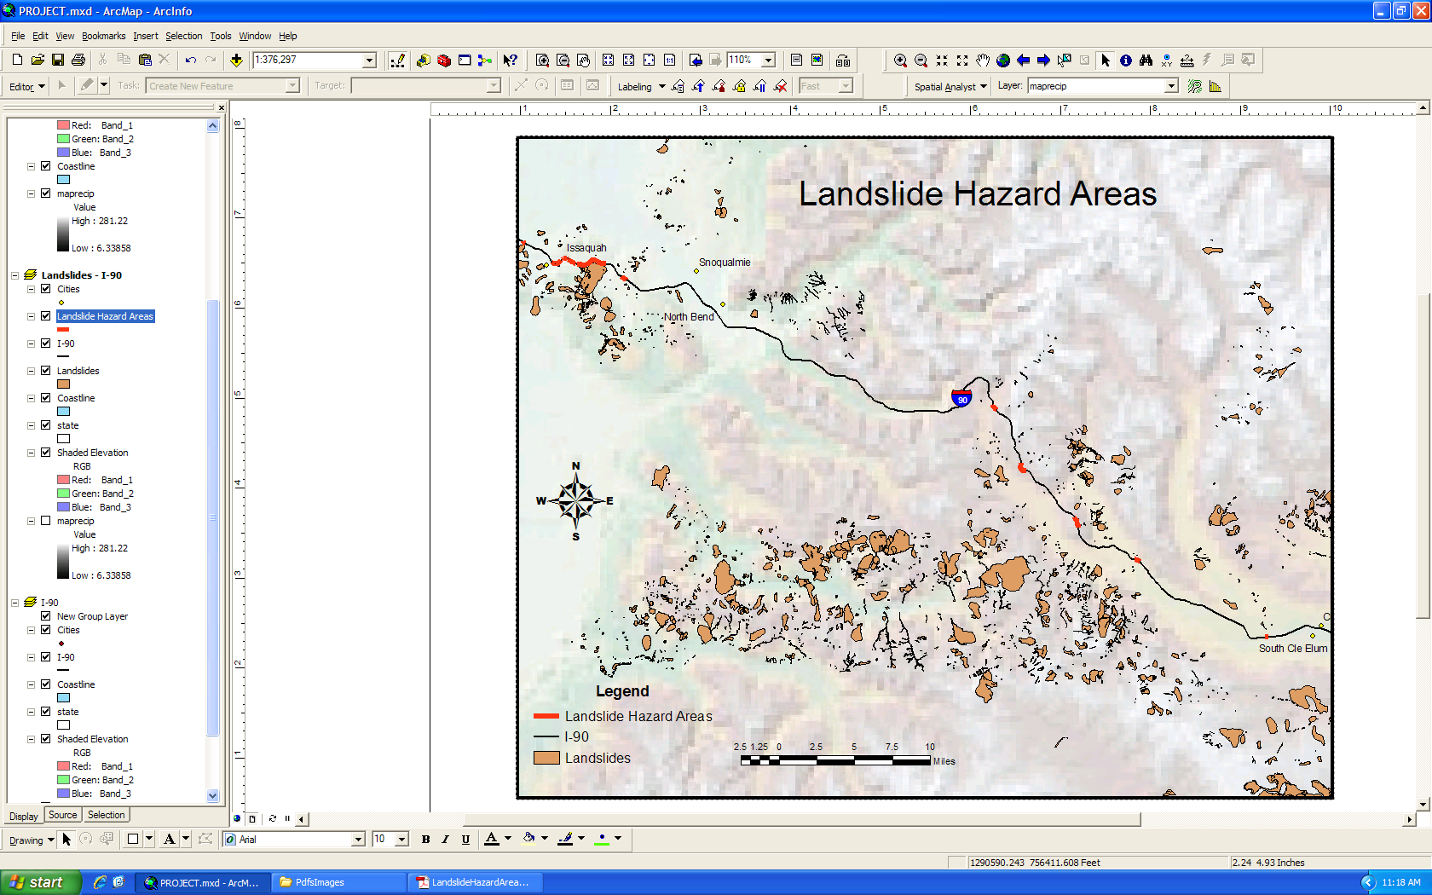
Landslide Buffers on Interstate 90

Slide 12
Thanks for listening. Any questions?

