Slide 1

Steep Slope Avoidance for Seattle Bicyclists in Wintry Weather
GIS Cyclists United
Presented By: Tori Hesedahl & Geoffrey Morgan

Slide 2
Objectives
Discern which bike paths in the Seattle area are hazardous to bikers during periods of severe weather such as snow and ice
By identifying areas of high slope and making maps available, bikers will be able to avoid hazardous areas and stay on safer routes

Slide 3
Data Sources
King County GIS
  Bike Lane Data
  Road Data
Puget Sound Lidar Consortium
  6ft Elevation LIDAR Data

Slide 4
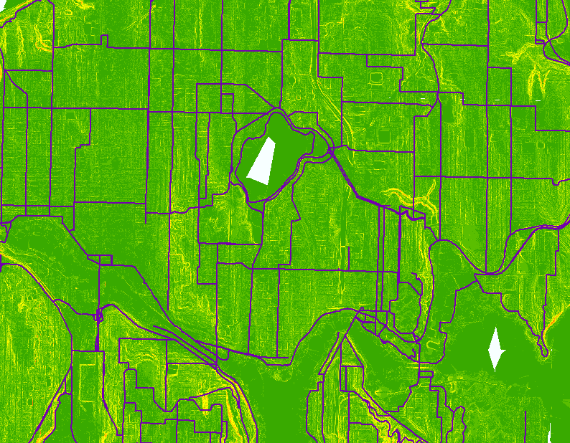
Analysis
Created a mosaic of the LIDAR data and then converted it to a slope raster using the spatial analyst function.
Used the raster calculator to create new raster files of slope of various percentages
Converted each newly classified raster into a polygon
Each polygon was then intersected with the bike path
Each intersection was then given a color to rate the slope severity

Slide 5
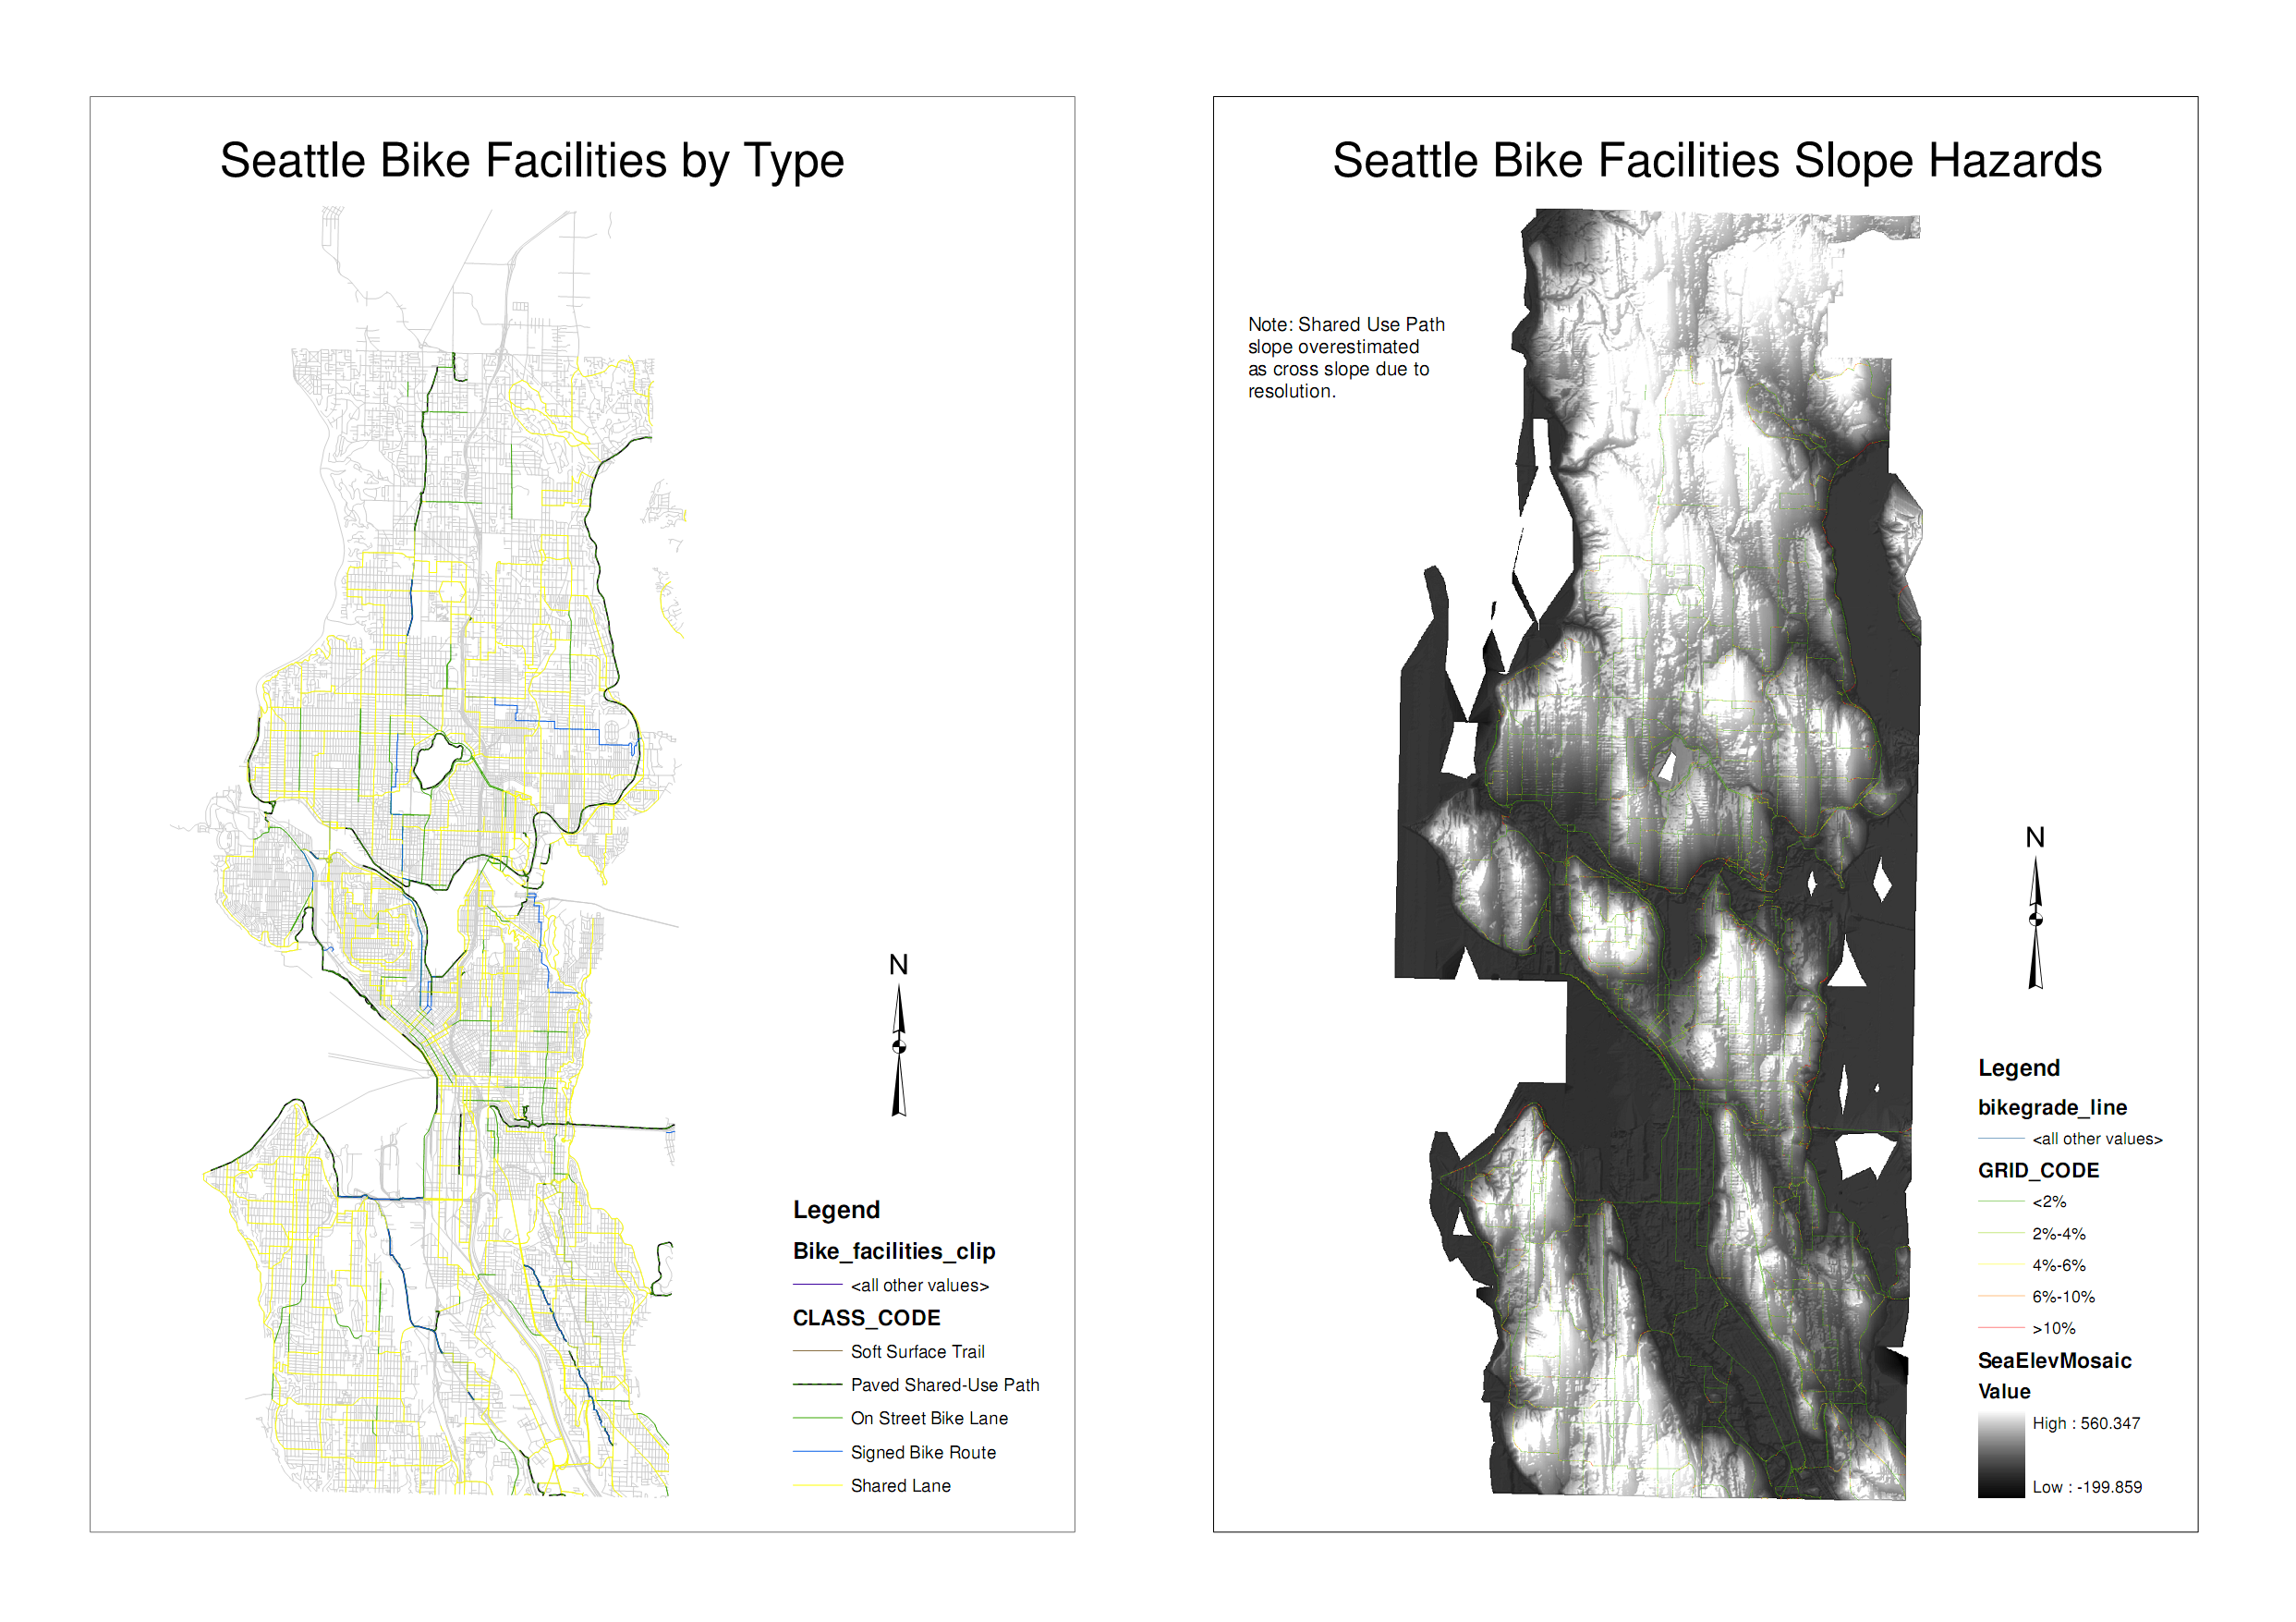
Finished Product

Slide 6
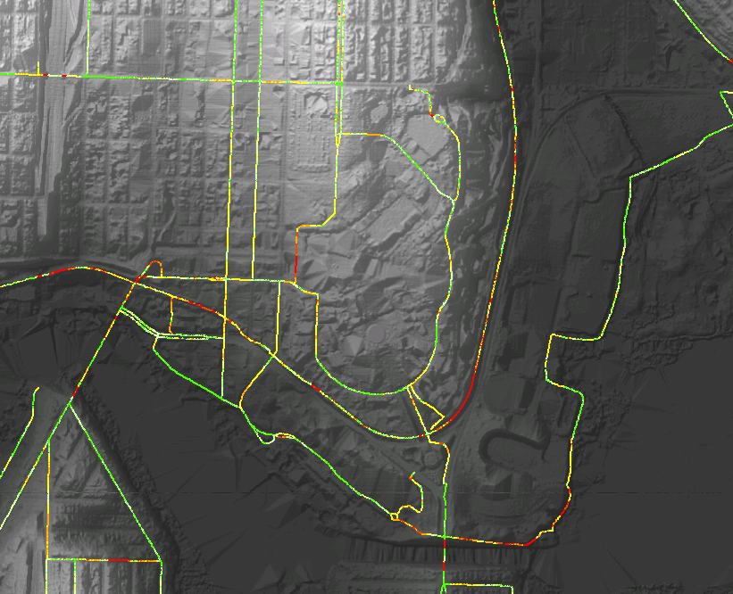
Discussion
After completion a few inaccuracies were observed in known bike slopes (the Burke)
This was due to cross-slope data interfering with the slope of the trail and inaccuracies in trail data placing it on the hill not on the trail
Since roads are wider this error was not perceived on shared lane paths

Slide 7
Sources
http://pugetsoundlidar.ess.washington.edu/lidardata/
https://wagda.lib.washington.edu/data/geography/wa_counties/king/index.html#topographic
photo courtesy of: http://www.dutchbikechicago.com/_blog/Dutch_Bike_Co_Weblog/tag/bicycles

