Slide 1
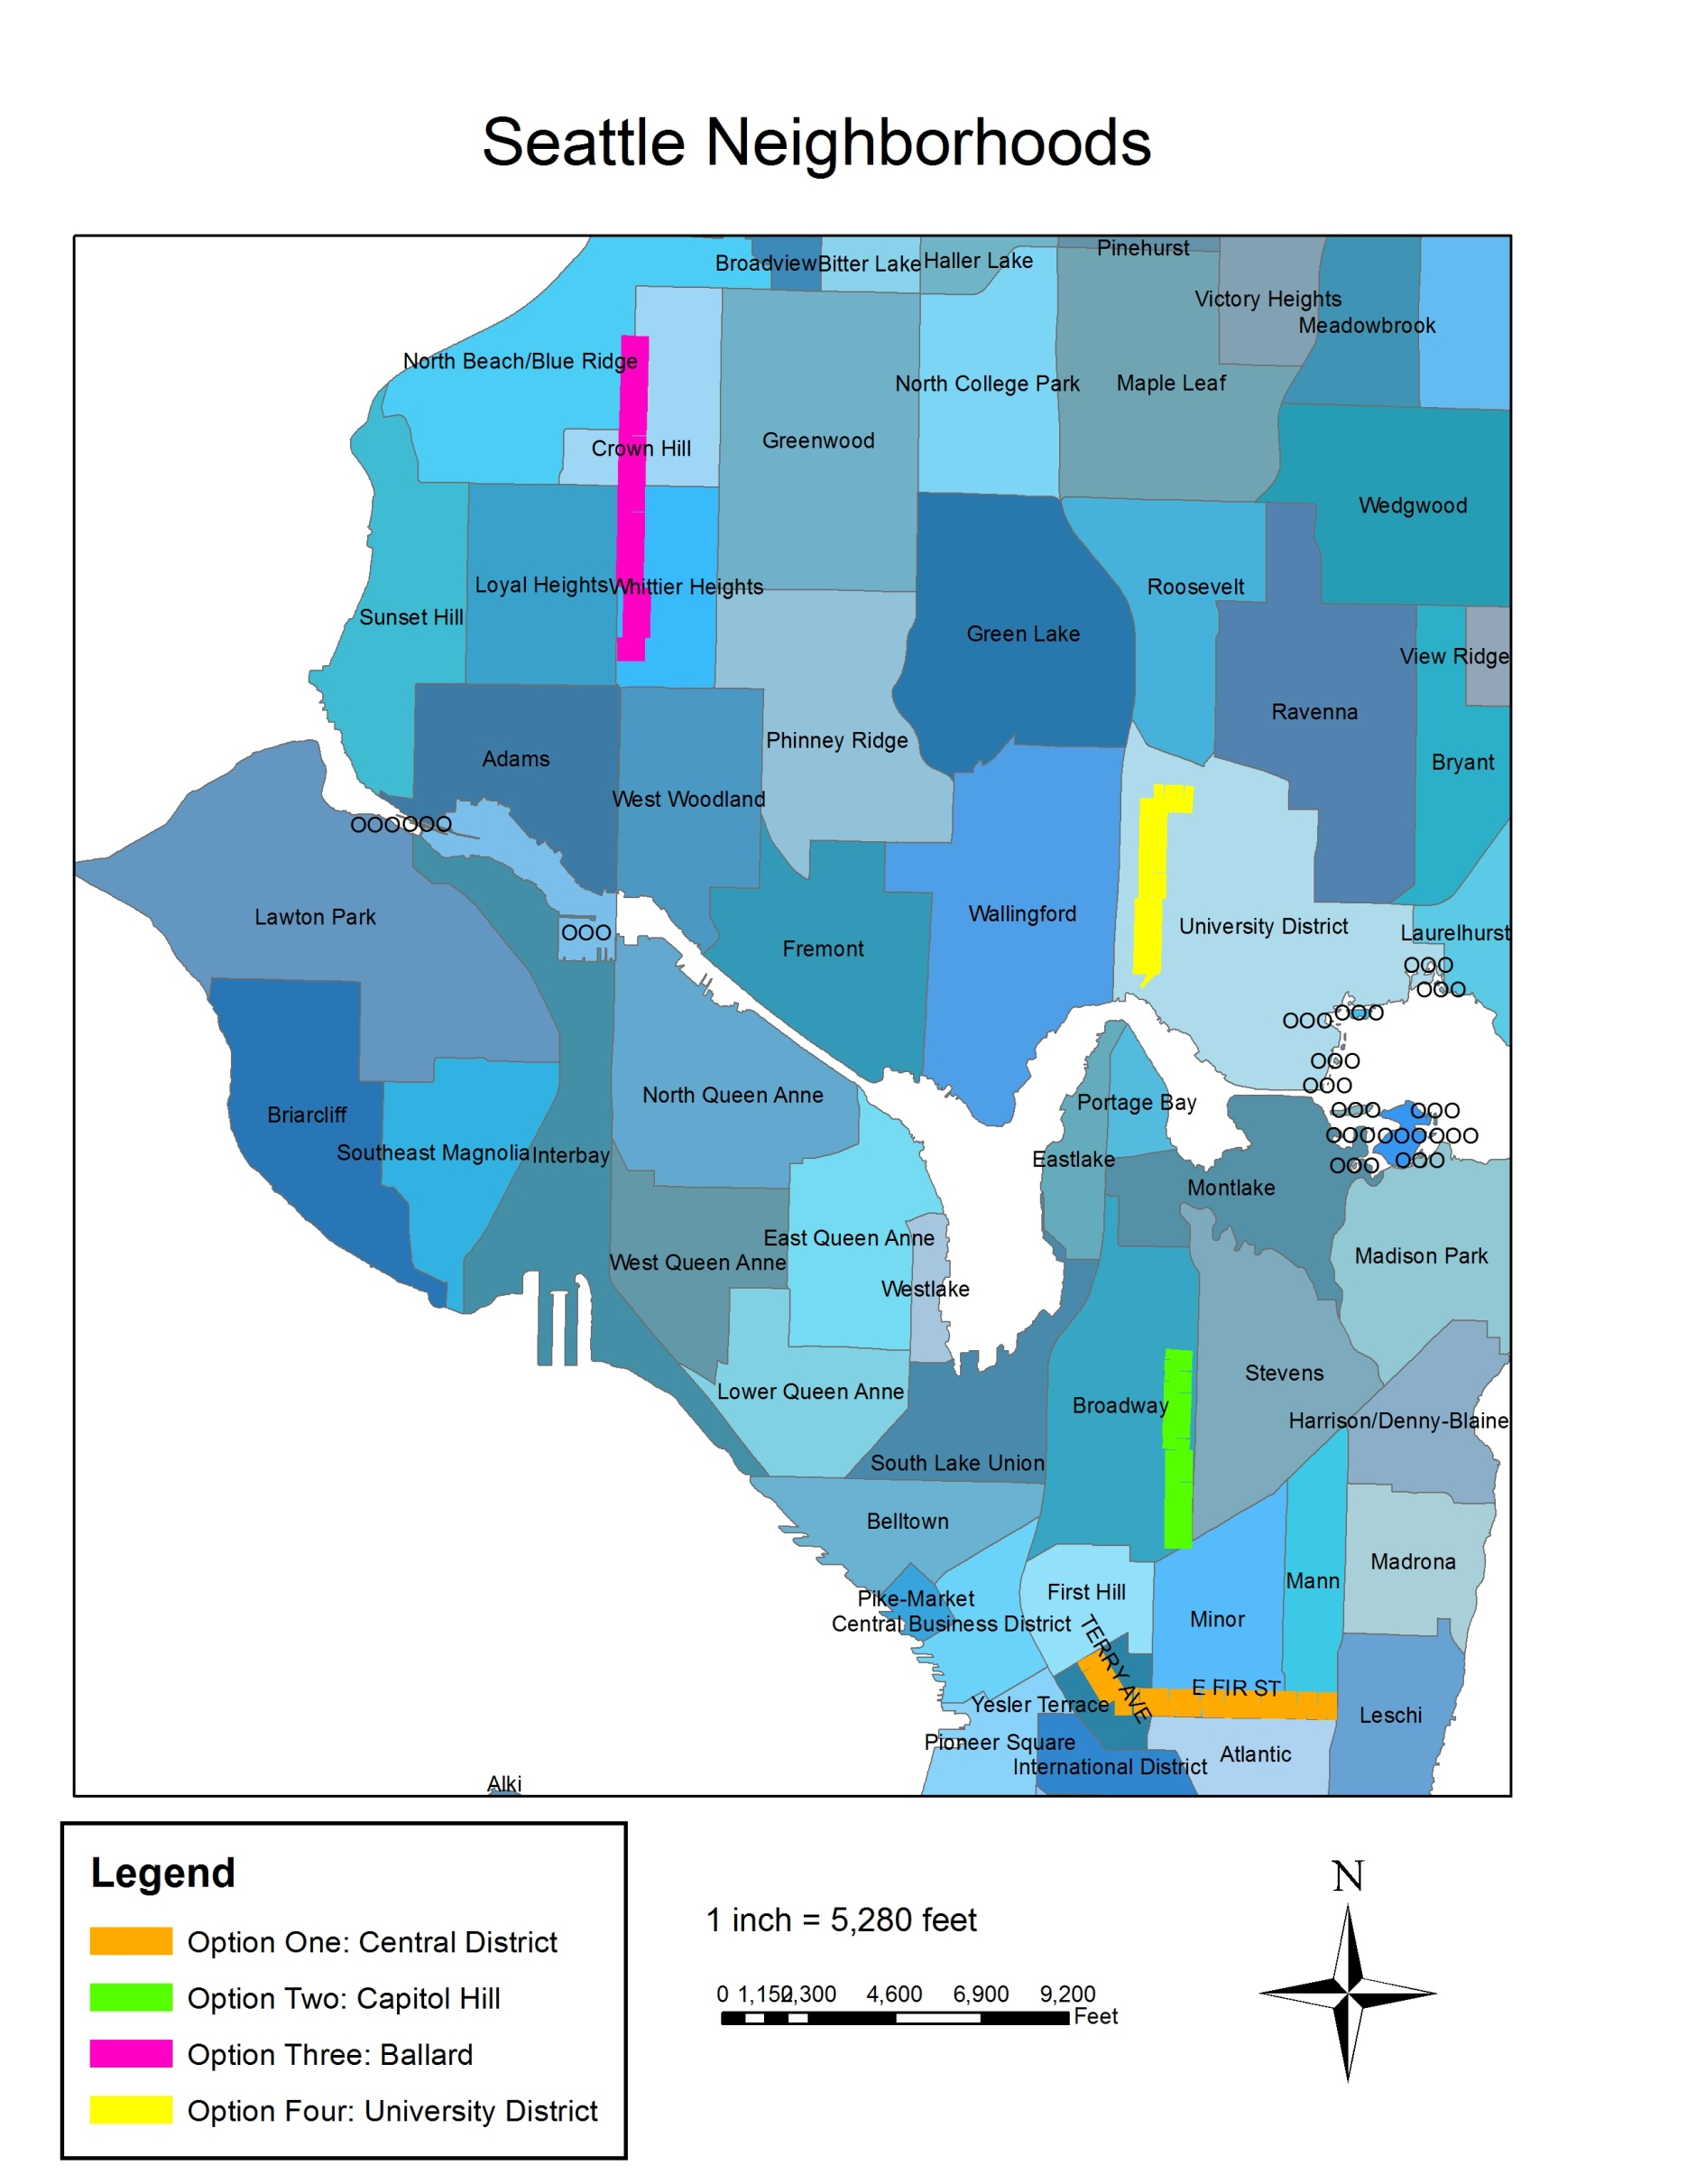
New Bicycle Boulevards in Seattle
Jebessa Dara
Josh Finley
Jon Gibson
Rodney Pfiefle

Slide 2
What is A Bicycle Boulevard?
Definition from North Carolina Highway Safety Research Center:
“A low volume street that has been optimized for bicycle travel through traffic calming and diversion, signage and pavement markings, and intersection crossing treatments.”
Also called neighborhood greenways and walk/bike streets.

Slide 3
Why Make a Bicycle Boulevard?
To get people out of their cars!
  Public health
  Environmental benefits
Provide safe, comfortable routes for riders of all abilities to common destinations
Low volume (<1000 cars/day) and low speed (<25 mph) streets
Minimize bicycle delay
Note: doesn’t prevent residents from accessing their homes with their cars

Slide 4
Typical Street Modifications:
  Traffic calming such as speed bumps and traffic circles
  Traffic barriers to reduce vehicular through traffic
Turn stop signs to favor bicycle boulevard
Provide signalized intersections and median islands at major crossings
Pavement markings show bicycles have right-of-way
Wayfinding signage to popular destinations

Slide 5
Project Objective
Identify best routes in Seattle for establishing new bicycle boulevards

Slide 6
Route Selection Criteria
Low volume, low-speed neighborhood streets
Proximity to schools, parks, libraries, post offices, shopping districts, and other common destinations
Close to arterials and transit routes
Connect with existing bicycle routes
Avoid steep grades when possible

Slide 7
Data Sources
City of Seattle
King County

Slide 8
Basic Procedure for Analysis
Obtain relevant data sets
Select suitable segments in street network based on various spatial analysis operations
  Mostly standard (buffer, intersect)
  A few less-used operations such as proximity
  One operation (turning contours into raster data to get grades) took 25 minutes!
Select and connect suitable segments based on visual inspection and additional research (data verification, street view inspection, etc.)

Slide 9

Results
4 Routes Identified
  Central District
  Capitol Hill
  Ballard
  University District
Connect community facilities such as parks and schools using neighborhood streets
Parallel major business districts

Slide 10
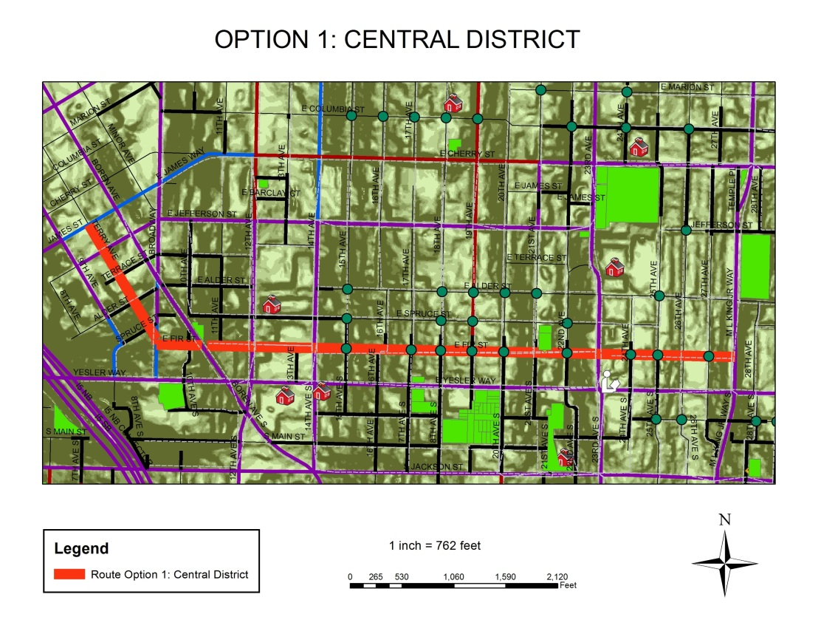
Option 1: Central District
Terry Ave and E Fir St between E James Way and MLK Way
Parallels Yesler (major business district)
Length: 1.4 mi

Slide 11
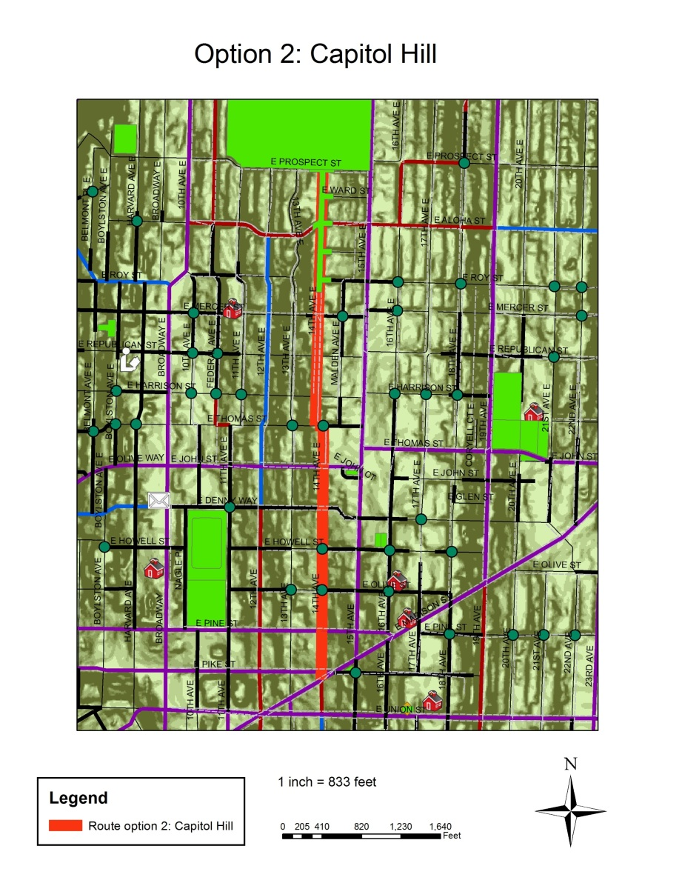
Option 2: Capitol Hill
14th Ave E between E Madison St and Volunteer Park
Parallels 15th Ave E (major business district)
Length: 1.1 mi

Slide 12
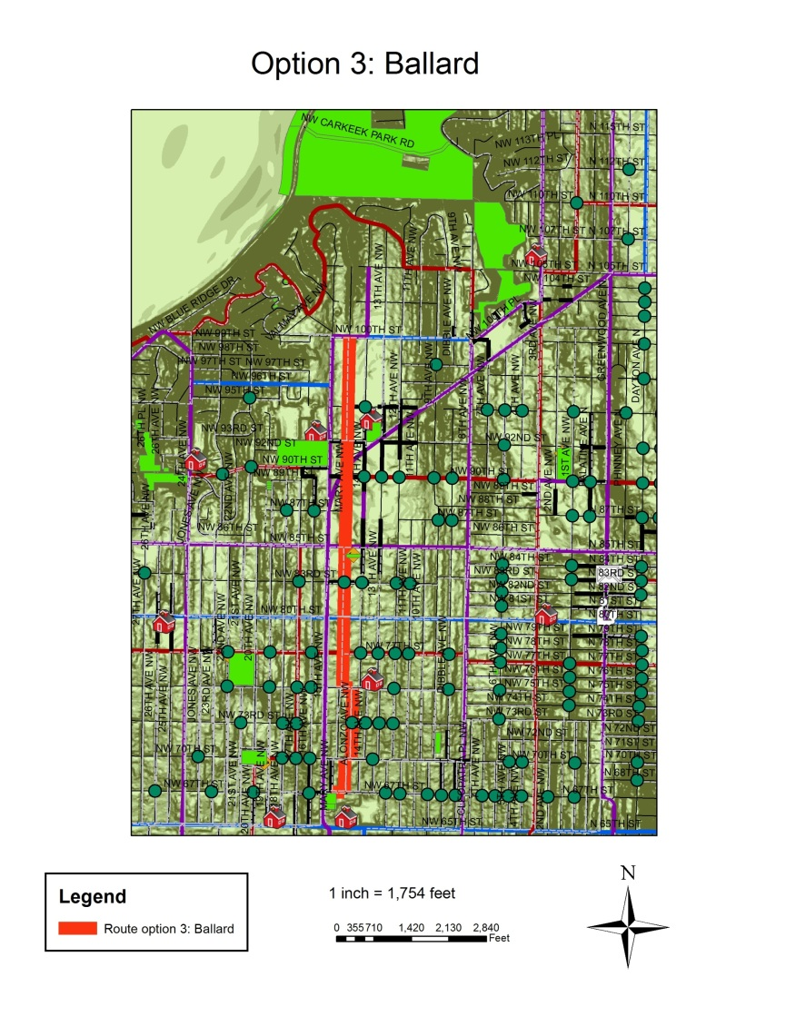
Option 3: Ballard
Mary Ave NW and Alonzo Ave NW between NW 100th St and NW 67th St
Parallels 15th Ave NW (major business district)
Length: 1.7 mi

Slide 13
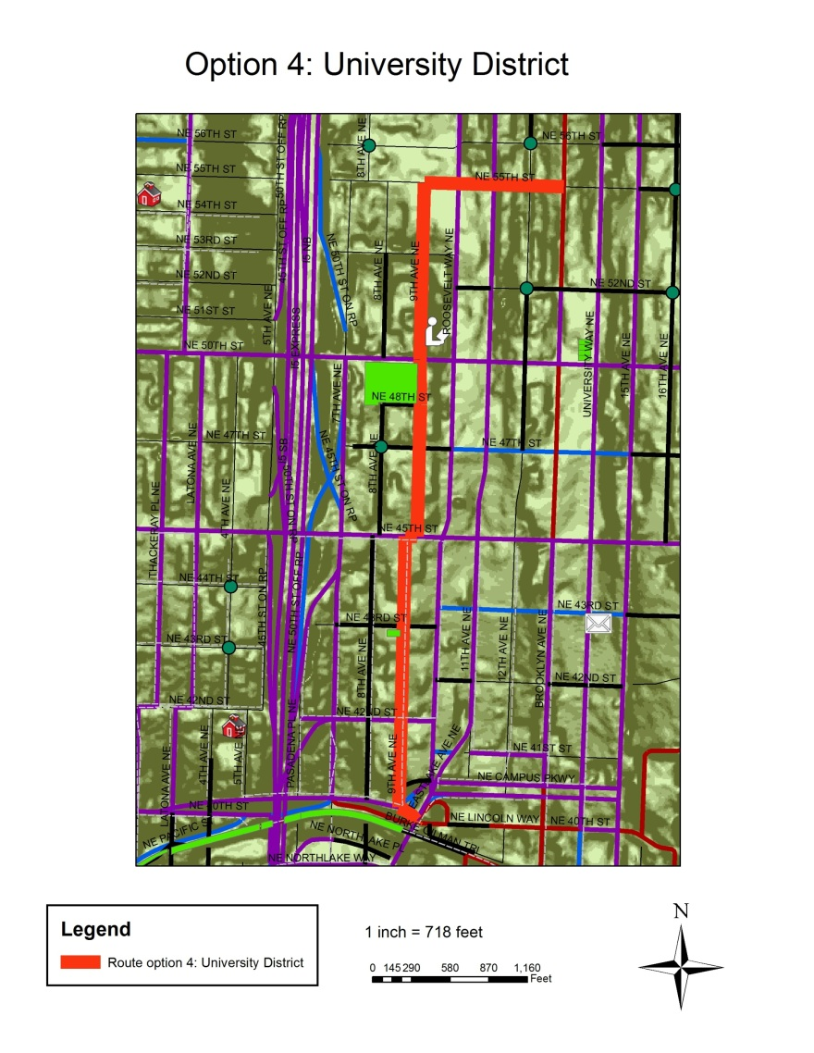
Option 4: University District
9th Ave NE between the Burke-Gilman Trail and NE 55th St (includes part of NE 55th)
Parallels Roosevelt Way NE (major business district)
Length: 1.1 mi

Slide 14
Summary
People love bike boulevards in other places where they’ve been put in
They reduce vehicular trips and make biking safe and fun.
Seattle has a lot of great locations for bike boulevards

