Slide 1
Optimizing Shuttle Services Between UW and
Hutchinson
Xiaolei Ma, Sa Xiao, Yihong Wang, Quanxin Mao
Dec 5, 2011 CEE 424

Slide 2


Outline
Objectives
Data
Analysis
Results
Conclusion
Notes:
Optimizing Shuttle Services Between UW and Hutchinson

Slide 3
Objectives
Two Shuttle Service Providers:
  University of Washington Medical Center
    Two Routes:
      UWMC → SLU
      SLU → HMC
  Fred Hutchinson Cancer Research Center
    Two Routes:
      Hutchinson → UWMC
      SCCA → Seattle Children's Hospital

Slide 4
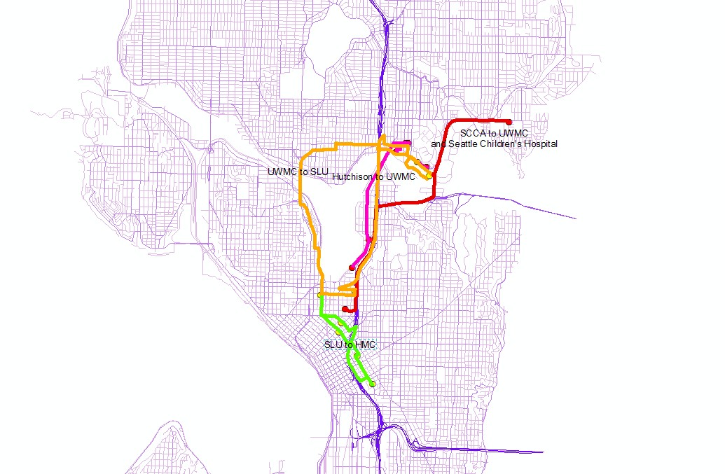
Original Shuttle Service Routes
Notes:
Harborview Medical Center (HMC)
South Lake Union (SLU)

Slide 5
Objectives
Goals:
  Reduce total travel time
  Reduce fuel cost
  Reduce emissions
Reduce total mileages

Slide 6
Data
Seattle Arterial Street Data
Shuttle Stop Data
Fuel Price Data
EPA Emission Data

Slide 7
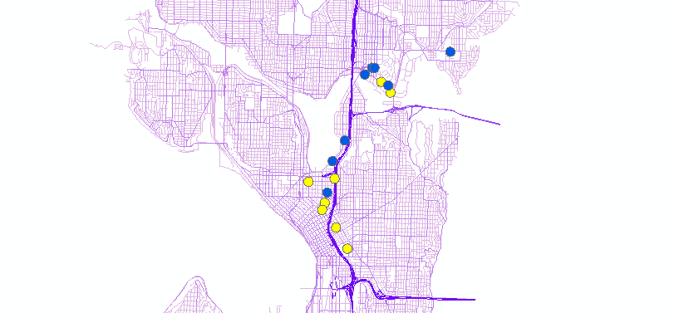
Analysis
Import stop locations data into the map
  Stops locations are collected from Google Maps
  Projection Transformation
  Geographic Coordinated → Projected Coordinated

Slide 8
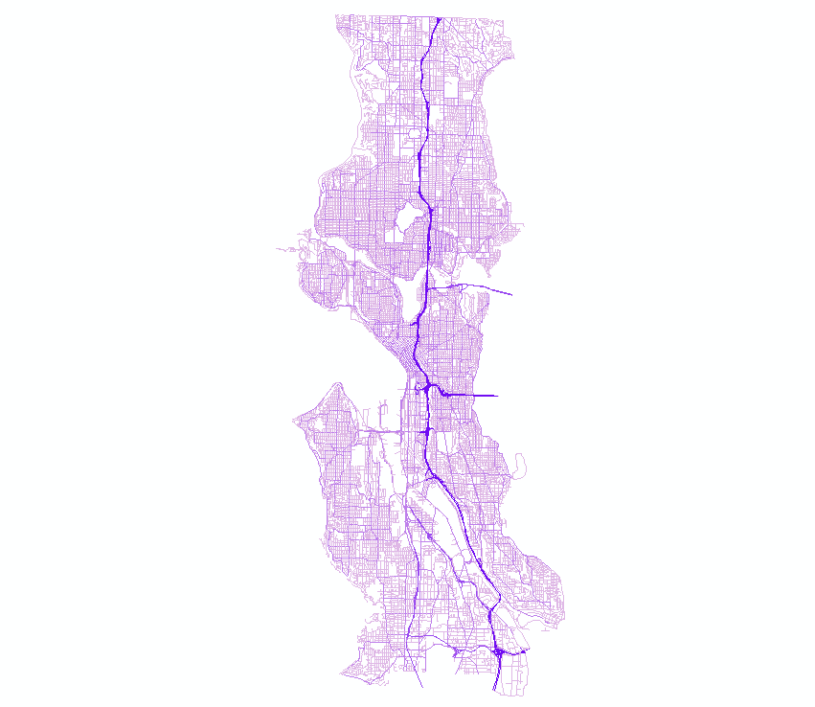
Analysis
Speed Classification

Slide 9
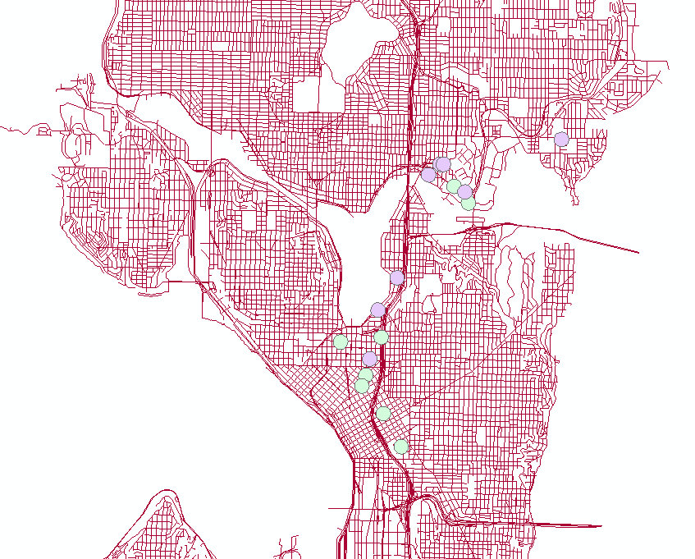
Analysis
Shuttle Stops Optimization
  Create a buffer with 150 meters around each stop
  Merge overlapped stops into one stop

Slide 10
Analysis
ArcGIS: Network Analyst Route Optimization
  Assumptions
    Optimization based on shortest travel time
    Time-of-day effect simplified
    2-minute Stop time
    Headway neglected

Slide 11
Results
Divided stops into two Service Areas
    Use SR-520 Bridge as cutoff
      UW Loop
      Downtown Loop
      Express Shuttle

Slide 12
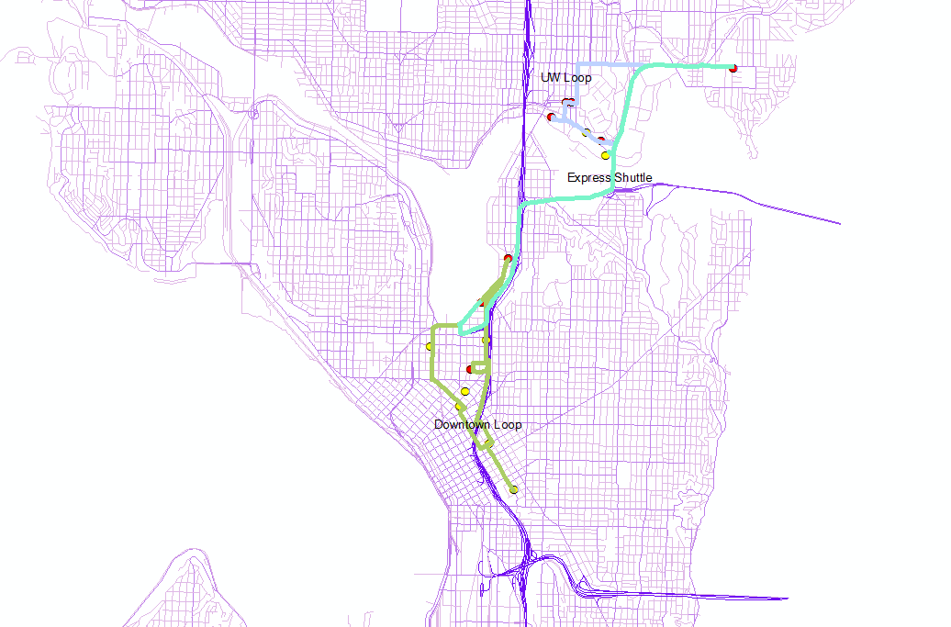
Results

Slide 13
Results
Travel Time
34.03% reduction
Fuel Consumption
44.54% reduction
Emissions
44.54% Nitrous-oxide reduction
44.54% Greenhouse gas reduction
44.54% Particulate matter reduction
Travel Mileage
44.54% reduction

Slide 14

Conclusion
Simplify the routes
Reduce costs
Reduce emissions

Slide 15
Resources
1. King County CKGIS Center. Web. 21 Nov 2011. http://www5.kingcounty.gov/gisdataportal/Default.aspx
2. “UW Shuttles: South Lake Union Shuttle.” University of Washington Facilities Services. Web. 21 Nov 2011.
http://www.washington.edu/facilities/transportation/uwshuttles/SouthLakeUnionShuttle
3. “Shuttles: FHCRC to U University of Washington Medical Center.” Fred Hutchinson Cancer Research Center. Web. 21 Nov 2011.
http://www.fhcrc.org/about/visitor/shuttles/fh-uw.html
4. “Green Vehicle Guide | US EPA." US Environmental Protection Agency. Web. 21 Nov 2011. http://www.epa.gov/greenvehicles/Index.do
5. “Current State Fuel Prices.” AAA’s Daily Fuel Gauge Report. Web. 21 Nov 2011. http://fuelgaugereport.aaa.com/?redirectto=http://fuelgaugereport.opisnet.com/index.asp
6. UW shuttle:
http://www.washington.edu/facilities/transportation/uwshuttles/SouthLakeUnionShuttle/stopLocations
Fred Hutchinson Cancer Research Center:
http://www.fhcrc.org/about/visitor/shuttles/
Seattle Arterial
https://wagda.lib.washington.edu/data/geography/wa_cities/seattle/index.html

Slide 16
Questions?
Q&A

