Slide 1
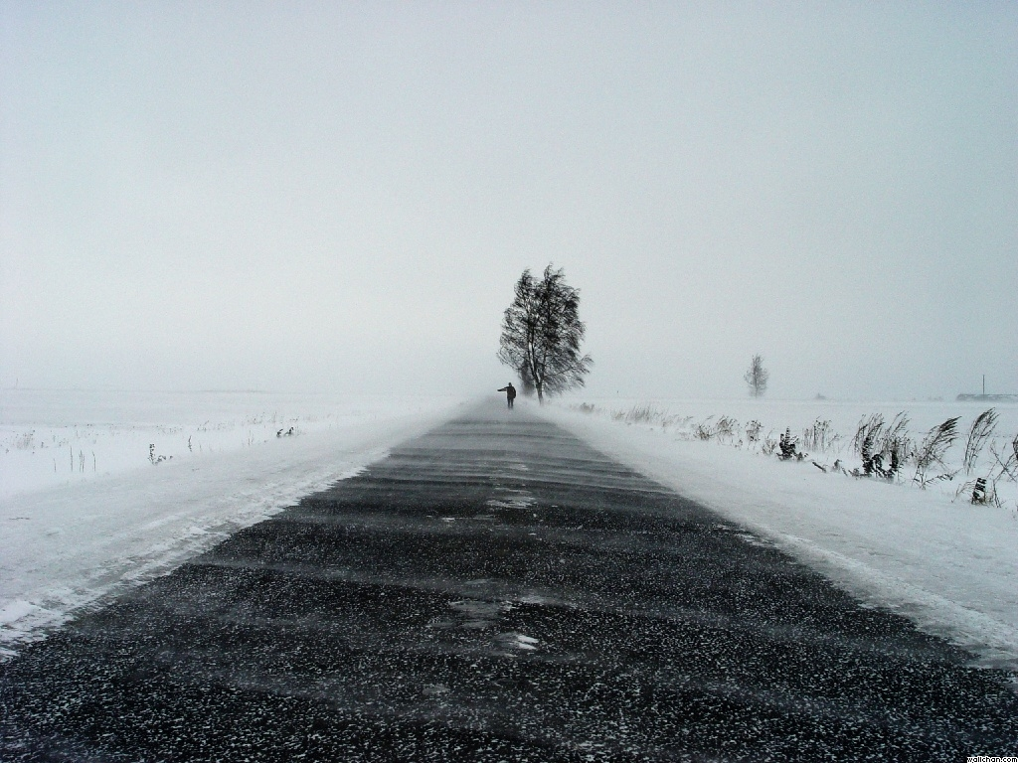

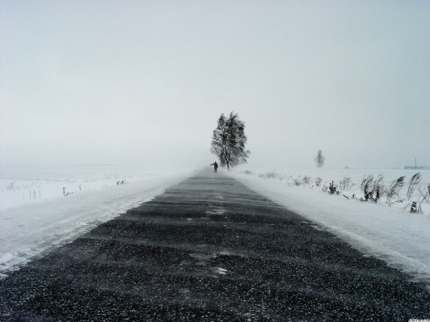
City wide collision prevention Plan (CWCPP):
Mitigating negative effects of inclement weather
Jason Teal
Nhut Nhan
Shengkun Yang
David Kagawa Casey Minnick

Slide 2
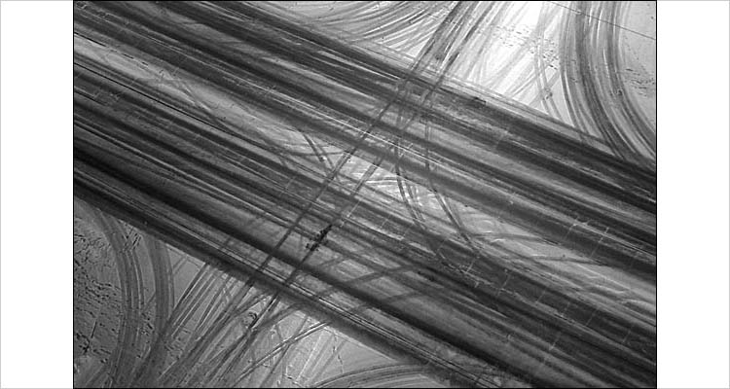
Introduction
WSDOT has contacted us to do a GIS analysis in attempt of coming up with a city wide collision preventative plan for inclement weather with minimal impacts on operation level (On a broad scale this entails mitigating collisions between any and all vehicles/pedestrians and preventing any road delays, consequently increasing safety)

Slide 4

Objectives
The slope of the route is within a 15 percent grade to ensure proper traction and driving feasibility.
The route is limited to cleared roads
The route approaches all local emergency response teams
The route coincides with high collision density trends
The route has a minimum arterial class of 5 (from 1 to 9, high arterial class meaning wider roads)

Slide 5
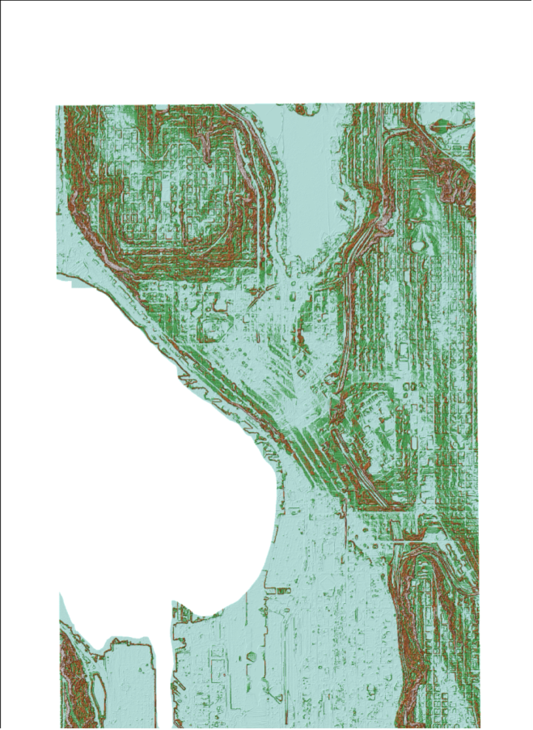
Steps
DEM /Elevation Raster
Slope Raster
Streets Layer
  Street Slopes
  Snow Routes
Collision Data
Emergency Data
  Hospital, Police Station, Fire Station

Slide 6
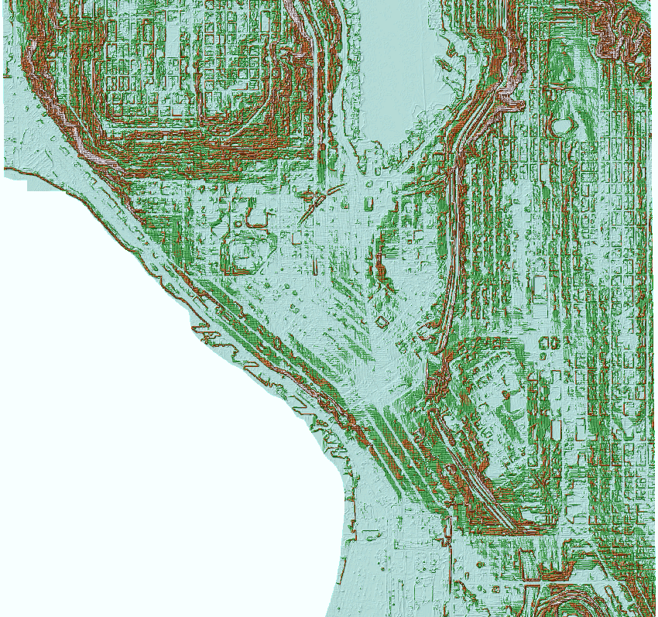
Maps-DEM

Slide 7
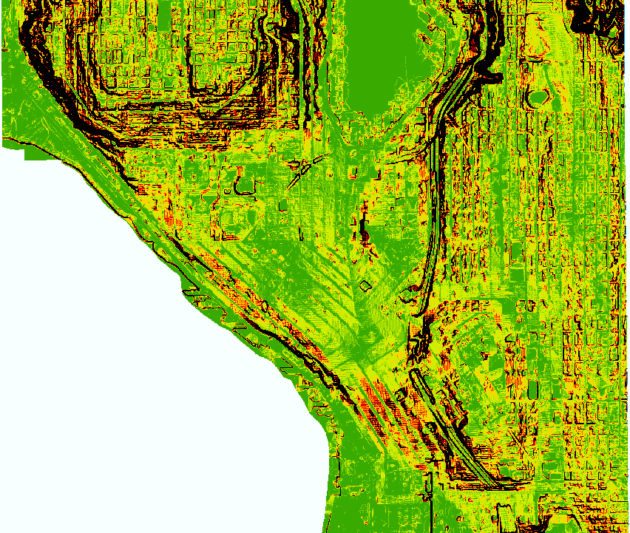
Maps-Slope Raster

Slide 8
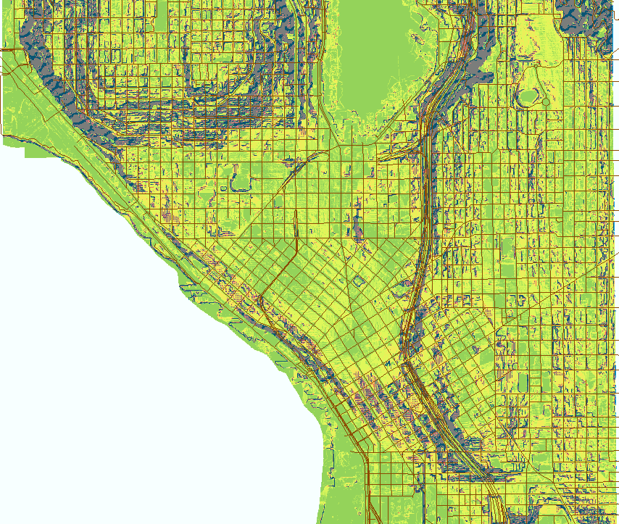
Maps-Street Shape File

Slide 9
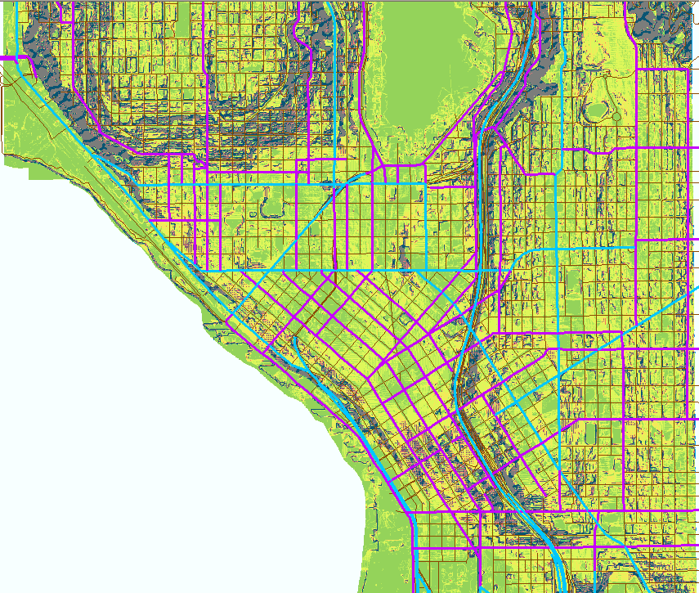

Slide 10
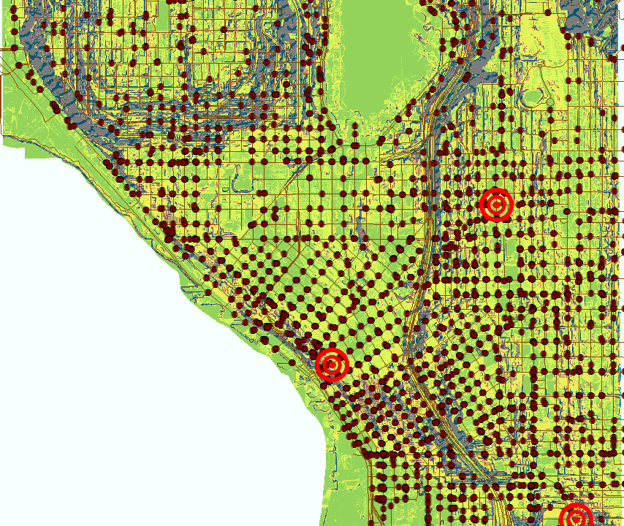
Maps-Collision Points

Slide 11



Maps-Local Emergency Data

Slide 12
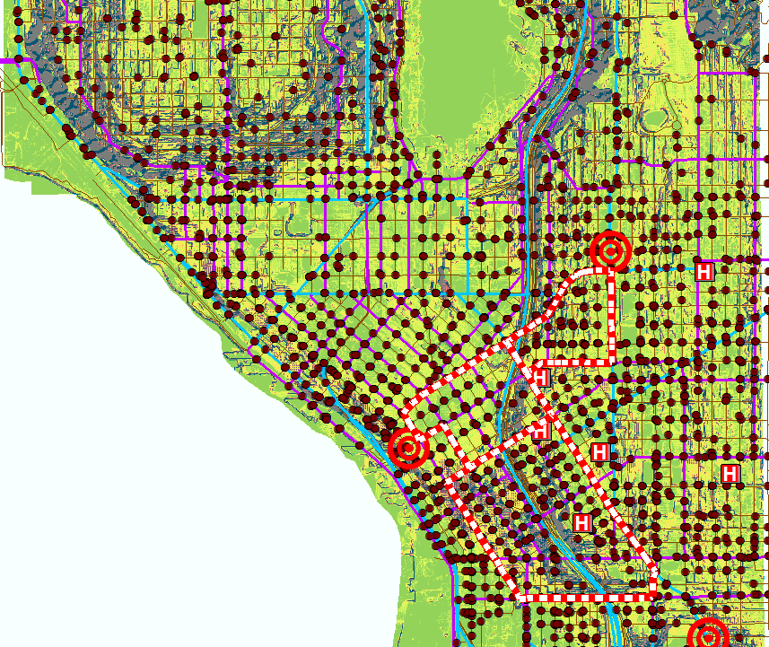
GIS Analysis-Emergency Route

Slide 13
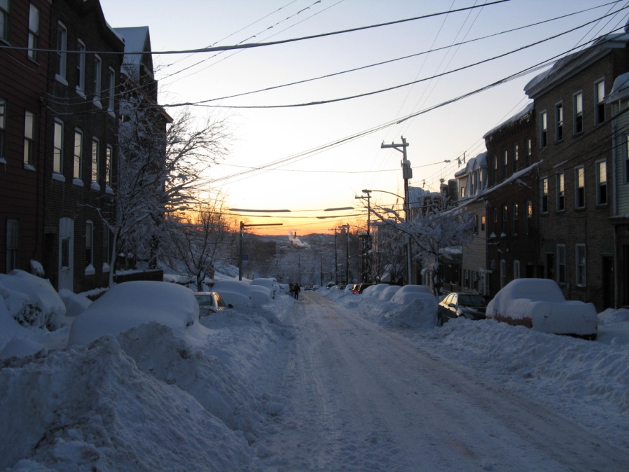
Results and Conclusion (Emergency Routes)
Three routes were selected
The routes also avoided using roads that had grades exceeding our limit
On top of this stipulation, the three loops provided access for all emergency response teams
Roads followed a trend

Slide 14
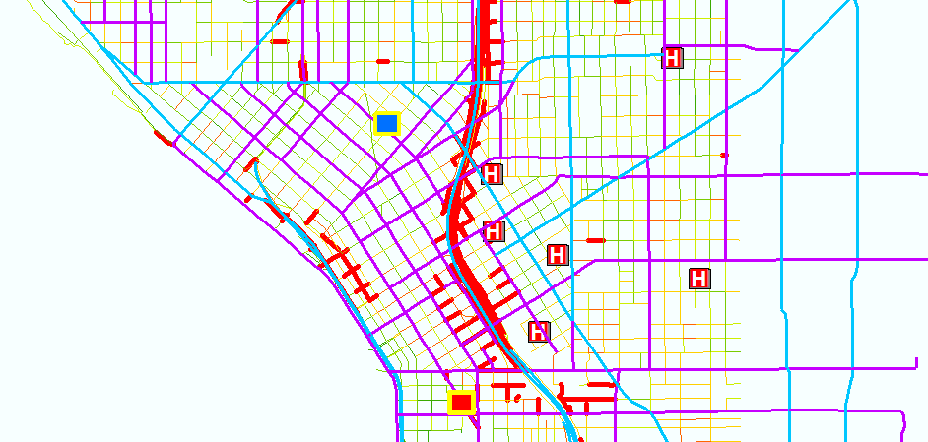
Results and Conclusion (Road Closure)
Based on road slope we determined roads unsuitable for general traffic
These roads would be closed off and alerts would be sent out

