Slide 1

Transit Center
Location Analysis
Autumn 2011
CEE 424
For University of Washington
Presented by:
Notes:
This template can be used as a starter file for presenting training materials in a group setting.
Sections
Sections can help to organize your slides or facilitate collaboration between multiple authors. On the Home tab under Slides, click Section, and then click Add Section.
Notes
Use the Notes pane for delivery notes or to provide additional details for the audience. You can see these notes in Presenter View during your presentation.
Keep in mind the font size (important for accessibility, visibility, videotaping, and online production)
Coordinated colors
Pay particular attention to the graphs, charts, and text boxes.
Consider that attendees will print in black and white or grayscale. Run a test print to make sure your colors work when printed in pure black and white and grayscale.
Graphics, tables, and graphs
Keep it simple: If possible, use consistent, non-distracting styles and colors.
Label all graphs and tables.

Slide 2
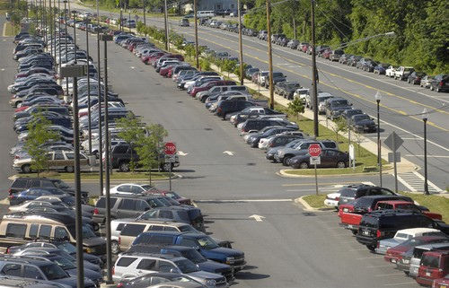
Objective
New transit facility is needed due to the current overcrowding of existing transit facilities and the rise in congestion in the southwest King County area
A way to boost property values and stimulate the local economy while solving congestion problems, promoting public transit use, and improving mobility and air quality.
Notes:
Give a brief overview of the presentation. Describe the major focus of the presentation and why it is important.
Introduce each of the major topics.
To provide a road map for the audience, you can repeat this Overview slide throughout the presentation, highlighting the particular topic you will discuss next.

Slide 3
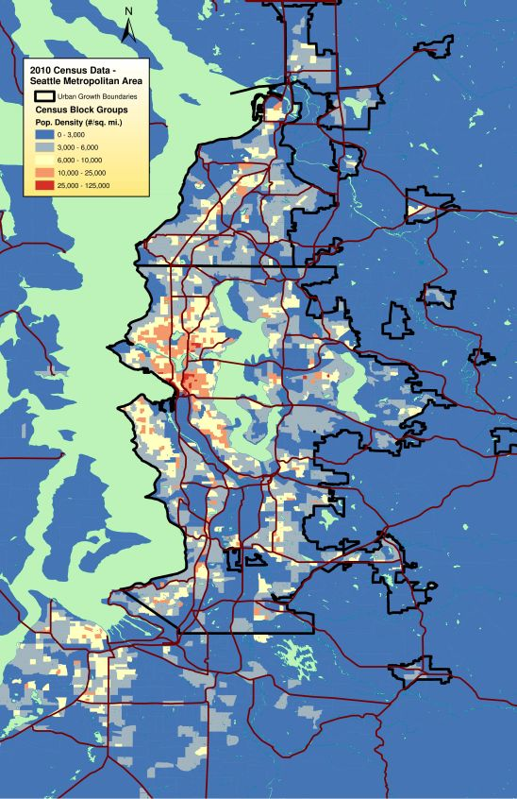
Data
Acquired data were collected from the King County GIS Center and the U.S. Census Bureau
http://www5.kingcounty.gov/gisdataportal/Default.aspx
Notes:
Give a brief overview of the presentation. Describe the major focus of the presentation and why it is important.
Introduce each of the major topics.
To provide a road map for the audience, you can repeat this Overview slide throughout the presentation, highlighting the particular topic you will discuss next.

Slide 4
Model Requirements
must be within ½ a mile of a freeway or highway.
cannot be within 3 miles of an existing transit center.
cannot be built in a known flood zone or floodway.
cannot be built on wetland.
cannot be built in a known landslide area.
cannot be built on existing park lands.
must have an adequate population base near it.
the property value of the land must not be exorbitant.
Notes:
Give a brief overview of the presentation. Describe the major focus of the presentation and why it is important.
Introduce each of the major topics.
To provide a road map for the audience, you can repeat this Overview slide throughout the presentation, highlighting the particular topic you will discuss next.

Slide 5
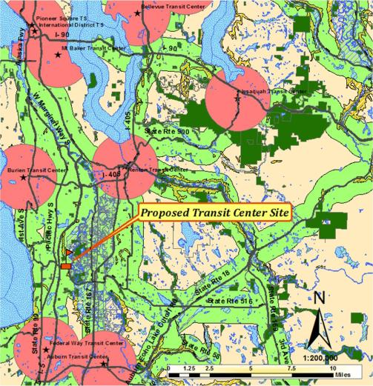
Analysis
Layers used arterials, transit centers, parks, wetlands, floodplains, floodways, and landslides
Land availability of 5-6 acres
Notes:
Give a brief overview of the presentation. Describe the major focus of the presentation and why it is important.
Introduce each of the major topics.
To provide a road map for the audience, you can repeat this Overview slide throughout the presentation, highlighting the particular topic you will discuss next.

Slide 6
Analysis
U-District was eliminated due to high property values and the inconvenience of relocating home owners
South Seattle was dismissed because it is an industrial area with a lower population density

Slide 7
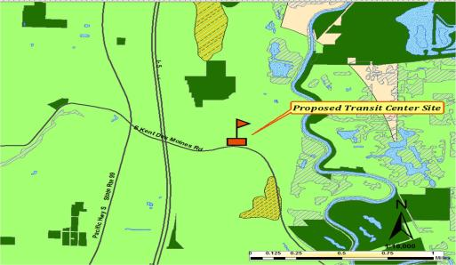
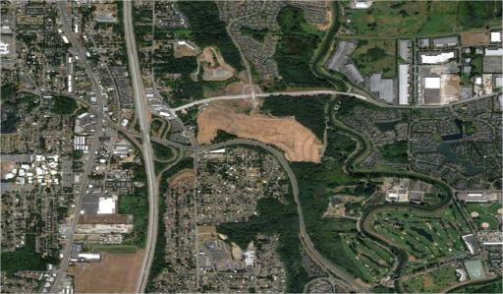
Recommendation
Proposed location is near Kent, near I-5 and highway 167
Land has been excavated as shown on the right
This location maximizes rider benefits and minimizes construction costs
Notes:
Give a brief overview of the presentation. Describe the major focus of the presentation and why it is important.
Introduce each of the major topics.
To provide a road map for the audience, you can repeat this Overview slide throughout the presentation, highlighting the particular topic you will discuss next.

Slide 8
Who’s Who
Lead | Contact information
Heva Mostafavi | hevamostfab@gmail.com
Rebecca Rumann | rruman@uw.edu
Wilkan Guatama | wilkanguatama@yahoo.com
Matt Weiss | mrmattw@uw.edu
Kyle Albert | Albertk.ak@gmail.com
Notes:
Keep it brief. Make your text as brief as possible to maintain a larger font size.

Slide 9
Questions?

