Slide 1
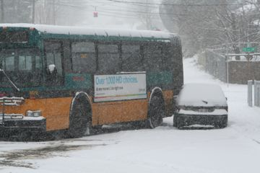
SEATTLE SNOW/ICE BUS REROUTES
Presented By : Henry Wright, Haoua Sereme, Lokman Ouijdani

Slide 2
Objectives
Design alternative safer snow/ice routes for king county metro buses

Slide 3
Scope
Daily ridership average is 375,000 people
174 out of 379 bus routes go through steep slopes
Freezing temperatures are reached 60 days per year

Slide 4
Important issues
Features to avoid:
High grade streets
Residential streets
Other considered features :
-Highly populated areas .
-Important destinations ( Employment centers, universities, etc… )

Slide 5
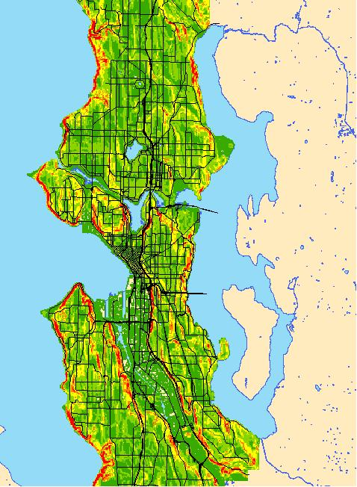
Analysis
-Determine the zones with highest slopes in the city from a topographic a map

Slide 6
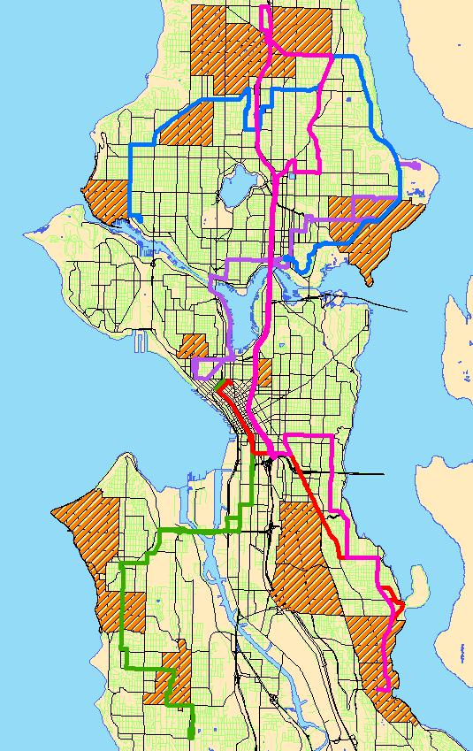
Determine the bus routes that serve highly populated areas, UW, and Downtown Seattle

Slide 7
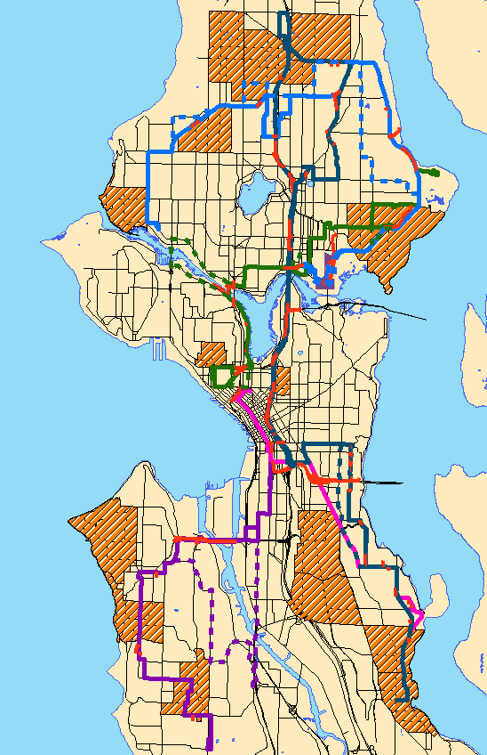
Determine which segments on the bus routes go through high grade streets, and determine alternative paths with minimum distortions

Slide 8
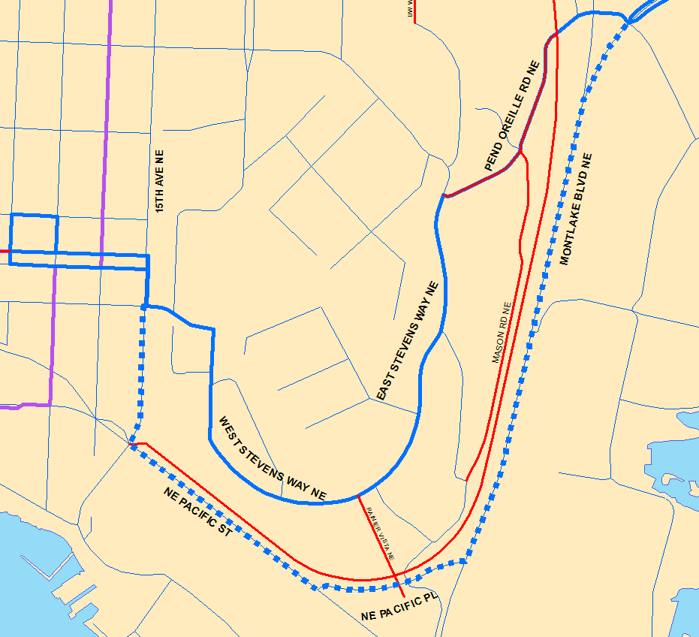
Results

Slide 9
Discussion
Flaws in our analysis :
Street Grades are different from the ground slopes used, leading to inaccurate street slopes.

Slide 10
Questions ?

