Slide 1
Using Origin-Destination Data to Determine Possible Carpools
Ariel Davis
Drew Cooper

Slide 2
Purpose
Develop mechanism to match commuters to others with similar origin and destination

Slide 3
Method
Data Collection
Data Formatting
Matching
Output

Slide 4
Data Collection
Ideally, data would be collected through an internet application.
Users would input their origin/destination
O-D data was not available, so we used a DAP File
Matched addresses from residential neighborhood (U-District) to addresses in commercial area (Downtown)

Slide 5
Data Formatting
Origins from U-District into Origin layer
Destinations from Downtown into Destination layer
Unique ID called “LINK” matches Origin to Destination
Join Origins and Destinations
Dissolve based on LINK to new O-D layer

Slide 6
Data Formatting
O-D layer – multipoint layer
Each feature contains:
  two points – Origin and Destination
  Complete address information for both

Slide 7
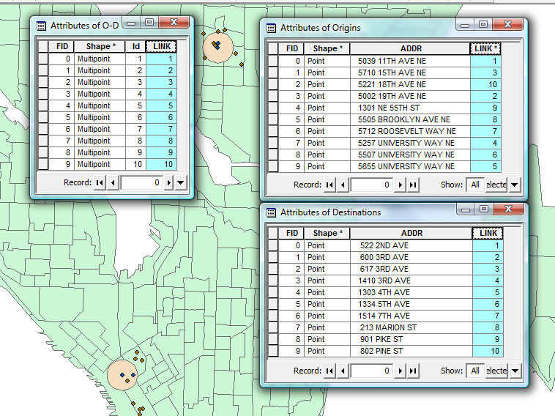

Slide 8
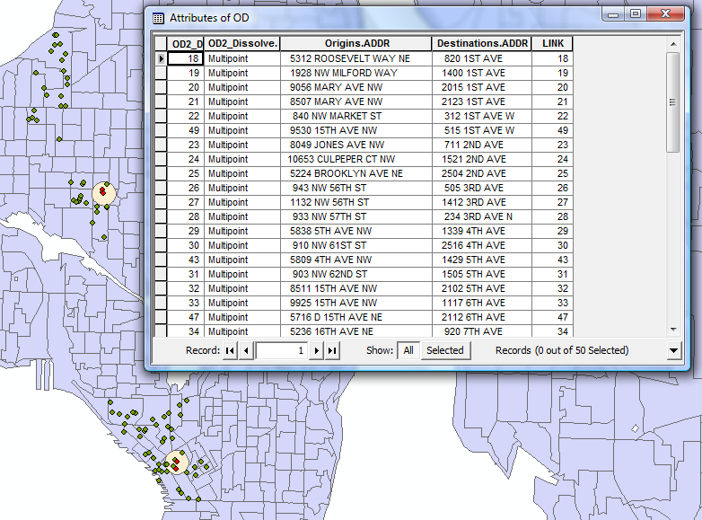

Slide 9
Matching
Method:
  Build buffer around Origin and Destination (1000 feet)
  Select from O-D layer features with Origins and Destinations within buffers
  Create layer from selected features

Slide 10
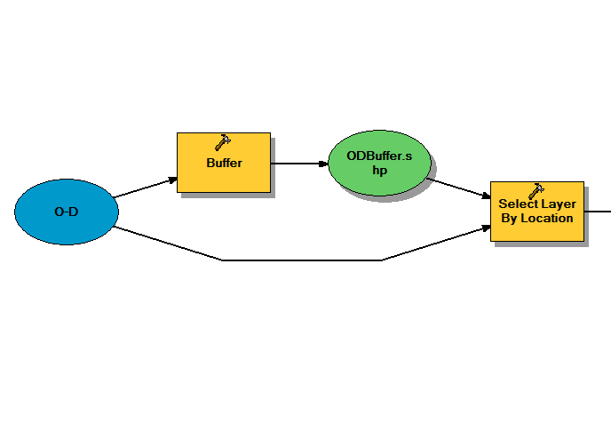

Slide 11
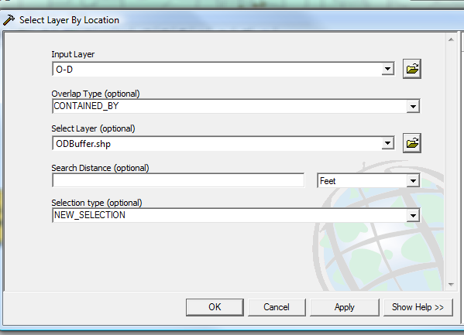

Slide 12


Slide 13
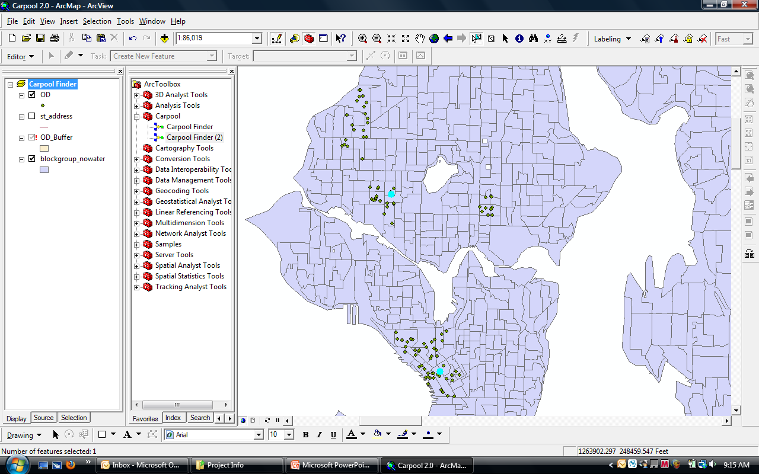
Select O-D

Slide 14
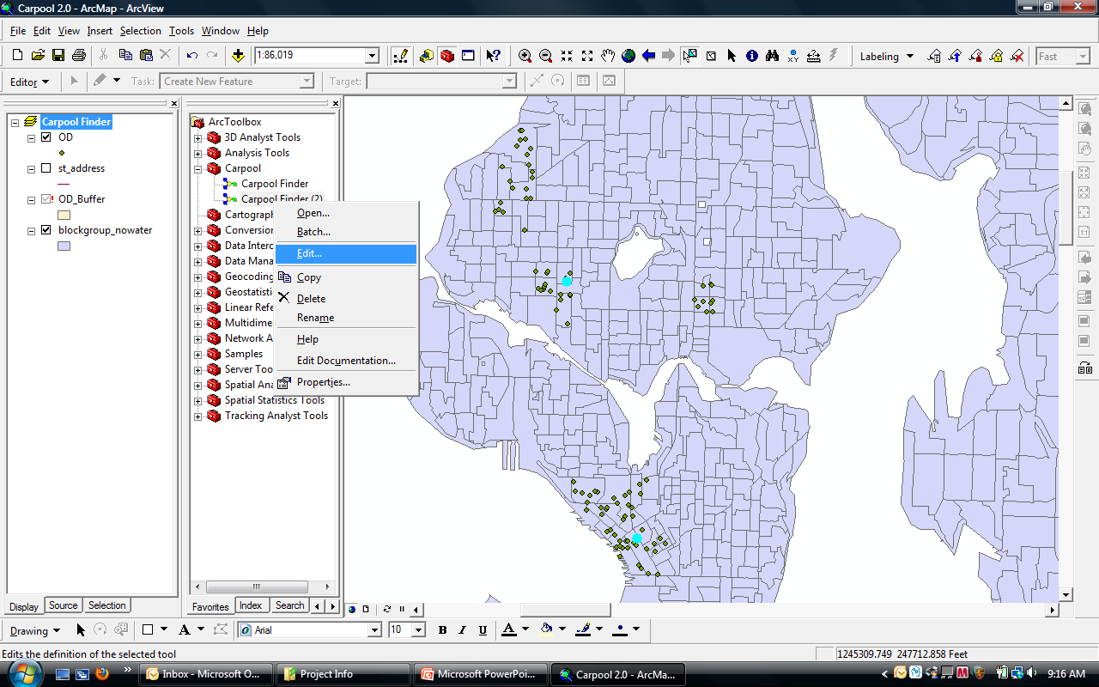
Open Carpool Finder

Slide 15
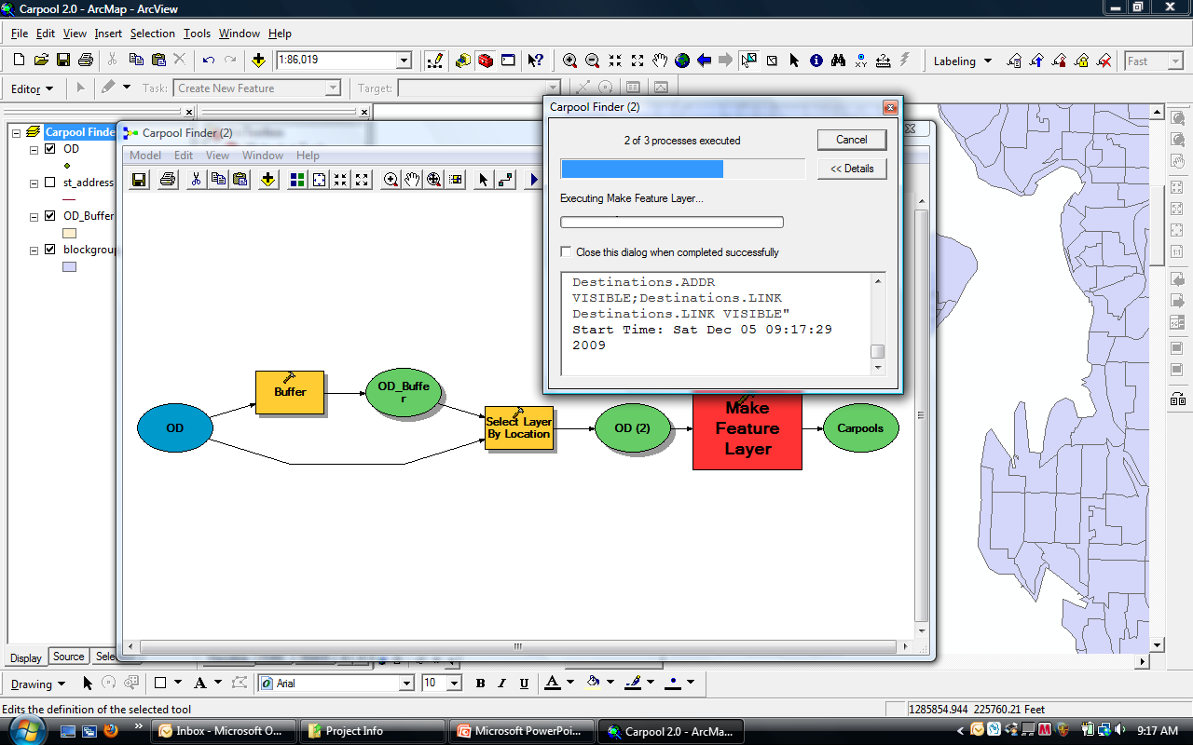
Run Carpool Finder

Slide 16
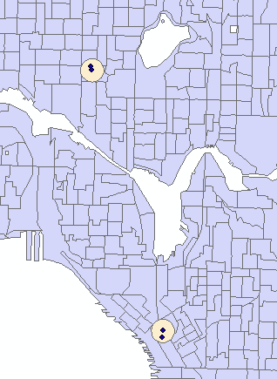
Results
Matches are output to new Carpools feature class.
This time there was one match

