Slide 1
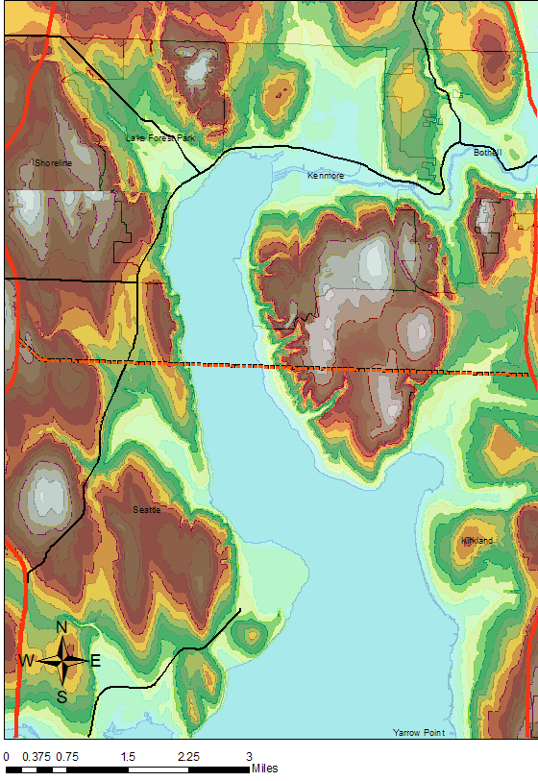
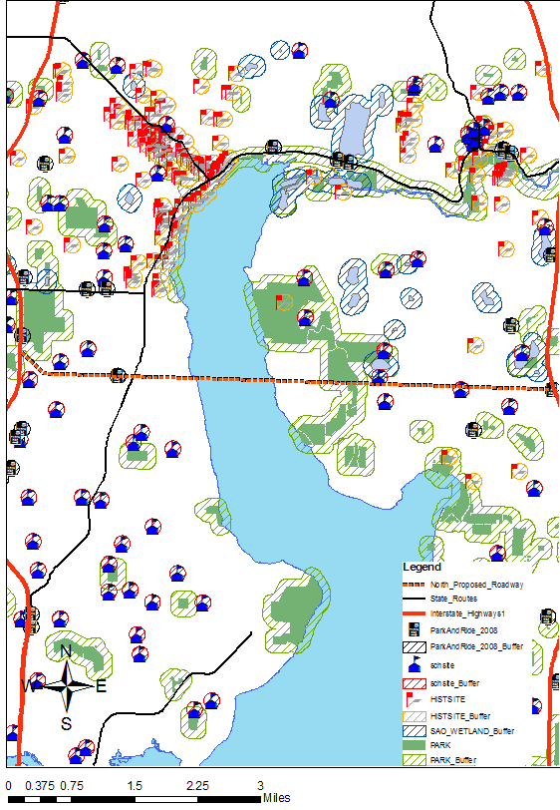
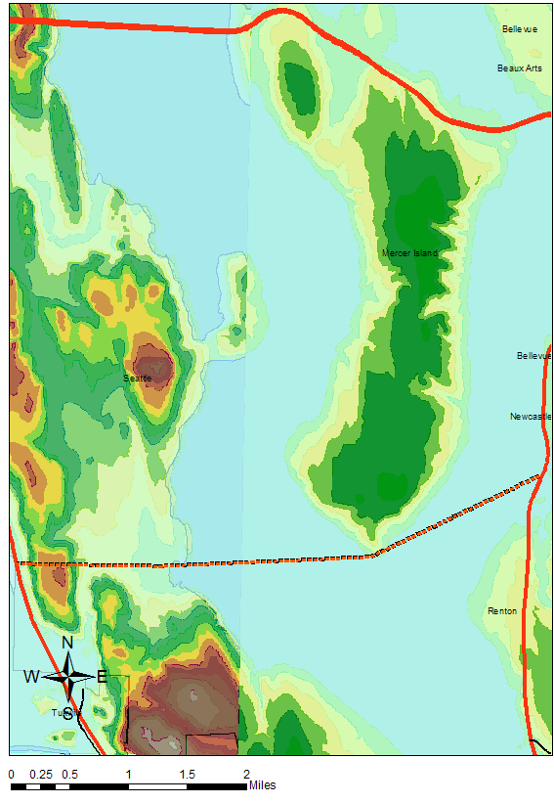
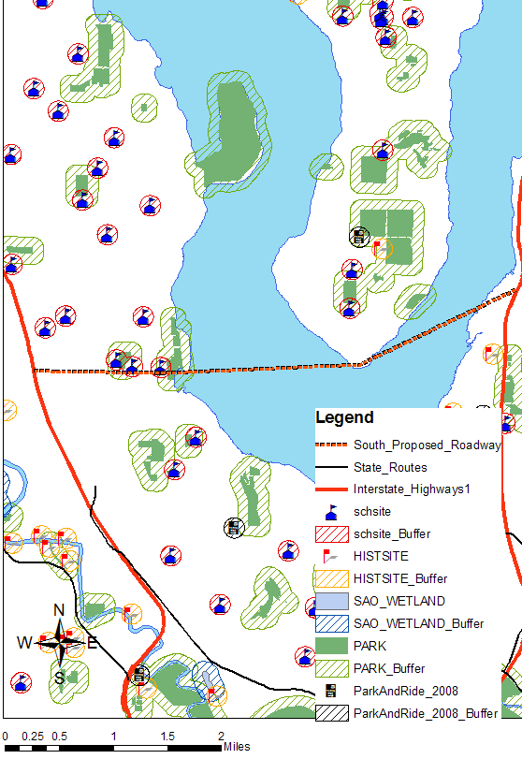
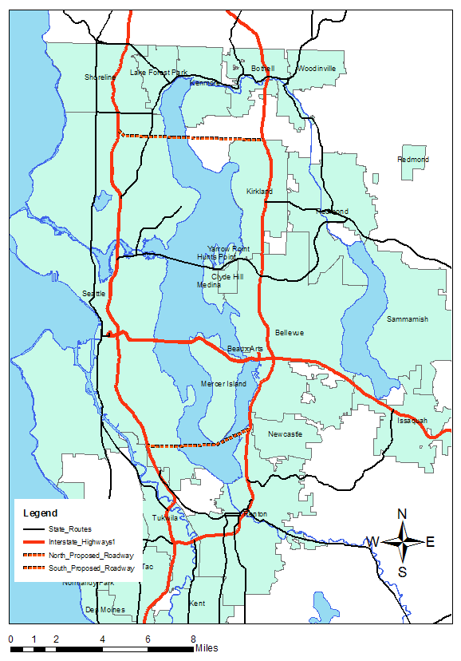
Crossing Lake Washington
Aaron Knight
Stephen Lau
Addition of a Third Bridge
North Crossing
South Crossing
Selected Crossing: South
Length of Segment: 6.42 Miles
Length of Bridge: 0.9 Miles
Parcels Within 250’: 995
Average Density within 10 miles: 7553 per/mi²
Within 500’:
  Wetlands: 0
  Parks: 1
  Schools: 3
  Historical Sites: 0
  Park & Rides: 2
Length of Segment: 4.62 Miles
Length of Bridge: 2.74 Miles
Parcels Within 250’: 287
Average Density within 10 miles: 6740 per/mi²
Within 500’:
  Wetlands: 0
  Parks: 2
  Schools: 3
  Historical Sites: 0
  Park & Rides: 2
Shorter Roadway
No tunnel required
Less parcel acquisition
Reduces congestion for
I-405 in Renton

