Slide 1
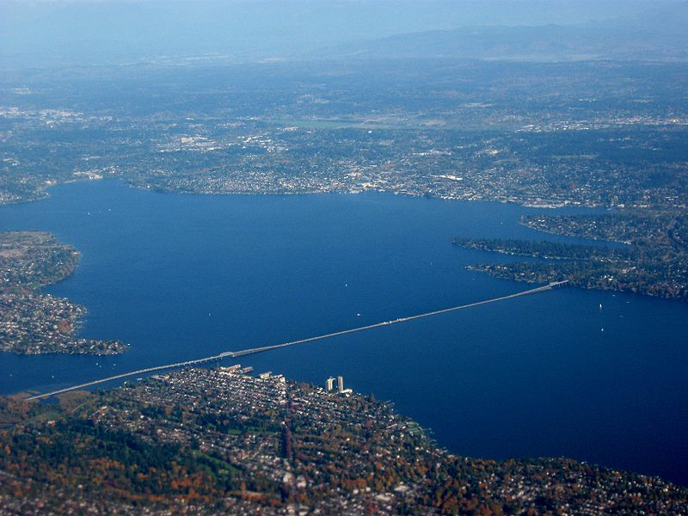
Crossing Lake Washington
Addition of a Third Bridge
Aaron Knight
Stephen Lau
Source: http://commons.wikimedia.org/wiki/File:Aerial_view_of_I-520_bridge_across_Lake_Washington_in_Seattle.jpg

Slide 2
Objectives
Connect I-5 to I-405
Minimize impact on existing housing and businesses
Connect areas of greatest density
Use the most effective bridge span length
Minimize impact on recreational areas
Minimize impact on wetland areas
Provide available Park & Ride Service
Minimize impact on school or historical sites
Suit the land topography

Slide 3
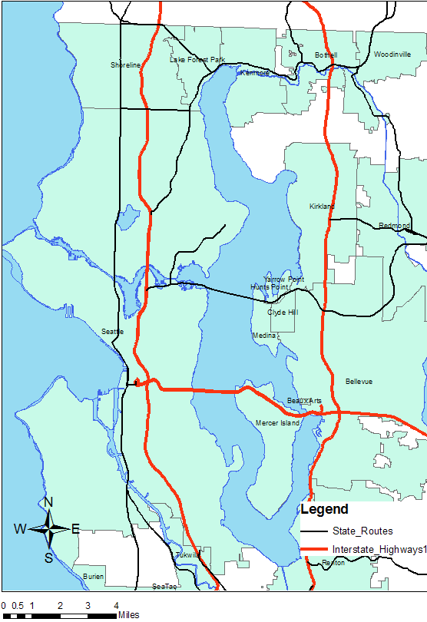
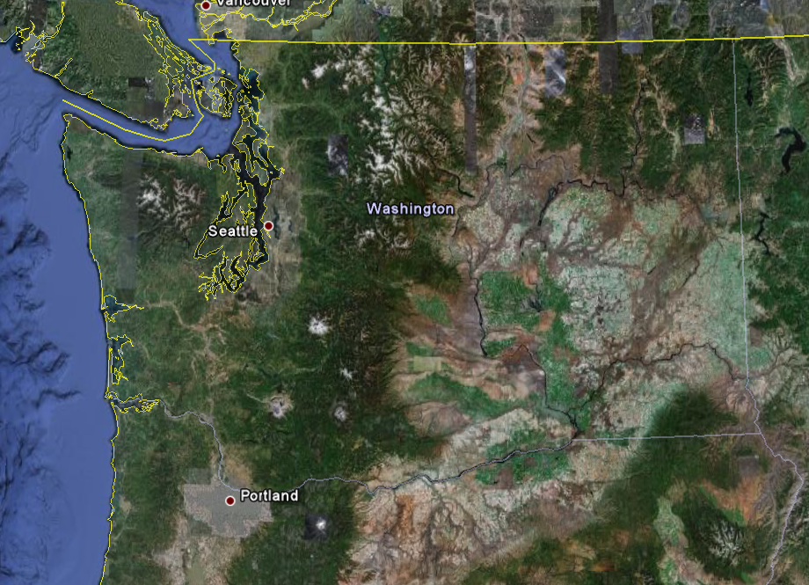
Project Area
Source: Google Earth

Slide 4
Data Evaluated
Data Type | Source
Highway Network | WSDOT
Cities | King County
Water Bodies | King County
Parcels | King County
2000 Census Blocks | King County
Wetlands | King County
Parks | King County
Schools | King County
Historical Sites | King County
Park & Rides | WSDOT
Topography | UW ESS

Slide 5
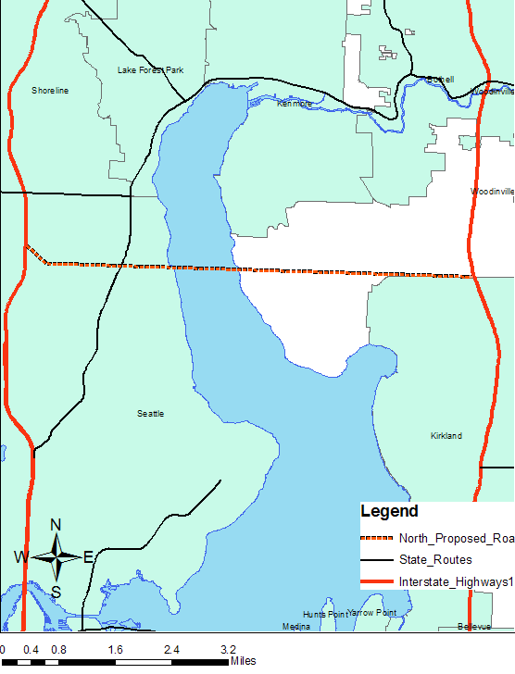
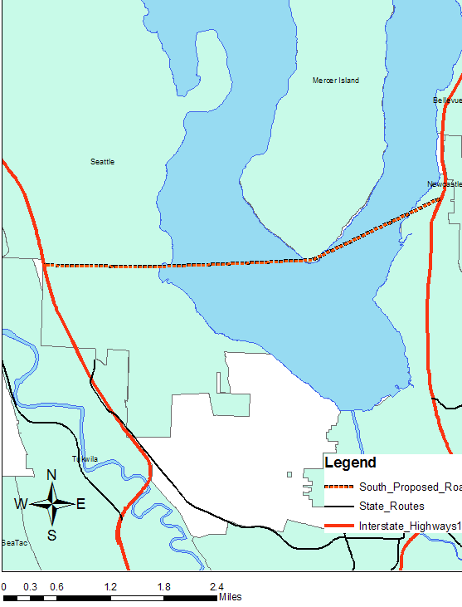
Alternatives
North Crossing
South Crossing

Slide 6
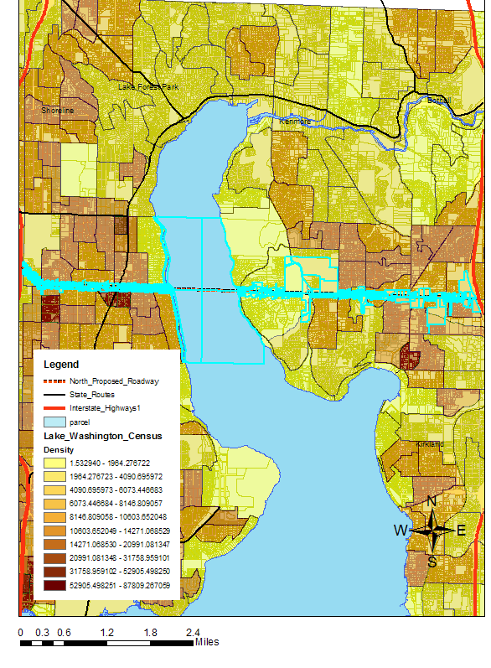
North Crossing
Length of Segment: 6.42 Miles
Length of Bridge:0.9 Miles
Parcels Within 250’: 995
Average Density, 10 miles: 7553 per/mi²

Slide 7
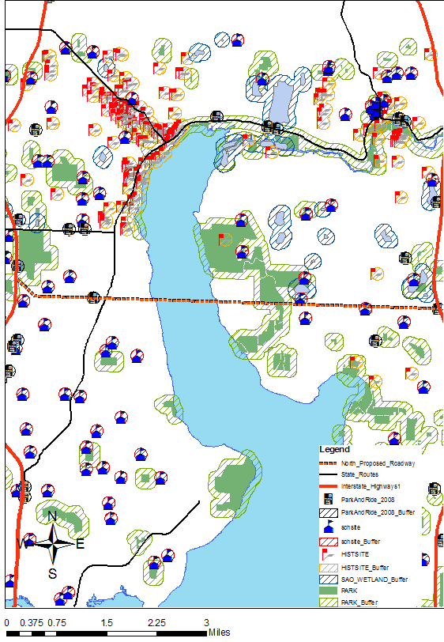
North Crossing
Within 500’:
Wetlands: 0
Parks: 2
Schools: 3
Historical Sites: 0
Park & Rides: 2

Slide 8
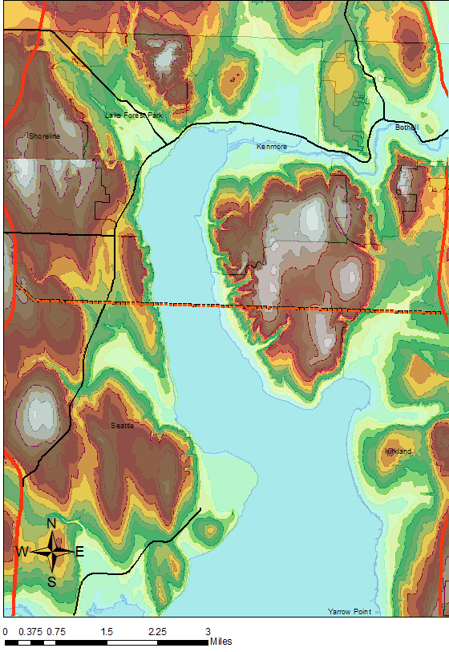
North Crossing
Topography information:
Significant elevation change, tunnel required

Slide 9
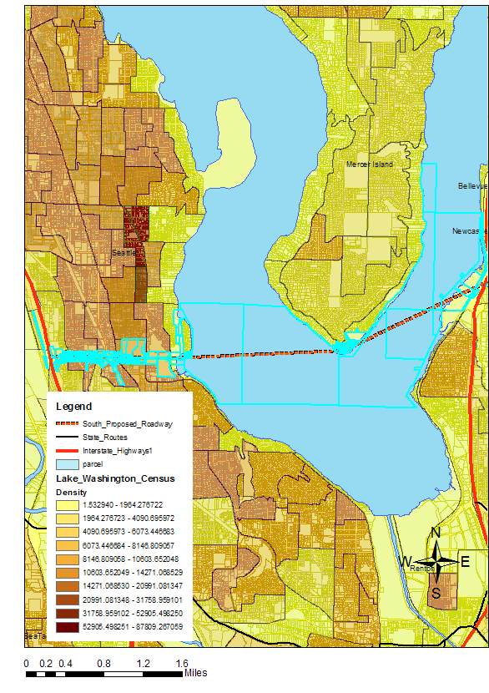
South Crossing
Length of Segment: 4.62 Miles
Length of Bridge: 2.74 Miles
Parcels Within 250’: 287
Average Density within 10 miles: 6740 per/mi²

Slide 10
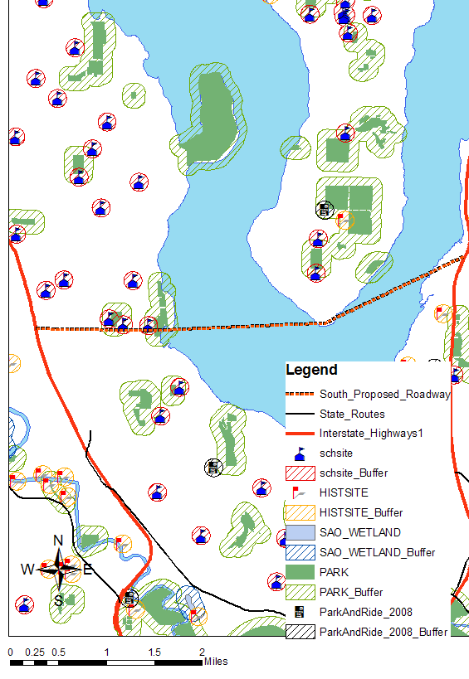
South Crossing
Within 500’:
Wetlands: 0
Parks:1
Schools: 3
Historical Sites: 0
Park & Rides: 2

Slide 11
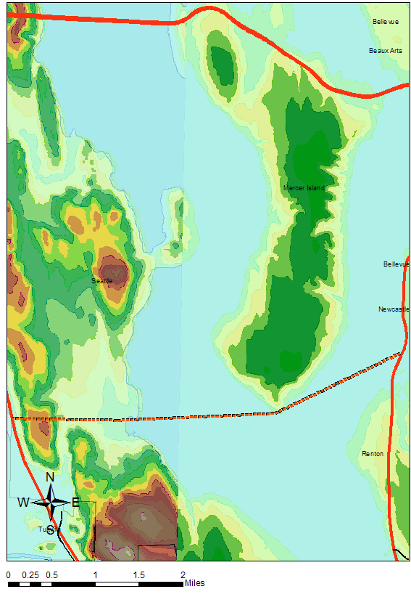
South Crossing
Topological information:
Relatively constant elevation

Slide 12
Comparison
 | North Crossing | South Crossing
Segment Length (mi) | 6.42 | 4.62
Bridge Length (mi) | 0.9 | 2.74
Parcels Within 250’ | 995 | 287
Average Density (per/mi²) | 7553 | 6740
Wetlands within 500’ | 0 | 0
Parks within 500’ | 1 | 2
Schools within 500’ | 3 | 3
Historical Sites within 500’ | 0 | 0
Park & Rides within 500’ | 2 | 2

Slide 13
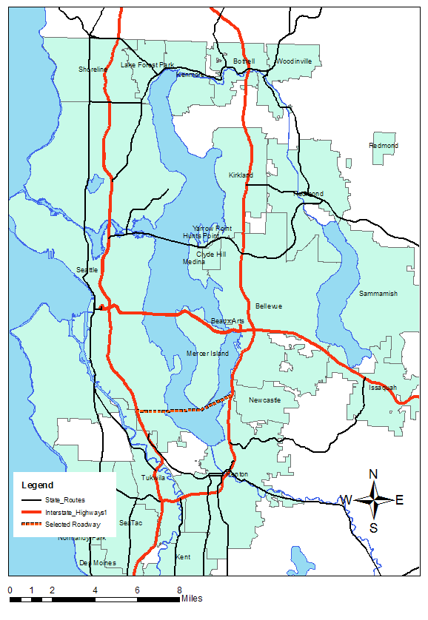
Preferred Alternative
Shorter Roadway
No tunnel required
Less parcel acquisition necessary
Reduces congestion for
I-405 in Renton

Slide 14
Resources
UW ESS Department http://gis.ess.washington.edu/data/raster/tenmeter/byquad/index.html
King County GIS https://wagda.lib.washington.edu/DATA/geography/wa_counties/king/index.html
WSDOT http://www.wsdot.wa.gov/mapsdata/geodatacatalog/default.htm

