Slide 1
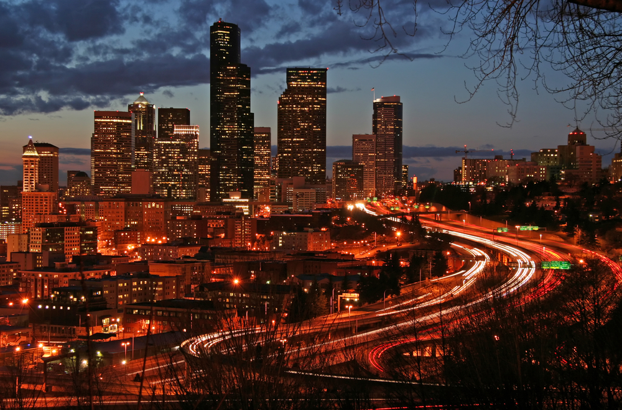
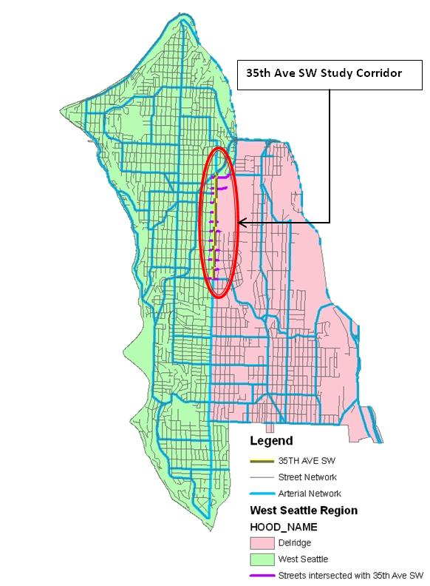
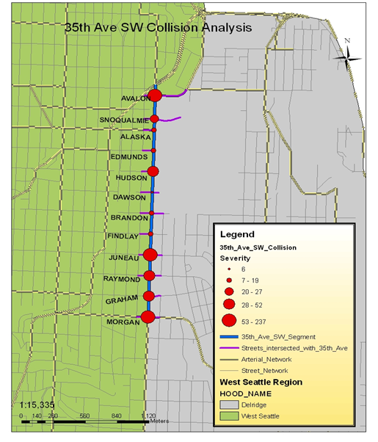
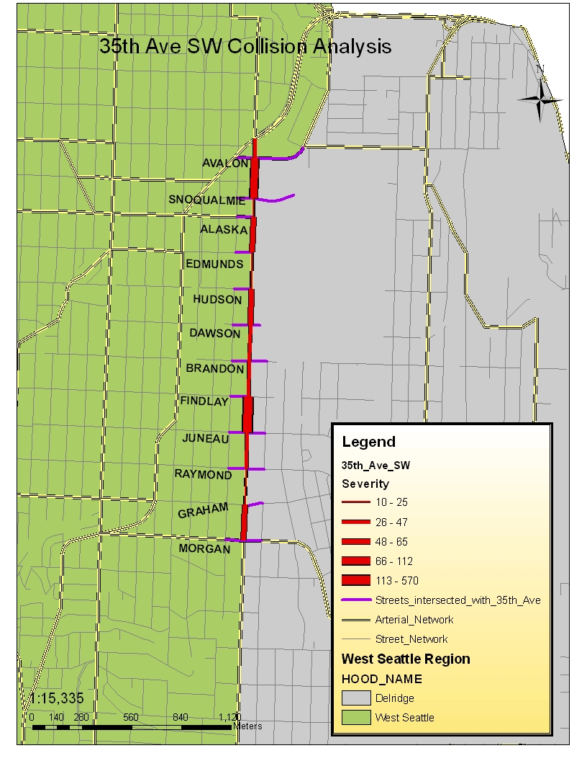
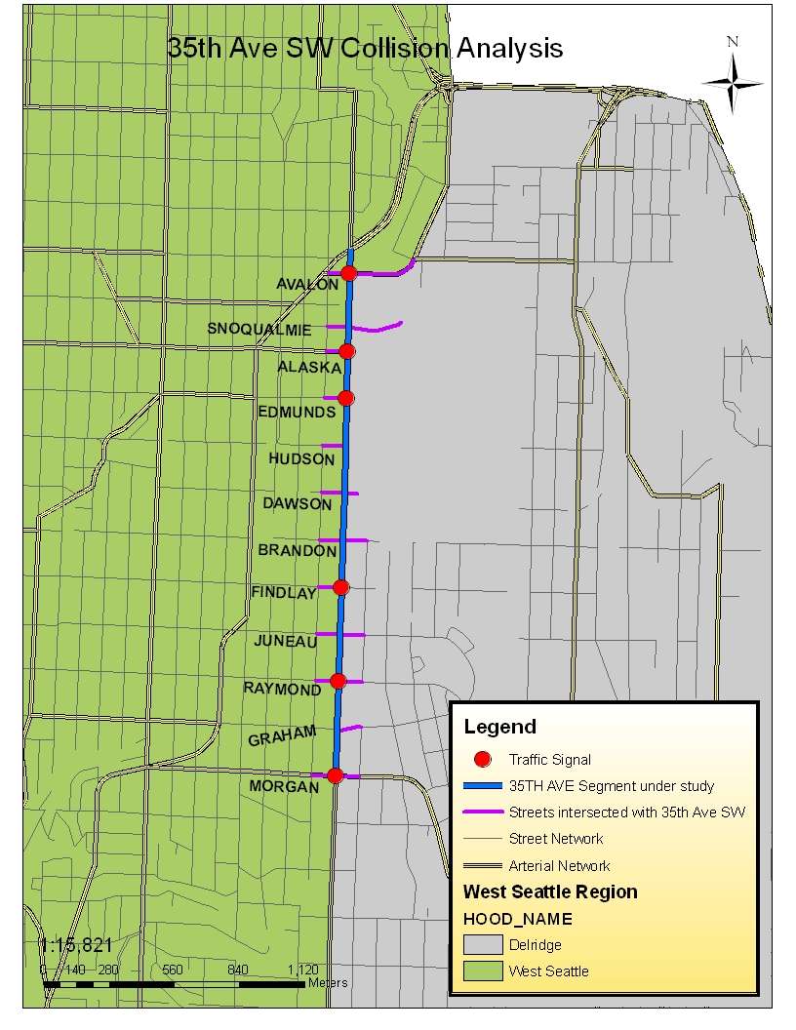
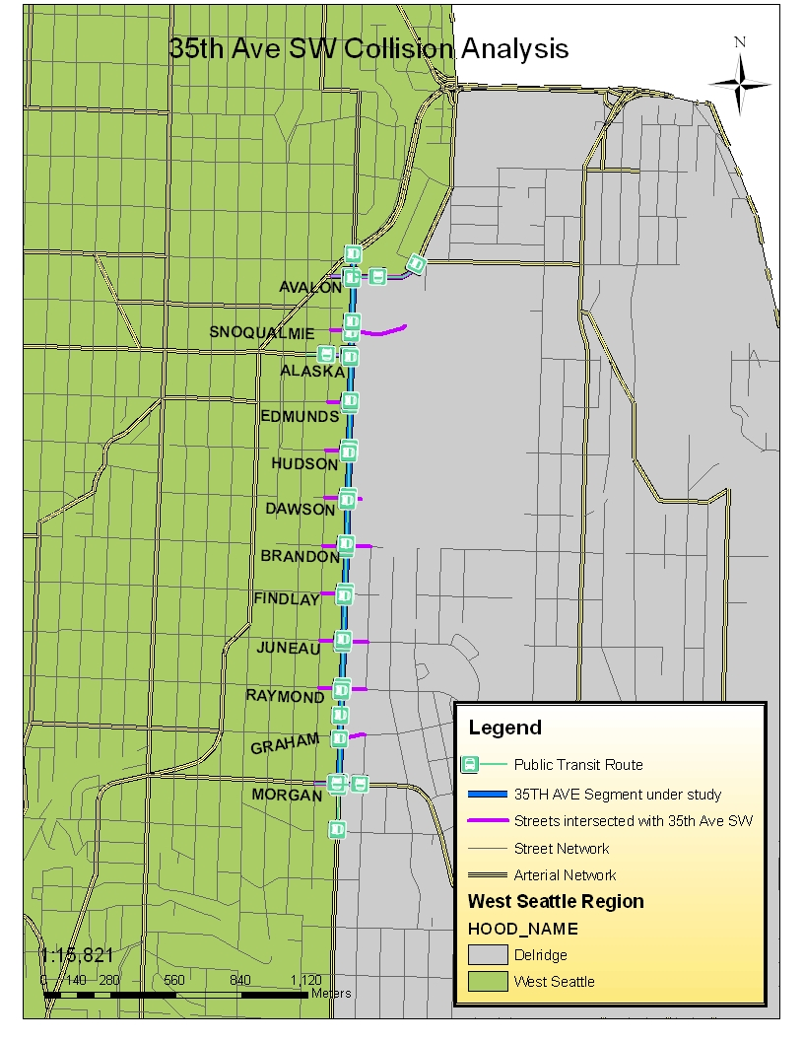
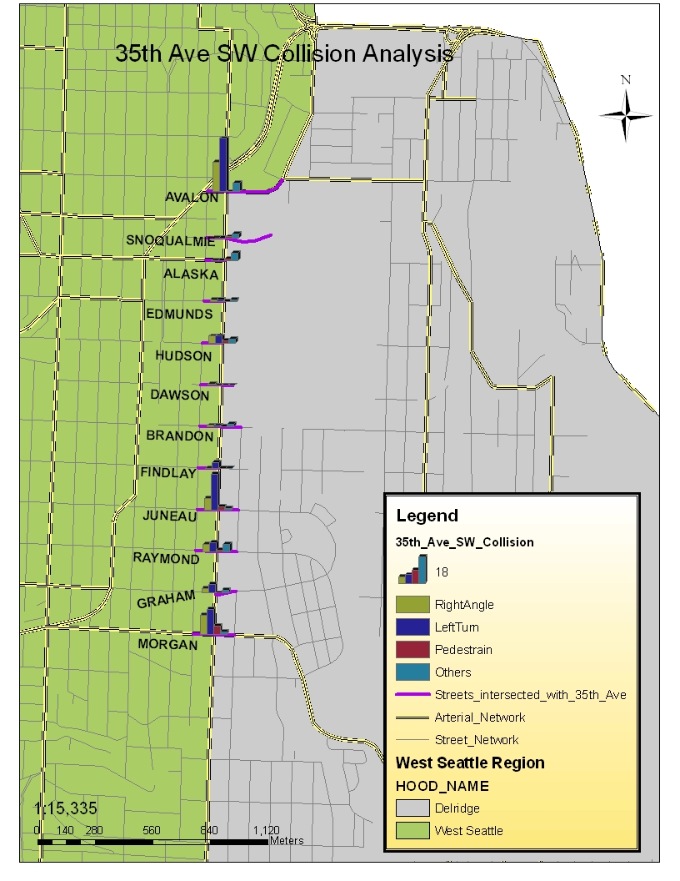
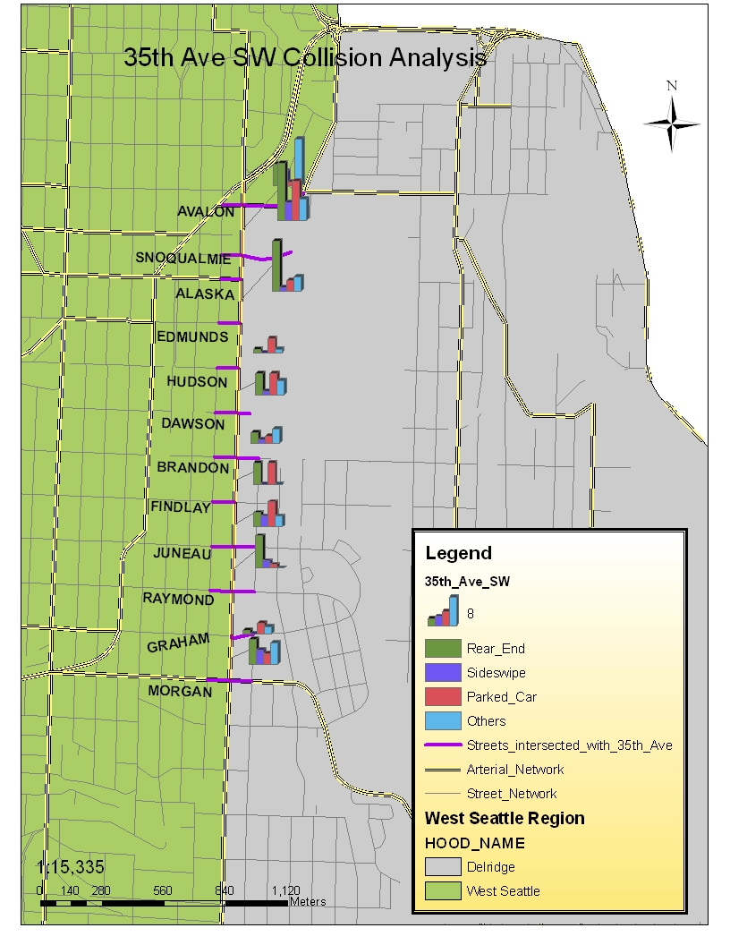
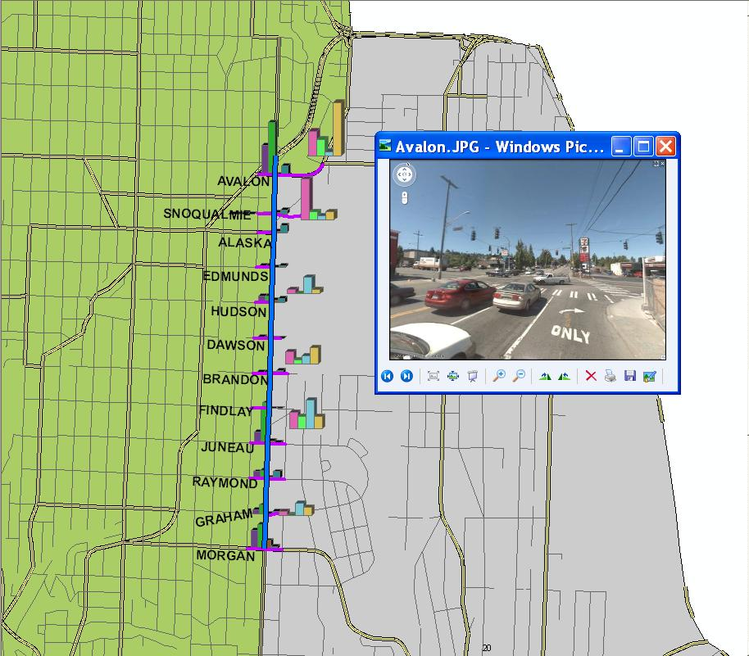
Collision and Safety Analysis for 35th Ave SW, Seattle, WA
Xiaoyue (Cathy) Liu, Wenjuan Zhao, Barrett Taylor
Department of Civil & Environmental Engineering, University of Washington
BACKGROUND AND METHODOLOGY
HOT SPOT IDENTIFICATION
SIGNALIZATION AND TRANSIT ROUTE
Classify the collision types and volume
Identify collision hot spots
Analyze cause of the collisions
Perform Countermeasures Analysis
Data Used
City of Seattle
  Collision Summary for 10 years
WAGDA
  Major Arterials
  Street Network
  Traffic Signals
  Principal Transit Routes
Collision Severity Evaluation: Equivalent-Property-Damage-Only (EPDO)
EPDO = PDO * 1 + INJ * 6 + FTL * 12
To weight the quantities of collisions so that fatality and injury collisions are given more importance than property-damage-only (PDO) collisions
COLLISION TYPES CLASSIFICATION
HYPERLINKING
Hot Spots
Intersection:
SW Avalon Way
SW Juneau St
SW Morgan St
Segment:
Between SW Avalon Way & SW Snoqualmie
Intersection vs. Roadway Section
Intersection
Right Angle
Left Turn
Roadway Section
Rear End
Parked Car (Side Swipe)
New Development: High Point
COUNTERMEASURES
SW Avalon Way Intersection
Add Protected Left Turn Signal ($1,000)
SW Juneau St. Intersection
Add Left Turn Pockets ($2,000)
Add Traffic Signals ($150,000)
SW Morgan St Intersection
Signal Retiming: PPLT can increase arrow can be confusing, use throughput, but when safety is of the major concern, it is highly recommended that the left phase be protected only
Section between SW Avalon Way & SW Snoqualmie
Reduce Rear End collisions: Speed detection signs ($15,000)
Road Diet -> Sharrow
Solution Highlight
Sharrow
Road Diet
Current
Road Diet
GIS Analysis
Intersect
Join
Clip
Select by Location
Spatial Join
Create Features
Hyperlink
Symbology
Preferred
Option
Acknowledgement
Image Source: Oran Viriyincy, University of Washington
We would like to express our sincere thanks to ITE Washington Section for providing the collision summary to us, and also Oran Viriyincy for designing the geometric configuration of Road Diet and Sharrow Solution .

