Slide 1
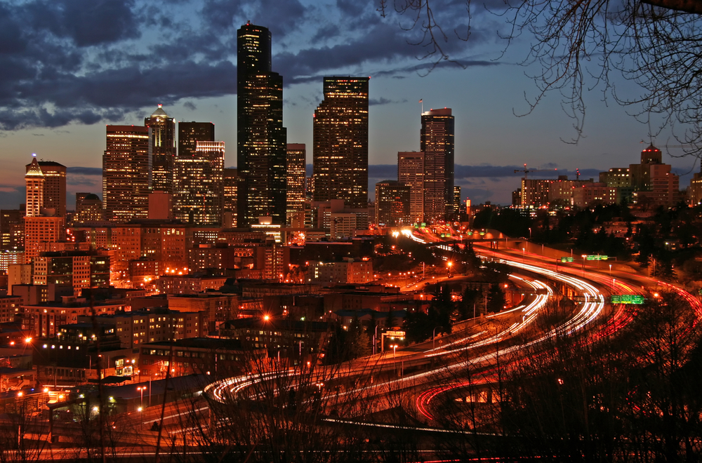
35th Ave SW Collision Analysis
CEE 424 GIS for Civil Engineers
Final Project
Xiaoyue (Cathy) Liu
Wenjuan Zhao
Barrett Taylor
Department of Civil & Environmental Engineering
University of Washington

Slide 2
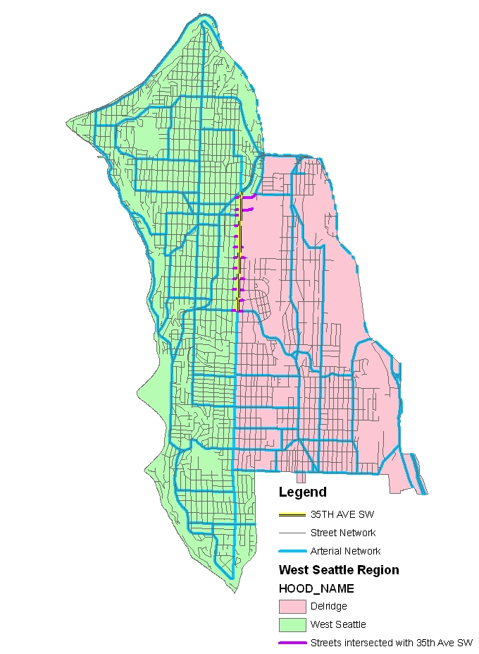
Study Objective
Background
Perform a collision and safety analysis for the 35th Avenue SW corridor
12 intersections
14 roadway sections
35th Ave SW Study Corridor
Notes:
SW between SW Morgan Street and Fauntleroy Way SW in West Seattle
The City has received reports from local citizens that there has been in increase inspeeding vehicles, accidents and unsafe conditions for pedestrians and cyclists on the street.
A collision analysis is required by the City of Seattle to evaluate the collision data and recommend treatments for reducing the number and severity of collisions within the corridor.

Slide 3
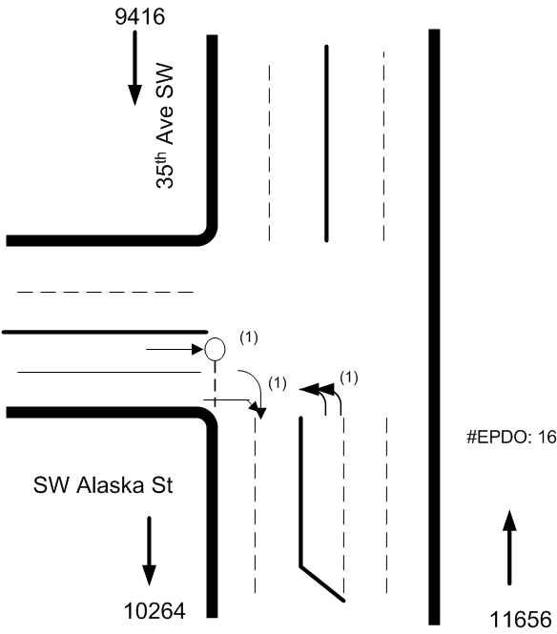
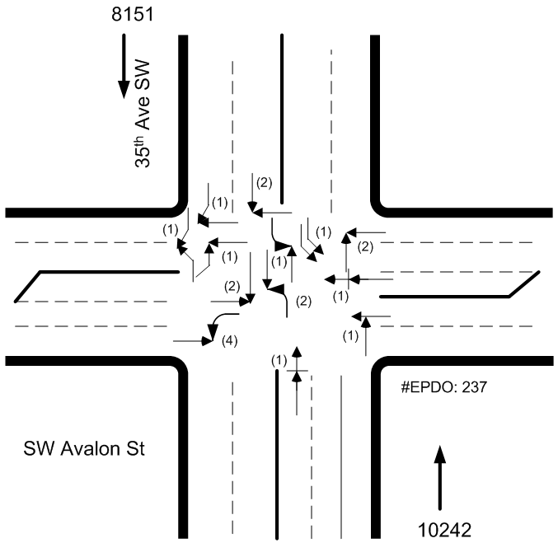
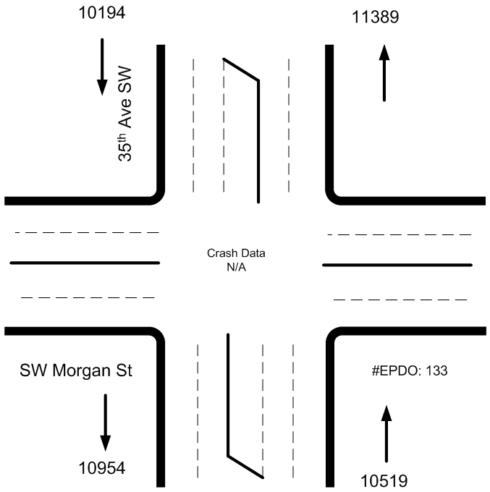
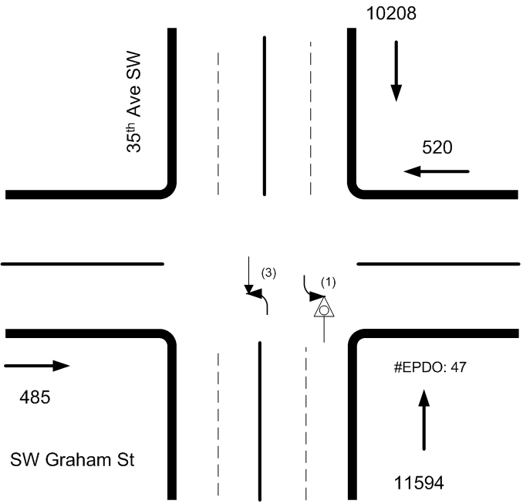
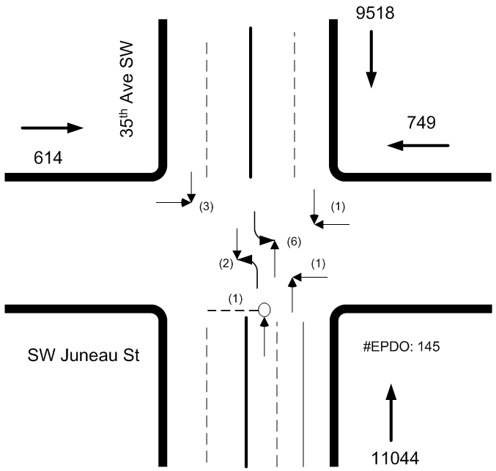
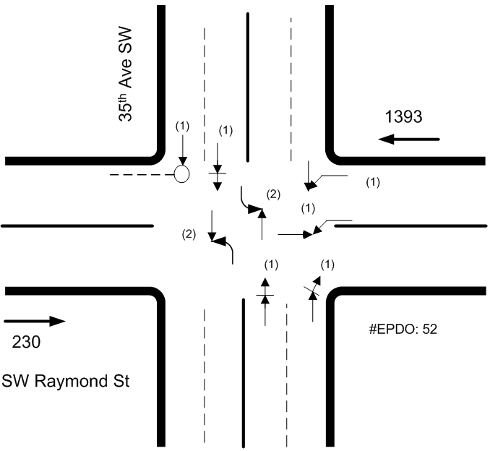
Data Used
City of Seattle
  Collision Summary for 10 years
WAGDA
  Neighborhood districts
  Major Arterials
  Street Network
  Traffic Signals
  Principal Transit Routes
VOLUME AND ACCIDENT TYPES
Notes:
Collision Severity Evaluation
EPDO = PDO * 1 + INJ * 6 + FTL * 12

Slide 4
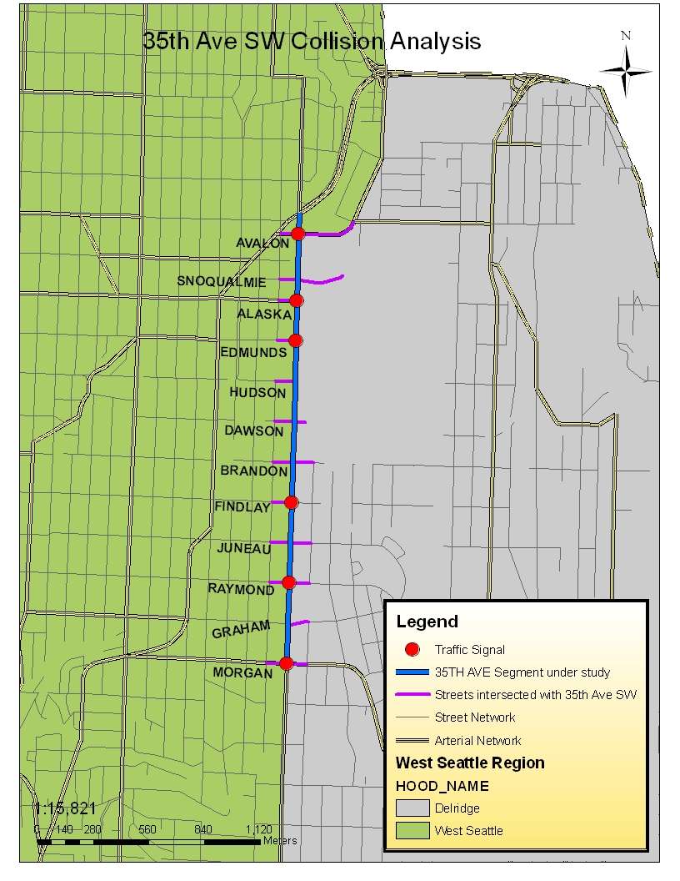
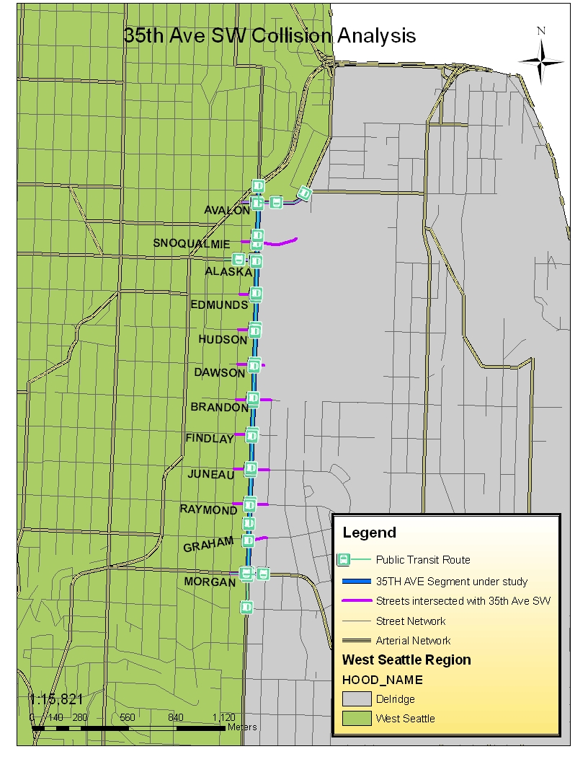

Slide 5
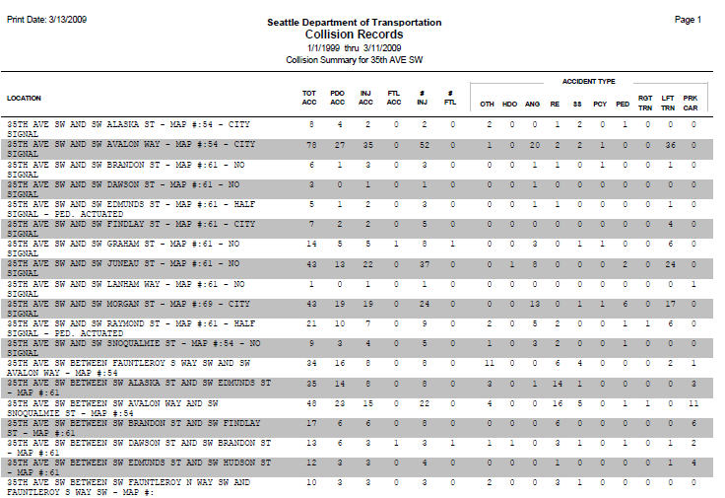
Notes:
Normally, the traffic engineering department will classify the collision records into separate file systems, one for road segments and one for intersections.
In order to compare locations in a jurisdiction, there are a number of calculations that need to be made. Collision severity numbers are created to weight the quantities of collisions so that fatality and injury collisions are given more importance than property-damage-only (PDO) collisions. The number we used here to weight the quantities of collisions is called EPDO which assigns a weight of 12 to a fatal collision, a 6 to serious personal injury collisions and a 1 to a PDO collision.
This means that 1 fatal collision is considered equivalent to 12 PDO collisions or 2 serious injury collisions. The sum of these weighted numbers is called the equivalent-property-damage-only (EPDO) number.

Slide 6
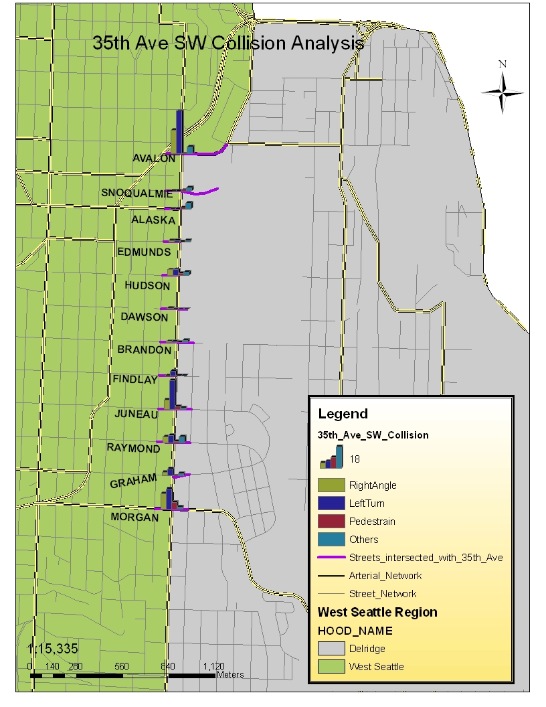
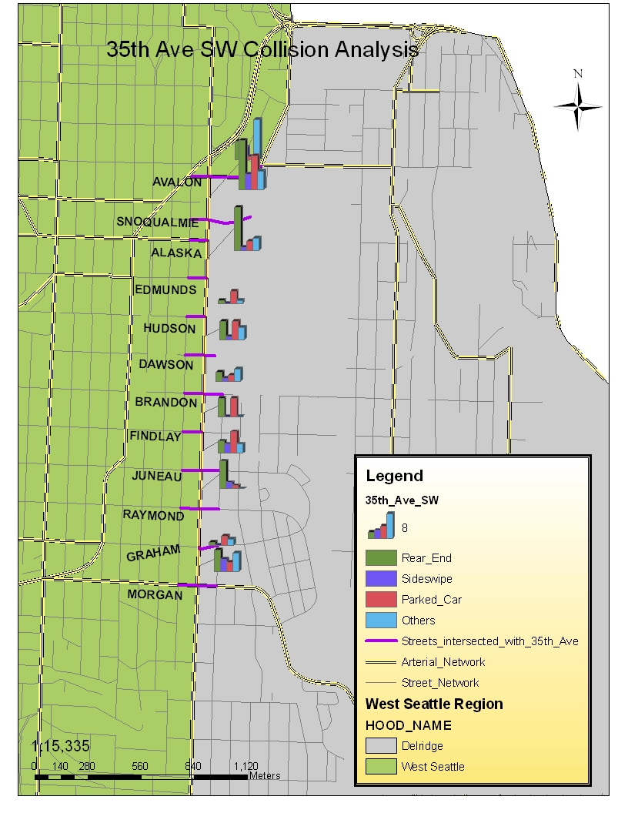
Accident Type
Intersection
Segment
Notes:
We use bar chart to represent the number of accident by types at each location.

Slide 7
Collision Severity Analysis
Notes:
In order to identify the hot pot in this area, we need to use a performance indicator to quantify the serverity of collision. We used EPDO (equavalent of property damange only) as a measurement to show the collision severity.

Slide 8
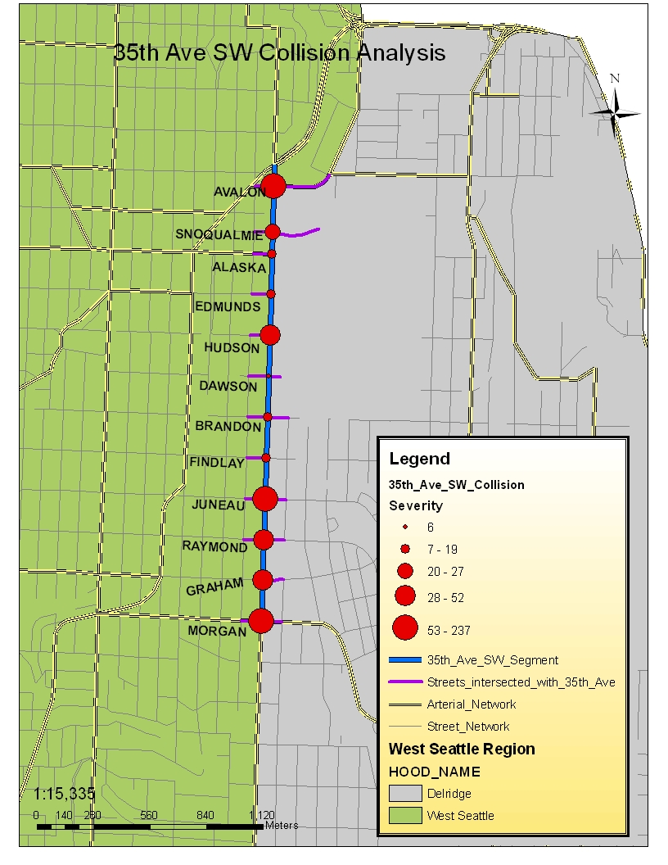
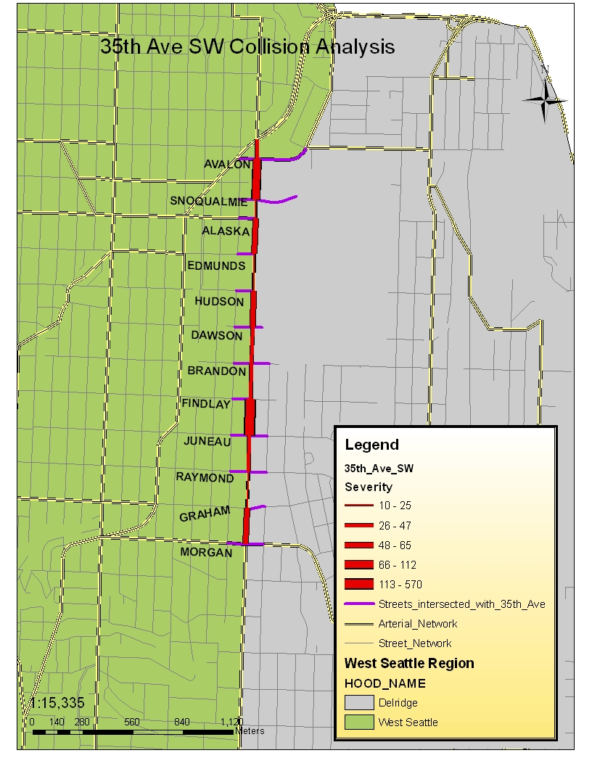
Hot Spot Identification
Intersection
Segment

Slide 9
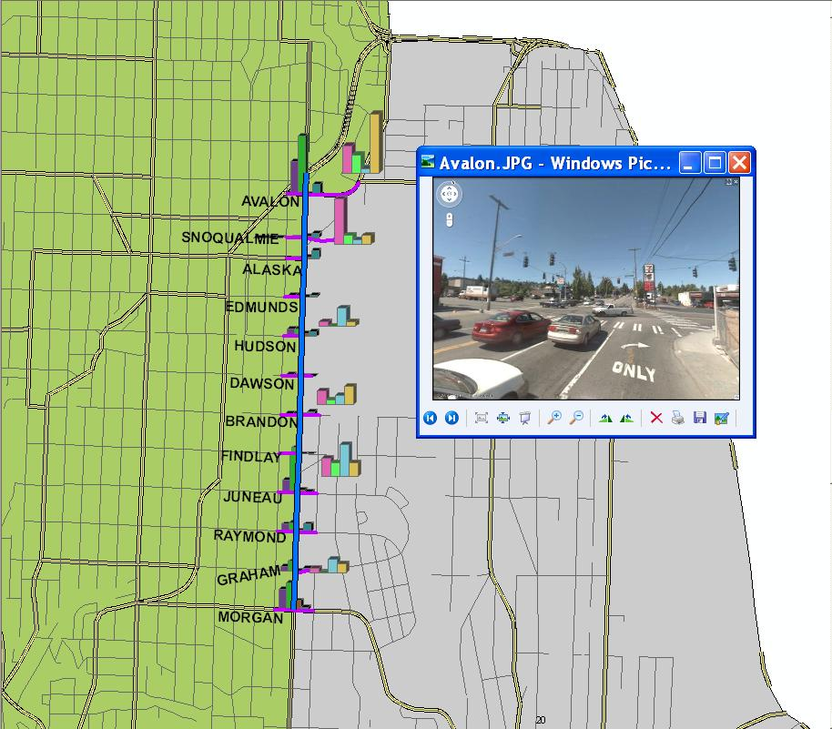

Slide 10
Countermeasure Analysis
Road Section between SW Avalon Way & SW Snoqualmie St.
Collision
  Highest Rear End Accidents : 16
  Highest Parked Car Collision: 11
Solution
  Reduce Rear End collisions:
    Speed detection signs ($15,000)
  Road Diet -> Sharrow

Slide 11
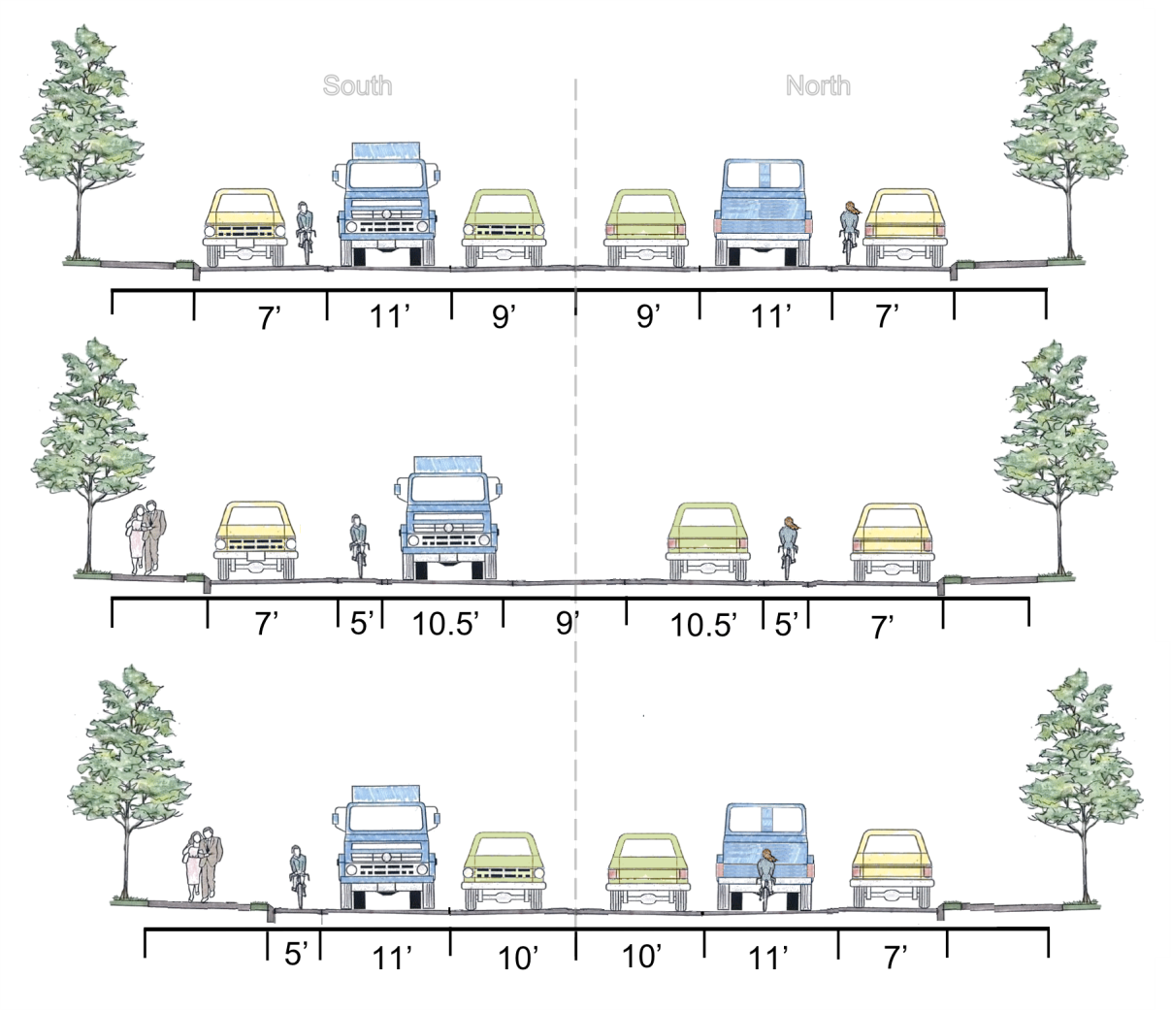
Preferred Option - Sharrow
Current
Road Diet
Preferred
Option
Image Source: Oran Viriyincy, University of Washington

Slide 12
Analysis
Intersect
Dissolve
Clip
Select by Location
Create Layer from Selected Feature
Create Attributes
Hyperlink
Symbology

