Slide 1
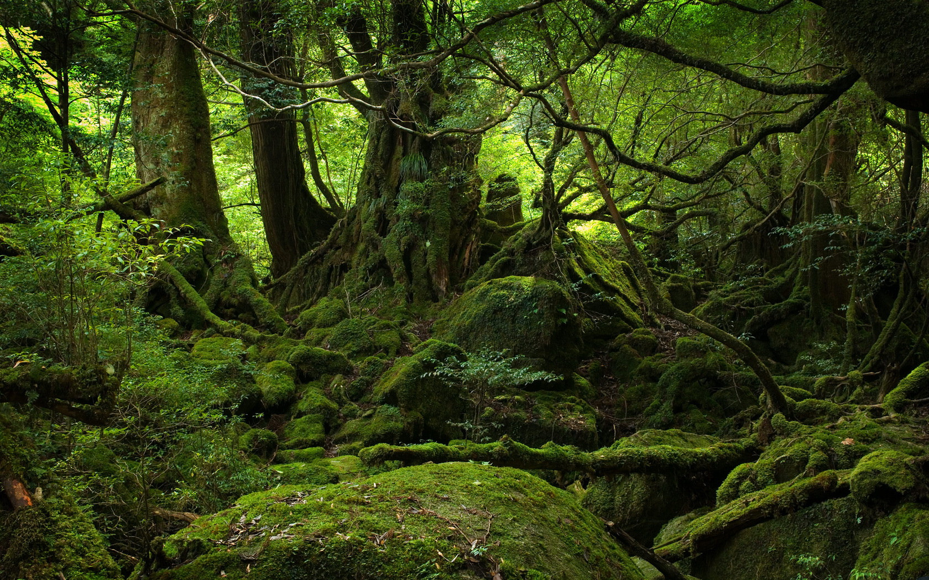
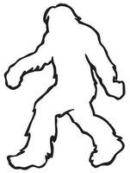
Plans for Bigfoot Research Station
Jared McDonald, Allison Petsche,
Kyle Wilcox

Slide 2
Overview
Project Scope
Data Collected and Analysis
  Location of Bigfoot
  Location of suitable sight for building Bigfoot Research Outpost
Results

Slide 3
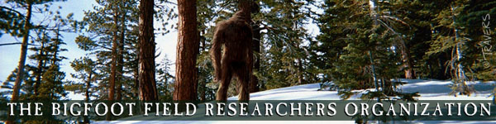
Project Scope
The Bigfoot Field Researchers Organization
  Requested a new outpost to be constructed
  Near most probable place to sight Bigfoot
  Most be constructed on suitable land area

Slide 4
Data Collected: Bigfoot Location
Where in Washington?
Layers used
  Forested Areas
  Population Density by County
  Number of Sighting by County
  Unpopulated Areas
?

Slide 5
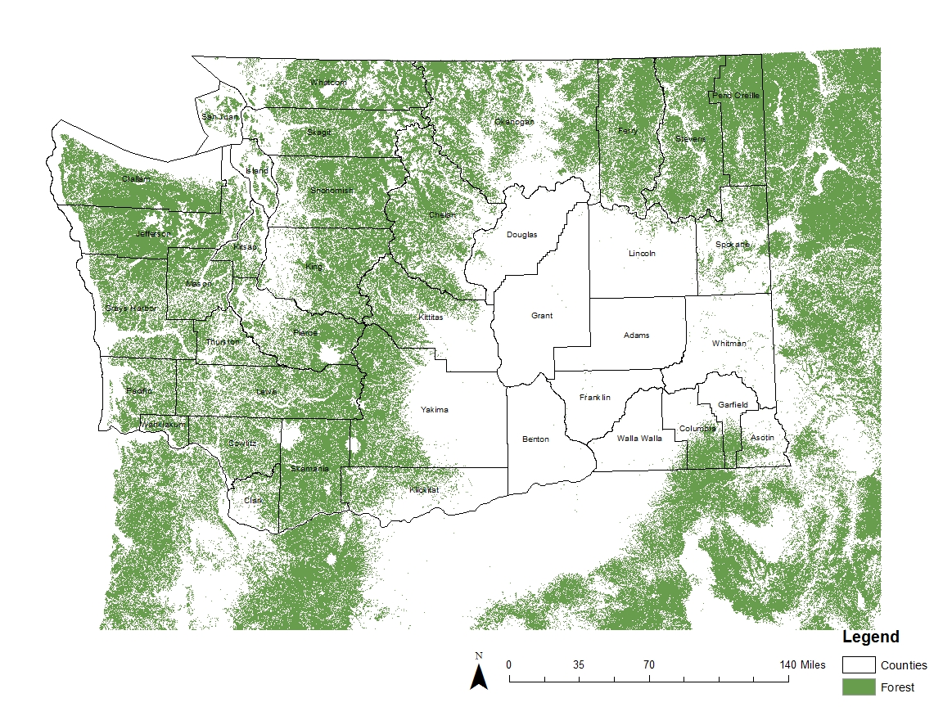
Forested Areas
Green:
Forested Areas
Location must reside in forested area

Slide 6
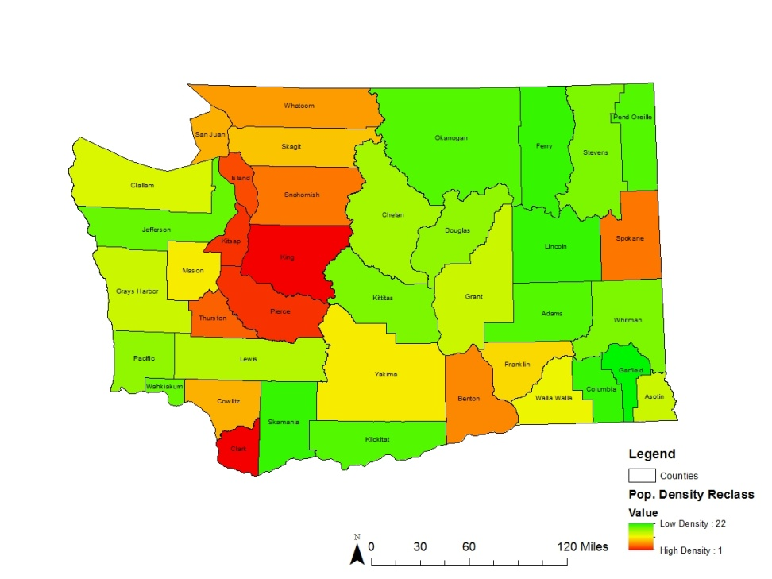
Population Density by County
Ranked Counties from low density to high density
Red:
High Density
Green:
Low Density

Slide 7
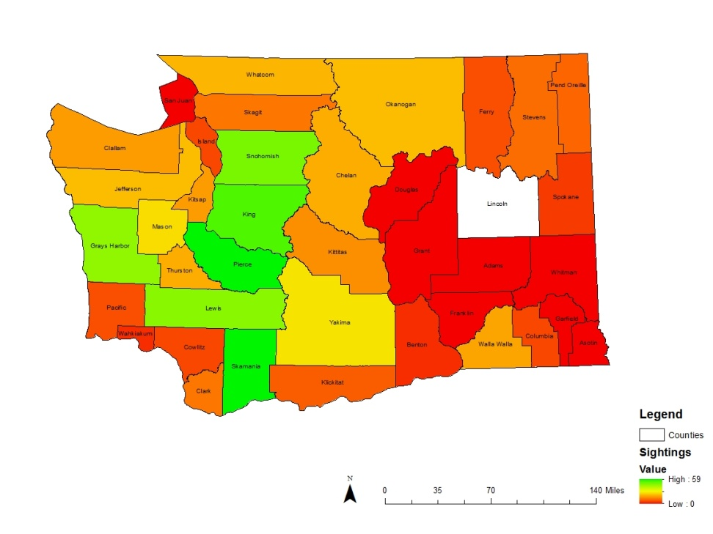
Number of Sighting by County

Slide 8
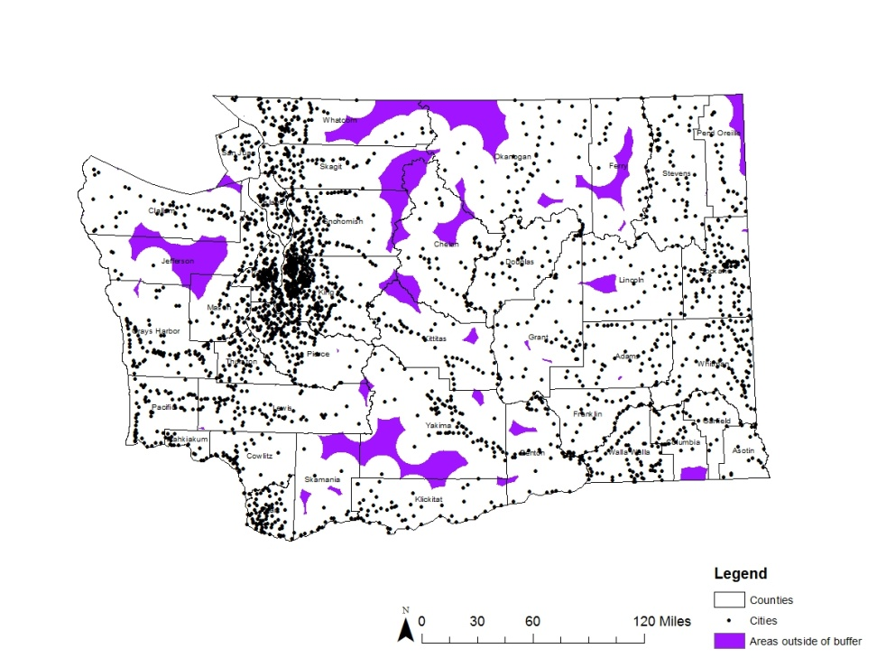
Unpopulated Areas
Dots:
Populated Places
Purple Area:
Location where there is no city within 10 miles

Slide 9
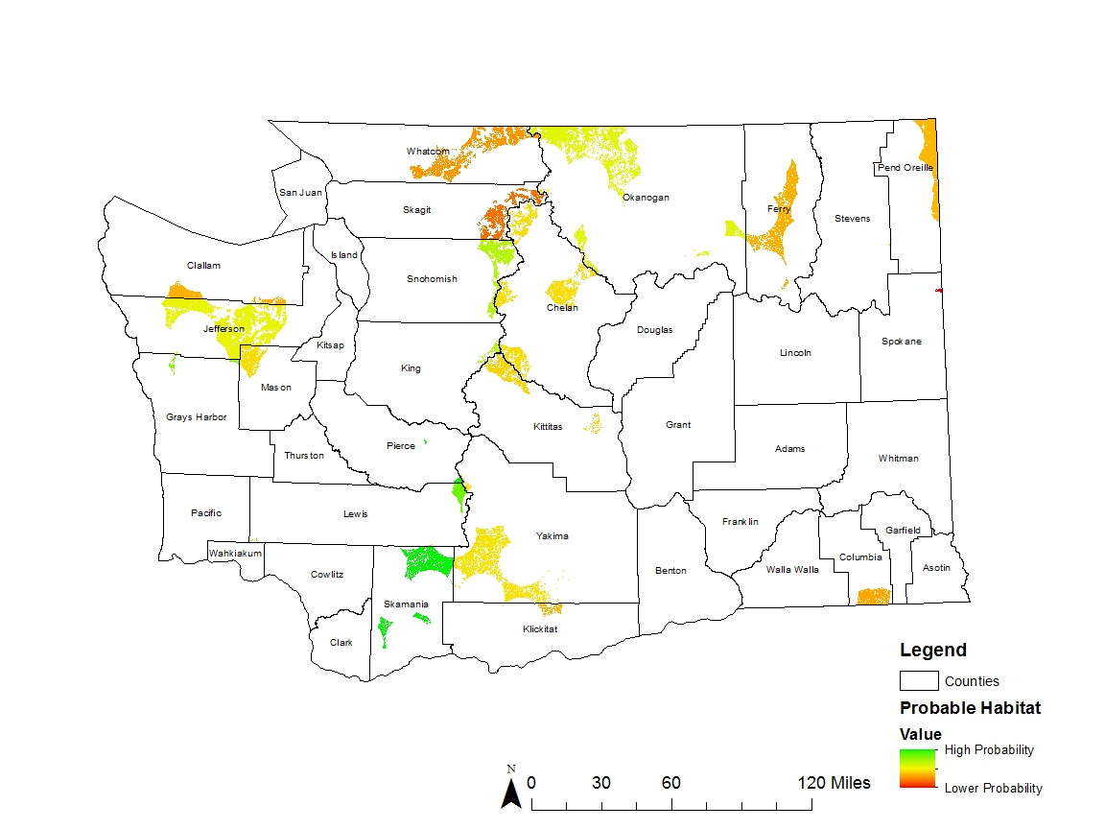
Data Analysis: Bigfoot Location
Combined Maps (Rasters) and added values
Highest value, in green, most likely place to find Bigfoot
Northeast Skamania County!

Slide 10
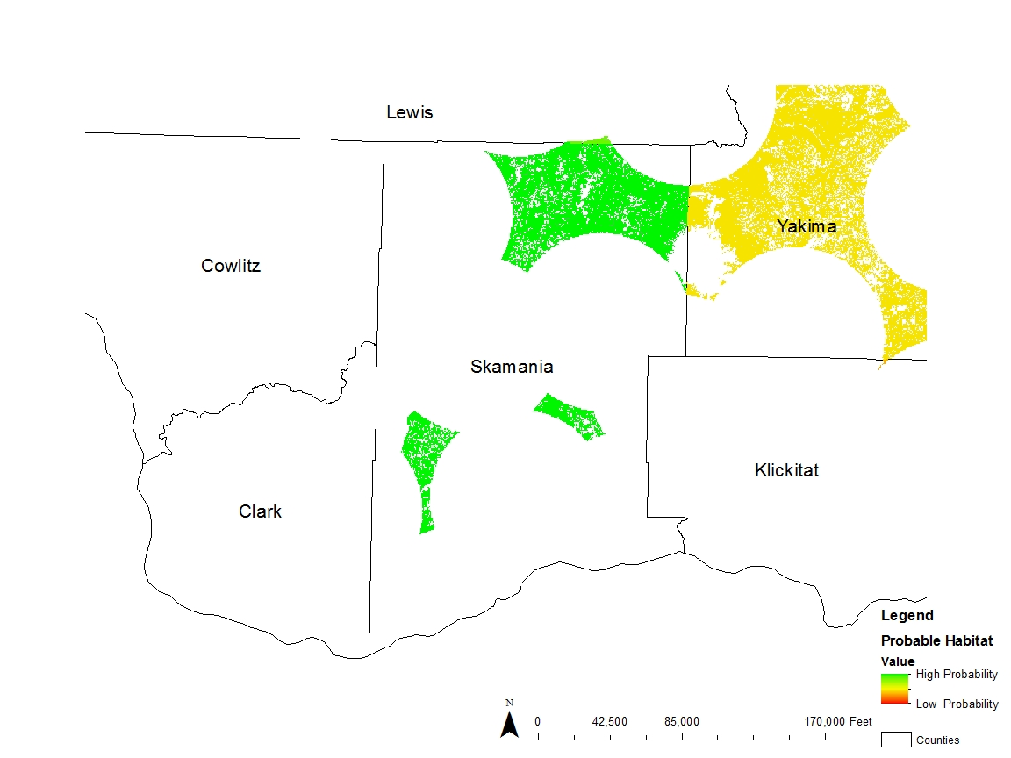
Zoomed Skamania County

Slide 11
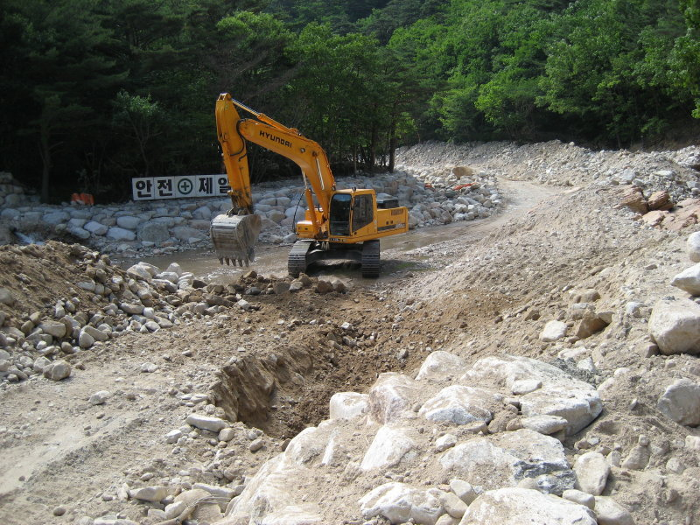
Data Collected: Suitable Construction Site
From Bigfoot Location Analysis:
  Build in Northeast Skamania County
Land Cover
Elevation
  Slope

Slide 12
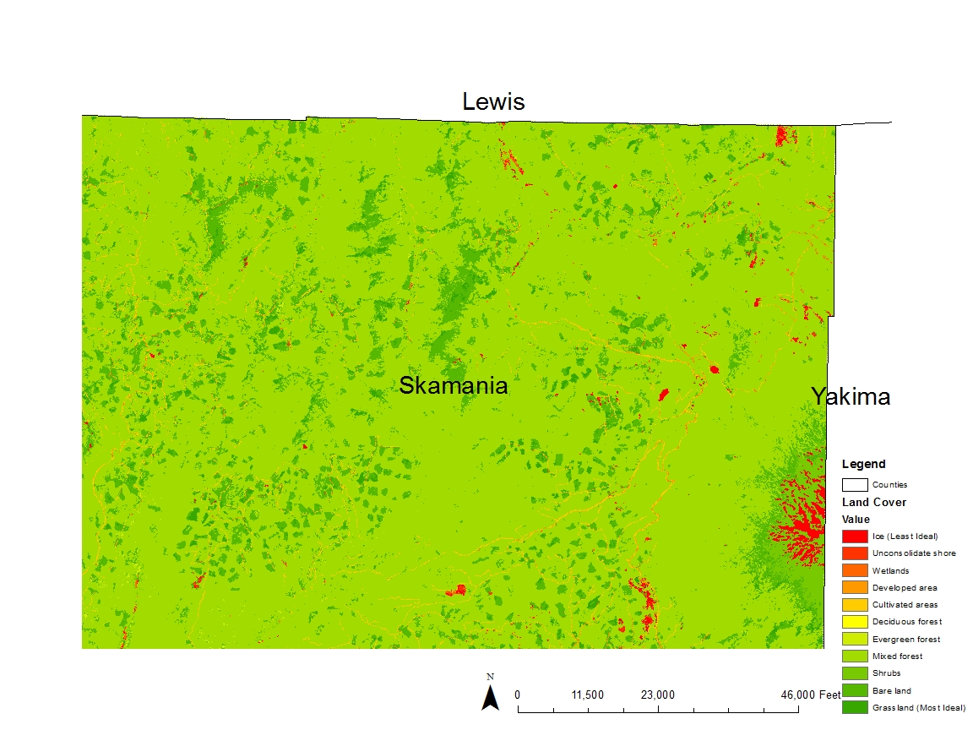
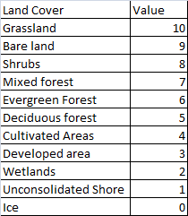
Land Cover

Slide 13
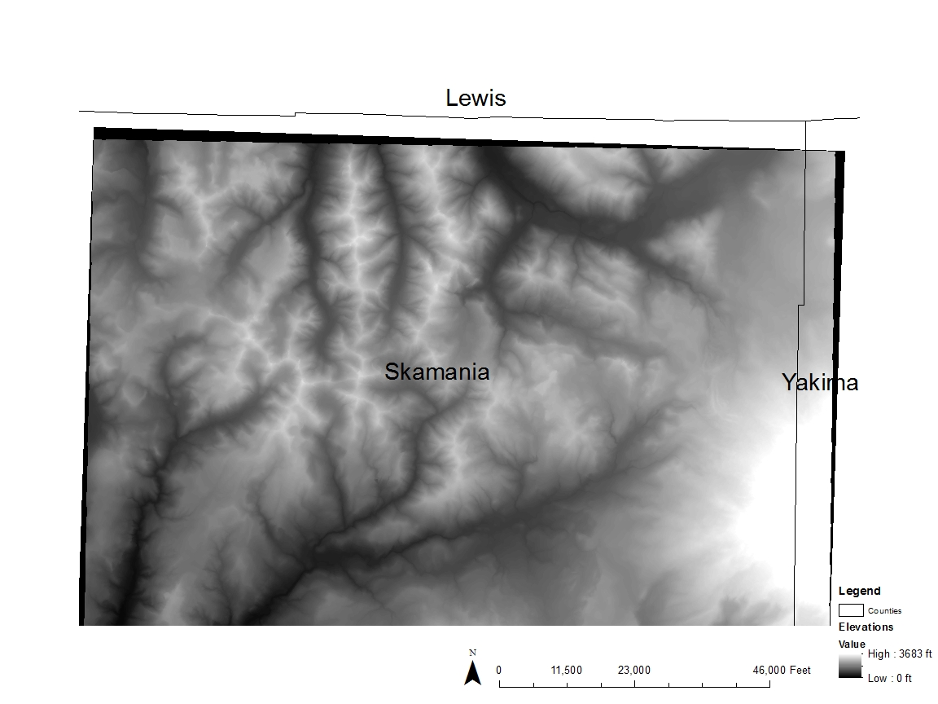
Elevation
Elevation of Northeast Skamania
Used to create slope

Slide 14
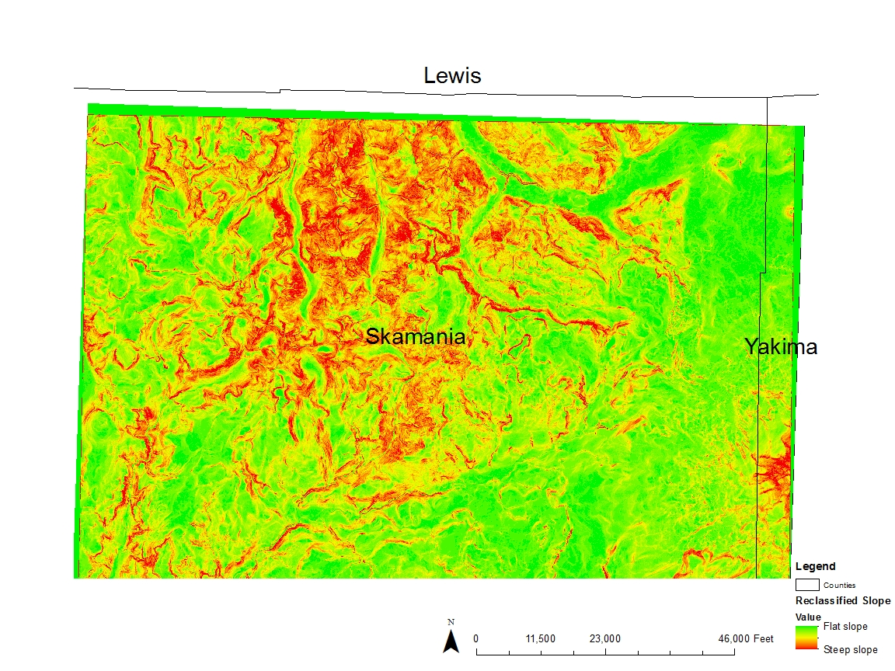
Slope
Elevation changed to slope
Green: Flattest Region
Red: Steepest Region

Slide 15
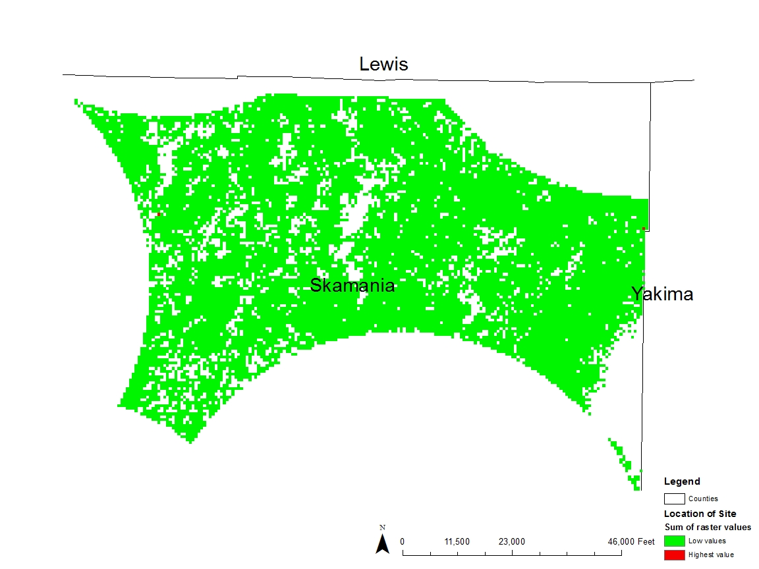
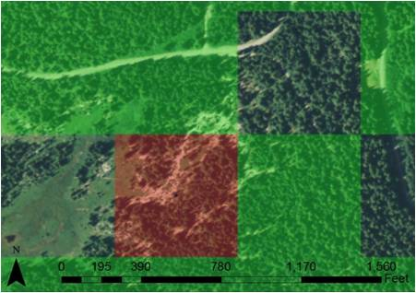
Data Analysis: Suitable Construction Site
Combined:
  Slope
  Land Cover
  Data Analysis of Bigfoot Location Layers
Green:
  Unsuitable Site
Red:
  Suitable site
Two Locations found
Determined site location

Slide 16
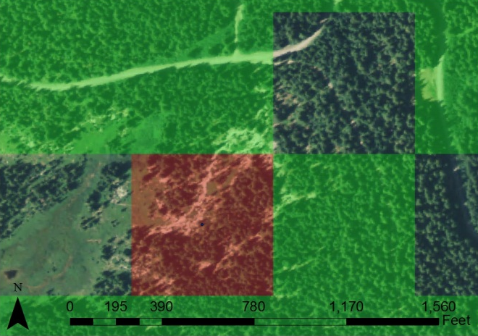
Results
Reason of Choice:
  Proximity to Road
  Flat Ground
  Good Location for Construction
  In Forested Area
  Remote Location
Aerial Photography agrees with our Raster Analysis

Slide 17
Questions
http://www.youtube.com/watch?v=lOxuRIfFs0w&feature=player_popout

