Slide 1
Professor Goodchild
CEE 500
October 14, 2009

Slide 2
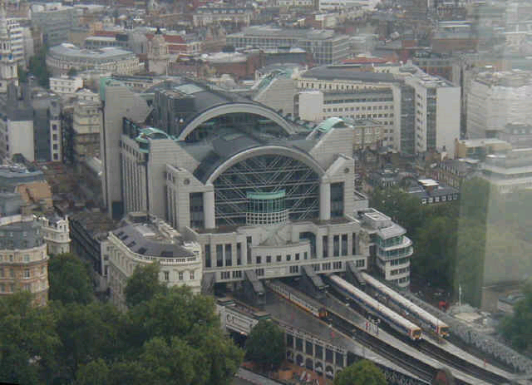
Consulting
  Applied Decision Analysis, Menlo Park CA
  PricewaterhouseCoopers, London UK

Slide 3
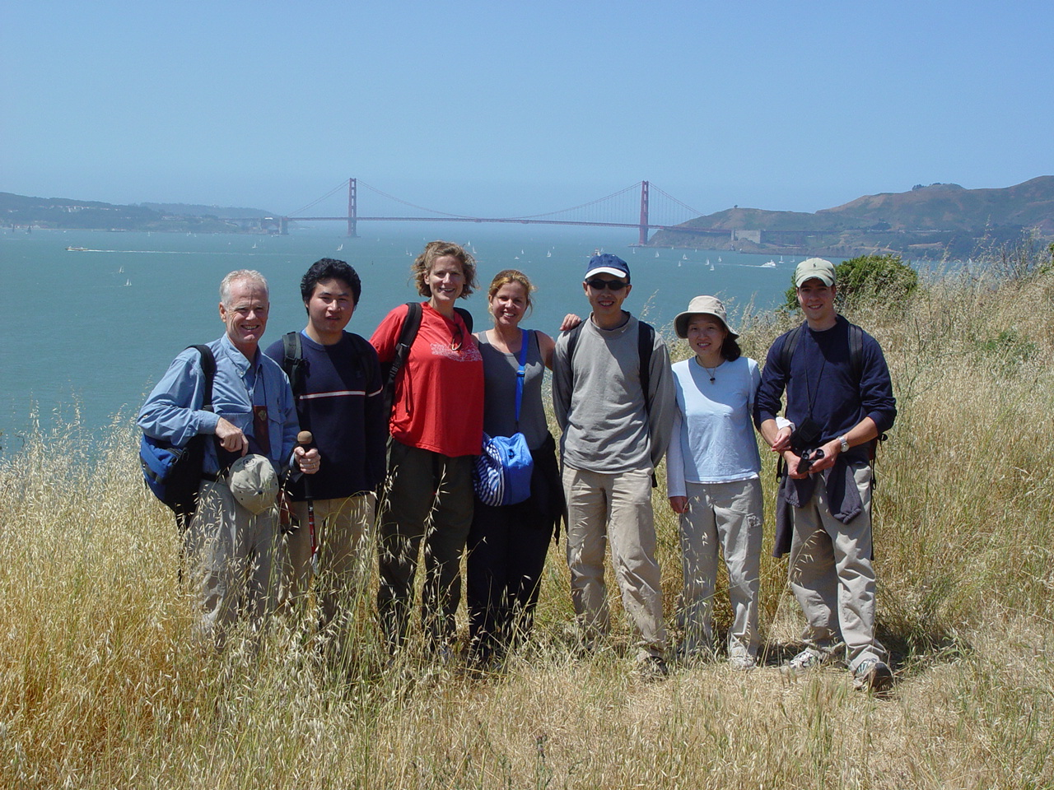
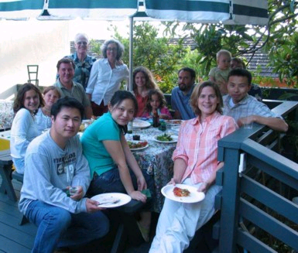
Background
MS, PhD
  Civil and
  Environmental
  Engineering
  UC Berkeley
BS
  Mathematics
  UC Davis

Slide 4

Joined UW 2005 after
completing my PhD

Slide 5
Teaching
CEE 320 – Introduction to Transportation Engineering
CEE 500 – Transportation and Construction Seminar
CEE 587 – Global Trade, Transportation Logistics Management (GTTL Core 1 course)
CEE 100 – Exploring Civil and Environmental Engineering
ENVIR 512 – Environmental Management Keystone Project

Slide 6
Research Interests
Freight Transportation and Logistics
Freight Policy Analysis
Reducing Externalities from Freight to Improve Sustainability

Slide 7
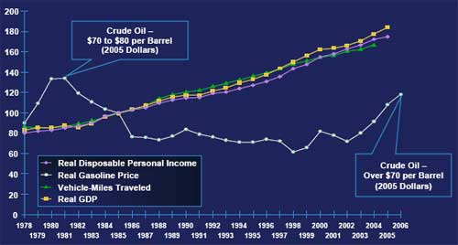

Slide 8
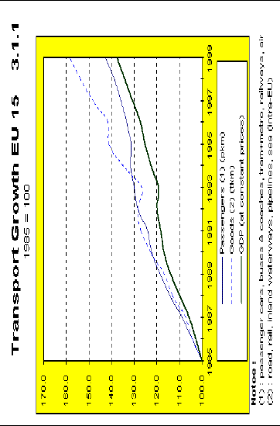

Slide 9
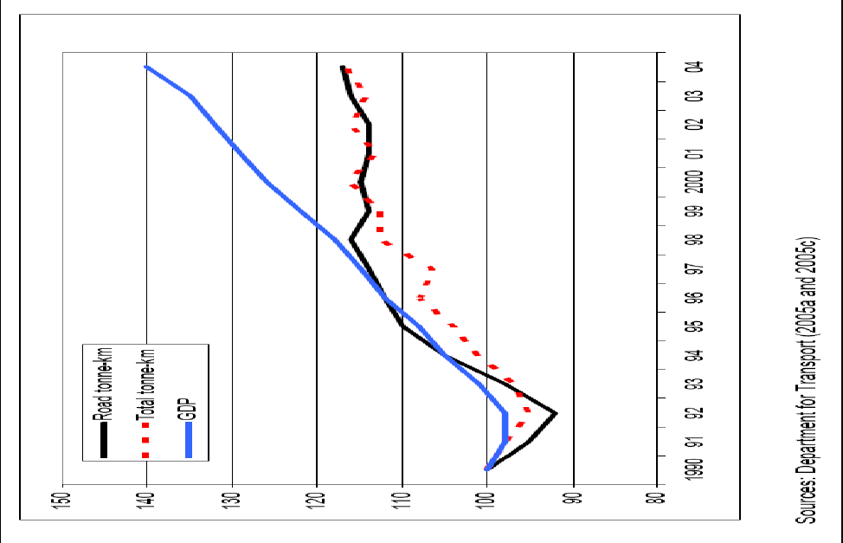

Slide 10
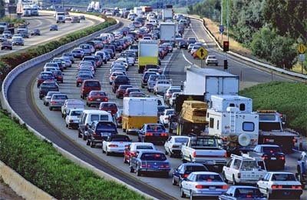
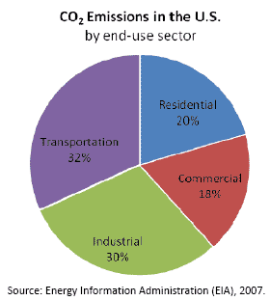
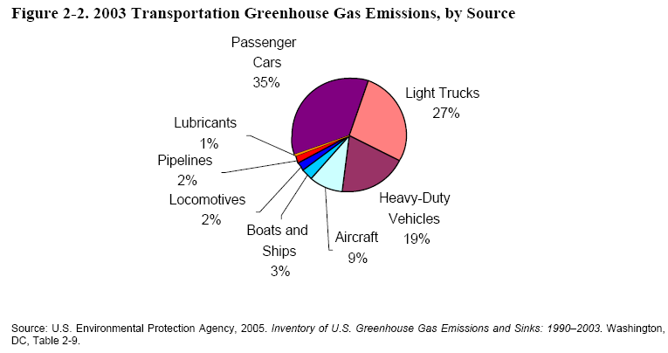
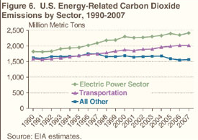
http://international.fhwa.dot.gov/scan/2010/images/01.jpg

Slide 11
Freight Transportation Challenges
Reduce externalities from freight activity
  Without un-necessarily disrupting economic activity
  Improve transportation at intermodal interfaces
    Marine ports
    International borders
Improve the freight transportation system’s ability to accommodate disruptions
  Prioritize trips that contribute most to the state’s economy
  Identify data needs, methods, and tools

Slide 12
Freight Transportation Needs
Address further complexity in the relationships that contribute to decision making about freight system use
  Interactions between agents at intermodal interfaces
  Model decision making and incentives
Widely available operational data
Relationships between cost, service, demand, and emissions

Slide 13

Near Border Operations
What is the impact of the border on logistical efficiency?
  Cabotage laws
  Size and weight restrictions
  How does this vary by commodity, origin, and destination?
Previous research describes:
  Impact of travel time variability
  on regional supply chains
  Profile of Cascade Gateway
  Relationship between delay and
  demand
  Intra-industry trade analysis

Slide 14
Cascade Gateway

Slide 15
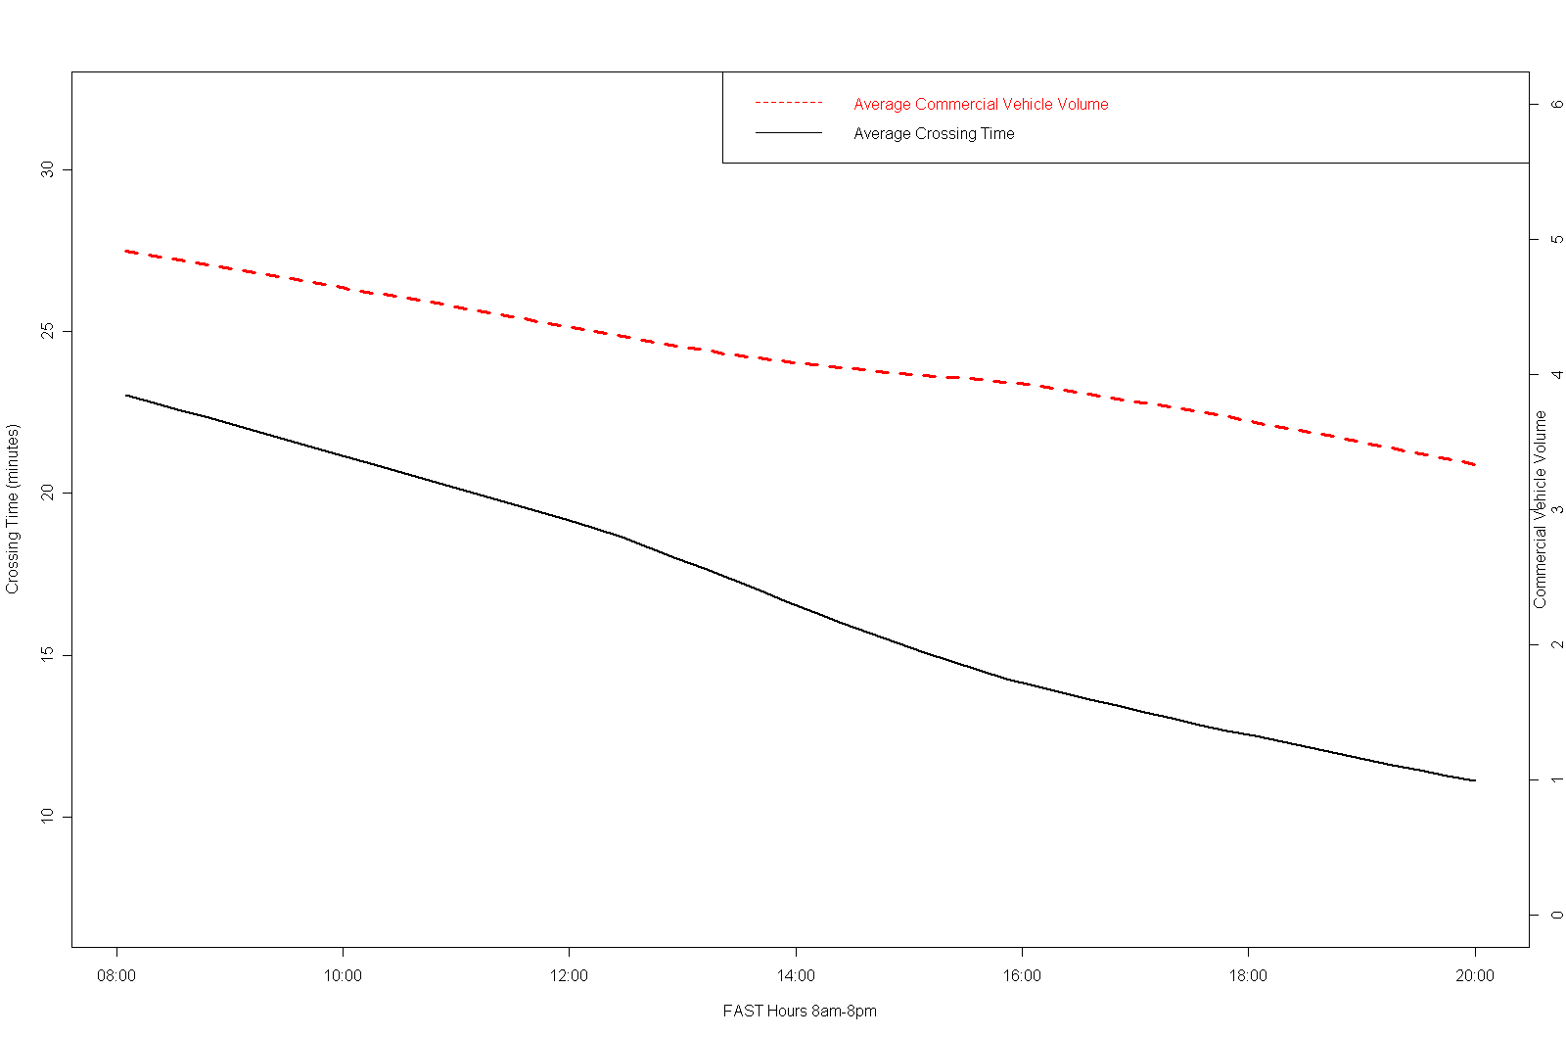
Typical arrival and delay pattern

Slide 17
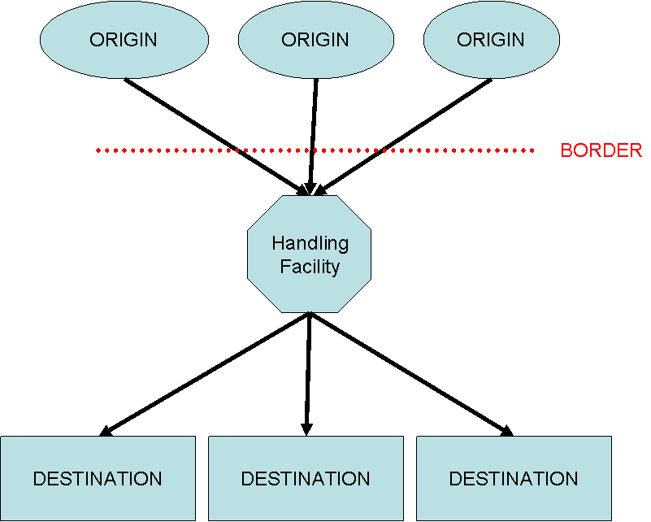
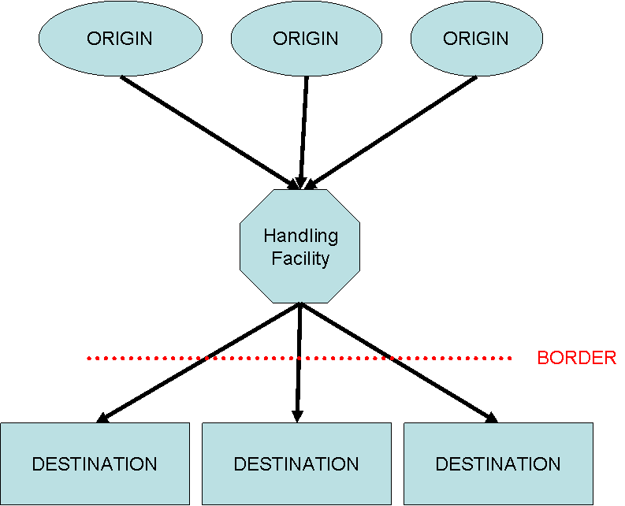

Slide 18
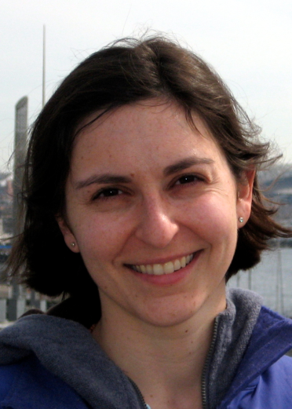

current projects
Urban Pick-up and Delivery Systems
  Trade-offs between cost, emissions, and service quality
  Amazon Fresh, Cascade Express, UW Mailing Service
  Implications of broad transportation replacement
  Relationships with land-use, policy

Slide 19
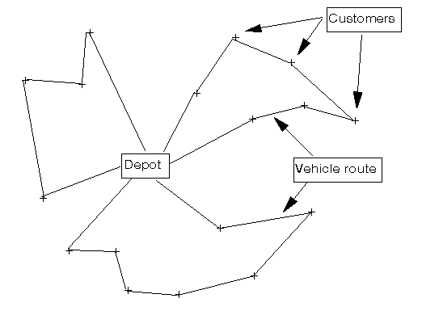

Slide 20


Network without Congestion
Pickup 3
Delivery 3
Pickup 4
Delivery 4
Pickup 1
Delivery 1
Pickup 2
Delivery 2

Slide 21
Results: Network with Congestion
Pickup 3
Delivery 3
Pickup 4
Delivery 4
Pickup 1
Delivery 1
Pickup 2
Delivery 2

Slide 22
Results: 3 Periods
Travel Time on link i
Period 2 (congestion)
Period 1
Period 3
6:30
7:30
9:00
10:00

Slide 23
Results: Assignment
Delivery 3
Pickup 3
Pickup 4
Delivery 4
Pickup 1
Delivery 1
Dark veh, which pollutes more, is assigned to a shorter route
Pickup 2
Minimal Cost Solution: Veh assigned differently (+2%)
Delivery 2

Slide 24

Statewide Freight Modeling
Improving freight resilience
  Mapping important supply chains
  Developed first statewide freight model
  Improving link cost functions to better represent freight movement
  Understanding how DOTs can improve system resilience

Slide 25
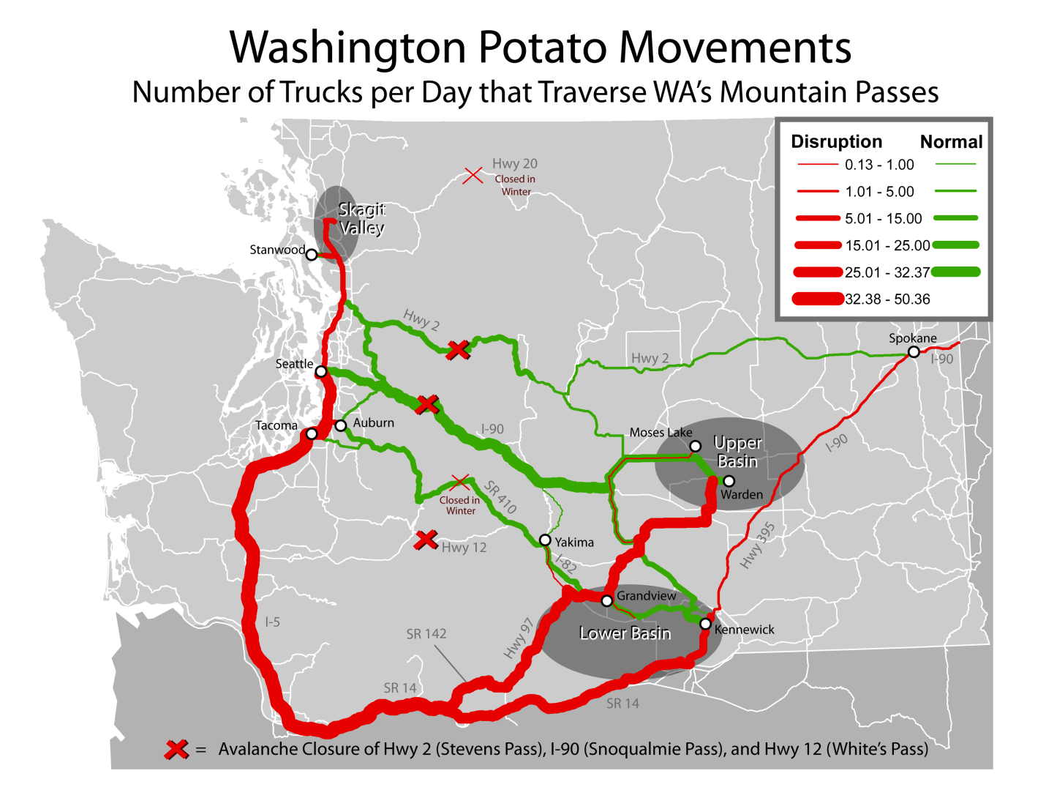

Slide 26
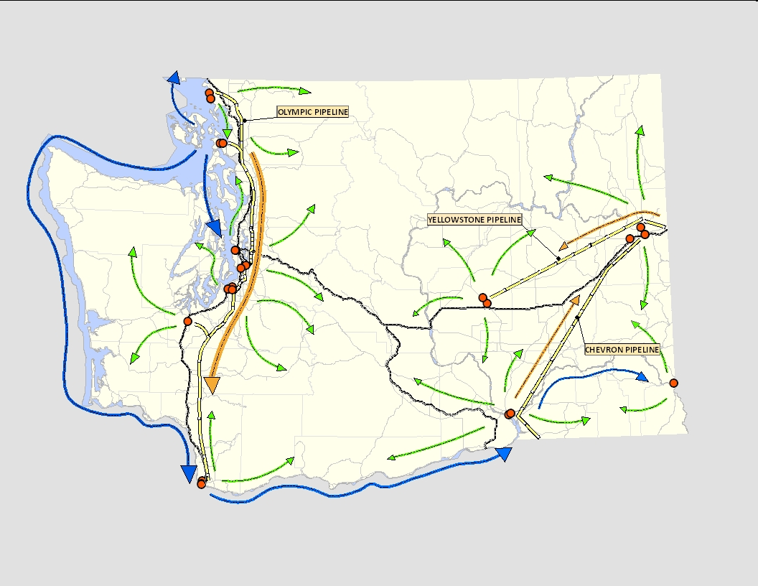
Mapping diesel flows
terminal racks
truck
pipeline
barge

Slide 27

Improving Transportation Education
Developing module for FHWA
  Distance learning
  Active learning
Transportation Policy course development

Slide 28
Previous Research
Distribution of warehousing activity and the impact on transportation
Modeling near port transloading activity
Evaluating policies to reduce port trucking delay
New models in North American port development
Evaluating supply chain GHG emissions
Air terminal operations
Identifying airline charter potential
Marine terminal operations

