Slide 1
Nihan - 500 Seminar

Slide 2
Intro
Who I am
Nancy L. Nihan
Professor, CEE Dept.
Director, Transportation Northwest (TransNow) University Transportation Center
What I do
Research
Teaching
Administration

Slide 3
What I’d like to talk about today
The class I teach next quarter
My research interests
TransNow UTC
How it supports you
How you can help us

Slide 4
What is your gender?
Male
Female

Slide 5
How long was your door-to-door trip to school today?
<15 mins
15-30 mins.
30-60 mins
60-90 mins
>90 mins

Slide 6
What travel mode did you use for the major part of your trip?
Walk
Bike
Motorcycle
Carpool or Vanpool
Bus
SOV
Other

Slide 8
Your First Quarter:
Now that you’ve been here awhile, you must be pretty impressed.
Some of you have already learned the correct answers to some of the most important and difficult transportation questions …

Slide 9
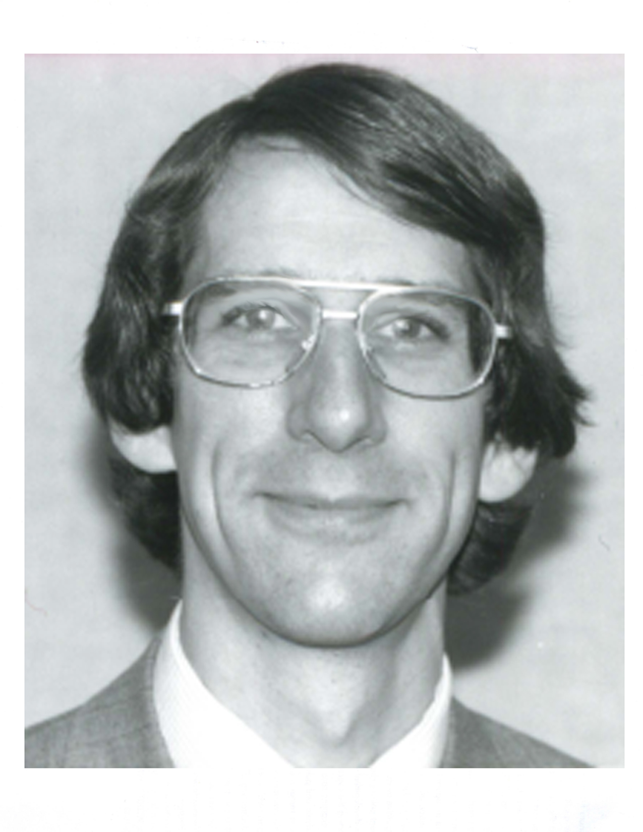
It depends.

Slide 10
CEE 410 – Traffic Engineering Fundamentals
Class limit of 45 has been reached.
Waiting list of 10
2 grad students
Prereq – CEE 320
See me after class

Slide 11
CEE 410 – Traffic Engineering Fundamentals (cont)
Prereq – CEE 320
Reviews some of the material on uninterrupted flows and their speed/flow/density relationships
Concentrates on flows for networks of signalized and unsignalized intersections
I send you out in traffic – 5 outside labs

Slide 12
CEE 410 – Traffic Engineering Fundamentals (cont.)
You learn how to use data collection equipment.
radar guns,
laptops, etc.
You learn to use key traffic software packages.
HCS – Highway Capacity Software. Uses the analysis methods from the Highway Capacity Manual
Synchro – Software that optimizes signal timings for street corridors and networks
SimTraffic – Micro-simulation model that produces animated simulations and reports

Slide 13
CEE 410 – Traffic Engineering Fundamentals (cont.)
And you get some demos of another micro-simulation package – VISSIM.
VISSIM Expert: Chris Hunter
Visiting Associate Professor
On sabbatical with us for the year
Today – a brief example
You will also hear from one or two local professionals who are working on transportation projects in the Seattle area

Slide 14
Research Interests
ITS applications to traffic operations
Improved single-loop and dual-loop real-time data collection
Use of video imaging technologies for collection of real-time traffic data
Vehicle tracking with GPS
Traffic modeling
Simulation models
Statistical and theoretical models

Slide 15
Possible Research Projects
Simulate active traffic management strategies
How effective are they?
Where do they break down?
Analyze freeway occupancy, volume, and speed data coming from freeway loop detectors to determine statistical relationships
Use time series analysis to isolate O-D patterns in freeway traffic streams
Attempt to approximate travel times and vehicle lengths from such patterns

Slide 16
Transportation Northwest
University Transportation Center (UTC)
Federal Region X

Slide 17
TransNow
How we got started and kept going
Transportation Acts
Competition
What we do
Research and Education
Outreach and Technology Transfer
What transportation groups join us
Consortium universities
Local, state, regional, and national partners

Slide 18
First (and Continuing) Regional UTC for Federal Region X
Established in September 1988
Consortium of 6 universities in the region with transportation programs
UW lead university
Now in our 22nd year of operation

Slide 19
Federal Region X
WA
OR
ID
4.0 % of U.S. Population
25.1% of Nation’s Land
AK

Slide 20
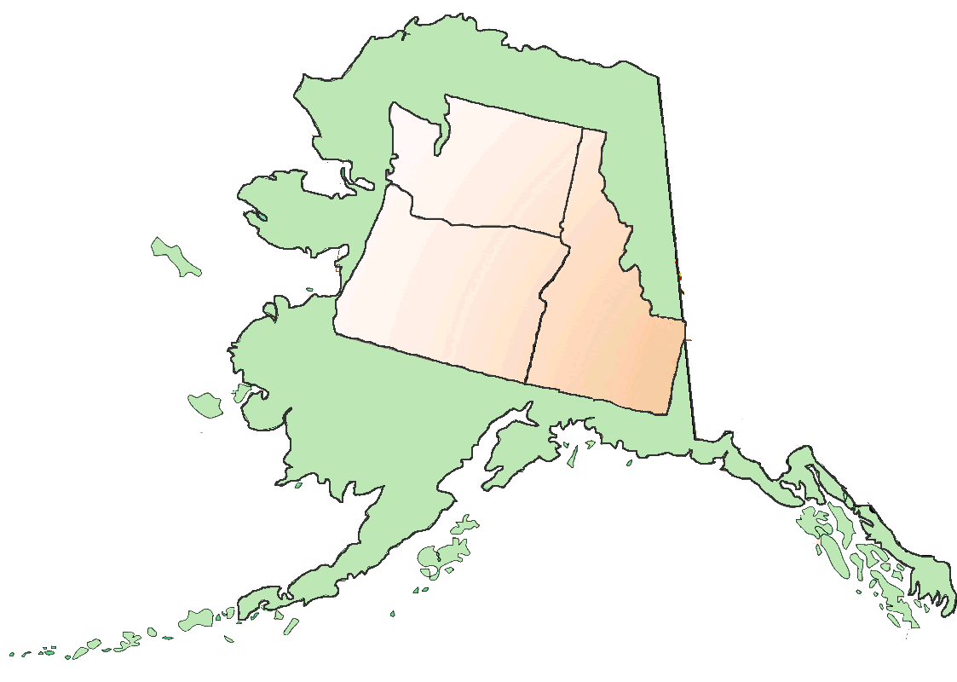

Slide 21
Surface Transportation Act of 1987
Established the University Transportation Centers Program
10

Slide 22
University Transportation Centers Program (UTCP)
Established 10 regional UTCs - Competition
$1 million per year authorized for each UTC
100% local match required
Administered by Research and Special Programs Administration (RSPA), USDOT

Slide 23
Intermodal Surface Transportation Efficiency Act of 1991
ISTEA
19
10 Regional UTCs
3 National UTCs*
6 Institutes*
*Designated

Slide 24
Transportation Equity Act for the 21st Century (1997)
TEA 21
TEA21
33
10 Regional UTCs
23 Designated UTCs

Slide 25
Safe, Accountable, Flexible, Efficient Transportation Equity Act: A Legacy for Users (August, 2005)
SAFETEA-LU
67
10 Regional UTCs
10 Tier I UTCs
47 Designated UTCs

Slide 26
TransNow – Then and Now

Slide 27
Then
1988–1997: One of the first 10 Regional UTCs (competition)
TransNow consortium - six universities: OSU, PSU, UAF, UI, UW, WSU
UW – Lead university
$1 million per year (federal)
$1 million per year local match (non-federal)
1998 – 2005: Still one of 10 Regional UTCs (competition)
UI becomes Tier I UTC (designated)
UW – Lead university, TransNow consortium of five – same level of funding

Slide 28
Now
2006 – Present
Idaho: UI – Tier 1 UTC (competition)
Alaska: National UTC (designated)
AUTC Consortium – UAF, UAA, UAS
UAF – Lead university
Oregon: National UTC (designated)
OTREC Consortium – OSU, PSU, UO, OIT
PSU – Lead university
Washington (competition)
TransNow Consortium – UW, WSU
UW – Lead university
Notes:
UAS – UASoutheast (located in Juneau)
UO – U of Oregon (Eugene)
OIT – Oregon Institute of Technology (Klamath Falls)
OSU – (Corvallis)

Slide 29
Now (continued)
Today – TransNow is still one of 10 Regional UTCs
$2 million per year (federal)
$2 million per year (non-federal)
Consortiums
Current TransNow Consortium – Two universities
Region X Consortium –
Four UTCs and four state DOTs
Universities in all four states with transportation programs

Slide 30
EDUCATION

Slide 31
How TransNow helps you
$$$$$$
class and research support

Slide 32
$$$$$$
Research Assistantships
Internships
Fellowships/Scholarships
Awards and Prizes
Travel Support

Slide 33
Research & Teaching Assistantships
If you are an RA with any of the transportation faculty, TransNow is probably paying all or part of your salary and tuition.
TransNow TA awards are quarterly and usually go to continuing grads (i.e., PhD students)

Slide 34
Internships
Students intern with local transportation organizations 15-20 hrs/wk
TransNow
Pays tuition
Uses salaries & benefits for local match
TransNow Internship Coordinator links students with organizations

Slide 35
Director, Internship Program
Come to the UW! I’ll find you an internship.

Slide 36
Education Support Services
TransNow STAR Lab
Coming soon – Pete Briglia told you about it
Mini Traffic Systems Center
Work stations for our 3 theme areas (freight mobility, traffic operations, transportation infrastructure)
TransNow Communications Center
Professional webinars
Multi-university class seminars
Equipment checkout
Transportation Software Packages in Computer Lab

Slide 37
Awards, Prizes, Fellowships, and Scholarships
Prizes for posters, demos, displays, etc.
Match for scholarships and fellowships
Tuition for WSDOT fellowship students
Outstanding Student of the Year (SOY) award
Graduate student from WSU or UW
GPA
Professional and extra-curricular activities
Written research paper, report, etc.

Slide 38
Awards and Prizes (continued)
Outstanding SOY (cont)
TransNow provides
$1000
trip to D.C. for annual TRB meeting
awards ceremony at CUTC banquet
framed certificate

Slide 39
Student Travel Support
TRB
Outstanding SOY
5 more
(it depends)
Northwest Student Conference
All who want to go
$100 max per person

Slide 40
Established Advanced Institutes (AIs) of Transportation, 1991
Formally established the program’s Educational Component
TransNow AI core program of courses, based in the CE graduate transportation program (Now CEE)
The courses you are taking are part of the TransNow AI program
We count you as the current AI class and try to keep track of you after you graduate
We will be developing a TransNow alumni web page in the near future

Slide 41
First Incoming Class

Slide 42
Outstanding Student of the Year (SOY)
Graduate student selected from the consortium universities each year.
GPA, professional activities, written research, other.
TransNow provides $1000 and trip to D.C. for the annual TRB meeting.
Special awards ceremony at TRB with top USDOT officials.
Lovely plaque – suitable for display

Slide 43
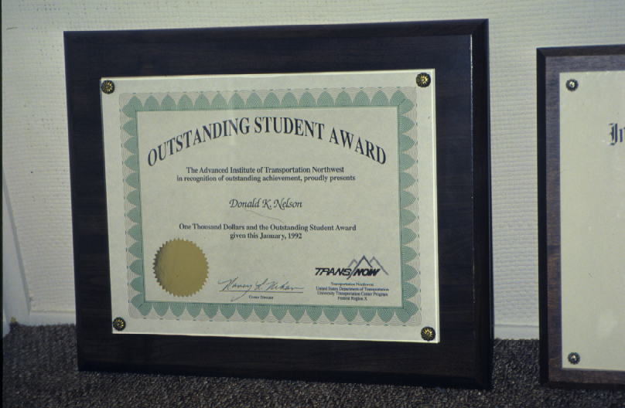

Slide 44
Outstanding SOY – 1993-94
David Dye

Slide 45
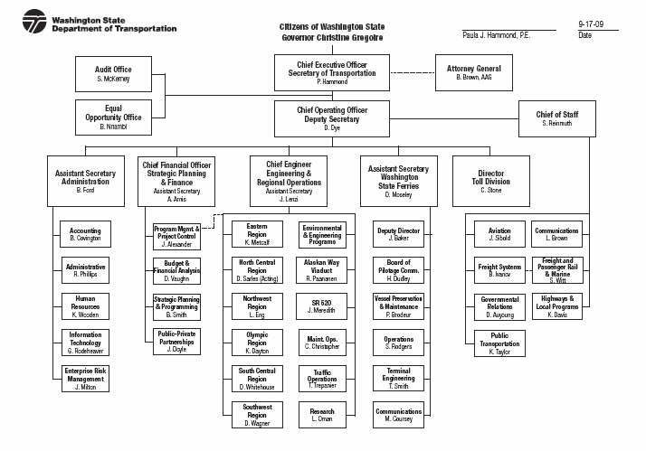

Slide 47
TransNow Staff Here Today
Deb Harper – Program Manager
Anthony Curreri – IT Specialist

Slide 48
How you can help us

Slide 49
“Volunteer”
TransNow-funded students commit to one or two service functions per year
We ask for six hours of your time per year
Example services
Help with the TransNow demos and displays at Engineering Open House
Take TransNow visitors on campus tour
Lots of opportunities to serve – create your own

Slide 50
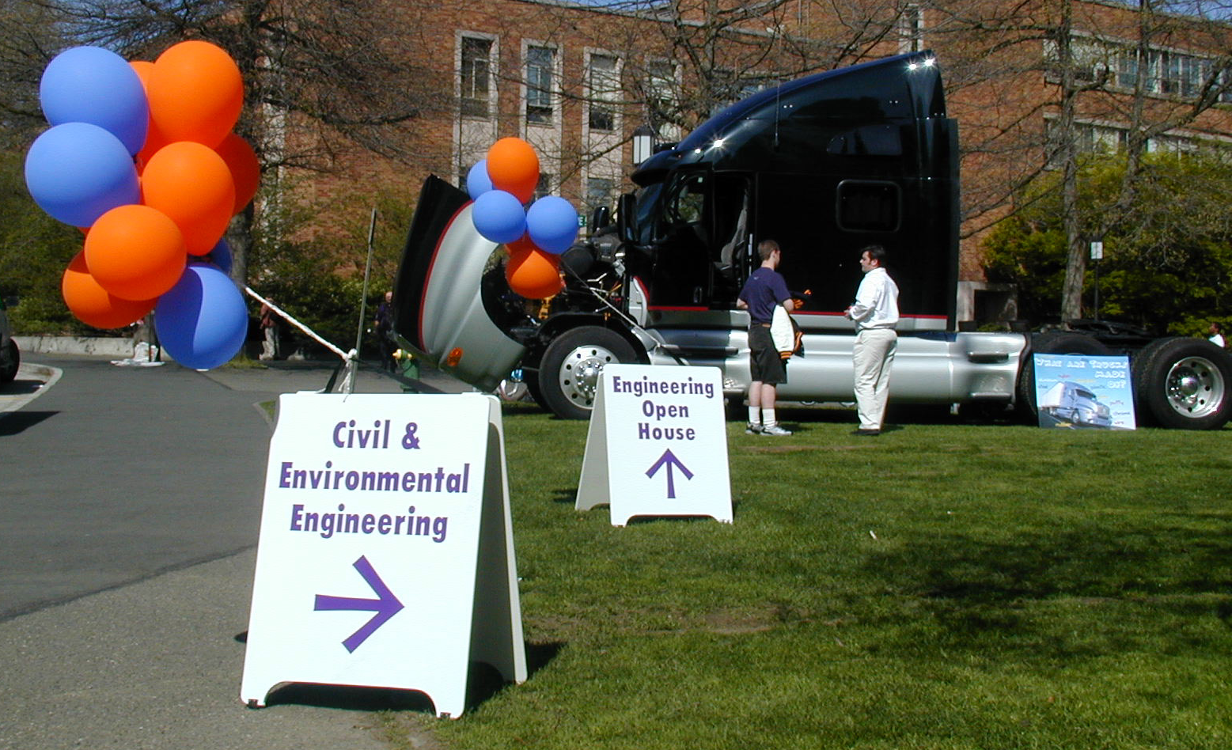
Engineering Open House

Slide 51
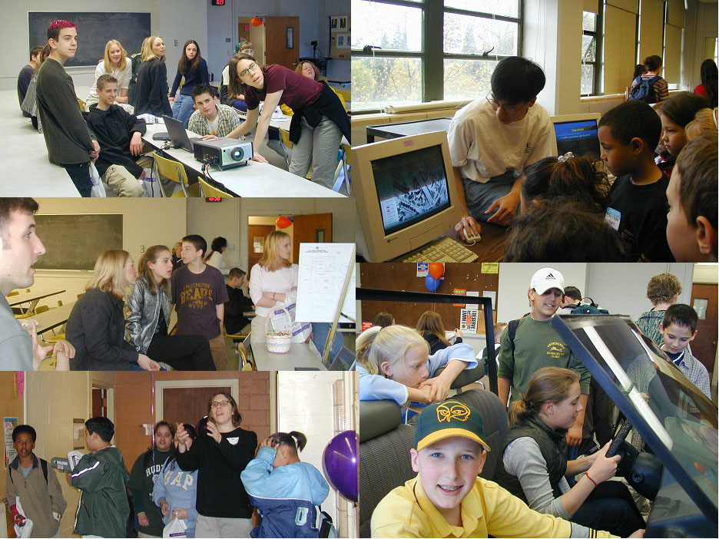

Slide 53
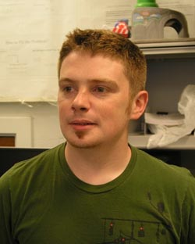
“Volunteer” (continued)
Traffic Hero: UW Student Creates New CoE Open House Demo
June 12, 2009 Yegor Malinovskiy (PhD) is developing Traffic Hero, a new College of Engineering (CoE) Open House demo, to fulfill his volunteering requirement as an Advanced Institute student. Traffic Hero is modeled after Guitar Hero and tracks the flow of traffic just as Guitar Hero tracks guitar chords in songs. The demo will be featured at the 2010 CoE Open House. For more information on the demo, read Yegor's synopsis.

Slide 54
Questions???

