Slide 1
GIS and Network Analyst
A. Goodchild
CEE 587
25 April 2011
Notes:
Have any of you used GIS before?
Taken a GIS class?
Used Network Analyst?

Slide 2
What is GIS?
Geographic Information System
Integrates spatial and non-spatial data
  Spatial (where something is)
  Non-spatial (name, number of residents, speed limit)
Great for making maps and analyzing spatial data
Notes:
Number of units Purchase price
Road class year built surface material
Many types of GIS → ArcGIS is probably the most common
Others: TransCAD, MapInfo, AutoDesk, Microstation, Maptitude
4-step modeling software/CAD software similar
→ need to integrate spatial and non-spatial
→ need to illustrate and analyze
“store, process, and manipulate geospatial data”
Worboys, M., & Duckham, M. (2004). GIS: A computing perspective. Boca Raton, Fla: CRC Press. Pg 1.

Slide 3
Uses of GIS
Examining density
Finding locations
Illustrating spatial information
Routing & directions
Notes:
Many fields use GIS:
public health
wastewater treatment
architects
site/civil
real estate
police/fire
rec department
public works
education
Clusters of diseases
Sewer inventories
School redistricting
Have you ever used Google maps?

Slide 4
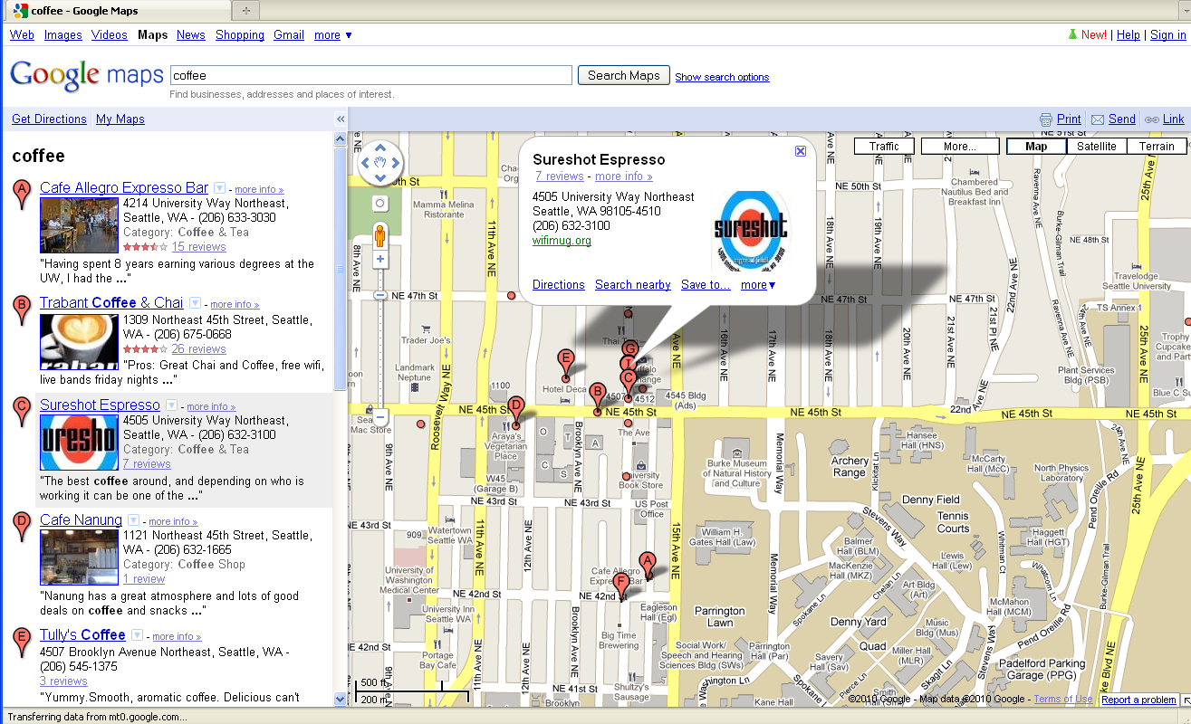
Uses of GIS: Example

Slide 5
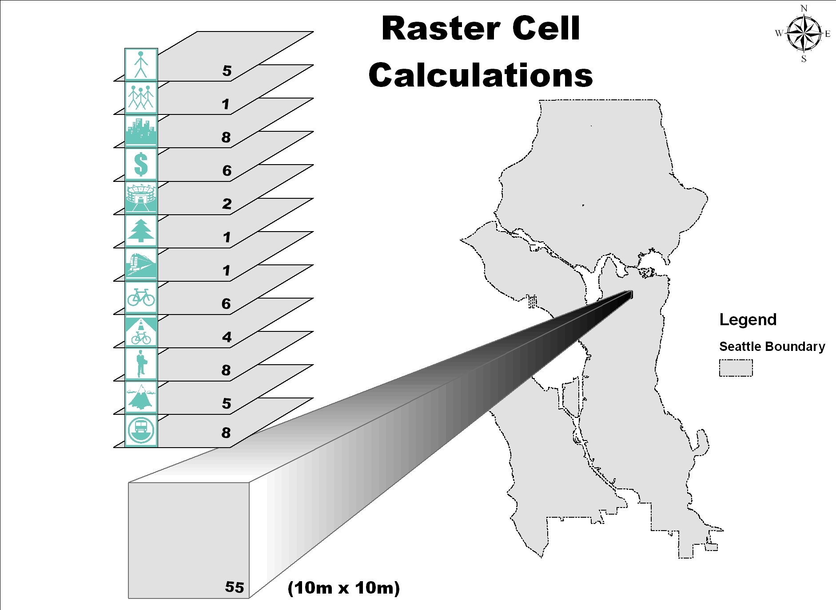
GIS Data Organization
Uses layers for different data sources
Gregerson, J. , Hepp-Buchanan, M., Rowe, D., Vander Sluis, J., Wygonik, E., Xenakis, M., and E. McCormack. (2010) Seattle Bike Share Feasibility Study. University of Washington, Seattle, WA.
Notes:
Each layer is a different data set
Each type of spatial data is its own layer:
municipal boundaries
streets
water bodies
telephone poles
bus stations
sewer lines

Slide 6
GIS data types
Two types of spatial data:
  Raster
  Vector
Many types of non-spatial data
Notes:
Raster is faster.
Vector is better.

Slide 7
GIS spatial data types
Vector Representation
Raster Representation
point
line
polygon
Alberti, Marina. Class Lecture. Urban and Regional Geo-spatial Analysis: Principles of GIS. University of Washington, Seattle, WA. 30 September 2009.
Notes:
These graphics illustrate the two types well, since it can be hard to understand the difference between vector and raster data.
Vector: specific locations, precise boundaries
Raster: location within a grid
density of the grid affects precision and file size

Slide 8
GIS data types
Two types of spatial data:
  Raster
    A grid of cells for an entire area, cell determines location
    One value for each grid cell
    Best for attributes with continuous features
  Vector
Many types of non-spatial data
Notes:
In transportation and logistics, we use raster for background images and grade calculations.
Raster: Satellite imagery, elevation, temperature.

Slide 9
GIS data types
Two types of spatial data:
  Raster
  Vector
    Data located by coordinates
    Referenced to attribute table
    Best for features with discrete boundaries
Many types of non-spatial data
Notes:
In transportation and logistics most of our data is vector data. Street networks, depot locations, political boundaries, bus stops, bus routes, stop light locations, data count info, etc.
Vector: Street networks, political boundaries, depot locations.

Slide 10
Attribute data
Attribute (non-spatial) data is associated with spatial vector data
Spatial Data
Attribute/Non-spatial Data
PIN | Name | Owner | # of Orders
101 | GMC | Dr. Goodchild | 32
102 | STAR | Dr. Wang | 17
103 | TDF | Dr. Chen | 123
104 | GreenRd | Dr. Muench | 57
Notes:
Significant benefits is the ability to link non-spatial data with spatial data
Called an Attribute table

Slide 11
Network Analyst
Combines spatial & non-spatial data
Optimizes using routing algorithms to find solutions
Can identify:
  Catchment/service area
  Shortest or fastest route
  Nearest facility
Notes:
Not just where but what needs to happen there that matters

Slide 12
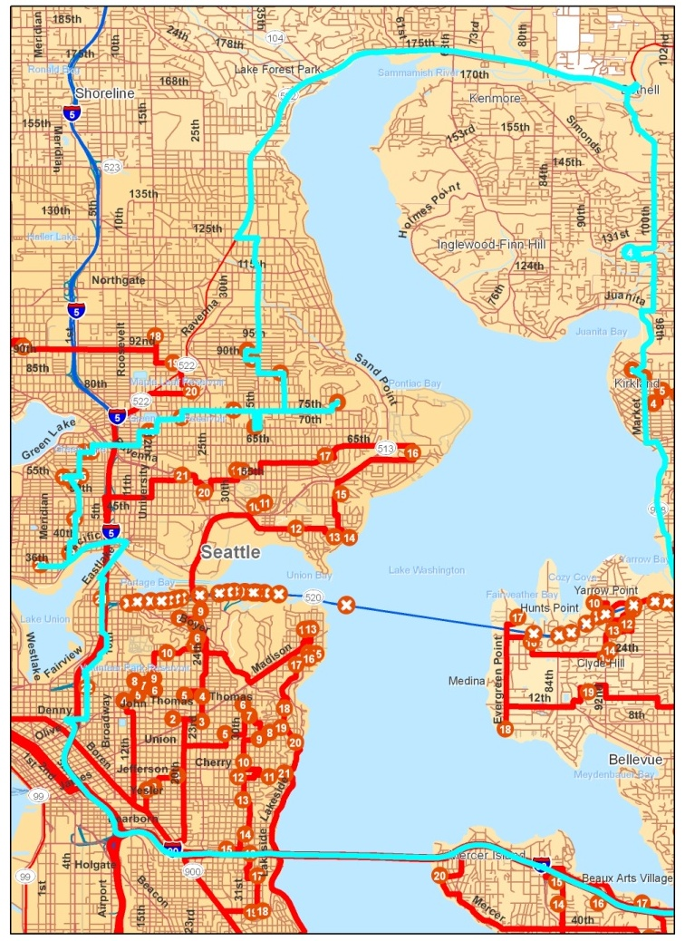
Network Analyst:
Example 1
Delivery Vehicle Routing
Sandoval, Felipe and Anne Goodchild. Research in Progress.
Notes:
Many locations to visit
Many vehicle available
Many roads available
What is the best use of resources?
Network analyst assigns each location to a vehicle
and finds the best route

Slide 13
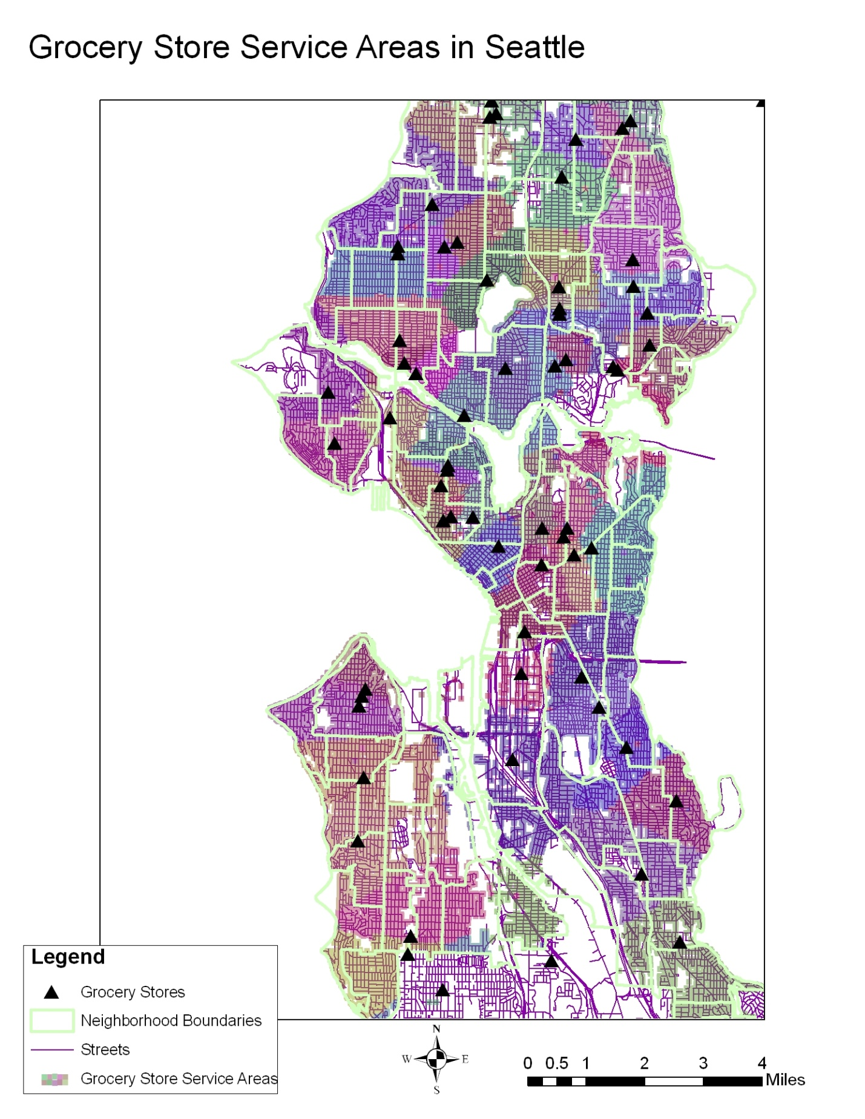
Network Analyst:
Example 2
Grocery Store Service Areas
Wygonik, Erica and Anne Goodchild. Research in Progress.
Notes:
Looking at the service area for grocery stores
Identifying the closest location based on shortest route

Slide 14
Network Analyst Class Exercise
Complete the Network Analyst Tutorial:
http://webhelp.esri.com/arcgisdesktop/9.2/pdf/Network_Analyst_Tutorial.pdf
Complete the in-class assignment
Let me know if you have questions
Notes:
http://courses.washington.edu/cee587/assignments.htm
http://courses.washington.edu/cee587/schedule.htm

