Slide 1
CSS 342
Data Structures, Algorithms, and Discrete Mathematics I
Lecture 5. 150121.
Carrano Ch 2, Appendix E.

Slide 2
Agenda
HW1 Grading
Rubric
PiggyBank.h detailed walk-through
QUIZ: Next Week. Moved to Wednesday.
Recursion. Recursion. Recursion. Recursion. Recursion. Recursion. Recursion. Recursion. Recursion. Recursion. Recursion. Recursion. Recursion. Recursion. Recursion. Recursion. Recursion. Recursion. Recursion. Recursion. Recursion. Recursion. Recursion. Recursion. Recursion. Recursion. Recursion. Recursion. Recursion. Recursion. Recursion. Recursion. Recursion. Recursion. Recursion. Recursion. Recursion. Recursion. Recursion. Recursion. Recursion. Recursion. Recursion. Recursion. Recursion. Recursion. Recursion. Recursion. Recursion. Recursion. Recursion. Recursion. Recursion. Recursion. Recursion. Recursion. Recursion. Recursion. Recursion. Recursion. Recursion. Recursion. Recursion. Recursion. Recursion. Recursion. Recursion. Recursion. Recursion. Recursion. Recursion. Recursion. Recursion. Recursion. Recursion. Recursion. Recursion. Recursion. Recursion. Recursion. Recursion. Recursion. Recursion.. Recursion. Recursion. Recursion. Recursion. Recursion. Recursion. Recursion. Recursion. Recursion. Recursion. Recursion. Recursion. Recursion. Recursion. Recursion. Recursion. Recursion. Recursion. Recursion. Recursion. Recursion. Recursion. Recursion. Recursion. Recursion. Recursion. Recursion. Recursion. Recursion. Recursion. Recursion. Recursion. Recursion Lecture .

Slide 3
#include <iostream>
using namespace std;
class PiggyBank
{
public:
// Constructors
PiggyBank();
PiggyBank(const string &name);
PiggyBank(const int &pennies, const int &nickels, const int &dimes, const int &quarters);
PiggyBank(const string &name, const int &pennies, const int &nickels, const int &dimes, const int &quarters);
~PiggyBank();
//getters/setters
int getPennies() const;
int getNickels() const;
int getDimes() const;
int getQuarters() const;
int getTotal() const;
int getName() const;
bool setPennies(const int &pennies);
bool setNickels(const int &nickels);
bool setDimes(const int &dimes);
bool setQuarters(const int &quarters);
bool setName(const string &name);
//Actions
bool AddCoins(const int &pennies, const int &nickels, const int &dimes, const int &quarters);
int Withdraw(int &pennies, int &nickels, int &dimes, int &quarters);
//Operator Overloads
bool operator==(const PiggyBank &piggy) const;
bool operator!=(const PiggyBank &piggy) const;
bool operator<=(const PiggyBank &piggy) const;
bool operator<(const PiggyBank &piggy) const;
bool operator>=(const PiggyBank &piggy) const;
bool operator>(const PiggyBank &piggy) const;
private:
int pennies, nickels, dimes, quarters;
string name;
};

Slide 4
Quiz on Wednesday. Some likely topics.
Tenants of OOP/C++
Development lifecycle
Interface Design
Encapsulation
C++ fundamentals
Constructors
Operator Overloading: When/How
Pass by value, ref, const ref
Recursion
Templates
Algorithms: bubble sort, insertion sort
Data structures: string, vector, array

Slide 5
In order to understand recursion, it helps to understand recursion.
In order to understand recursion, it helps to understand recursion

Slide 6
In order to understand recursion, it helps to understand recursion.
In order to understand recursion, it helps to understand recursion

Slide 7
Recursive Solutions
Recursion breaks a problem into smaller identical problems
Some recursive solutions are inefficient, impractical
Complex problems can have simple recursive solutions

Slide 8
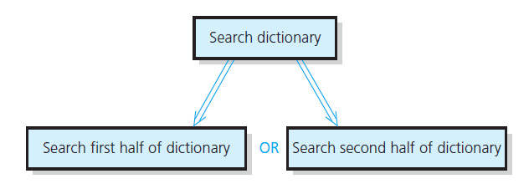
Recursive Solutions
FIGURE 2-1 A recursive solution

Slide 9
Recursive Solutions
A recursive solution calls itself
Each recursive call solves an identical, smaller problem
Test for base case enables recursive calls to stop
Eventually one of smaller calls will be base case

Slide 10
Compute n! recursively
Base Case: n=1
Recursive: n! = n * (n-1)
CODE:

Slide 11
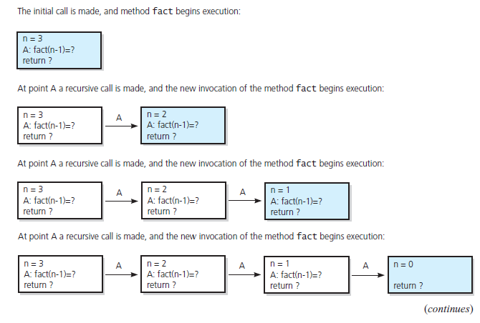
The Box Trace
FIGURE 2-5 Box trace of fact(3)

Slide 12
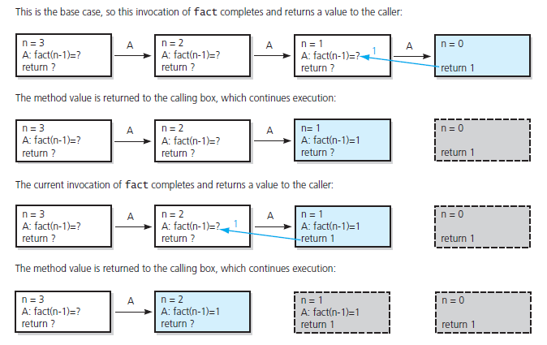
The Box Trace
FIGURE 2-5 Box trace of fact(3) … continued

Slide 13
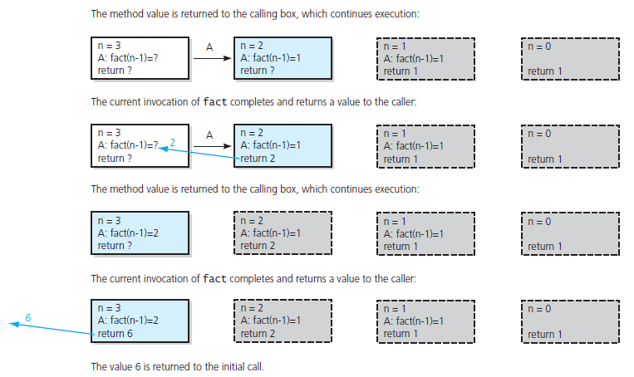
The Box Trace
FIGURE 2-5 Box trace of fact(3) … continued

Slide 14
The Stack (and recursion)
Stack
Location in process which stores temp variables, call stack frames,
One per thread of execution
Heap
Location in process which stores dynamically allocated memory (coming soon)
Recursion
Each call to a function creates stack frame
Frame holds temp variables and locals
Data in the BOX of the BOX trace
Deep Recursion can allocate lots of space on the stack

Slide 15
Time of Invocation (constructors)
Automatic Local
Each time block is executed
Static Local
Once –first time it is hit
Global
In order of declaration in translation unit
Typically before main() is entered
Destroyed in reverse order of construction
Dynamic (tbd)
malloc/free
new/delete

Slide 16
n! puzzle
If an algorithm takes n! operations on a data set of size n, how big of a data set can can today’s computers solve?

Slide 17
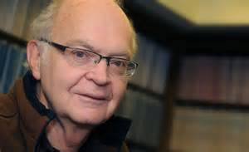
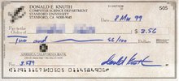
Computer Scientist of the week
Donald Knuth
Born Milwaukee, WI. 1938
Professor Emeritus at Stanford
Father of Analysis of Algorithms
Formalization of mathematical study of complexity of programs
Wrote “Art of Computer Programming”, the definitive text on computer algorithms.
Creator of TeX
Won Grace Hopper Award, Turning Award, John von Neumann Medal.
Opposed to granting computer patents

Slide 18
Recursive example 2.
The maximum number of leaves in a tree can be expressed by the following formula:
$$f\left(0, b\right)=1$$
$$f\left( h, b\right)=b∗f(h−1, b)$$
h = height of the tree
b = max number of branches per node.
Write a recursive function which computes$f\left( h, b\right)$.

Slide 19
Recursion w/Alice
http://www.bing.com/videos/search?q=teaching%20programming%20recursion&qs=n&form=QBVR&pq=teaching%20programming%20recursion&sc=017&sp=1&sk=#view=detail&mid=17C444E18A3FFB1146E017C444E18A3FFB1146E0

Slide 20
Quick review of base conversions
100101₂ = 32 + 4 + 1 = 37
more on board…

Slide 21
Printing Numbers in Any Base
How to convert a decimal to a hexadecimal
Dividend Remainder
16) 123456790₍₁₀₎……..…
16) 7716049₍₁₀₎………6
16) 482253₍₁₀₎………1
16) 30140₍₁₀₎…13(D)
16) 1883₍₁₀₎…12(C)
16) 117₍₁₀₎…11(B)
16) 7₍₁₀₎……....5
16) 0₍₁₀₎……....7
1. Divide by a base(16)
2. Print each reminder from
the bottom: 75BCD16(16)

Slide 22
Printing numbers in any base (recursively)
Base Case:
if (num < base) { print out num }
Recursive:
Pre-pend to the answer ( num % base )
Recursively call with num/base

Slide 23
Printing numbers in any base (recursively)
void PrintBase(int num, int base, string &ans)
{
string static DIGIT_ARRAY = "0123456789ABCDEF";
if (num < base)
{
ans = DIGIT_ARRAY[num] + ans;
cout << ans;
}
else
{
ans = DIGIT_ARRAY[num % base] + ans;
PrintBase(num / base, base, ans);
}
}

Slide 24
Binary Search
An entire sorted list
First half
Second half
First half
Second half
First half
Find a value in an array.

Slide 25
Binary Search
Base Case: low or high index finds number
Recursive:
Determine midpoint (high+low)/2
Search either lower or upper array

Slide 26
Binary Search
int BinarySearch(int value, int arr[], int index1, int index2)
{
if (value == arr[index1]) return index1;
else if (value == arr[index2]) return index2;
else if (index2 <= index1 + 1) return -1;
else
{
int midpoint = (index1 + index2) / 2;
if (arr[midpoint] > value)
return BinarySearch(value, arr, index1, midpoint);
else
return BinarySearch(value, arr, midpoint, index2);
}
}

Slide 27
What does the box trace look like for binary search?

