Slide 1
CSS 342
Data Structures, Algorithms, and Discrete Mathematics I
Lecture 6. 150126.
CARRANO Carrano Ch 5.3-5.4; Cusack Ch 8: Optional

Slide 2
Agenda
Recursion
HW2 Peer Design Review
C++: Dynamic allocations, Vectors
Intro to Induction

Slide 3
Recursive Solutions
Recursion breaks a problem into smaller identical problems
Base Case
Call into current function
Some recursive solutions are inefficient, impractical
Complex problems can have simple recursive solutions

Slide 4
Binary Search
An entire sorted list
First half
Second half
First half
Second half
First half
Find a value in an array.

Slide 5
Binary Search
Base Case:
low or high index finds number
Recursive:
Determine midpoint (high+low)/2
Search either lower or upper array

Slide 6
Binary Search
int BinarySearch(int value, int arr[], int index1, int index2)
{
if (value == arr[index1]) return index1;
else if (value == arr[index2]) return index2;
else if (index2 <= index1 + 1) return -1;
else
{
int midpoint = (index1 + index2) / 2;
if (arr[midpoint] > value)
return BinarySearch(value, arr, index1, midpoint);
else
return BinarySearch(value, arr, midpoint, index2);
}
}

Slide 7
Choosing k out of n.
A child can have one sweet a day while on vacation. The vacation lasts k days and there are n total different types of sweets. How many different combination of sweets can the child enjoy assuming order is not important and the child does not repeat sweets.
(k)
n
Let’s use recursion to determine the answer.

Slide 8
Choosing k out of n.
Hint: think of an array of n items; item i is either in chosen (k) or not.
Recursion: f(n, k) = f(n-1, k-1) + f(n-1, k)
Possible Base cases:
f(n,0) = 1
f(n, 1) = n
f(n,n) = 1

Slide 9
int KOutOfN(int n, int k)
{
if (k == 0)
{
return 1;
}
else if (k == n)
{
return 1;
}
else
{
return KOutOfN(n - 1 , k) + KOutOfN(n - 1, k - 1);
}
}

Slide 10
Typical types of recursion
Returns Value (n!, …)
Performs an action (adds to a string, …
Divides in half recursively (binary search, …
Tail Recursion
Backtracking (will introduce in future slides)

Slide 11
Peer Design Reviews for HW2

Slide 12
Costs of Recursion/when to use recursion
Main cost of recursion is memory usage on stack
Stack v. Heap
Compiler chooses where to allocate space from. Not always clear and compiler can make optimizations.
Stack is per thread and limited. When space runs out: Stack Overflow.
Function calls place locals, call parameters on stack
Heap gets calls to malloc/free; new/delete generally on heap

Slide 13
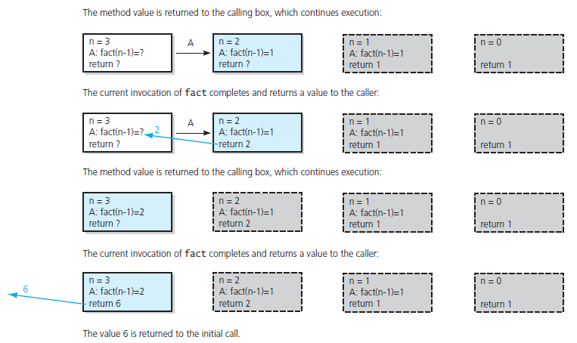
The Box Trace. Memory usage on thread stack!
FIGURE 2-5 Box trace of fact(3) … continued

Slide 14
Dynamic Allocation
Pointer declaration int *p, *q;
Dynamic allocation p = new int; q = new int;
De-allocation delete p;
p = NULL;
Memory leak q = new int;
1
?
2
?
3
NULL
4
NULL
p
p
p
p
Leak!
?
?
?
?
q
q
q
q
?

Slide 15
Dynamic Allocation
Works with all Object types
Bird *pBigBird
pBigBird = Bird(“chicken”);
string s = pBigBird->species;

Slide 17
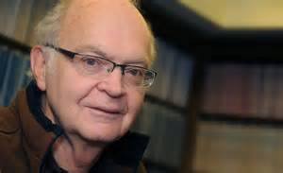
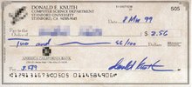
Computer Scientist of the week
Donald Knuth
Born Milwaukee, WI. 1938
Professor Emeritus at Stanford
Father of Analysis of Algorithms
Formalization of mathematical study of complexity of programs
Wrote “Art of Computer Programming”, the definitive text on computer algorithms.
Creator of TeX
Won Grace Hopper Award, Turning Award, John von Neumann Medal.
Opposed to granting computer patents

Slide 18
Recursive Applications
Discrete Mathematics (Combinatorics, Puzzles, Coding Theory)
Tower of Hanoi and Gray Code
Divide and Conquer
Mergesort, Convex Hall, and Fast Fourier Transform
Backtrack
8 Queens, Maze and Classic Chess Program
Fractal Figures
Koch, Sierpinski Allowhead, Gosper, Hilbert, and Dragon curves

Slide 19
For practice…
A Catalan number is defined by the following recursive formula:
Write a recursive function which computes the nth Catalan number.

Slide 20
Backtracking as a problem solving technique
While (solution not complete)
{
if (in good state) “move forward guessing at solution”
else “backtrack to last good state”
}
Often used in combination with Recursion

Slide 21
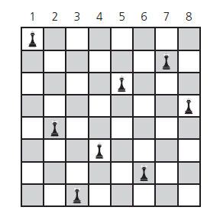
Backtrack: 8 queens problem
Place 8 queens on a 8 * 8 chessboard so that no queen can attack any other queen.

Slide 22
Place one queen in one column at a time.
Backtrack when problems occur.
*from Carranno

Slide 23
8 Queens: Pseudo-code
bool addQueen( bool t[SIZE][SIZE], int col ) {
if ( col >= SIZE )
return true; // all cols have been examined
for ( int row = 0; row < SIZE; row++ )
{
if ( safeLocation( t, row, col ) )
{ // this row may be a candidate
t[row][col] = true; // place a new queen;
if ( addQueen( t, col + 1 ) )
return true; // all the following cols were filled
else
t[row][col] = false; // A wrong position. Try the next row
}
}
return false; // all rows examined, but no candidates
}

Slide 24
Induction
Axiom: The principle of mathematical induction
A property P(n) that involves an integer n is true for all n ≥ 0 if
the following are true:
P(0) is true.
If P(k) is true for any k ≥ 0, then P(k+1) is true.

Slide 25
Intuitive Reasoning about proofs by induction
Imagine a monkey climbing a ladder
Teach how to go from one rung to another rung: K to K+1
Teach how to get onto Rung 1
Imagine a set of dominoes
The k numbered domino knocks over the k+1 domino
Knock over the first domino
Syllabus updates: Cusack book optional for induction, but helpful

