Slide 1
CSS 342
Data Structures, Algorithms, and Discrete Mathematics I
Lecture 7. 150128.

Slide 2
Agenda
Recursion
Induction
Quiz

Slide 3
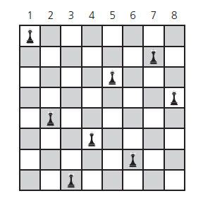
Backtrack: 8 queens problem
Place 8 queens on a 8 * 8 chessboard so that no queen can attack any other queen.

Slide 4
Place one queen in one column at a time.
Backtrack when problems occur.
*from Carranno

Slide 5
8 Queens: Pseudo-code
bool addQueen( bool t[SIZE][SIZE], int col ) {
if ( col >= SIZE )
return true; // all cols have been examined
for ( int row = 0; row < SIZE; row++ )
{
if ( safeLocation( t, row, col ) )
{ // this row may be a candidate
t[row][col] = true; // place a new queen;
if ( addQueen( t, col + 1 ) )
return true; // all the following cols were filled
else
t[row][col] = false; // A wrong position. Try the next row
}
}
return false; // all rows examined, but no candidates
}

Slide 6
Induction
Axiom: The principle of mathematical induction
A property P(n) that involves an integer n is true for all n ≥ 0 if
the following are true:
P(0) is true.
If P(k) is true for any k ≥ 0, then P(k+1) is true.

Slide 7
Intuitive Reasoning about proofs by induction
Imagine a monkey climbing a ladder
Teach how to go from one rung to another rung: K to K+1
Teach how to get onto Rung 1
Imagine a set of dominoes
The k numbered domino knocks over the k+1 domino
Knock over the first domino
Syllabus updates: Cusack book optional for induction, but helpful

Slide 8
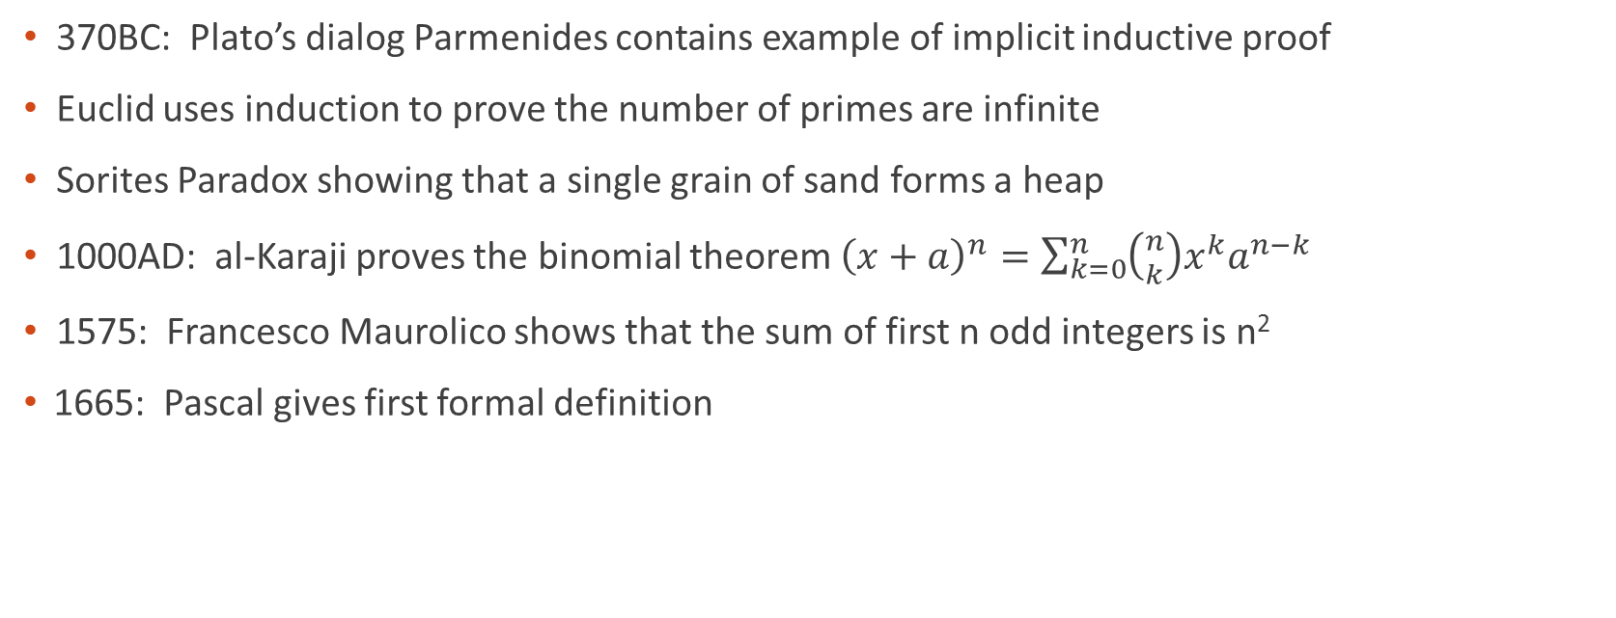
Some history*
370BC: Plato’s dialog Parmenides contains example of implicit inductive proof
Euclid uses induction to prove the number of primes are infinite
Sorites Paradox showing that a single grain of sand forms a heap
1000AD: al-Karaji proves the binomial theorem ${\left(x+a\right)}^{n}=\sum_{k=0}^{n}{\left({n \atop k}\right)x^{k}a^{n−k}}$
1575: Francesco Maurolico shows that the sum of first n odd integers is n²
1665: Pascal gives first formal definition
*from our good friends at Wickapedia

Slide 9
Prove$: \sum_{i=1}^{n}{i=n\left(n+1\right)}$/2
Basis: n=1
$\sum_{i=1}^{1}{i=1\left(1+1\right)}$/2 = 1
The formula is true.
Inductive hypothesis:
Assume that: $\sum_{i=1}^{k}{i=k\left(k+1\right)}$/2
Inductive step:
Show that $\sum_{i=1}^{k+1}{i=(k+1)\left(k+2\right)}$/2
$\sum_{i=1}^{k+1}{i= }$1 + 2 + …+ k + (k+1) = $\sum_{i=1}^{k}{i}$ + (k+1)
=k(k+1)/2 + (k+1)
= k(k+1)/2 + 2(k+1)/2
=(k(k+1) + 2(k+1))/2
=(k+1)(k+2)/2
Therefore, by the principle of mathematical induction, the formula is true when n ≥ 1.

Slide 10
Proof by Induction for x^{n}
Write a recursive function which calculates x^{n}
Prove the correctness of the recursive solution using inductoin
int pow(int x, int n)
{
if (n == 0)
return 1;
else
return x * pow(x, n-1);
}

Slide 11
Proof by Induction for x^{n}
Basis:
When n = 0, pow(x, 0) = 1.
x⁰ = 1.
The recursive function is correct.
Inductive hypothesis:
When n = k, assume that pow(x, k) is correct, i.e., x^{k}.
Inductive step:
Show the pow(x, k+1) is correct.
pow(x, k+1) = x * pow(x, k)
By the inductive hypothesis, pow(x, k) returns the value x^{k}.
Thus, pow(x, k+1) = x * x^{k}
= x^{k+1}
If pow(x, k) is correct, pow(x, k+1) is correct. Therefore, by the principle of mathematical induction, pow(x, n) is correct for any n ≥ 1.

Slide 12
Quiz

