Slide 1
CSS 342
Data Structures, Algorithms, and Discrete Mathematics I
Lecture 8. 150202.
Carrano C++ Interlude 2, Chapt 4, 6.

Slide 2
Agenda
HW3 Questions
Finish Induction
Assignment and Copy Constructor.
Linked Lists

Slide 3
Induction
Axiom: The principle of mathematical induction
A property P(n) that involves an integer n is true for all n ≥ 0 if
the following are true:
P(0) is true.
If P(k) is true for any k ≥ 0, then P(k+1) is true.

Slide 4
Proof by Induction
Write a recursive function which calculates x^{n}
Prove the correctness of the recursive solution using induction
int pow(int x, int n)
{
if (n == 0)
return 1;
else
return x * pow(x, n-1);
}

Slide 5
Proof by Induction for x^{n}
Basis:
When n = 0, pow(x, 0) = 1.
x⁰ = 1.
The recursive function is correct.
Inductive hypothesis:
When n = k, assume that pow(x, k) is correct, i.e., x^{k}.
Inductive step:
Show the pow(x, k+1) is correct.
pow(x, k+1) = x * pow(x, k)
By the inductive hypothesis, pow(x, k) returns the value x^{k}.
Thus, pow(x, k+1) = x * x^{k}
= x^{k+1}
If pow(x, k) is correct, pow(x, k+1) is correct. Therefore, by the principle of mathematical induction, pow(x, n) is correct for any n ≥ 1.

Slide 6
Prove: a+ar¹+ar²+ar³+ … +ar^{n} =a(r^{n+1} – 1)/(r-1)

Slide 7
Strong Form of Mathematical Induction
A property P(n) that involves an integer n is true for all
n ≥ 0 if the following are true:
P(0) is true.
If P(0), P(1), …, P(k) are true for any k ≥ 0, then P(k+1) is true.
Difference from ordinary form of mathematical induction:
P(k+1) is factorized in a combination of two or more of P(0) through to P(k).
Proof by strong form of mathematical induction
Base case or (basis): prove P(0) is true.
Inductive step:
Inductive hypothesis: Assume P(1),P(2),..,P(k) is true for any k ≥ 0
Inductive conclusion: Prove P(k+1) is true.

Slide 8
Prove using induction: Every Integer > 1 Can Be Written as a Product of Prime Integers
Basis: n = 2. 2 is a prime number itself, and thus can be written as a product of prime integers.
The proposition is true.
Strong Inductive hypothesis:
Assume that the proposition is true for each of the integers 2, 3, … k
Inductive step:
Show the proposition is true for k + 1.
If k + 1 is a prime number, there is nothing more to show.
If k + 1 is NOT a prime number, k + 1 is divisible and can be written
k + 1= x * y where 1 < x < k + 1 and 1 < y < k + 1
Notice that x and y can be written as a product of prime integers by inductive hypothesis.
If k is a product of prime numbers, k+1 is a product of prime numbers. Therefore, by the principle of mathematical induction, the proposition is true when n ≥ 1.

Slide 9
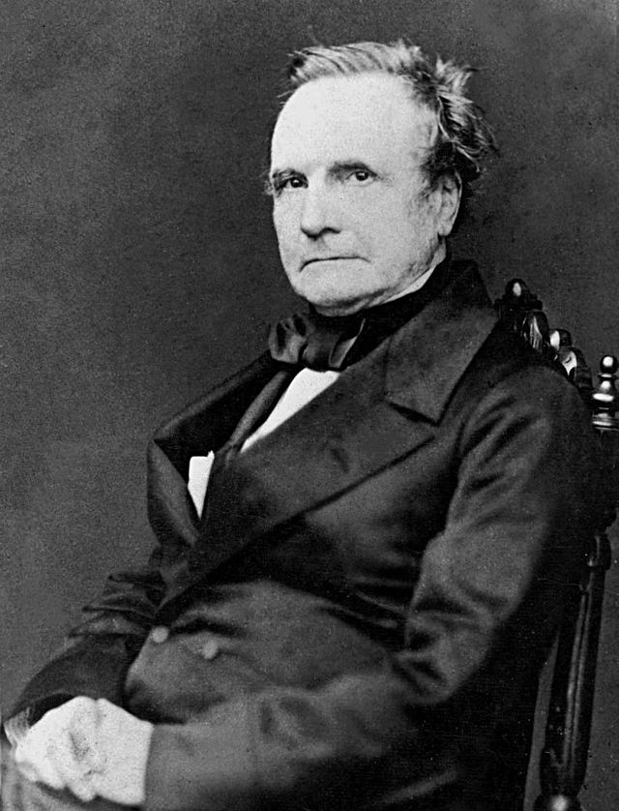
Computer Scientist of the week
Charles Babbage
Mathematician, Philosopher, Mechanical Engineer
Invented the first mechanical computer
Difference Engine: Computed values of polynomial functions
If completed at the time would have had 25000 parts
Finished in 1991
Analytical Engine
Punch card based
Branching and looping supported
Currently being build: 7Hz and 675 Bytes

Slide 10
Copy Constructor Assignment Overload

Slide 11
Assignment / Copy Constructor
class Bird
{
friend ostream& operator<<(ostream &, Bird &);
public:
Bird();
Bird(string name, int ID);
void setFlu(bool flu);
~Bird();
private:
string name;
bool flu;
int id;
};
1) Bird b1("eagle", 123);
2) Bird b2;
cout << "bird 1 " << b1;
cout << "bird 2 " << b2;
3) b2 = b1;
cout << "bird 2 " << b2;
4) Bird b3 = b1;
cout << "bird 3 " << b3;
Constructor(string, int)
Default Constructor
Assignment
Copy Constructor

Slide 12
Assignment/Copy Constructor
All objects have implicit assignment operator and Copy constructor
Chains to the assignment operators of the class members
Built-in types do straight-forward copies
This often works. However, when memory is dynamically allocated in the class it has problems.
Need to override = and copy constructor in these cases
Assignment: MyClass& operator=(const MyClass &myobj)
Copy Constructor: MyClass(const MyClass &source)

Slide 13
Overriding copy and == constructor
Bird::Bird() { }
Bird::Bird(string name, int n)
{
birdName = name;
id = n;
flu = false;
}
Bird::Bird(const Bird &b)
{
cout << "copy constructorcalled " << endl;
}
Bird& Bird::operator=(const Bird &b)
{
cout << "assignement has been called!!" << endl;
}

Slide 14
Assignment
If Assignment = is over-ridden then all copying / allocation must be done on the object
General steps
MyClass& MyClass::operator= (const MyClass &source)
{
1) If (this == &source) return;
2) //chain all member’ assignments operators
3) // manage all dynamic memory that has been utilized
// de-allocate memory in destination
// allocate new memory for a deep copy or just copy ref for a shallow copy
4) return *this;
}

Slide 15
Copy Constructor
Can be implemented with call to default constructor and then assignment (may not be most efficient)
MyClass::MyClass(const MyClass &source)
{
MyClass();
*this = source;
}
Copy Constructor is invoked in these three cases:
MyObj o1 = o2
Pass by Value
Return by Value

Slide 16
Linked Lists…

Slide 17
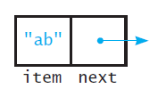
A node
Struct Node
{
string item;
Node *next;
}

Slide 18
A linked list
FIGURE 4-2 Several nodes linked together

Slide 19
A linked list with headPtr
FIGURE 4-3 A head pointer to the first of several linked nodes

Slide 20
Let’s build an Int Stack
Use a linked list as a data structure
Use the following “node” structure
struct Node
{
int value;
Node *next;
};
Overload the following operators:
<<
Assign =
+
Change into a sorted list
Add Remove / Peek function

Slide 21
Push/Pop impl.
bool IntStack::Push(int val)
{
Node *insNode;
insNode = new Node;
insNode->value = val;
insNode->next = head;
head = insNode;
return true;
}
bool IntStack::Pop(int &val)
{
if (head == NULL)
{
return false;
}
else
{
Node *temp;
temp = head;
val = temp->value;
head = head->next;
delete temp;
return true;
}
}
IntStack::IntStack()
{
head = NULL;
}
IntStack::~IntStack()
{
this->Clear();
}

Slide 22
More next time…

