Slide 1
CSS 342
Data Structures, Algorithms, and Discrete Mathematics I
Lecture 9. 150204.
CARRANO Chapt. 7, 8

Slide 2
Agenda
HW3 Questions
Finish Stack implementation
Linked Lists
Quiz turn-back review

Slide 3
A linked list with head pointer
FIGURE 4-3 A head pointer to the first of several linked nodes

Slide 4
Let’s build an Int Stack
Use a linked list as a data structure
Use the following “node” structure
struct Node
{
int value;
Node *next;
};
Implement Push/Pop
Overload the following operators:
<<
Assign = and Copy Constructor
+, +=

Slide 5
Push/Pop impl.
bool IntStack::Push(int val)
{
Node *insNode;
insNode = new Node;
insNode->value = val;
insNode->next = head;
head = insNode;
return true;
}
bool IntStack::Pop(int &val)
{
if (head == NULL)
{
return false;
}
else
{
Node *temp;
temp = head;
val = temp->value;
head = head->next;
delete temp;
return true;
}
}
IntStack::IntStack()
{
head = NULL;
}
IntStack::~IntStack()
{
this->Clear();
}

Slide 6
Proper stack clean up
IntStack::~IntStack()
{
this->Clear();
}
void IntStack::Clear()
{
int a;
while (Pop(a));
}

Slide 7
Let’s build an Int Stack
Use a linked list as a data structure
Use the following “node” structure
struct Node
{
int value;
Node *next;
};
Implement Push/Pop
Overload the following operators:
<<
Assign = and Copy Constructor
+, +=

Slide 8
Print Stack
ostream& operator<<(ostream &outStream, const IntStack &stack)
{
Node *pNode;
pNode = stack.head;
while (pNode != NULL)
{
outStream << pNode->value << endl;
pNode = pNode->next;
}
return outStream;
}

Slide 9
Let’s build an Int Stack
Use a linked list as a data structure
Use the following “node” structure
struct Node
{
int value;
Node *next;
};
Implement Push/Pop
Overload the following operators:
<<
Assign =, copy constructor
+

Slide 10
Computer Scientist of the week
Anonymous
Computer Scientist Hactivists
Named 100 most influential people in the world (Time)
Generally attack through DDOS
Philosophy generally anarchic and swings between entertaining pranks or political activism
Strong support Occupy Movement and Arab Spring
Controversial methods

Slide 11
Assignment (=)
void IntStack::operator=(IntStack &source)
{
Node *sNode, *dNode, *insNode;
if (this == &source) return;
this->Clear();
if (source.head == NULL) return;
dNode = new Node;
dNode->value = (source.head)->value;
this->head = dNode;
sNode = (source.head)->next;
while (sNode != NULL)
{
insNode = new Node;
insNode->value = sNode->value;
dNode->next = insNode;
dNode = dNode->next;
sNode = sNode->next;
}
}

Slide 12
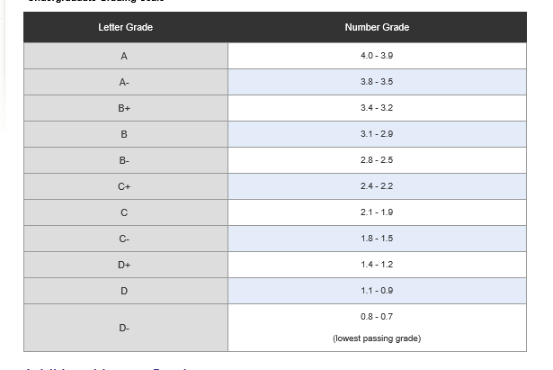
Quiz Review
http://www.uwb.edu/registration/policies/grading/grading-ug

