Slide 1
CSS 342
Data Structures, Algorithms, and Discrete Mathematics I
Lecture 11. 2/18/2015
CARRANO CHAPT 10

Slide 2
Agenda
HW 4
Algorithm Efficiency.
Big O notation.

Slide 3
Quality Metrics
Performance
Space
Time
Scalability
Maintainability
Readability
Extensibility
Debug-ability
Correctness
Cost of bug for boxed-product v. service
Testability
Usability

Slide 4
Performance: Where in the lifecycle?
Performance should be considered in three places in the lifecycle
Design
Algorithm Analysis
Code / Data factoring
Pre-Release
Under load (service)

Slide 5
Execution Time: counting operations
Traversal of linked nodes – example:
Displaying data in linked chain of n nodes requires time proportional to n

Slide 6
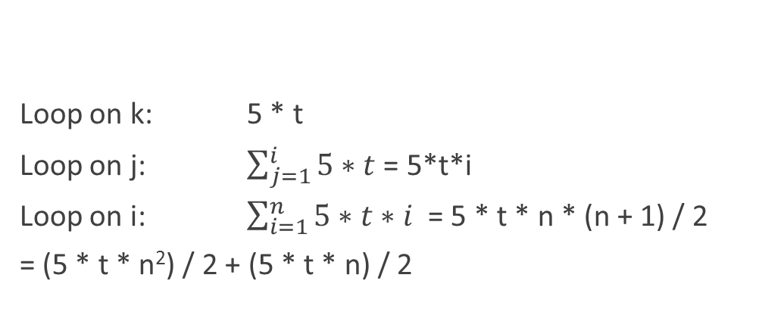
Counting operations
for (i = 1; i <= n; i++)
{
for j = 1; j <= i; j++)
{
for (k = 1 k <= 5; k++)
{
Task
}
}
}
Loop on k: 5 * t
Loop on j: $\sum_{j=1}^{i}{5∗t}$ = 5*t*i
Loop on i: $\sum_{i=1}^{n}{5∗t∗i }$= 5 * t * n * (n + 1) / 2
= (5 * t * n²) / 2 + (5 * t * n) / 2

Slide 7
Analysis and Big O Notation
Algorithm A is order f ( n ): Denoted O( f ( n ))
If constants k and n₀ exist
Such that A requires no more than k × f ( n ) time units to solve a problem of all sizes n ≥ n₀
Big O is upper-bound, not tight upper bound
Algorithm A grows no faster than O(n)
Tight upper bound is Big Theta Θ
However, it is often abused in CS to mean the tight upper bound

Slide 8
An aside… with more detail
Computer scientists are lazy mathematicians…
From a pure mathematical sense
Big O is upper-bound, not tight upper bound: Algorithm A grows no faster than O( f(n) )
Ω(n) is lower-bound: Algorithm A grows faster than Ω ( f(n) )
Tight upper bound is Θ(f(n)). Algorithm A is Θ( f(n) ) when it is both O( f(n) ) and Ω( f(n) )
O(n) is often abused in CS to mean the tight upper bound as well

Slide 9
Proving an algorithm / code snippet is O( f(n) )
Determine a formula for the number of important operations in algorithm or snippet as a function of n. Say g(n).
Show there is a constant, k, such that k * f(n) > g(n) for all n greater than some number.
Rejoice!

Slide 10
Complexity calculations
g(n) = (5 * t * n²) / 2 + (5 * t * n) / 2
Find k and n₀ such that k*n² > f(n) for all n>n₀
k = 3t, n₀=5
3tn² > 2.5tn² + 2.5tn
3 > 2.5 + 2.5/n, n>5
g(n) is O(n²)

Slide 11
What is lower bound Big-O complexity of this snippet
j = n;
while (j >= 1)
{
Call.Task();
j = j / 3;
}
g(n): number of calls to Call.Task()
g(n) = log₃n + 1
Snippet is O(log₃n)

Slide 12
What is lower bound Big-O complexity of this algorithm
j = n;
while (j >= 1)
{
for (i = 1; i <= j; i++)
{
Call.Task();
}
j = j / 2
}
g(n): number of calls to Call.Task()

Slide 13
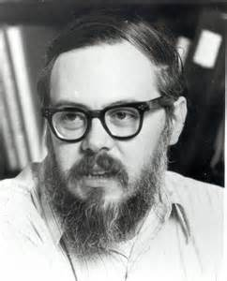
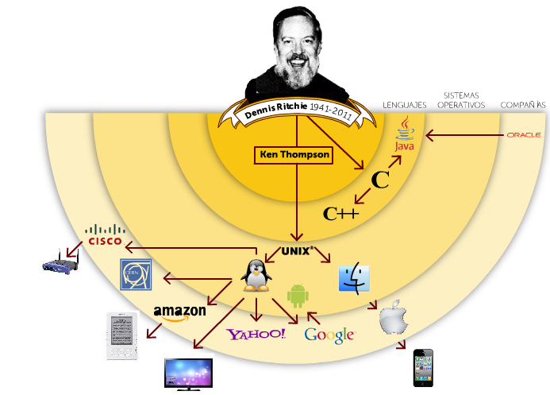
Computer Scientist of the week
Dennis Ritchie
Inventor of Unix with Ken Thompson
Kernel, Shell, Utilities
Goals: simple, communal
Inventor of C
Turing award in 1983
http://www.bing.com/videos/search?q=dennis+ritchie+&FORM=HDRSC3#view=detail&mid=DB6306C75D1B677FD6AADB6306C75D1B677FD6AA

Slide 14
In the 1st while-loop, j = n. for-loop executes Call.Task() n times.
In the 2nd while-loop, j <= n/2, n/2 times
In the 3rd while-loop, j <= n/4, n/4 times
In the z^{th} while-loop, j <= n/2^{z} n/2^{z} times = 1
g(n) = n + (n/2) + (n/4) + (n/8) + …. + (n/2^{z}) where z = log₂n
Geometric Sum:
a + ar + ar² + …. + ar^{n} = a(r^{n+1} – 1)/(r – 1), where r != 1.
g(n) = n + n/2 + n/4 + … + n/2^{z}
= n + n*(1/2) + n*(1/2)² + … + n * (1/2)^{z}
= n( (1/2) ^{z-1} -1)/(1/2 – 1) = n( (1/2) ^{z-1}-1)/(-1/2)
= 2n(1-1/2^{z-1}) = n(2 – 1/2^{z}) = n(2 – 1/n) = 2n - 1
let k = 2, n₀ = 1
g(n) is O( n )

Slide 15
Intuitive interpretation of growth-rate functions
O(1)
Constant
Independent of problem size
O(log₂n)
Logarithmic
Increase slowly as size increases. Ex. Binary search
O(n)
Linear
Increase directly with size. Searching an unsorted list or malformed tree.
O(nlog₂n)
Increase more rapidly than a liner algorithm. Ex. Merge sort
O(n²)
Quadratic
Ex. Two nested loops; bubble sort
O(n³)
Cubic
Ex. Three nested loops
O(2^{n})
Exponential
Increase too rapidly to be practical

Slide 16
Order of growth of common functions

Slide 17
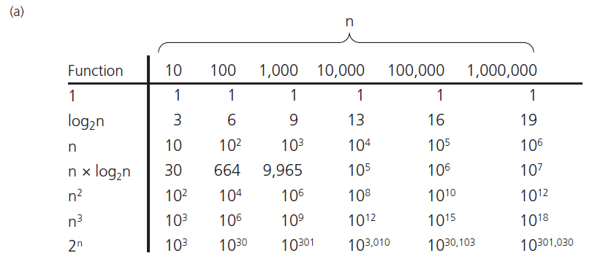
Analysis and Big O Notation
FIGURE 10-3 A comparison of growth-rate functions: (a) in tabular form

Slide 18
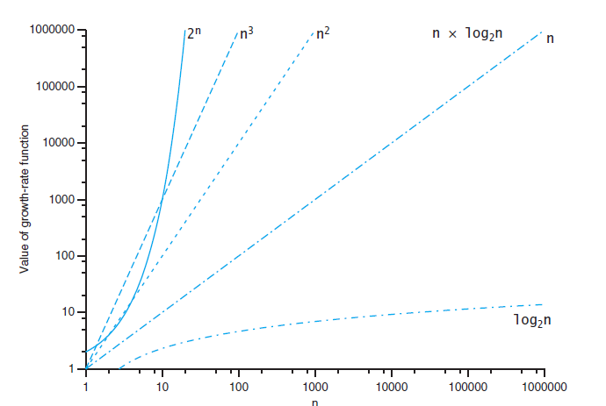
Analysis and Big O Notation

Slide 19
Big O Simplifications
Focus on the dominant factor:
Low-order terms can be ignored. O(n³+4n) = O(n³)
Multiplicative constant in the high-order term can be ignored. O(3n³+4) = O(n³)
O(f(n)) + O(g(n)) = O(f(n) + g(n))
If f(n) = O(g(n)) and g(n) = O(h(n)) , then f(n)=O(h(n))

Slide 20
Worst, Best, and Average-case Analysis
Worst-case analysis:
Algorithm A requires no more than k * f(n) time units.
It might happen rarely, if at all, in practice.
Best-case analysis:
Like worst-case analysis, it might happen rarely.
Average-case analysis:
A requires no more than k * f(n) time units for all but a finite number of values of n
Difficulties: determining probability and distribution of size n and input data

Slide 21
Efficiency of Sequential Search
29
10
14
37
13
52
46
75
5
43
21
69
88
1
Hit!
Best case
O(1)
Hit!
Worst case
O(n)
Hit!
Average case
O(n/2) = O(n)

Slide 22
Complexity of Binary Search
x
low =0
mid = (15 + 0)/2 = 7
high=15
10
a
1
5
10
13
14
21
29
37
43
46
52
69
75
88
91
99
new high=7–1=6
int binarySearch( const vector<int> &a, const int x )
{
int low = 0;
int high = a.size( ) – 1;
int mid;
while ( low <= high ) {
mid = ( low + high ) / 2;
if ( a[mid] < x )
low = mid + 1;
else if ( a[mid] > x )
high = mid – 1;
else
return mid;
}
return NOT_FOUND; // NOT_FOUND = -1
}

Slide 23
1
5
10
13
14
21
29
37
43
46
52
69
75
88
91
99
1st step
2nd step
3rd step
Hit!
N = 2 K = 1
N = 4 K = 2
N = 8 K = 3
N = 16 K = 4
N = 2^{k} K = K
2^{K-1} < N < 2^{K}
K – 1 < log₂N < K
K < 1 + log₂N < K + 1 K = O(log₂N)
4th step

Slide 24
Big-O complexity. Lab3
+ operator on two lists
What was your efficiency?
Call insert on each element?
One list after the other?
Merge operator
What was your efficiency?

Slide 25
Minimum Element in an Array
Given an array of N items, find the smallest item.
What order (in big O) will this problem be bound to?
1
N
3
9
1
8
5
2
0
7
4
6
-1
10
-2

Slide 26
Closest Points in the Plane
Given N points in a plane (that is, an x-y coordinate system), find the pair of points that are closest together.
What order (in big O) will this problem be bound to?
y
sqrt( (x₂ – x₁)² + (y₂ – y₁)² )
2,1
1,4
1,6
4,5
4,7
5,4
5,6
6,3
6,7
7,1
x
8,4

Slide 27
Intractable, Unsolvable, and NP problems
Tractable problems
Their worst-case time is proportional to a polynomial (class P)
However, sometimes this can take a long time
Intractable problems
Their worst-case time cannot be bounded to a polynomial.
Unsolvable algorithms:
They have no algorithms at all.
Turing’s Halting problem
NP(Non-Polynomial) problems
No solution with Polynomial worst-case performance, but when solved can be checked polynomial time
NP-Complete Problems
Class of problems that if any can be solved with polynomial worst-case, all can be solved
Ex, Traveling salesperson problem

