Slide 1
CSS 342
Data Structures, Algorithms, and Discrete Mathematics I
Lecture 13. 150225.
Chapter 11.

Slide 2
Agenda
HW 4: questions.
Sorts: MergeSort, Selection Sort, Quick Sort.
Linked list problem on midterm

Slide 3
HW4
Turn in, in a .zip (not gz, etc..):
(1) Your SortImpls.h file which has implementations of all of the sorts
(2) Your .exe or a.out file
(3) A separate report in word or pdf which includes:
a) a one-page output of your improved IterativeMergeSort program; output for it running with when #items = 29
b) Graphs that compares the performance among the different sorting algorithms with increasing data size.

Slide 4
Sorts and sorting

Slide 5
Sorting the Sorts
Selection Sort worst/average O(n²)
Bubble Sort worst/average O(n²)
Insertion Sort worst/average O(n²)
Shell Sort worst O(n²)/average O(n^{3/2})
Merge Sort worst/average O(n log n)
Quick Sort worst O(n²)/average O(n log n)
Radix Sort worst/average O(n)

Slide 6
MergeSort
Key: THE MERGE!
Assuming that we have already had two sorted array,
How can we merge them into one sorted array?
1
4
8
13
14
20
25
2
3
5
7
11
23
1
2
3
4
5
7
8
11
13
14
20
23
25

Slide 7
MergeSort: successive merges
38
16
27
39
12
17
24
5
16
38
27
39
12
17
5
24
16
27
38
39
5
12
17
24
5
12
16
17
24
27
38
39
Use recursion to get here

Slide 8
MergeSort
mid=(fist + last)/2
first
last
theArray
38
16
27
39
12
17
24
5
mid=(fist + last)/2
mid=(fist + last)/2
first
last
first
last
first < last
38
16
27
39
12
17
24
5
first
last
38
16
27
39
12
17
24
5
first
last
38
16
27
39
12
17
24
5

Slide 9
MergeSort: Overview
mid=(fist + last)/2
first
last
theArray
38
16
27
39
12
17
24
5
void MergeSort(vector<int> &iVector, int first, int last)
{
if (first < last)
{
int mid = (first + last) / 2;
MergeSort(iVector, first, mid);
MergeSort(iVector, mid + 1, last);
Merge(iVector, first, mid, last);
}
}
38
16
27
39
12
17
24
5
first
last
38
16
27
39
12
17
24
5
38
16
27
39
12
17
24
5
16
38
27
39
12
17
5
24
16
27
38
39
5
12
17
24
http://en.wikipedia.org/wiki/Merge_sort#mediaviewer/File:Merge-sort-example-300px.gif
5
12
16
17
24
27
38
39

Slide 10
MergeSort: (Efficiency Analysis)
Level | # sub-arrays | #comparisons # copies per merge
1 | 4 | 1 2 * 2
2 | 2 | 3 4 *2
3 | 1 | 7 8 * 2
X | n/2^{x} | 2^{x}-1 2^{x} * 2
38
16
27
39
12
17
24
5
16
38
27
39
12
17
5
24
16
27
38
39
5
12
17
24
5
12
16
17
24
27
38
39
At level X, #nodes in each sub-array = 2^{x}
At level X, # major operations = n/ 2^{x} * (3 * 2^{x} – 1) = O(3n)
#levels = log n, where n = # array elements ( if n is a power of 2 )
#levels = log n + 1 if n is not a power of 2
# operations = O(3n) * (log n + 1) = O(3 n log n) = O(n log n)

Slide 11
Selection Sort
0
size-1
Initial array
29
10
14
37
13
Scan item 0 to size-1, locate the largest item,
and swap it with the rightmost item.
After 1st swap
29
10
14
13
37
Scan item 0 to size-2, locate the 2nd largest item,
and swap it with the 2nd rightmost item.
After 2nd swap
13
10
14
29
37
Scan item 0 to size-3, locate the 3rd largest item,
and swap it with the 3rd rightmost item.
After 3rd swap
13
10
14
29
37
Scan item 0 to size-4, locate the 4th largest item,
and swap it with the 4th rightmost item.
After 4th swap
10
13
14
29
37
Scan item 0 to size-5, locate the 5th largest item,
and swap it with the 5th rightmost item.

Slide 12
Selection Sort
void SelectionSort( vector<int> &a )
{
for ( int last = a.size( ) - 1; last >= 1; --last )
{
int indexSoFar = 0;
for ( int i = 1; i <= last; ++i )
{
if ( a[i] > a[indexSoFar] )
indexSoFar = i;
}
swap( a[indexSoFar], a[last] );
}
}
indexSoFar
0
last = a.size( ) - 1
swap
indexSoFar
0
last
swap
indexSoFar
0
last
swap

Slide 13
Efficiency of Selection Sort
Comparisons Swapping
Initial array
29
10
14
37
13
N-1 (=4) 1
After 1st swap
29
10
14
13
37
N-2 (=3) 1
After 2nd swap
13
10
14
29
37
N-3 (=2) 1
After 3rd swap
13
10
14
29
37
N-4 (=1) 1
After 4th swap
10
13
14
29
37

Slide 14
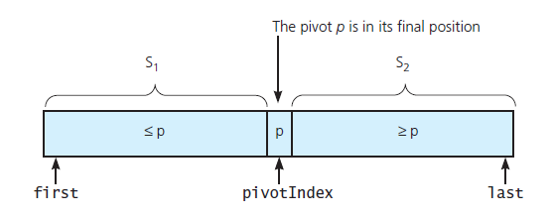
The Quick Sort

Slide 15
Quicksort: Recursive Overview
void quicksort(vector<int> &a, int first, int last)
{
int pivotIndex;
if ( first < last )
{
pivotIndex = choosePivot(a, first, last);
partition( a, fist, last, pivotIndex );
quicksort( a, first, pivotIndex - 1 );
quicksort( a, pivotIndex + 1, last );
}
}

Slide 16
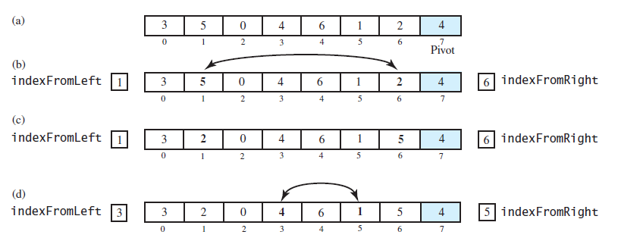
The Quick Sort (after the pivot chosen)

Slide 17
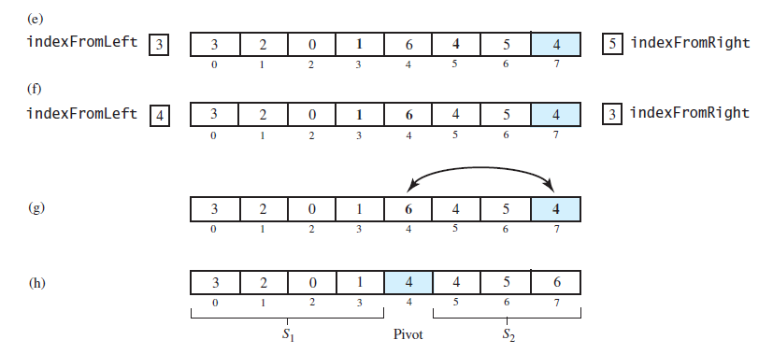
The Quick Sort: (after the pivot chosen)
FIGURE 11-10 Partitioning of array during quick sort

Slide 18
Choosing the pivot
Ideally it is the median as this will split array in half
Not feasible without sorting
Avoid bad pivots
At first, Pivot chosen was last in array. Generally bad behavior
Suggestion: Choose mid of first, middle, last (Sedgewick)
This turns out to be quite decent

Slide 19
Computer Scientist of the week
Sir Charles Antony Richard Hoare
“Tony” Hoare
Developed QuickSort
Dining Philosopher’s problem
ALGOL 60
1980 Turing award
Invented the NULL Reference

Slide 20
The Quick Sort
FIGURE 11-11 Median-of-three pivot selection: (a) The original array; (b) the array with its
first, middle, and last entries sorted

Slide 21
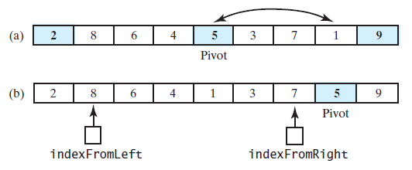
The Quick Sort
FIGURE 11-12 (a) The array with its first, middle, and last entries sorted; (b) the array after positioning the pivot and just before partitioning

Slide 22
Visual of Quicksort
http://en.wikipedia.org/wiki/Quicksort#mediaviewer/File:Sorting_quicksort_anim.gif

Slide 23
void QuickSort(vector<int> &itemVector, int first, int last)
{
if (last - first < 4)
{
InsertionSort(itemVector, first, last);
return;
}
int mid = (first + last) / 2;
if (itemVector[first] > itemVector[last])
{
swap(itemVector[first], itemVector[last]);
}
if (itemVector[first] > itemVector[mid])
{
swap(itemVector[first], itemVector[mid]);
}
else if (itemVector[mid] > itemVector[last])
{
swap(itemVector[mid], itemVector[last]);
}
int pivot = itemVector[mid];
swap(itemVector[mid], itemVector[last - 1]);

Slide 24
int left = first + 1;
int right = last - 2;
bool done = false;
while (! done)
{
while (itemVector[left] < pivot)
{
left++;
}
while (itemVector[right] > pivot)
{
right--;
}
if (right > left)
{
swap(itemVector[left], itemVector[right]);
right--;
left++;
}
else
{
done = true;
}
}
swap(itemVector[left], itemVector[last - 1]);
QuickSort(itemVector, first, left - 1);
QuickSort(itemVector, left + 1, last);
}

Slide 25
Quicksort: Efficiency Analysis
Worst case: If the pivot is the smallest item in the array segment, S1 will remain empty.
S2 decreases in size by only 1 at each recursive call.
Level 1 requires n-1 comparisons.
Level 2 requires n-2 comparisons.
Thus, (n-1) + (n-2) + …. + 2 + 1 = n(n-1)/2 = O(n²)
Average case: S1 and S2 contain the same number of items.
log n or log n + 1 levels of recursions occur.
Each level requires n-k comparisons
Thus, at most (n-1) * (log n + 1) = O(n log n )

Slide 26
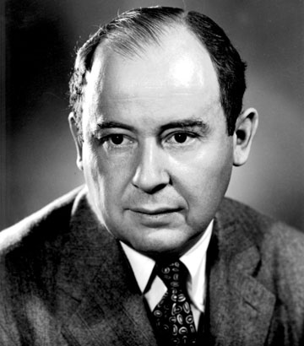
Mergesort versus Quicksort

Slide 27
Mergesort versus Quicksort
 | Worst case | Average case
Mergesort | n log n | n log n
Quicksort | n² | n log n
Why is Quicksort still around?
Reasons:
Mergesort requires item-copying operations from the array a to the temp
array and vice versa.
A worst-case situation is not typical.
Quicksort has very good memory characteristics
Then, why do we need Mergesort?
Reason:
If you sort a linked list, no item-copying operations are necessary.

Slide 28
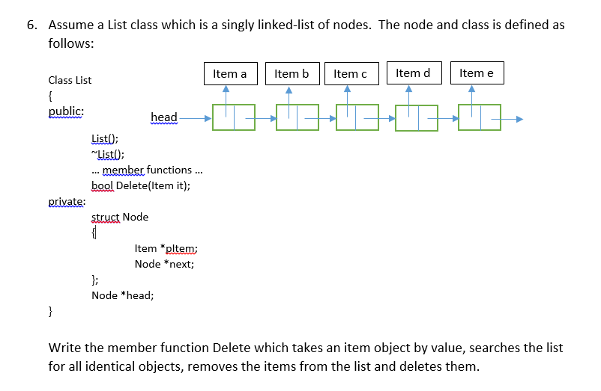

Slide 29
ShellSort
Generalization of the Insertion Sort
Optimized to reduce data movement
Developed 1959 by Donald Shell
Choose an Interleave/gap size (n) and sort the arrays chosen by that size
This moves data large distances quickly
Complexity has not been fully determined
Depends on gap size (see appendix)
Works best on partially sorted data

Slide 30
Shell Sort Example
Using gaps of size 5, 3, 1.

Slide 31
0
gap = 3/2.2 = 1
16
81
94
11
96
12
35
17
95
28
58
41
75
15
85
87
38
20
15
11
12
12
gap = 17/2 = 8
11
15
81
94
11
96
12
35
17
95
20
58
11
75
12
35
17
38
17
17
28
58
41
75
15
85
87
38
sort
28
94
41
96
15
85
87
95
38
20
20
81
28
28
gap = 8/2.2 = 3
20
sort
35
41
38
20
58
11
15
12
11
35
41
75
12
35
sort
17
38
28
75
58
17
38
28
20
41
35
58
75
94
41
96
75
58
87
87
81
15
85
87
94
81
96
94
85
95
81
95
85
81
87
96
94
95
95
85
96

