Slide 1
CSS 342
Data Structures, Algorithms, and Discrete Mathematics I
Lecture 17. 150311.
CUSACK CHAPT 4.

Slide 2
Agenda
HW5: Questions / Discussion.
Final Exam: Monday 3/16.
Propositional Logic… Will be on final.
Final Exam Review.

Slide 3
Lab 5: What to turn in
http://courses.washington.edu/css342/dimpsey/Lab5.pdf
Turn in:
All .cpp and .h files for your project (incl. stdafx.cpp, stdafx, …)
Output file called BankTransOut.txt which is your program run against sample input on site
Your .exe or a.out file
How will we grade this?
Place all of your .cpp/.h in a directory and build using
Cl *cpp
g++ *cpp or g++ -std=c++11 *cpp
Run the created .exe/a.out against a number of test BankTrans.txt files
PLEASE PRACTICE THIS YOURSELF BEFORE TURNING IN

Slide 4
It’s our last class!!!!

Slide 5
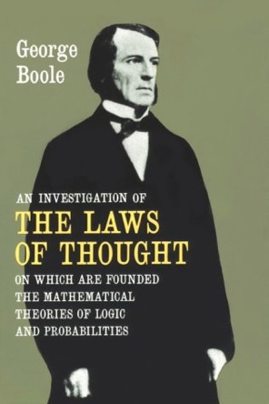
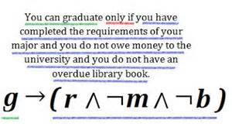
Propositional Logic

Slide 6
Text Book
An Active Introduction to Discrete Mathematics and Algorithms, Charles Cusack, David Santos, GNU Free
Software, 2014.
http://www.cs.hope.edu/~cusack/Notes/Notes/Books/Active%20Introduction%20to%20Discrete%20
Mathematics%20and%20Algorithms/ActiveIntroToDiscreteMathAndAlgorithms.pdf
Chapter 4: Logic.

Slide 7
Theorems for Boolean algebra
Commutative Law
p v q = q v p
p ^ q = q ^ p
Associative Law
p v (q v r) = (p v q) v r
p ^ (q ^ r) = (p ^ q) ^ r
Distributive Law
p ^ (q v r) = (p ^ q) v (p ^ r)
p v (q ^ r) = (p v q) ^ (p v r)
Identity
p v F = p
P ^ T = p
Domination
p v T = T
p ^ F = F
Complement Law
p ^ ¬p = F
p v ¬p = T
Square Law
p ^ p = p
p v p = p
Double Negation
¬(¬p) = p
Absorption
p ^ (p v q) = p
p v (p ^ q) = p

Slide 8
Precedence of Operators
NOT: ¬
AND: ^
XOR
OR: v
Conditional: ->

Slide 9
Prove the following Boolean equations
¬p ^ q v p ^ ¬q = (¬p v ¬q) ^ (p v q)
p ^ q v p ^ q ^ r v p ^ ¬ q = p
(p ^ q v r ) ^ q = p ^ q ^ ¬r v ¬p ^ q ^ r v p ^ q ^ r

Slide 10
Truth Tables
Table iterating all possible combinations for a proposition
Example: p ^ q v p ^ r
p | q | r | p ^ q | p ^ r | p ^ q v p ^ r
0 | 0 | 0 | 0 | 0 | 0
0 | 0 | 1 | 0 | 0 | 0
0 | 1 | 0 | 0 | 0 | 0
0 | 1 | 1 | 0 | 0 | 0
1 | 0 | 0 | 0 | 0 | 0
1 | 0 | 1 | 0 | 1 | 1
1 | 1 | 0 | 1 | 0 | 1
1 | 1 | 1 | 1 | 1 | 1

Slide 11
Conditional Propositions
Given two propositions such as p and q,
If p then q or p → q
is called a conditional proposition.
P: hypothesis, antecedent, or sufficient condition
Q: conclusion, consequent, or necessary condition

Slide 12
Truth Table of Conditional Propositions
Chair Statement: if CSS gets an additional $80,000, it will hire one new faculty member.
P: CSS gets an additional $80,000.
Q: CSS will hire one new faculty member.
If both p and q are true, the chair said a correct statement.
If p is true but q is false, the chair said a wrong statement.
If p is false, the chair is not responsible for his statement. We should regard it as true.
p | q | p → q
T | T | T
T | F | F
F | T | T
F | F | T

Slide 13
If and only if
Given two propositions such as p and q,
p if and only if q or p <-> q
Called a bi-conditional proposition.
True when p and q have the same truth value
False otherwise
p iff q
Show the truth table for:
(p <-> q)<-> (q <-> p)

Slide 14
In-class problem
Let p, q, and r be the propositions.
p: Grizzly bears have been seen in the area.
q: Hiking is safe on the trail.
r: Berries are ripe along the trail.
Write these propositions using p, q, and r and logical connectives.
Berries are ripe along the trail, but grizzly bears have not been seen in the area.
Grizzly bears have not been seen in the area and hiking on the trail is safe, but berries are ripe along the traile
If berries are ripe along the trail, hiking is safe if and only if grizzly bears have not been seen in the area.
It is not safe to hike on the trail, but grizzly bears have not been seen in the area and the berries along the trail are ripe.
For hiking on the trail to be safe, it is necessary but not sufficient that berries not be ripe along the trail and for grizzly bears not to have been seen in the area.
Hiking is not safe on the trail whenever grizzly bears have been seen in the area and berries are ripe along the trail.

Slide 15
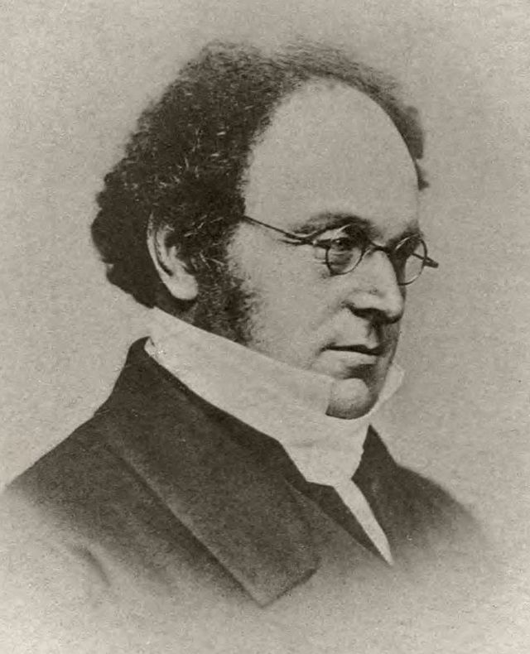
Computer Scientist of the Week
Augustus De Morgan
British Mathematician and logician (1806 – 1871)
De Morgan’s Laws
Introduced the term Mathematical Induction
Discovered Relation Algebra: extension of Boolean algebra
Interested in Spiritualism, Clairvoyance, and psychic phenomenon

Slide 16
De Morgan’s Laws
Show De Morgan’s Law is true
¬(p ^ q) ≡ ¬p v ¬q
¬(p v q) ≡ ¬p ^ ¬q
p | q | p ^ q | ¬(p ^ q) | ¬p | ¬q | ¬p v ¬q
T | T | T | F | F | F | F
T | F | F | T | F | T | T
F | T | F | T | T | F | T
F | F | F | T | T | T | T

Slide 17
Logical Equivalence
If two different compound propositions have the same truth values they are called logically equivalent
Show: ¬(p v q) ≡ ¬p ^ ¬q
p | q | p v q | ¬(p v q) | ¬p | ¬q | ¬p ^ ¬q
T | T | T | F | F | F | F
T | F | T | F | F | T | F
F | T | T | F | T | F | F
F | F | F | T | T | T | T

Slide 18
Logical Equivalence
Let p and q be propositions
Some definitions:
P is a tautology if it is always true
P is a contradiction if it is always false
P is a contingency if it can be either true or false depending on input
p and q are logically equivalent iff
p = q
p and q have the same truth tables
Also written, q ≡ p
Show: ¬p v q ≡ p -> q

Slide 19
¬p v q ≡ p -> q
p | q | ¬p | ¬p v q | p -> q
T | T | F | T | T
T | F | F | F | F
F | T | T | T | T
F | F | T | T | T

Slide 20
Logical Equivalence
if p then q ≡ p only if q ≡ not p or q all called logically equivalent.
If John takes CSS342, he advances to CSS343
John may take CSS342 only if he advances to CSS343.
John does not take CSS342 or he advances to CSS343.

Slide 21
Logical Equivalence
For each pair of propositions P and Q, show whether or not P ≡ Q.
P: p, Q: p v q
P: p → q, Q: ¬p v q
P: p → q, Q: ¬ q → ¬ p
P: (p → q) ^ (q → r), Q: p → r
P: (p → q) → r, Q: p → (q → r)

