Slide 1
CSS 342
Data Structures, Algorithms, and Discrete Mathematics I
9/29/2016. Lecture 1.
CarrANO Ch 1, Appendix A.

Slide 2
CSS342 FAQ
I know Java, do I need to know C++ to take this course?
I missed the C++ bootcamp, will this be a problem?
Is the Rosen book required for this course?
How much math is required for this class?
Should I take CSS332 as well?
Is this class a lot work?
Any advice on success?

Slide 3
Intro: Who am I?
Email: dimpsey@uw.edu
Class page and syllabus: http://courses.Washington.edu/css342/dimpsey
We will use Canvas for
Announcements
Assignments
Grades
Discussions
Office Hours

Slide 4
Course Objectives: Why are you here?
Design, implement, debug, and test Objected-Oriented Programs (OOP)
Learn C++
Course uses C++ to reach goals
Course is not focused on teaching C++ but we will teach aspects of it
In particular: objects, allocation/deallocation, pointers, operator overloading, constructors, templates, STL
Understand key data structures utilized in programming
stack, list, array, queue, binary search tree
Introduce key algorithms and algorithmic techniques
Recursion, Sorting, Searching
Discrete math as the underpinnings of Computer Science
Formally analyze complexity of algorithms: Big O space and time
Induction
Propositional logic

Slide 5
Course Objectives
Problem Solving
Designing and coding industry quality applications

Slide 6
Assignments / Tests / Grades
Assignments
Programs: 5
Some written exercises which are not turned in
Tests
Quizzes: 1
Midterm
Final
Grades
65% Tests
35% Programs

Slide 7
Programs
IDEs
Use any IDE you like to develop
In class I will use Microsoft 2015 Community edition
Canvas will be used to collect labs
Each lab will have specific and detailed instructions on what to turn in
READ THESE CAREFULLY
Start labs early
Ask questions early

Slide 8
Labs
Program Grading
Design
Style
Correctness
Efficiency
Grading will be done using either
Linux Lab systems
VS 2015

Slide 9
Available resources
Tour: http://courses.Washington.edu/css342/dimpsey
Tour: Canvas

Slide 10
Quick in-class program
Write a program which takes in two numbers from the console and outputs the largest

Slide 11
Why Object Oriented Programming (OOP)?
Abstraction
Encapsulation
Hierarchy
Polymorphism

Slide 12
Why C++?
Supports OOP fundamentals
Elegant
Efficient
Some nice features
Type Safety
Operator Overloading
Provides system understanding
Memory (stack/heap), OS, threads, etc..
Usage of pointers / memory allocation/deallocation
Low level functionality

Slide 13
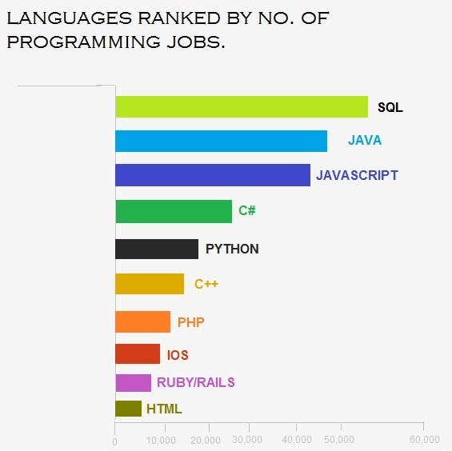
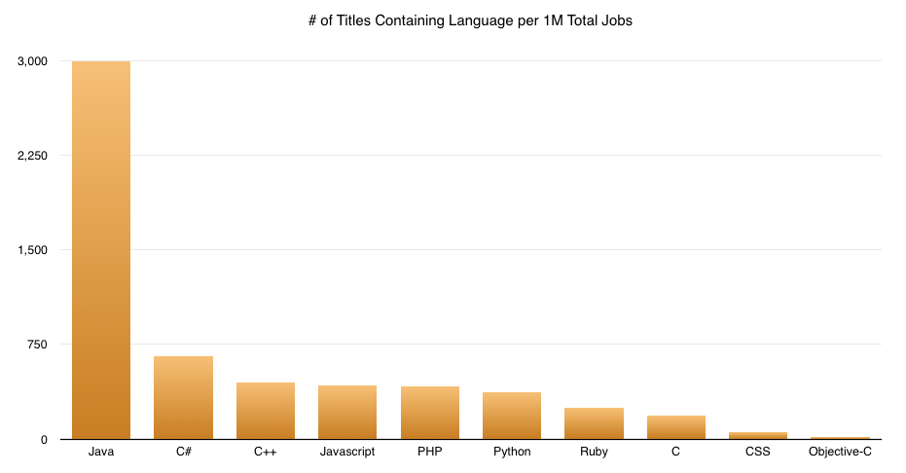
Why C++?

Slide 14
Abstraction

Slide 15
Design first
Design modules before coding
Interface specified: functions that are to be called
Implementation is secondary
Relationship between modules
Include pre-conditions and post-conditions
Modular design
Re-use
Loosely Coupled

Slide 16
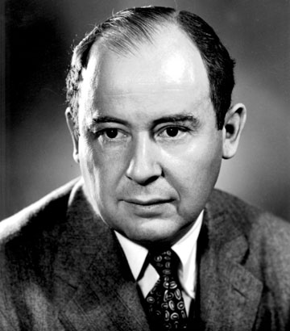
Computer Scientist of the week
John Von Neumann!
Innovations in Set theory, Geometry, Quantum Mechanics, Economics, Statistics
Founded Game Theory
Monte Carlo Method
EDVAC: data and program both in same address space
ENIAC: First computer to use a stored program
Von Neumann Architecture!
Manhattan Project
MAD: Mutually Assured Destruction
Merge Sort Algorithm

Slide 17
Interface Design
Simple
Complete
Cohesive
Descriptive
Intuitive
Minimal
No Public Data
Amenable to loosely couple

Slide 18
Abstraction
Separate Implementation from use of class
Specify Contract / Interface for class first
ADT
Abstract Data Type
Can be specified using Uniform Modeling Language (UML)
UML does not use language specific syntax

Slide 19
UML Class Diagram
ClassName
__dataFieldName1: dataType
__dataFieldName2: dataType
constructorName(arg1: argType)
methodName1(arg1: argType) : returnType
methodName2(arg1: argType) : returnType

Slide 20
Data Abstraction
Data Abstraction
A collection of data and a set of well-defined operations
The data can be reused without knowing the internal data representation and structure.
Objects
Instances of such abstracted data structure = the first-class objects

Slide 21
Enforcing Abstraction in C++
Modules map to C++ classes
Objects == instances
myClassName myObject;
Class is made of two files
C++ Headers file contain interface and data definition (.h)
Code files contain implementation (.cpp)
In this class we will not use UML much as the .h file does an excellent job of describing the contract

Slide 22
Problem
Design an interface for a class representing a push/pop stack

Slide 23
class IntStack
{
public:
bool Pop();
int Top();
bool Push(int number);
int Size();
int Peek();
};

Slide 24
Programming Style / Guidelines
Very important!
Code is read much more than written
You are writing code for others not yourself
You often inherit others code
Consumer should not have to rely on comments to understand code
Will be an important component in grade for class
Good code follows prescribed style rules

Slide 25
Programming Guidelines
We’ll use some ideas from Google C++ guidelines as well
http://google-styleguide.googlecode.com/svn/trunk/cppguide.html#General_Naming_Rules
We’ll use some ideas from .NET Framework Design Guidelines
Framework Design Guidelines, Conventions, Idioms, and Patterns for Reusable .NET libraries, Krzysztof Cwalina, Brad Abrams
We will keep to a few simple rules
This will impact grade of programs

Slide 26
Naming
Definitions
PascalCasing: RedTop, FirstInLine, BigScaryMonster
camelCasing: blueBallThingy, sock, theItem, lastInLine
Do use PascalCasing for class names, namespaces, public functions
Do use camelCasing for parameters, assessors (getValue, setValue…), private functions
Do use CAPS_CAPS for const
const int CARDS_IN_DECK = 52
Do choose easy readable identifier names
Do favor readability over brevity
Do not use underscores, hyphens, or other non-alphanumeric characters (except for const where underscore is acceptable)

Slide 27
Spacing/lines
Do keep opening and closing braces on their own lines
Do use a single space after a comma between parameters
Do not use spaces after or before brackets b[13] or before flow control statement
Do indent each block even if braces are not used
void foo(char a, int b)
{
while(x < y)
{
x = 13;
}
}

Slide 28
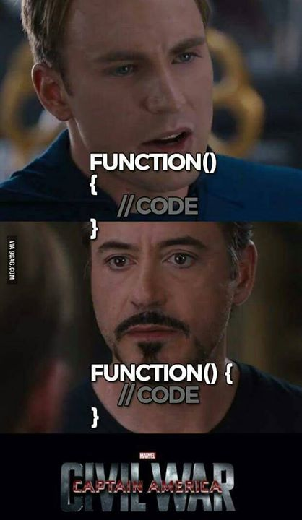

Slide 29
Comments
Do comment functions appropriately using // before the function
Use in-line comments sparingly
Use comments to describe something not obvious to someone reading the code
// This function is based on the zipterian algorithm.
int void Zip(string firstName)
{
}

Slide 30
Problem 2
Design an interface for a class representing a deck of playing cards

Slide 31
Bell Rang

Slide 32
#include "Card.h"
#include "Hand.h"
const int CARDS_IN_DECK = 52;
class Deck
{
public:
Deck();
~Deck();
Card DealSingleCard();
Hand DealHand(int number);
void Shuffle();
void Cut();
int CountCardsRemaining();
void ReturnHand(Hand theHand);
void ReturnCard(Card theCard);
int CountValuesRemaining(int val);
int CountSuitsRemaing(Suit suit);
bool isEmpty();
bool isComplete();
private:
Card deck[CARDS_IN_DECK];
};

Slide 33
Interface Design Checklist
Constructors
Setters/Getters
Actions (verbs)
Operator Overloads
Private Data Types

Slide 34
Preview Assignment One

Slide 35
C++ Fundamentals
LET’S CODE

Slide 36
IO: Console
#include <iostream>
using namespace std;
{
int age;
cout << "hello world. How old are you (in years)?\n";
cin >> age;
cout << "that is " << (365 * age) << " days.";
}

Slide 37
string
http://www.cprogramming.com/tutorial/string.html
Mutable; Copied not shared.
string firstName = "jimmy";
string lastName("hoffa");
string fullName;
fullName = firstName + " " + lastName;
cout << fullName << endl;
cout << "First and last letters are:" << fullName[0] << " " << fullName[fullName.length() - 1] << endl;
if (fullName == "jimmy hoffa")
{
cout << "Found !!!! ";
}
else
{
cout << "oh where oh where have you gone";
}

Slide 38
Call by Value, Reference, and Constant Reference
struct Rectangle
{
int length;
int width;
};
int Area(Rectangle rect)
int Area(Rectangle &rect)
int Area(const Rectangle &rect)
{
int temp;
temp = rect.length;
rect.length = 35;
return(temp * rect.width);
}
int main()
{
int result;
Rectangle r = { 3, 3 };
result = Area(r);
cout << "length = " << r.length << endl;
cout << "width = " << r.width << endl;
cout << "Area = " << result << endl;
return 0;
}

Slide 39
In class code
Write a function which takes two integers and “swaps” them

Slide 40
Call by Value, Reference, and Constant Reference
Arrays, Pointers, and Structures
Which of swap functions is appropriate?
void swap(string a, string b)
{
string tmp = a;
a = b;
b = tmp;
}
void swap(string &a, string &b)
{
string tmp = a;
a = b;
b = tmp;
}
void swap(const string &a, const string &b)
{
string tmp = a;
a = b;
b = tmp;
}
Which of findMax functions is appropriate?
int findMax(vector<int> a)
{
int max = a[0];
int i;
for (i=1; i < a.size(); i++)
if (a[i] > max)
max = a[i];
return max;
}
int findMax(vector<int> &a)
{
int max = a[0];
int i;
for (i=1; i < a.size(); i++)
if (a[i] > max)
max = a[i];
return max;
}
int findMax(const vector<int> &a)
{
int max = a[0];
int i;
for (i=1; i < a.size(); i++)
if (a[i] > max)
max = a[i];
return max;
}

