Slide 1
CSS 342
Data Structures, Algorithms, and Discrete Mathematics I
Lecture 5. 161013.
Carrano Ch 2, Appendix E.

Slide 2
Agenda
Lab2 I
How to prepare for Quiz
Website Collateral
Quiz Next Thursday!
Finish Templatizing
Bubble Sort
Insertion Sort
Program 1 Example
Recursion. Recursion. Recursion. Recursion. Recursion. Recursion. Recursion. Recursion. Recursion. Recursion. Recursion. Recursion. Recursion. Recursion. Recursion. Recursion. Recursion. Recursion. Recursion. Recursion. Recursion. Recursion. Recursion. Recursion. Recursion. Recursion. Recursion. Recursion. Recursion. Recursion. Recursion. Recursion. Recursion. Recursion. Recursion. Recursion. Recursion. Recursion. Recursion. Recursion. Recursion. Recursion. Recursion. Recursion. Recursion. Recursion. Recursion. Recursion. Recursion. Recursion. Recursion. Recursion. Recursion. Recursion. Recursion. Recursion. Recursion. Recursion. Recursion. Recursion. Recursion. Recursion. Recursion. Recursion. Recursion. Recursion. Recursion. Recursion. Recursion. Recursion. Recursion. Recursion. Recursion. Recursion. Recursion. Recursion. Recursion. Recursion. Recursion. Recursion. Recursion. Recursion. Recursion.. Recursion. Recursion. Recursion. Recursion. Recursion. Recursion. Recursion. Recursion. Recursion. Recursion. Recursion. Recursion. Recursion. Recursion. Recursion. Recursion. Recursion. Recursion. Recursion. Recursion. Recursion. Recursion. Recursion. Recursion. Recursion. Recursion. Recursion. Recursion. Recursion. Recursion. Recursion. Recursion. Recursion Lecture .

Slide 3
How to Study
Do problems
Practice Quiz (on line)
Study Groups
Review Slides
Understand Program 1
Read Books
Start from end and work backwards

Slide 4
Quiz Topics
C++ core tenets
Class Design
ADT
C++ Language
Coding Guidelines
Operator Overloading
pass by const, const &, value
References
Recursion -- TBD
Stack v. Heap allocations -- TBD
Constructors
Object Lifetime
Templates
Vectors, Strings
Sorting: Bubble, Insertion
C++ program lifecycle: preprocess, compiler, etc
binary, octal, hex -- TBD

Slide 5
In Class Pop Quiz
Write a function which takes in a string and reverses the string in-place but returns the original string

Slide 6
Templatize Class
SORTED LIST

Slide 7
SortedList Class Template Example
Example to show templates on a class which keeps a sorted set of items
Add an item
Print out items
Sort
Bonus Points: concatenate two lists
Data Structure: Vector
Sorts
BubbleSort
Insertion sort algorithm

Slide 8
#ifndef SORTED_LIST_H
#define SORTED_LIST_H
#include <iostream>
#include <vector>
using namespace std;
template <class ItemType>
class SortedList
{
public:
SortedList();
~SortedList();
void Add(const ItemType &item);
void Print() const;
void Sort();
private:
vector<ItemType> thelist;
};
#include "SortedList.cpp"
#endif
#ifndef SORTED_LIST_CPP
#define SORTED_LIST_CPP
#include "SortedList.h"
template<class ItemType>
SortedList<ItemType>::SortedList(){ }
template<class ItemType>
void SortedList<ItemType>::Add(const ItemType &item)
{
thelist.push_back(item);
return;
}
template<class ItemType>
void SortedList<ItemType>::Print() const
{
for (int i = 0; i < thelist.size(); i++)
{
cout << thelist[i] << endl;
}
}
#endif

Slide 9
Bubblesort or Sinking Sort
Used to sort an array of items by traversing (n-1) times and bubbling largest current item to the bottom
Graphical Representation : http://en.wikipedia.org/wiki/Bubble_sort#mediaviewer/File:Bubble-sort-example-300px.gif
Bad memory and speed characteristics.
“the bubble sort seems to have nothing to recommend it, except a catchy name and the fact that it leads to some interesting theoretical problems“, Donald Knuth

Slide 10
Insertion Sort
Sorted
Unsorted
29
10
14
37
13
Copy 10
29
29
14
37
13
Shift 29
10
29
14
37
13
Insert 10, copy 14
unsortedTop
10
29
29
37
13
Shift 29
10
14
29
37
13
Insert 14; copy 37
10
14
29
37
13
Shift nothing
10
14
29
37
13
Insert 37; Copy 13
10
14
14
29
37
Shift 37, 29 and 14.
10
13
14
29
37
Insert 13
Or Carranno 311-313, Or:
http://en.wikipedia.org/wiki/Insertion_sort#mediaviewer/File:Insertion-sort-example-300px.gif

Slide 11
Function for Insertion Sort
template<class ItemType>
void SortedList<ItemType>::Sort()
{
for (int place = 1; place < thelist.size(); place++)
{
ItemType temp = thelist[place];
int i = place;
while ((i > 0) && (thelist[i-1] > temp))
{
thelist[i] = thelist[i-1];
i--;
}
thelist[i] = temp;
}
}

Slide 12
VendingBank.h (pt 1)
class VendingBank
{
public:
//constructors
VendingBank();
VendingBank(int id);
VendingBank(int id, int pennies, int nickels, int dimes, int quarters, int halves);
VendingBank(int id, int amount);
// getters - setters
int getPennies() const;
int getNickels() const;
int getDimes() const;
int getQuarters() const;
int getHalves() const;
int getId() const;
void setPennies(const int &num);
void setNickels(const int &num);
void setDimes(const int &num);
void setQuarters(const int &num);
void setHalves(const int &num);
void setId(const int &id);

Slide 13
VendingBank.h (pt 2)
//actions
bool AddCoins(int pennies, int nickels, int dimes, int quarters, int halves);
bool RemoveCoins(int pennies, int nickels, int dimes, int quarters, int halves);
bool CanMakeChange(int amount) const;
bool isEmpty() const;
//operator overloads
bool operator==(const VendingBank &) const;
bool operator!=(const VendingBank &) const;
VendingBank operator+(const VendingBank &) const;
VendingBank& operator+=(const VendingBank &);
~VendingBank();
private:
int pennies;
int nickels;
int dimes;
int quarters;
int halves;
int id;
Coins makeChange(int amount);
};

Slide 14
Recursion
Recursion

Slide 15
In order to understand recursion, it helps to understand recursion.
In order to understand recursion, it helps to understand recursion

Slide 16
In order to understand recursion, it helps to understand recursion.
In order to understand recursion, it helps to understand recursion

Slide 17
Recursive Solutions
Recursion breaks a problem into smaller identical problems
Some recursive solutions are inefficient, impractical
Complex problems can have simple recursive solutions

Slide 18
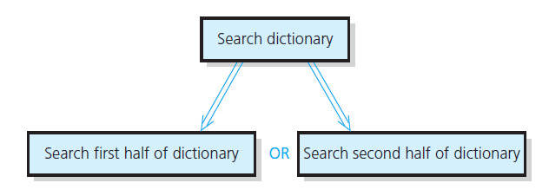
Recursive Solutions

Slide 19
Recursive Solutions
A recursive solution calls itself
Each recursive call solves an identical, smaller problem
Test for base case enables recursive calls to stop
Eventually one of smaller calls will be base case

Slide 20
Compute n! recursively
Base Case: n=1
Recursive: n! = n * (n-1)
CODE
int Factorial(int n)
{
if (n < 0)
{
return 0;
}
else if (n == 0)
{
return 1;
}
else
{
return Factorial(n - 1) * n;
}
}

Slide 21
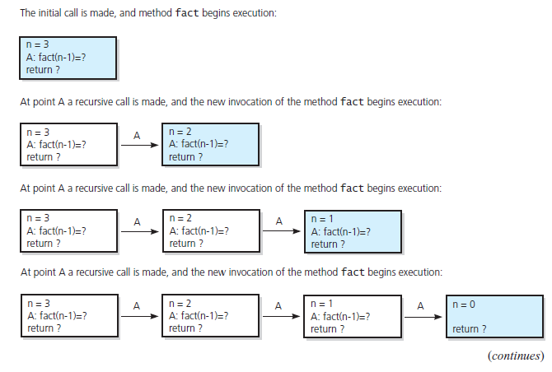
The Box Trace
FIGURE 2-5 Box trace of fact(3)

Slide 22
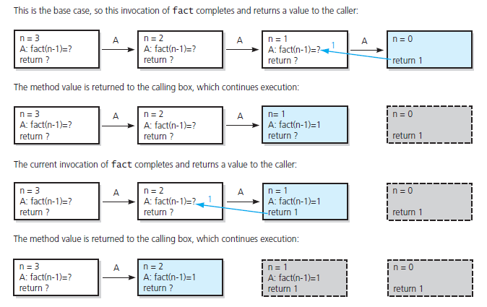
The Box Trace
FIGURE 2-5 Box trace of fact(3) … continued

Slide 23
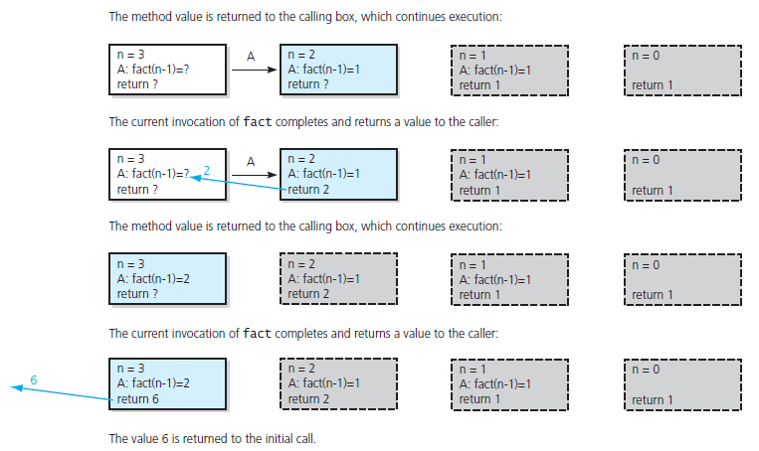
The Box Trace
FIGURE 2-5 Box trace of fact(3) … continued

Slide 24
The Stack (and recursion)
Stack
Location in process which stores temp variables, call stack frames,
One per thread of execution
Heap
Location in process which stores dynamically allocated memory (coming soon)
Recursion
Each call to a function creates stack frame
Frame holds temp variables and locals
Data in the BOX of the BOX trace
Deep Recursion can allocate lots of space on the stack

Slide 25
Recursive example Quiz: Code in class.
The maximum number of leaves in a tree can be expressed by the following formula:
$$f\left(1, b\right)=1$$
$$f\left( h, b\right)=b∗f(h−1, b)$$
h = height of the tree
b = max number of branches per node.
Write a recursive function which computes$f\left( h, b\right)$.

Slide 26
Class Bell

Slide 27
Time of Invocation (constructors)
Automatic Local
Each time block is executed
Static Local
Once –first time it is hit
Global
In order of declaration in translation unit
Typically before main() is entered
Destroyed in reverse order of construction
Dynamic (tbd)
malloc/free
new/delete

Slide 28
Printing Numbers in Any Base
How to convert a decimal to a hexadecimal
Dividend Remainder
16) 123456790₍₁₀₎……..…
16) 7716049₍₁₀₎………6
16) 482253₍₁₀₎………1
16) 30140₍₁₀₎…13(D)
16) 1883₍₁₀₎…12(C)
16) 117₍₁₀₎…11(B)
16) 7₍₁₀₎……....5
16) 0₍₁₀₎……....7
1. Divide by a base(16)
2. Print each remainder from
the bottom: 75BCD16(16)

Slide 29
Quick review of base conversions
100101₂ = 32 + 4 + 1 = 37
more on board…

Slide 30
Printing Numbers in Any Base
How to convert a decimal to a hexadecimal
Dividend Remainder
16) 123456790₍₁₀₎……..…
16) 7716049₍₁₀₎………6
16) 482253₍₁₀₎………1
16) 30140₍₁₀₎…13(D)
16) 1883₍₁₀₎…12(C)
16) 117₍₁₀₎…11(B)
16) 7₍₁₀₎……....5
16) 0₍₁₀₎……....7
1. Divide by a base(16)
2. Print each reminder from
the bottom: 75BCD16(16)

Slide 31
Printing numbers in any base (recursively)
Base Case:
if (num < base) { print out num }
Recursive:
Pre-pend to the answer ( num % base )
Recursively call with num/base

Slide 32
Printing numbers in any base (recursively)
bool PrintBase(int num, int base, string &ans)
{
string static DIGIT_ARRAY = "0123456789ABCDEF";
if ((num < 0) || (base <= 0) || (base > 16))
{
return false;
}
if (num < base)
{
ans = DIGIT_ARRAY[num] + ans;
return true;
}
else
{
ans = DIGIT_ARRAY[num % base] + ans;
PrintBase(num / base, base, ans);
}
}

Slide 33
Recursion w/Alice
https://www.youtube.com/watch?v=-3Mcu7o1YSg

Slide 34
Binary Search
An entire sorted list
First half
Second half
First half
Second half
First half
Find a value in an array.

Slide 35
Binary Search
Base Case: low or high index finds number
Recursive:
Determine midpoint (high+low)/2
Search either lower or upper array

Slide 36
Binary Search
int BinarySearch(int value, int arr[], int index1, int index2)
{
if (value == arr[index1]) return index1;
else if (value == arr[index2]) return index2;
else if (index2 <= index1 + 1) return -1;
else
{
int midpoint = (index1 + index2) / 2;
if (arr[midpoint] > value)
return BinarySearch(value, arr, index1, midpoint);
else
return BinarySearch(value, arr, midpoint, index2);
}
}

Slide 37
What does the box trace look like for binary search?

Slide 38
C++ Fundamentals

Slide 39
Pointers
Pointer variables int *p, *q;
Static allocation int x;
Address-of operator p = &x;
Memory cell to which P points *p = 6;
Pointer operations q = p;
3
4
1
?
?
?
?
?
?
6
p
q
x
p
q
x
p
q
x
5
6
p
q
x

Slide 40
Arrays
Arrays: reservation and construction of indexed set of objects or built-in types
int x=5;
int arr1[100]
int arr2[3] = {34, 7, 34};
char cArr1[7];
char cArr2[10][5];
arr1[x] = 32;
arr2[0] = arr1[x];
cArr2[3][3] = ‘a’;
Arrays v Pointers (following are equivalent)
void Foo(int arr[]) { }
void Foo(int *arr) { }
MyFooClass theFooObj;
MyFooClass arrFoo[200]; //default constructors run
MyFooClass *pFoo;
pFoo = arrFoo;
arrFoo[54] = theFooObj;
pFoo = &theFooObj;

