Slide 1
CSS 342
Data Structures, Algorithms, and Discrete Mathematics I
Lecture 13. 11/15/2016.
CARRANO CHAPT 10

Slide 2
Agenda
Big O notation.
Lab4 Intro.
Midterms Returned

Slide 3
Algorithm Efficiency
BIG O

Slide 4
Analysis and Big O Notation
Algorithm A is order f ( n ): Denoted O( f ( n ))
If constants k and n₀ exist
Such that A requires no more than k × f ( n ) time units to solve a problem of all sizes n ≥ n₀
Big O is upper-bound, not tight upper bound
Algorithm A grows no faster than O(n)
Tight upper bound is Big Theta Θ
However, it is often abused in CS to mean the tight upper bound

Slide 5
Proving an algorithm / code snippet is O( f(n) )
Determine a formula for the number of important operations in algorithm or snippet as a function of n.
Express this as g(n).
Show there is a constant, k, such that k * f(n) > g(n) for all n greater than some number.
You have proven g(n) is O(f(n))
Rejoice!

Slide 6
BigO: pop quiz
If func2() is O(1), what is the bigO of the code snippet?
for (int i = -n; i < n; i++)
{
func(i);
}
int func(int a)
{
int b = 0;
for (int i = 0; i < a; i++)
{
b += func2(i*i);
}
return b;
}

Slide 7
Intuitive interpretation of growth-rate functions
O(1)
Constant
Independent of problem size
O(log₂n)
Logarithmic
Increase slowly as size increases. Ex. Binary search
O(n)
Linear
Increase directly with size. Searching an unsorted list or malformed tree.
O(nlog₂n)
Increase more rapidly than a liner algorithm. Ex. Merge sort
O(n²)
Quadratic
Ex. Two nested loops; bubble sort
O(n³)
Cubic
Ex. Three nested loops
O(2^{n})
Exponential
Increase too rapidly to be practical

Slide 8
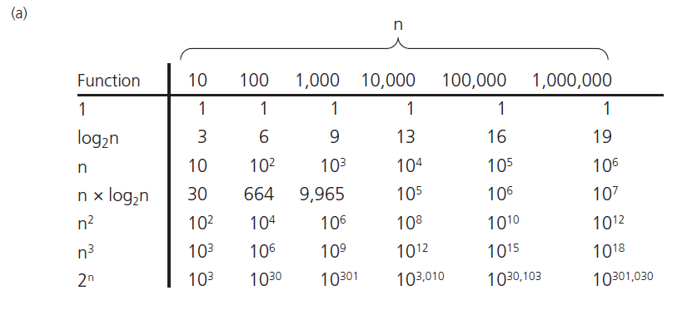
Analysis and Big O Notation
FIGURE 10-3 A comparison of growth-rate functions: (a) in tabular form

Slide 9
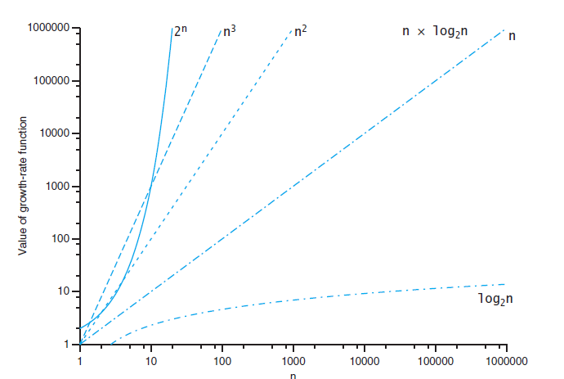
Analysis and Big O Notation

Slide 10
Empirical Overview of Efficiency*
All algorithms take approximately same time for N = 10
Any algorithm with N! running time is useless for N ≥ 20
2^{N} is intractable for n ≥ 40
O(N²) is usable for N = 10,000 but horrendous for N ≥ 1,000,000
O(N) and O(N log N) are practical for inputs of size 1,000,000,000
O(log N) was okay for any input size
*From “The Algorithm Design Manual”

Slide 11
Big O Simplifications
Focus on the dominant factor:
Low-order terms can be ignored
O(n³+4n) = O(n³)
Multiplicative constant in the high-order term can be ignored.
O(3n3+4) = O(n3)
O(f(n)) + O(g(n)) = O(f(n) + g(n))
If f(n) = O(g(n)) and g(n) = O(h(n)) , then f(n)=O(h(n))

Slide 12
Worst, Best, and Average-case Analysis
Worst-case analysis:
Algorithm A requires no more than k * f(n) time units.
It might happen rarely, if at all, in practice.
Best-case analysis:
Like worst-case analysis, it might happen rarely.
Average-case analysis:
A requires no more than k * f(n) time units for all but a finite number of values of n
Difficulties: determining probability and distribution of size n and input data

Slide 13
Efficiency of Sequential Search
29
10
14
37
13
52
46
75
5
43
21
69
88
1
Hit!
Best case
O(1)
Hit!
Worst case
O(n)
Hit!
Average case
O(n/2) = O(n)

Slide 14
Lab4
Sorting

Slide 15
Complexity of Binary Search
x
low =0
mid = (15 + 0)/2 = 7
high=15
10
a
1
5
10
13
14
21
29
37
43
46
52
69
75
88
91
99
new high=7–1=6
int binarySearch( const vector<int> &a, const int x )
{
int low = 0;
int high = a.size( ) – 1;
int mid;
while ( low <= high ) {
mid = ( low + high ) / 2;
if ( a[mid] < x )
low = mid + 1;
else if ( a[mid] > x )
high = mid – 1;
else
return mid;
}
return NOT_FOUND; // NOT_FOUND = -1
}
Write code for binary search

Slide 16
1
5
10
13
14
21
29
37
43
46
52
69
75
88
91
99
1st step
2nd step
3rd step
Hit!
DATA SIZE #Recursive Calls
N = 2 1
N = 4 2
N = 8 3
N = 16 4
N = 2^{k} K
2^{K} < N < 2^{K+1} K+1
K < log₂N < K+1
O(log₂N)
4th step

Slide 17
Big-O complexity. Lab3
+ operator on two lists
What was your efficiency?
Call insert on each element?
One list after the other?
Merge operator
What was your efficiency?
BuildList Operator

Slide 18
Minimum Element in an Array
Given an array of N items, find the smallest item.
What order (in big O) will this problem be bound to?
1
N
3
9
1
8
5
2
0
7
4
6
-1
10
-2

Slide 19
Closest Points in the Plane
Given N points in a plane (that is, an x-y coordinate system), find the pair of points that are closest together.
What order (in big O) will this problem be bound to?
y
sqrt( (x₂ – x₁)² + (y₂ – y₁)² )
2,1
1,4
1,6
4,5
4,7
5,4
5,6
6,3
6,7
7,1
x
8,4

Slide 20
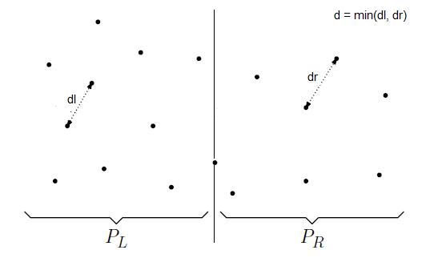
nlogn solution
Sort input array by x cords
Find the middle point P[n/2]
Divide array into two halves: P_{L} and P_{R}
Recursively find the min in each array, distL and distR. Let dist = min(distL, distR)

Slide 21
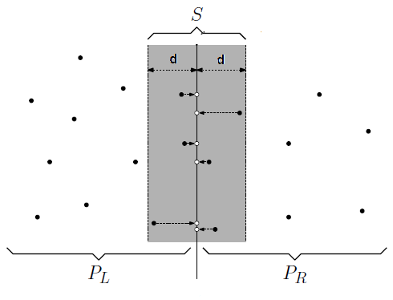
Nlogn solution
dist is an upper bound on distance. Need to consider pairs of points one in P_{L} and one in P_{R} . But we do not need to consider points outside this .
Build array s whose x coord is close to middle line at P[n/2]
Sort the array s by y coord; for each point in strip we need to check only 7 points (beyond scope, but see this: http://people.csail.mit.edu/indyk/6.838-old/handouts/lec17.pdf

Slide 22
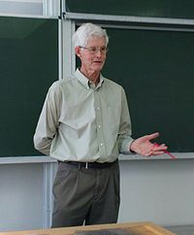
Computer Scientist of the week (very difficult…. possibly NP-Complete)
Stephen Cook
Forefather of computational complexity theory
Theory of NP-Completeness
Prof. at University of Toronto
Proposed P = NP problem
1982: Turing award winner

Slide 23
Intractable, Unsolvable, and NP problems
Tractable problems
Their worst-case time is proportional to a polynomial (class P) on a deterministic machine
However, sometimes this can take a long time
Intractable problems
Their worst-case time cannot be bounded to a polynomial.
Unsolvable algorithms:
They have no algorithms at all.
Example: Turing’s Halting problem
NP(Non-Deterministic Polynomial Time) problems
No solution with Polynomial worst-case performance (on a deterministic machine), but when solved can be checked polynomial time
There is a solution on a non-deterministic machine
Traveling Salesperson problem
NP-Complete Problems
Class of problems that are NP
Poly-time reducible to another NP complete problem
Ex, Traveling salesperson problem
https://en.wikipedia.org/wiki/List_of_NP-complete_problems

Slide 24
More BigO?
http://courses.washington.edu/css342/dimpsey/ProgramExamples/BigOwAnswers.pdf

Slide 25
Midterm
Median: 71

Slide 26
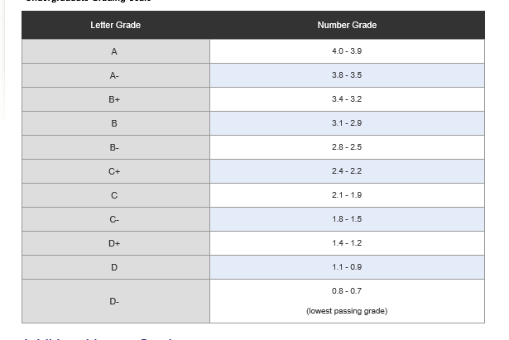
Grades Review
Labs (5): 35%
Exams/Quizzes: 65%
http://www.uwb.edu/registration/policies/grading/grading-ug

Slide 27
Midterm
SCORE | GRADE
86-100 | 3.5-4
68-85 | 2.5-3.4
60-67 | 2.0-2.4
<60 | <2.0

