Slide 1
CSS 342
Data Structures, Algorithms, and Discrete Mathematics I
Lecture 14. 11/17/2016.
CARRANO CHAPT 11

Slide 2
Agenda
Lab3 Grading Questions
Lab4 Questions
Midterm list question
Sorting

Slide 3
Sorts and sorting

Slide 4
Sorting the Sorts
Selection Sort worst/average O(n²)
Bubble Sort worst/average O(n²)
Insertion Sort worst/average O(n²)
Shell Sort worst O(n²)/average O(n^{3/2})
Merge Sort worst/average O(n log n)
Quick Sort worst O(n²)/average O(n log n)
Radix Sort worst/average O(n)

Slide 5
Sorts previously covered
Bubble Sort: http://en.wikipedia.org/wiki/Bubble_sort#mediaviewer/File:Bubble-sort-example-300px.gif
→ let’s determine why it is O(n²)
Insertion Sort: http://en.wikipedia.org/wiki/Insertion_sort#mediaviewer/File:Insertion-sort-example-300px.gif
→ let’s determine why it is O(n²)

Slide 6
Efficiency of Bubble Sort: O(n²)
Pass 1
Pass 2
29
10
14
37
13
10
14
29
13
37
10
29
14
37
13
10
14
29
13
37
10
14
29
37
13
10
14
29
13
37
10
14
29
37
13
10
14
13
29
37
10
14
29
13
37
Comparison
Swapping
N-1
N-1
N-2
N-2
…
…
1
1

Slide 7
Efficiency of Insertion Sort: O(n²)
Sorted
Unsorted
Max Max
Comp. Shift Insert Operations
29
10
14
37
13
10
29
14
37
13
1 1 1 2+1
10
29
14
37
13
10
14
29
37
13
2 2 1 4+1
10
14
29
37
13
10
14
29
37
13
3 3 1 6+1
10
14
29
37
13
10
13
14
29
37
4 4 1 8+1

Slide 8
MergeSort
Key: THE MERGE!
Assuming that we have already had two sorted array,
How can we merge them into one sorted array?
1
4
8
13
14
20
25
2
3
5
7
11
23
1
2
3
4
5
7
8
11
13
14
20
23
25

Slide 9
sorted
sorted
first
mid
last
theArray
first1
last1
last2
first2
<
>=
tempArray
index
sorted
sorted
first
mid
theArray
first1
last1
last2
first2
tempArray
index

Slide 10
void Merge(vector<int> &itemVector, int first, int mid, int last)
{
int *tempArr;
int size = last - first + 1;
tempArr = new int[size];
int first1 = first;
int last1 = mid;
int first2 = mid + 1;
int last2 = last;
int index = 0;
while ((first1 <= last1) && (first2 <= last2))
{
if (itemVector[first1] < itemVector[first2])
{
tempArr[index] = itemVector[first1];
first1++;
}
else
{
tempArr[index] = itemVector[first2];
first2++;
}
index++;
}

Slide 11
while (first1 <= last1)
{
tempArr[index] = itemVector[first1];
first1++;
index++;
}
while (first2 <= last2)
{
tempArr[index] = itemVector[first2];
first2++;
index++;
}
for (index = 0; index < size; index++)
{
itemVector[first] = tempArr[index];
first++;
}
delete[] tempArr;
}

Slide 12
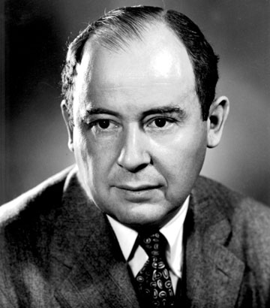
Computer Scientist of the week
John Von Neumann!
Innovations in Set theory, Geometry, Quantum Mechanics, Economics, Statistics
Founded Game Theory
Monte Carlo Method
EDVAC: data and program both in same address space
ENIAC: First computer to use a stored program
Von Neumann Architecture!
Manhattan Project
MAD: Mutually Assured Destruction
Merge Sort Algorithm

Slide 13
MergeSort: successive merges
38
16
27
39
12
17
24
5
16
38
27
39
12
17
5
24
16
27
38
39
5
12
17
24
5
12
16
17
24
27
38
39
Use recursion to get here

Slide 14
MergeSort
mid=(fist + last)/2
first
last
theArray
38
16
27
39
12
17
24
5
mid=(fist + last)/2
mid=(fist + last)/2
first
last
first
last
first < last
38
16
27
39
12
17
24
5
first
last
38
16
27
39
12
17
24
5
first
last
38
16
27
39
12
17
24
5

Slide 15
MergeSort: Overview
mid=(fist + last)/2
first
last
theArray
38
16
27
39
12
17
24
5
void MergeSort(vector<int> &iVector, int first, int last)
{
if (first < last)
{
int mid = (first + last) / 2;
MergeSort(iVector, first, mid);
MergeSort(iVector, mid + 1, last);
Merge(iVector, first, mid, last);
}
}
38
16
27
39
12
17
24
5
first
last
38
16
27
39
12
17
24
5
38
16
27
39
12
17
24
5
16
38
27
39
12
17
5
24
16
27
38
39
5
12
17
24
http://en.wikipedia.org/wiki/Merge_sort#mediaviewer/File:Merge-sort-example-300px.gif
5
12
16
17
24
27
38
39

Slide 16
MergeSort: (Efficiency Analysis)
Level (n items in array) | # sub-arrays | #comparisons per sub-array # copies per sub-array
1 | 4 | 1 2 * 2
2 | 2 | 3 4 * 2
3 | 1 | 7 8 * 2
38
16
27
39
12
17
24
5
16
38
27
39
12
17
5
24
16
27
38
39
5
12
17
24
5
12
16
17
24
27
38
39
At level X, #nodes in each sub-array = 2^{x}
At level X, # major operations = (#sub-arrays) * (ops/sub-array)
n/2^{x} * (2 * 2^{x} + 2^{x} – 1) = n/2^{x} * (3 * 2^{x} - 1) = ~3n
O(3n)
#levels = log n, where n = # array elements ( if n is a power of 2 )
#levels = log n + 1 if n is not a power of 2
# operations = O(3n) * (log n + 1) = O(3 n log n) = O(n log n)
X | n/2^{x} | 2^{x}-1 2^{x} * 2

Slide 17
Class Discussion. n! puzzle
If an algorithm takes n! operations on a data set of size n, how big of a data set can today’s computers solve?

Slide 18
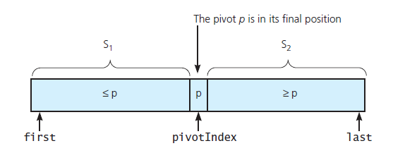
The Quick Sort

Slide 19
Quicksort: Recursive Overview
void quicksort(vector<int> &a, int first, int last)
{
int pivotIndex;
if ( first < last )
{
pivotIndex = choosePivot(a, first, last);
partition( a, fist, last, pivotIndex );
quicksort( a, first, pivotIndex - 1 );
quicksort( a, pivotIndex + 1, last );
}
}

Slide 20
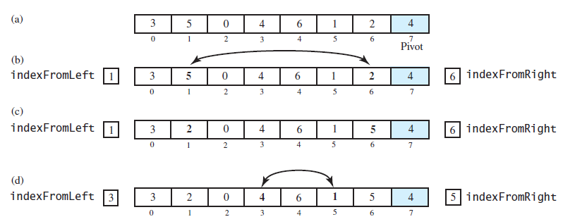
The Quick Sort (after the pivot chosen)

Slide 21
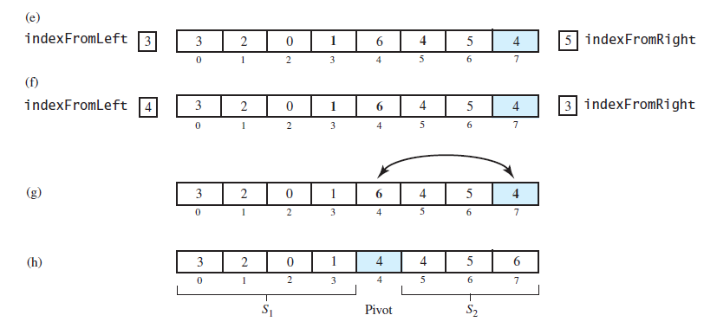
The Quick Sort: (after the pivot chosen)
FIGURE 11-10 Partitioning of array during quick sort

Slide 22
Choosing the pivot
Ideally it is the median as this will split array in half
Not feasible without sorting
Avoid bad pivots
At first, Pivot chosen was last in array. Generally bad behavior
Suggestion: Choose mid of first, middle, last (Sedgewick)
This turns out to be quite decent

Slide 23
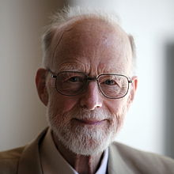
Computer Scientist of the week
Sir Charles Antony Richard Hoare
“Tony” Hoare
Developed QuickSort
Dining Philosopher’s problem
ALGOL 60
1980 Turing award
Invented the NULL Reference

Slide 24
The Quick Sort
FIGURE 11-11 Median-of-three pivot selection: (a) The original array; (b) the array with its
first, middle, and last entries sorted

Slide 25
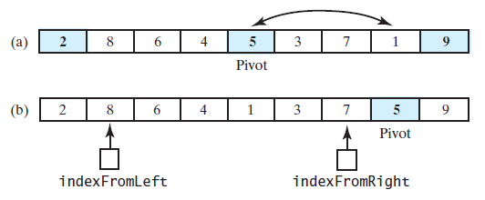
The Quick Sort
FIGURE 11-12 (a) The array with its first, middle, and last entries sorted; (b) the array after positioning the pivot and just before partitioning

Slide 26
Visual of Quicksort
http://en.wikipedia.org/wiki/Quicksort#mediaviewer/File:Sorting_quicksort_anim.gif

Slide 27
Class Bell

Slide 28
void QuickSort(vector<int> &itemVector, int first, int last)
{
if (last - first < 4)
{
InsertionSort(itemVector, first, last);
return;
}
int mid = (first + last) / 2;
if (itemVector[first] > itemVector[last])
{
swap(itemVector[first], itemVector[last]);
}
if (itemVector[first] > itemVector[mid])
{
swap(itemVector[first], itemVector[mid]);
}
else if (itemVector[mid] > itemVector[last])
{
swap(itemVector[mid], itemVector[last]);
}
int pivot = itemVector[mid];
swap(itemVector[mid], itemVector[last - 1]);

Slide 29
int left = first + 1;
int right = last - 2;
bool done = false;
while (! done)
{
while (itemVector[left] < pivot)
{
left++;
}
while (itemVector[right] > pivot)
{
right--;
}
if (right > left)
{
swap(itemVector[left], itemVector[right]);
right--;
left++;
}
else
{
done = true;
}
}
swap(itemVector[left], itemVector[last - 1]);
QuickSort(itemVector, first, left - 1);
QuickSort(itemVector, left + 1, last);
}

Slide 30
Quicksort: Efficiency Analysis
Worst case: If the pivot is the smallest item in the array segment, S1 will remain empty.
S2 decreases in size by only 1 at each recursive call.
Level 1 requires n-1 comparisons.
Level 2 requires n-2 comparisons.
Thus, (n-1) + (n-2) + …. + 2 + 1 = n(n-1)/2 = O(n²)
Average case: S1 and S2 contain the same number of items.
log n or log n + 1 levels of recursions occur.
Each level requires n-k comparisons
Thus, at most (n-1) * (log n + 1) = O(n log n )

Slide 31
Mergesort versus Quicksort

Slide 32
Mergesort versus Quicksort
 | Worst case | Average case
Mergesort | n log n | n log n
Quicksort | n² | n log n
Why is Quicksort still around?
Reasons:
Mergesort requires item-copying operations from the array a to the temp
array and vice versa.
A worst-case situation is not typical.
Quicksort has very good memory characteristics
Then, why do we need Mergesort?
Reason:
If you sort a linked list, no item-copying operations are necessary.

Slide 33
Program 3
One of the harder programs!
If you did it, then you understand lists!
If not, and you have time, worth taking another look
Average Score: 81
Rubric
75 points correctness: Test cases posted as Microsoft Unit Tests
Unit tests in canvas
http://courses.washington.edu/css342/dimpsey/VSUnitTest.pdf
25 points efficiency/guidelines
Points off for using Insert() function in +=, +, etc…
Grader went out of way to get code to compile, and also looked for errors to see if pervasive issues. Gave partial credit if found things.
Some folks we could not get to compile but executable was turned in
Cannot Grade
If wrong code was submitted then send me correct code in then resubmit the correct code in the next hour or so
If our environment was wrong then bring in environment so I can see how it compiled

Slide 34
Shell Sort

Slide 35
ShellSort
Generalization of the Insertion Sort
Optimized to reduce data movement
Developed 1959 by Donald Shell
Choose an Interleave/gap size (n) and sort the arrays chosen by that size
This moves data large distances quickly
Complexity has not been fully determined
Depends on gap size (see appendix)
Works best on partially sorted data

Slide 36
Shell Sort Example
Using gaps of size 5, 3, 1.

Slide 37
0
gap = 3/2.2 = 1
16
81
94
11
96
12
35
17
95
28
58
41
75
15
85
87
38
20
15
11
12
12
gap = 17/2 = 8
11
15
81
94
11
96
12
35
17
95
20
58
11
75
12
35
17
38
17
17
28
58
41
75
15
85
87
38
sort
28
94
41
96
15
85
87
95
38
20
20
81
28
28
gap = 8/2.2 = 3
20
sort
35
41
38
20
58
11
15
12
11
35
41
75
12
35
sort
17
38
28
75
58
17
38
28
20
41
35
58
75
94
41
96
75
58
87
87
81
15
85
87
94
81
96
94
85
95
81
95
85
81
87
96
94
95
95
85
96

