Slide 1
CSS 342
Data Structures, Algorithms, and Discrete Mathematics I
Lecture 19. 161208.
CUSACK CHAPT 4.

Slide 2
Agenda
Final Exam: 12/15
Program 5 Questions
Propositional logic
Final Prep

Slide 3
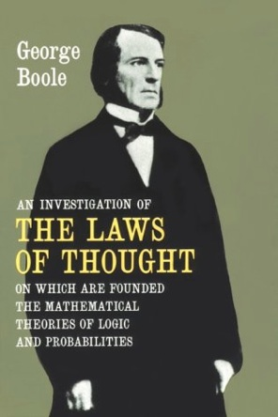
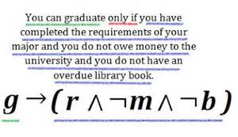
Propositional Logic

Slide 4
Text Book
An Active Introduction to Discrete Mathematics and Algorithms (version 2.6), Charles Cusack, David Santos, GNU Free Software, 2016:
http://www.cs.hope.edu/~cusack/Notes/Notes/Books/Active%20Introduction%20to%20Discrete%20Mathematics%20and%20Algorithms/ActiveIntroToDiscreteMathAndAlgorithms.2.6.pdf
Chapter 4: Logic.

Slide 5
Theorems for Boolean algebra
Commutative Law
p v q = q v p
p ^ q = q ^ p
Associative Law
p v (q v r) = (p v q) v r
p ^ (q ^ r) = (p ^ q) ^ r
Distributive Law
p ^ (q v r) = (p ^ q) v (p ^ r)
p v (q ^ r) = (p v q) ^ (p v r)
Identity
p v F = p
P ^ T = p
Domination
p v T = T
p ^ F = F
Complement Law (tautologies)
p ^ ¬p = F
p v ¬p = T
Square Law
p ^ p = p
p v p = p
Double Negation
¬(¬p) = p
Absorption
p ^ (p v q) = p
p v (p ^ q) = p

Slide 6
Precedence of Operators
NOT: ¬
AND: ^
XOR:
OR: v
Conditional: →
iff: ↔

Slide 7
Prove the following Boolean equations
¬p ^ q v p ^ ¬q = (¬p v ¬q) ^ (p v q)
p ^ q v p ^ q ^ r v p ^ ¬ q = p
(p ^ q v r ) ^ q = p ^ q ^ ¬r v ¬p ^ q ^ r v p ^ q ^ r

Slide 8
Conditional Propositions
Given two propositions such as p and q,
If p then q or p → q
is called a conditional proposition.
P: hypothesis, antecedent, or sufficient condition
Q: conclusion, consequent, or necessary condition

Slide 9
Truth Table of Conditional Propositions
Chair Statement: if CSS gets an additional $80,000, it will hire one new faculty member.
P: CSS gets an additional $80,000.
Q: CSS will hire one new faculty member.
If both p and q are true, the chair said a correct statement.
If p is true but q is false, the chair said a wrong statement.
If p is false, the chair is not responsible for his statement. We should regard it as true.
p | q | p → q
T | T | T
T | F | F
F | T | T
F | F | T

Slide 10
If and only if
Given two propositions such as p and q,
p if and only if q or p <-> q
Called a bi-conditional proposition.
True when p and q have the same truth value
False otherwise
p iff q
Show the truth table for:
(p <-> q)<-> (q <-> p)

Slide 11
In-class problem
Let p, q, and r be the propositions.
p: Grizzly bears have been seen in the area.
q: Hiking is safe on the trail.
r: Berries are ripe along the trail.
Write these propositions using p, q, and r and logical connectives.
Berries are ripe along the trail and grizzly bears have not been seen in the area.
Grizzly bears have not been seen in the area and hiking on the trail is safe and berries are ripe along the trail
If berries are ripe along the trail, then hiking is safe if and only if grizzly bears have not been seen in the area.
It is not safe to hike on the trail; grizzly bears have not been seen in the area and the berries along the trail are ripe.
For hiking on the trail to be safe, it is necessary but not sufficient that berries not be ripe along the trail and for grizzly bears not to have been seen in the area.
Hiking is not safe on the trail whenever grizzly bears have been seen in the area and berries are ripe along the trail.

Slide 12
De Morgan’s Laws
Show De Morgan’s Law is true
¬(p ^ q) ≡ ¬p v ¬q
¬(p v q) ≡ ¬p ^ ¬q
p | q | p ^ q | ¬(p ^ q) | ¬p | ¬q | ¬p v ¬q
T | T | T | F | F | F | F
T | F | F | T | F | T | T
F | T | F | T | T | F | T
F | F | F | T | T | T | T

Slide 13
Logical Equivalence
If two different compound propositions have the same truth values they are called logically equivalent
Show: ¬(p v q) ≡ ¬p ^ ¬q
p | q | p v q | ¬(p v q) | ¬p | ¬q | ¬p ^ ¬q
T | T | T | F | F | F | F
T | F | T | F | F | T | F
F | T | T | F | T | F | F
F | F | F | T | T | T | T

Slide 14
Logical Equivalence
Let p and q be propositions
Some definitions:
P is a tautology if it is always true
P is a contradiction if it is always false
P is a contingency if it can be either true or false depending on input
p and q are logically equivalent iff
p = q
p and q have the same truth tables
Also written, q ≡ p
Show: ¬p v q ≡ p -> q

Slide 15
¬p v q ≡ p -> q
p | q | ¬p | ¬p v q | p -> q
T | T | F | T | T
T | F | F | F | F
F | T | T | T | T
F | F | T | T | T

Slide 16
Logical Equivalence
if p then q ≡ p only if q ≡ not p or q all called logically equivalent.
If John takes CSS342, he advances to CSS343
John may take CSS342 only if he advances to CSS343.
John does not take CSS342 or he advances to CSS343.

Slide 17
Logical Equivalence
For each pair of propositions P and Q, show whether or not P ≡ Q.
P: p, Q: p v q
P: p → q, Q: ¬p v q
P: p → q, Q: ¬ q → ¬ p
P: (p → q) ^ (q → r), Q: p → r
P: (p → q) → r, Q: p → (q → r)

